Slide 1
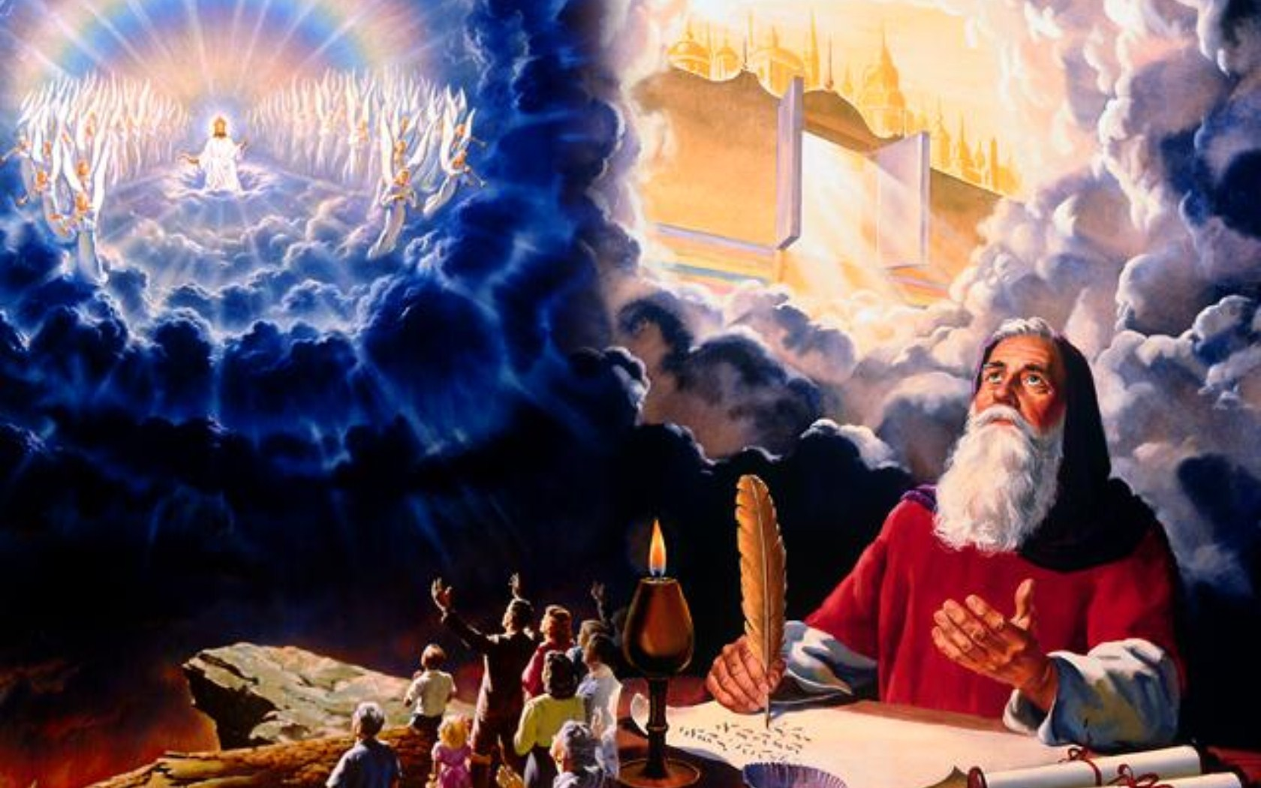

Slide 2

ADD INTODUCTION ANIMATION

Slide 3
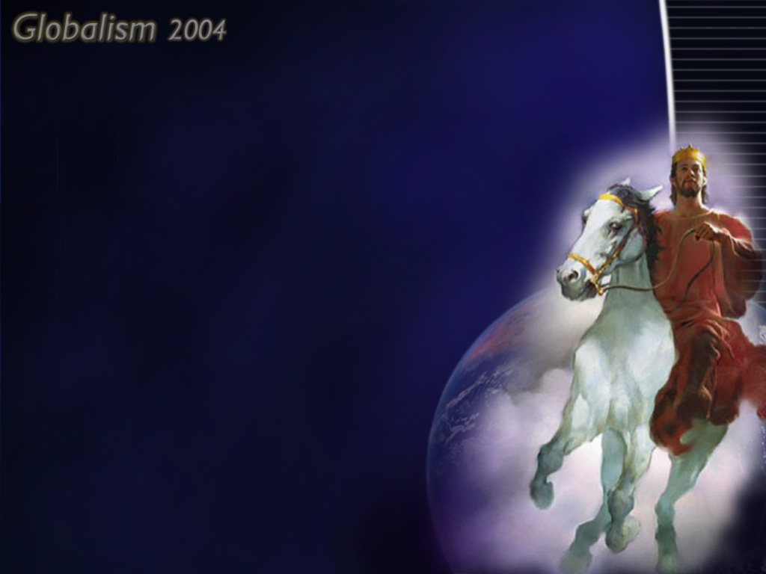

JUSTIFICATION BY FAITH
Made righteous: “Not by works of righteousness which we have done, but according to His mercy He saved us, by the washing of regeneration, and renewing of the Holy Ghost; which He shed on us abundantly through Jesus Christ our Saviour; that being justified by His grace, we should be made heirs according to the hope of eternal life.” Titus 3: 5 - 7
Judgement of the Living

Slide 4
End of
Probation
Christ’s Second
Coming
A Reform Movement
Sealing
Time of Trouble
Latter Rain
Millennium
Seven Plagues
Loud Cry
Shaking
Jacob’s Trouble
Early Time of Trouble
Now
Liberation
Sunday Law
Death Decree
Leave Large
Cities
Leave Small
Cities
Persecution

Slide 5
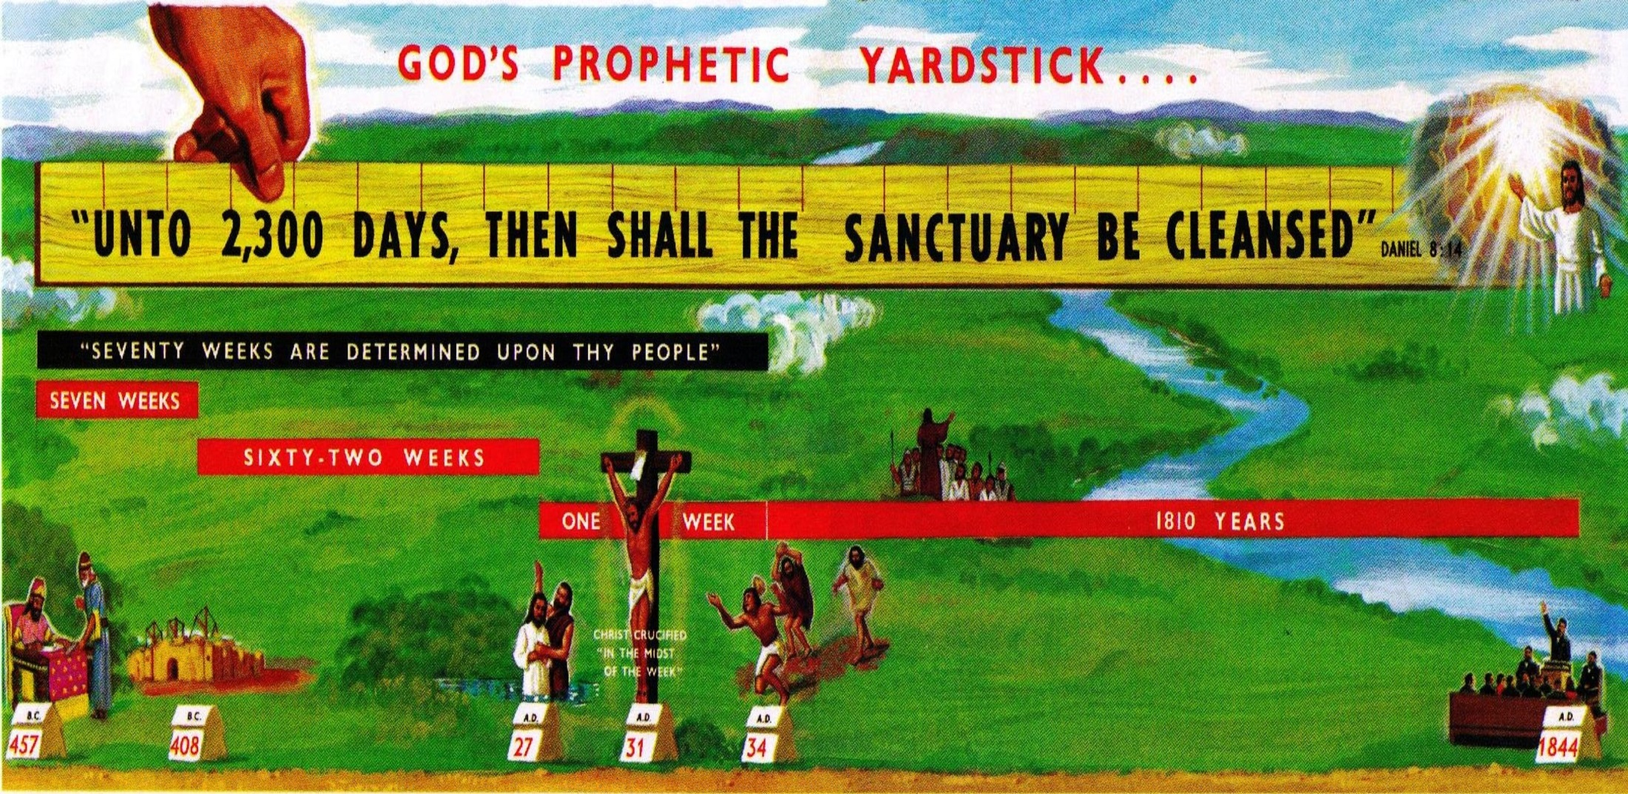

Slide 6

The investigative judgment is the closing work within the heavenly Sanctuary.
It focuses on all those who have ever lived on earth, who have professed faith in Christ and concerns both the dead and the living.
This judgment began in 1844.
Soon, none know how soon, it will pass to the cases of the living.
It will end at the general close of probation. There is no further probation after it ends.

Slide 7
The sentencing judgment of the wicked is a distinct and separate work which will occur during the millennium.
All of the wicked receive their sentences during that millennial examination both those who have never professed faith in Christ, and those who falsely did so and were examined during the investigative judgment.
In the investigative judgment, men’s lives will be tested by God’s law. It is the standard of the judgement

Slide 8
Through the enabling grace of Christ, every man can obey the law of God, and is required to do so. The only question asked in the investigative judgment is “Have they been obedient to My commandments?”
The first angel’s message announced the beginning of the judgment.
The investigative judgment began in 1844 with the cases of the dead.

Slide 9
When does it pass to the cases of the living?
We know that it will pass to the living before the plagues begin and the Second Advent occurs. (Testimony to Ministers 446)

Slide 10
End of
Probation
Christ’s Second
Coming
A Reform Movement
Sealing
Time of Trouble
Latter Rain
Millennium
Seven Plagues
Loud Cry
Shaking
Jacob’s Trouble
Early Time of Trouble
Now
Liberation
Sunday Law
Death Decree
Leave Large
Cities
Leave Small
Cities
Persecution

Slide 11
The following statements indicate that the investigative judgment will pass to the cases of the living when men begin making their decisions in regard to the already enacted National Sunday Law:

Slide 12
SUNDAY LAW DECREE BRINGS JUDGEMENT TO THE LIVING
The judgment passes to the living at the time when the mark and seal is given.
“The time devoted to that which does not tend to assimilate the soul to the likeness of Christ is so much time lost for eternity. This we cannot afford, for every moment is freighted with eternal interests. Now, when the great work of judging the living is about to begin, shall we allow unsanctified ambition to take possession of the heart and lead us to neglect the education required to meet the needs in this day of peril?

Slide 13

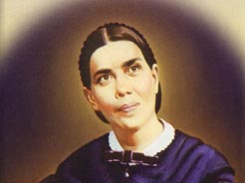
6 Testimonies p 130
“In every case the great decision is to be made whether we shall receive the mark of the beast or his image, or the seal of the living God. And now, when we are on the borders of the eternal world, what can be of so much value to us as to be found loyal and true to the God of heaven?”

Slide 14
5 Testimonies page 526
“The principles necessary for our youth to cultivate must be kept before them in their daily education, that when the decree shall go forth requiring all to worship the beast and his image, they may make the right decisions, and have strength to declare, without wavering, their confidence in the commandments of God and the faith of Jesus, even at the very time when the law of God is made void by the religious world.

Slide 15
5 Testimonies page 526
“It is no time to be ashamed of our faith. We are a spectacle to the world, to angels, and to men. The whole universe is looking with inexpressible interest to see the closing work of the great controversy between Christ and Satan. At such a time as this, just as the great work of judging the living is to begin, shall we allow unsanctified ambition to take possession of the heart? What can be of any worth to us now except to be found loyal and true to the God of heaven? What is there of any real value in this world when we are on the very borders of the eternal world? What education can we give to the students in our schools that is so necessary as a knowledge of ‘What said the Scripture’?”

Slide 16
Testimonies to Ministers 234-235
In the judgment, one person is retained in the book of life, while another receives the mark of separation.
“The time of the judgment is a most solemn period, when the Lord gathers His own from among the tares. Those who have been members of the same family are separated. A mark is placed upon the righteous. ‘They shall be Mine, said the Lord of hosts, in that day when I make up My jewels; and I will spare them, as a man spareth his own son that serveth him.’

Slide 17
Testimonies to Ministers 234-235
Those who have been obedient to God’s commandments will unite with the company of the saints in light; they shall enter in through the gates into the city, and have right to the tree of life. The one shall be taken. His name shall stand in the book of life, while those with whom he associated shall have the mark of eternal separation from God.”

Slide 18
When does the investigative judgment occur in relation to the sealing?
A person’s probation has to have ended before the judgment can pass to his name. This is to be expected, otherwise the decision in his case would either be unfair or have to continually be re-examined and re-determined.
So the judgment can pass to an individual’s case only after his personal probation has closed.

Slide 19
In 1844 it could only begin with the cases of the dead because their probation had closed. When the three-fold deciding factor later occurs (the National Sunday Law is enacted, men know the issues, and they make their choice between Sunday keeping and Sabbath sacredness), then the judgment and marking/sealing can individually occur for them.

Slide 20
SO, IN SUMMARY, THIS IS THE SEQUENCE:
By his ongoing decisions whether or not to accept Christ and, in His strength, obey His Word, each soul is now deciding his character and ultimate destiny.
The National Sunday law is enacted.
The person learns and understands the basic issues − or already knows them.

Slide 21
He makes his decision whether to honor his Creator and keep His Sabbath holy, in spite of threatened imprisonment and death; or go along with the majority and the law of the land, and honor the papal Sabbath.
The investigative judgment in heaven immediately passes to his name.
He receives the seal or mark.

Slide 22
SEVERAL IMPORTANT POINTS SHOULD BE NOTED HERE:
1. Nowhere in the Bible or Spirit of Prophecy is there any Indication that a person can receive the mark, then lose it, and, perhaps, then regain it again. Once a person is marked, it is for time and eternity! The same applies to the sealing given to the righteous when, in the sealing/marking time, they make their final decisions to resolutely stand for God and His truth.

Slide 23
2. The marking and sealing does not begin until the enactment of the National Sunday Law. Not only must the law be enacted, but each person must understand the issues involved. For many, this post-Sunday law education process takes some time. Therefore, both the marking and sealing continue on for a time.

Slide 24
This educational and decision-making process will be much more rapid during the loud cry. Decisions for eternity will be made quickly. The faithful are filled with the Spirit, and their words have a powerful convicting impact. In contrast, the miracles and threatening's of the majority, who are devil-filled, are equally strong. The pivotal point here will be the basic character an individual has when he is confronted by this need to decide. Throughout his earlier life, he will have formed the character which will determine his present choices. In the little tests of life, character is developed. In the crises of life, the character formed is strikingly revealed (COL 412). Suddenly, all the tests and trials of life will come to their focus − and decisions will quickly be made.

Slide 25
It is in a crisis that character is revealed. When the earnest voice proclaimed at midnight, "Behold, the bridegroom cometh; go ye out to meet him," and the sleeping virgins were roused from their slumbers, it was seen who had made preparation for the event. Both parties were taken unawares; but one was prepared for the emergency, and the other was found without preparation. So now, a sudden and unlooked-for calamity, something that brings the soul face to face with death, will show whether there is any real faith in the promises of God. It will show whether the soul is sustained by grace. The great final test comes at the close of human probation, when it will be too late for the soul's need to be supplied.
Christ Object Lessons p412

Slide 26
How does judgment relate to the close of probation?
As people make their final decision in regard to the enacted national Sunday law, they enter the judgment, are sealed or marked as their destiny is fixed, and their individual probation closes. At a later time, when the last person on earth has entered the judgment, probation for the last human being has ended-and there is no probation for anyone on earth. We call that moment the general close of probation.

Slide 27
This also explains why a loud cry must occur after each nation enacts its own national Sunday law, and why it must continue until the general close of probation. People must be told the issues, so they can make their final decision, enter the judgment, and be marked or sealed for eternity.
This is also part of the reason why the latter rain must begin when the sealing begins.
Those who receive the seal have made their final decision for eternity and henceforth “are eternally secure from the tempter’s devices” (5T 475). They are not only marked with the Seal as God’s special property, but they are filled with His Spirit−which would be a natural accompaniment.

Slide 28
But there is a second pressing reason why that rain must fall. Like the early rain before it, the latter rain is given to empower men and women to proclaim God’s truth to the world. This they do in a loud cry of the third angel’s message.
This message has two parts:
[1] a most solemn warning to keep the Bible Sabbath in order to avoid receiving the mark of the beast (Rev 14:9-11), and
[2] the great truth of Righteousness by Faith (Rev 14:12).

Slide 29
Evangelism p190.
And what is that great truth?
The fact and experience that, through the enabling strength of Christ, both forgiveness and obedience are freely available to all, That is why righteousness by faith can be termed both “the most fearful threatening ever addressed to mortals” and “the third angel’s message in verity”

Slide 30
THE TIMING OF THE INVESTIGATIVE JUDGMENT
In view of the above information, should we not be able to pinpoint the year when the investigative judgment will begin, or at be able to tell how many months occur between it and some other event?
No, it is not possible to set a date for the occurrence of this event, or to determine time spans leading to or away from it. None can know how soon it will pass to the cases of the living and no man know how near we are to the close of it (GC 490-491)
As with every other aspect of closing events, no man can deduce no accurate time setting, no dates, and no time spans.

Slide 31
Judgement still Future
The judgement has not yet passed to the living. But this is understandable, since the event that would initiate the setting up of the image, by the enactement of the National Sunday Law, has not yet occurred.
It should be noted here that Senator Blair had introduced the Blair Sunday Rest Bill to the US Congress at the time these next two statements were penned (around 1887-1888). We were told that, if the act had become law of the land, it would mean that the judgement was about to pass to the living.
However, in God’s mercy, the Blair Act was never enacted and Congress has not since tried to enact a National Sunday Law.

Slide 32
5 Testimonies p526
1 - The judgment will pass to the living at the time of the national Sunday law.
“It is no time to be ashamed of our faith. We are a spectacle to the world, to angels, and to men. The whole universe is looking with inexpressible interest to see the closing work of the great controversy between Christ and Satan. At such a time as this, just as the great work of judging the living Is to begin, shall we allow unsanctified ambition to take possession of the heart? What can be of any worth to us now except to be found loyal and true to the God of heaven? What is there of any real value in this world when we are on the very borders of the eternal world?”

Slide 33
6 Testimonies p130
“Now, when the great work of judging the living is about to begin. . In every case the great decision is to be made whether we shall receive the mark of the beast or his image, or the seal of the living God.”-

Slide 34
5 Testimonies, p590
2 - Now is the time to prepare for the judgment.
“I cannot express to you the intense desire of my soul that you should all seek the Lord most earnestly while He may be found. We are in the day of God’s preparation. Let nothing be regarded as of sufficient worth to draw your minds from the work of preparing for the great Day of Judgment. Get ready. Let not cold unbelief hold your souls away from God, but let His love burn on the altar of your hearts.”

Slide 35
JUDGED BY THE LIGHT WE HAVE RECEIVED
1 - In the investigative judgment, all will be judged by how they acted in relation to what they knew. “All must wait for the appointed time, until the warning shall have gone to all parts of the world, until sufficient light and evidence have been given to every soul. Some will have less light than others, but each one will be judged according to the light received.”-
Last Day Events, 217
“Many who have not had the privileges that we have had will go into heaven before those who have had great light and who have not walked in it. Many have lived up to the best light they have had and will be judged accordingly. “
Last Day Events, 216.

Slide 36
“We have been given great light in regard to God’s law. This law is the standard of character. To it man is now required to conform, and by it he will be judged in the last great day. In that day men will be dealt with according to the light they have received.”-
Last Day Events, 217
“Those who have had great light and have disregarded it stand in a worse position than those who have not been given so many advantages. They exalt themselves but not the Lord. The punishment inflicted on human beings will in every case be proportionate to the dishonour they have brought on God.”
8 Manuscript Releases, 168.
“Everyone is to have sufficient light to make his decision intelligently.”-
Great Controversy, 605

Slide 37
2 - No one will be judged on the basis of light they did not have opportunity to accept.
“None will be condemned for not heeding light and knowledge that they never had, and they could not obtain. But many refuse to obey the truth that is presented to them by Christ’s ambassadors, because they wish to conform to the world’s standard, and the truth that has reached their understanding, the light that has shone in the soul, will condemn them in the judgment.”
5 Bible Commentary, p1145

Slide 38
“Those who have an opportunity to hear the truth and yet take no pains to hear or understand it, thinking that if they do not hear they will not be accountable, will be judged guilty before God the same as if they had heard and rejected. There will be no excuse for those who choose to go in error when they might understand what is truth. In His sufferings and death Jesus has made atonement for all sins of ignorance, but there is no provision made for wilful blindness.
We shall not be held accountable for the light that has not reached our perception, but for that which we have resisted and refused.
A man could not apprehend the truth which had never been presented to him, and therefore could not be condemned for light he had never had.”
5 Bible Commentary, p1145

Slide 39
THE HINGE OF THE JUDGMENT
1 - A key decision in the investigative judgment will turn upon practical benevolence: Have we really tried to minister to the needs of those around us, or did we just live selfish lives? In that day, the question will focus on what we have done to help others.
“The decisions of the last day turn upon our practical benevolence. Christ acknowledges every act of beneficence as done to Himself.”
Testimonies to Ministers, p 400

Slide 40
“When the nations are gathered before Him, there will be but two classes, and their eternal destiny will be determined by what they have done or have neglected to do for Him in the person of the poor and suffering.
“Among the heathen are those who worship God ignorantly, those to whom the light is never brought by human instrumentality, yet they will not perish. Though ignorant of the written law of God, they have heard His voice speaking to them in nature, and have done the things that the law required. Their works are evidence that the Holy Spirit has touched their hearts, and they are recognized as the children of God.

Slide 41
“How surprised and gladdened will be the lowly among the nations, and among the heathen, to hear from the lips of the Saviour, ‘Inasmuch as ye have done it unto one of the least of these My brethren, ye have done it unto Me’! How glad will be the heart of Infinite Love as His followers look up with surprise and joy at His words of approval!”
Desire of Ages, p 637, 638

Slide 42
2 - Motives as well as actions will be considered in the judgment. God values sincere, heartfelt efforts are what counts.
“In the day of judgment some will plead this good deed and that as a reason why they should receive consideration. They will say, ‘I set up young men in business. I gave money to found hospitals. I relieved the necessities of widows, and took the poor into my home.’ Yes, but your motives were so defiled by selfishness that the deed was not acceptable in the sight of the Lord. In all that you did, self was brought prominently to view.”
Last Day Events, p219
“It is the motive that gives character to our acts, stamping them with ignominy or with high moral worth.”
-Desire of Ages, p615.

Slide 43
JUSTIFICATION BY FAITH
Romans 13:11
And that, knowing the time, that now it is high time to awake out of sleep: for now is our salvation nearer than when we believed.
Made righteous: “Not by works of righteousness which we have done, but according to His mercy He saved us, by the washing of regeneration, and renewing of the Holy Ghost; which He shed on us abundantly through Jesus Christ our Saviour; that being justified by His grace, we should be made heirs according to the hope of eternal life.” Titus 3: 5 - 7

