Slide 1
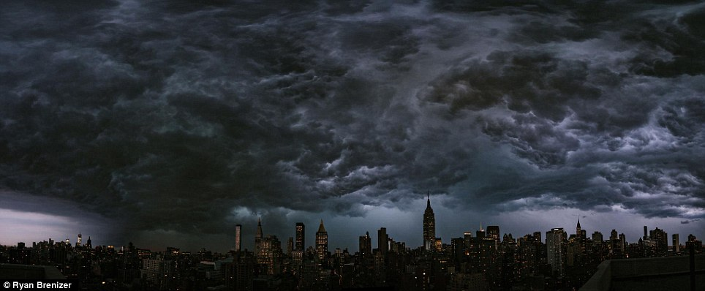
The rising storm
Study based on Mark 6:45.46

Slide 3
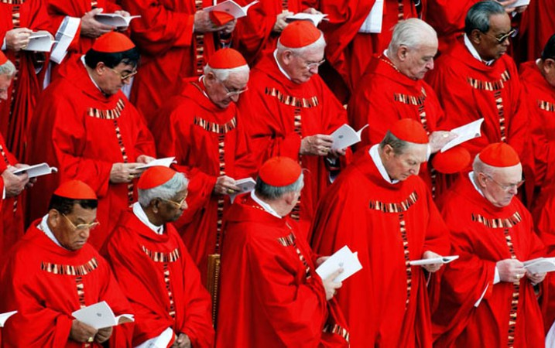
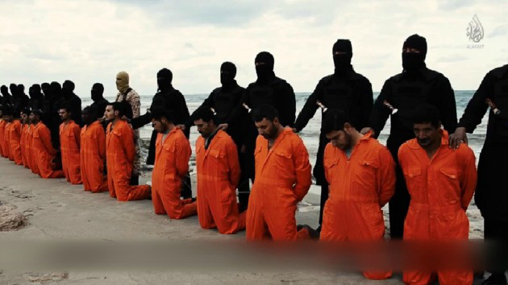
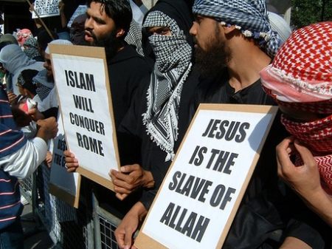
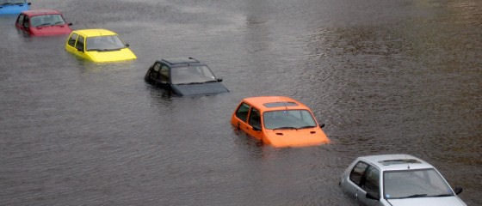
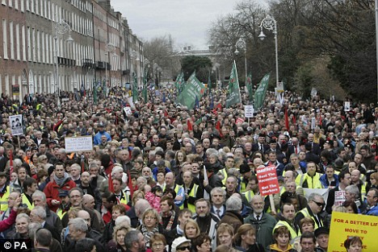
Floods
Pope Francis is poised to
change Catholicism forever
Islamic State Threatens to 'Conquer Rome

Slide 4
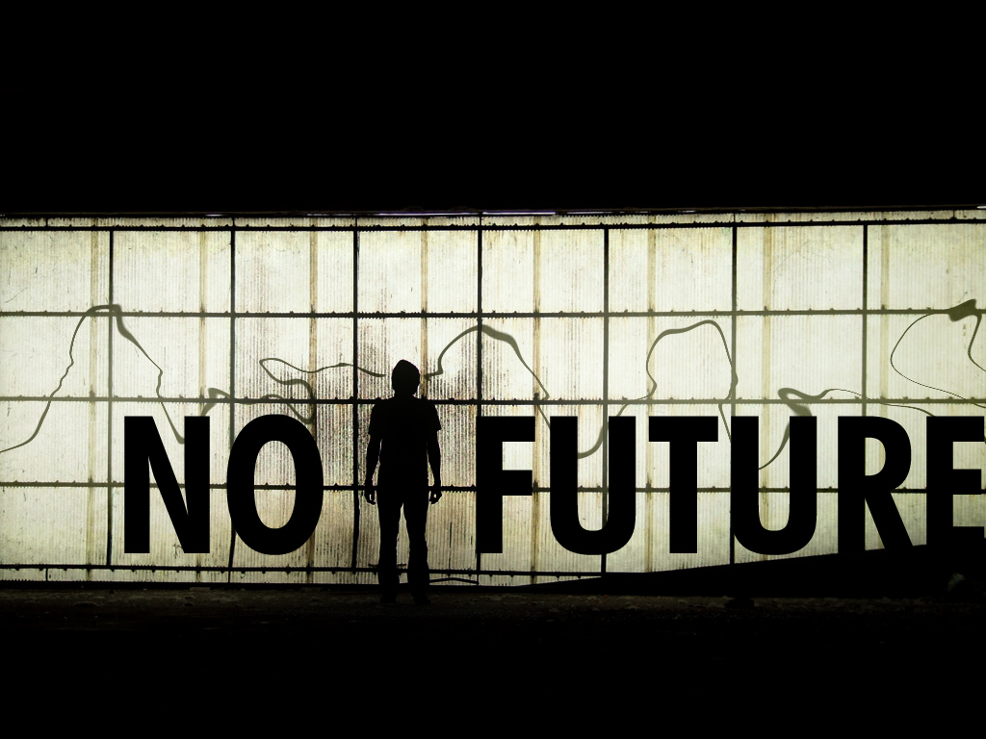
“There is no future, there is no past. I live this moment as my last. There's only us, there's only this; forget regret, or life is yours to miss, no other road, no other way, no day but today.”

Slide 5
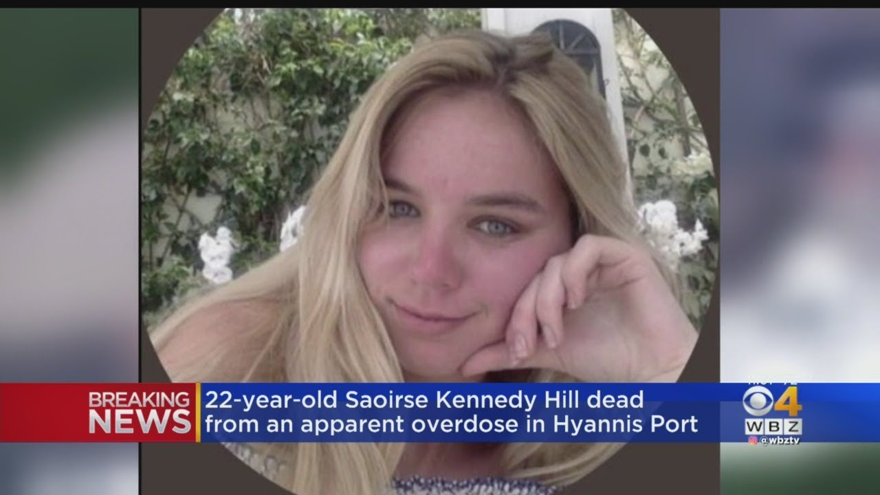

Slide 6
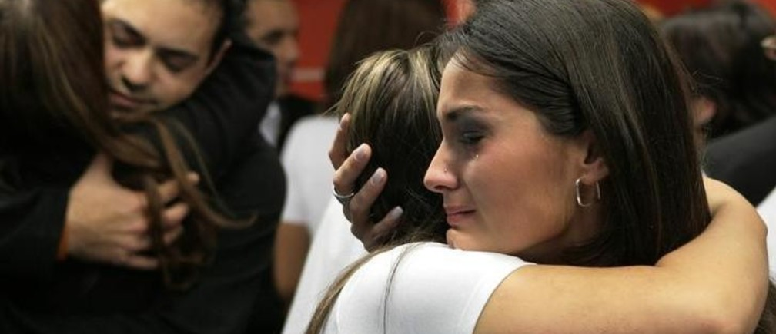
Depression is the no. 1 cause of ill health and disability worldwide

Slide 7
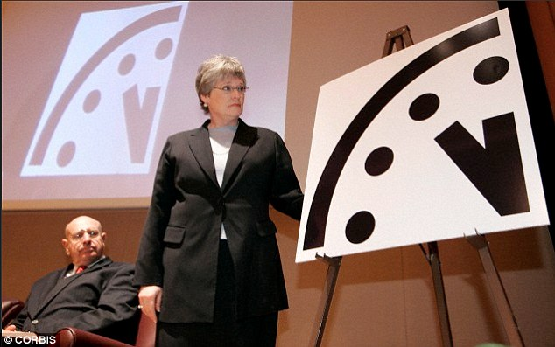
Atomic scientists set to make 'major announcement' about Doomsday Clock…
11:58 PM

Slide 8
Did GOD abandon us?
Going through seasons
Weeping and laughter
Winning and losing
Up and down
Joy and sadness
NO!
WHY
Is this all
HAPPENING?

Slide 9
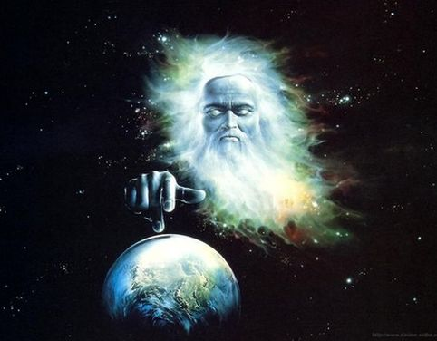
Genesis 1:14
Let there be lights in the vault of the sky to separate the day from the night, and let them serve as signs to mark seasons and days and years, TNIV

Slide 10
The significance of these divine appointments
Signs that occur in natural world
Periodically
On elected dates
On holidays God established as feast days for his people as signs of an everlasting covenant
Passover
Feast of tabernacles (Succoth)

Slide 11
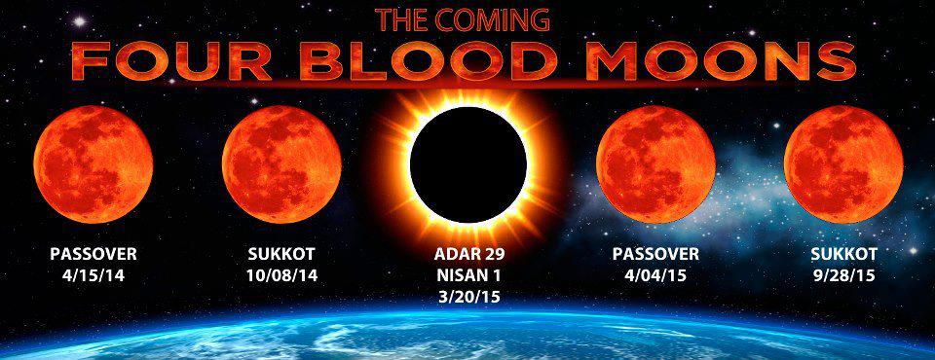
Divine appointments

Slide 12
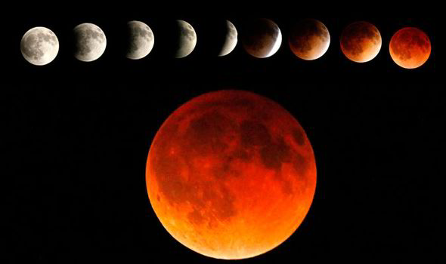
162 - 163 AD, coinciding with the worst persecution of Jews… and Christians in the history of the Roman Empire. Within 3 years the Antonine Plague killed eight million people, a third of the population.
First Blood moon Tetrad

Slide 13
795 - 796 AD while King Charlemagne of the Holy Roman Empire established a DMZ buffer zone between France and Spain, ending centuries of Arab invasions into Western Europe.
Second Blood moon Tetrad

Slide 14
842 - 843 AD. Shortly after the eclipses the Vatican church in Rome was attacked and looted by an Islamic invasion from Africa.
Third Blood moon Tetrad

Slide 15
860 - 861 AD. Shortly after the eclipses the Byzantine Empire defeated Arab armies at the Battle of Lalakaon in Turkey and permanently stopped the Islamic invasion of Eastern Europe.
Forth Blood moon Tetrad

Slide 16
1492 -1493 was the same year that the Jews were expelled from Spain and Christopher Columbus ‘amazingly’…. discovered America
Fifth Blood moon Tetrad

Slide 17
1949 - 1950 during the 1st Arab - Israeli War for Independence just after Israel had become a nation again for the first time in 2,000 years.
Sixth Blood moon Tetrad

Slide 18
1967 - 1968 coinciding with the 6 Day War when Israel recaptured Jerusalem.
Seventh Blood moon Tetrad

Slide 19
Eight Blood moon Tetrad
2014 – 2015
?

Slide 20
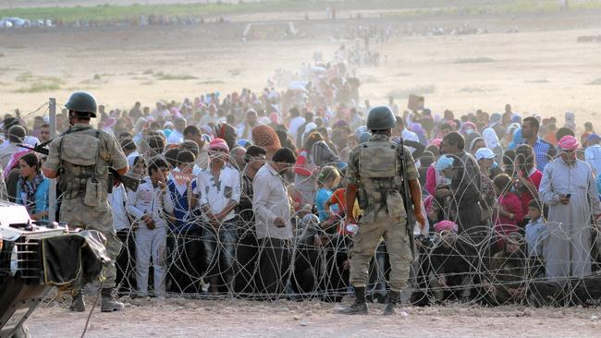
European refugee/emigrant
CRISIS…

Slide 21
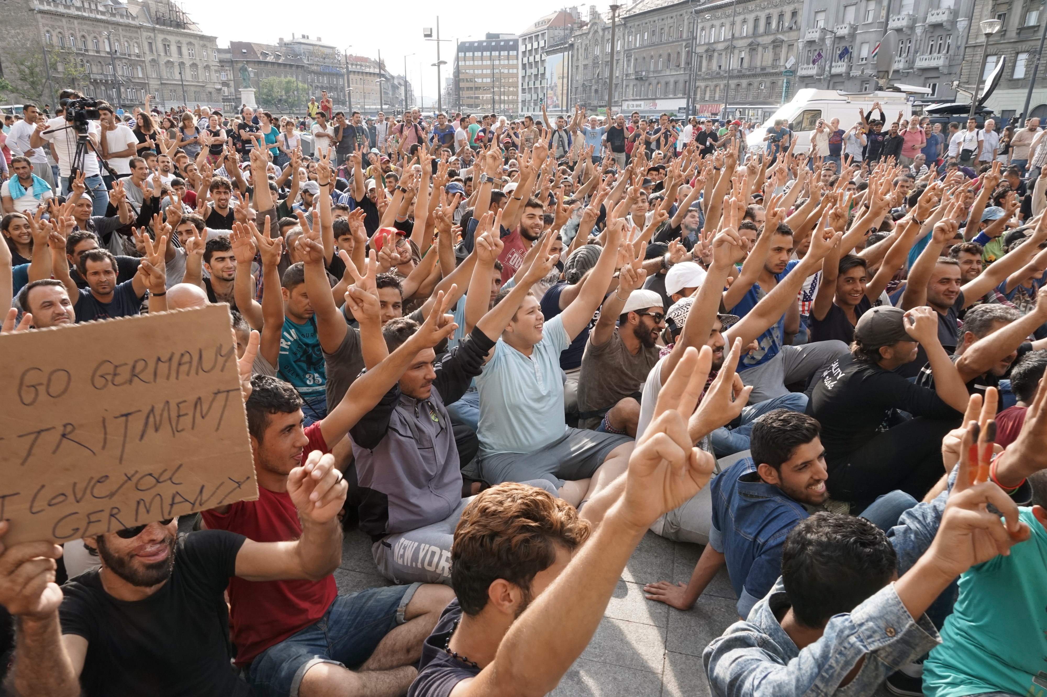
The biggest Exodus in last 3000 years

Slide 22
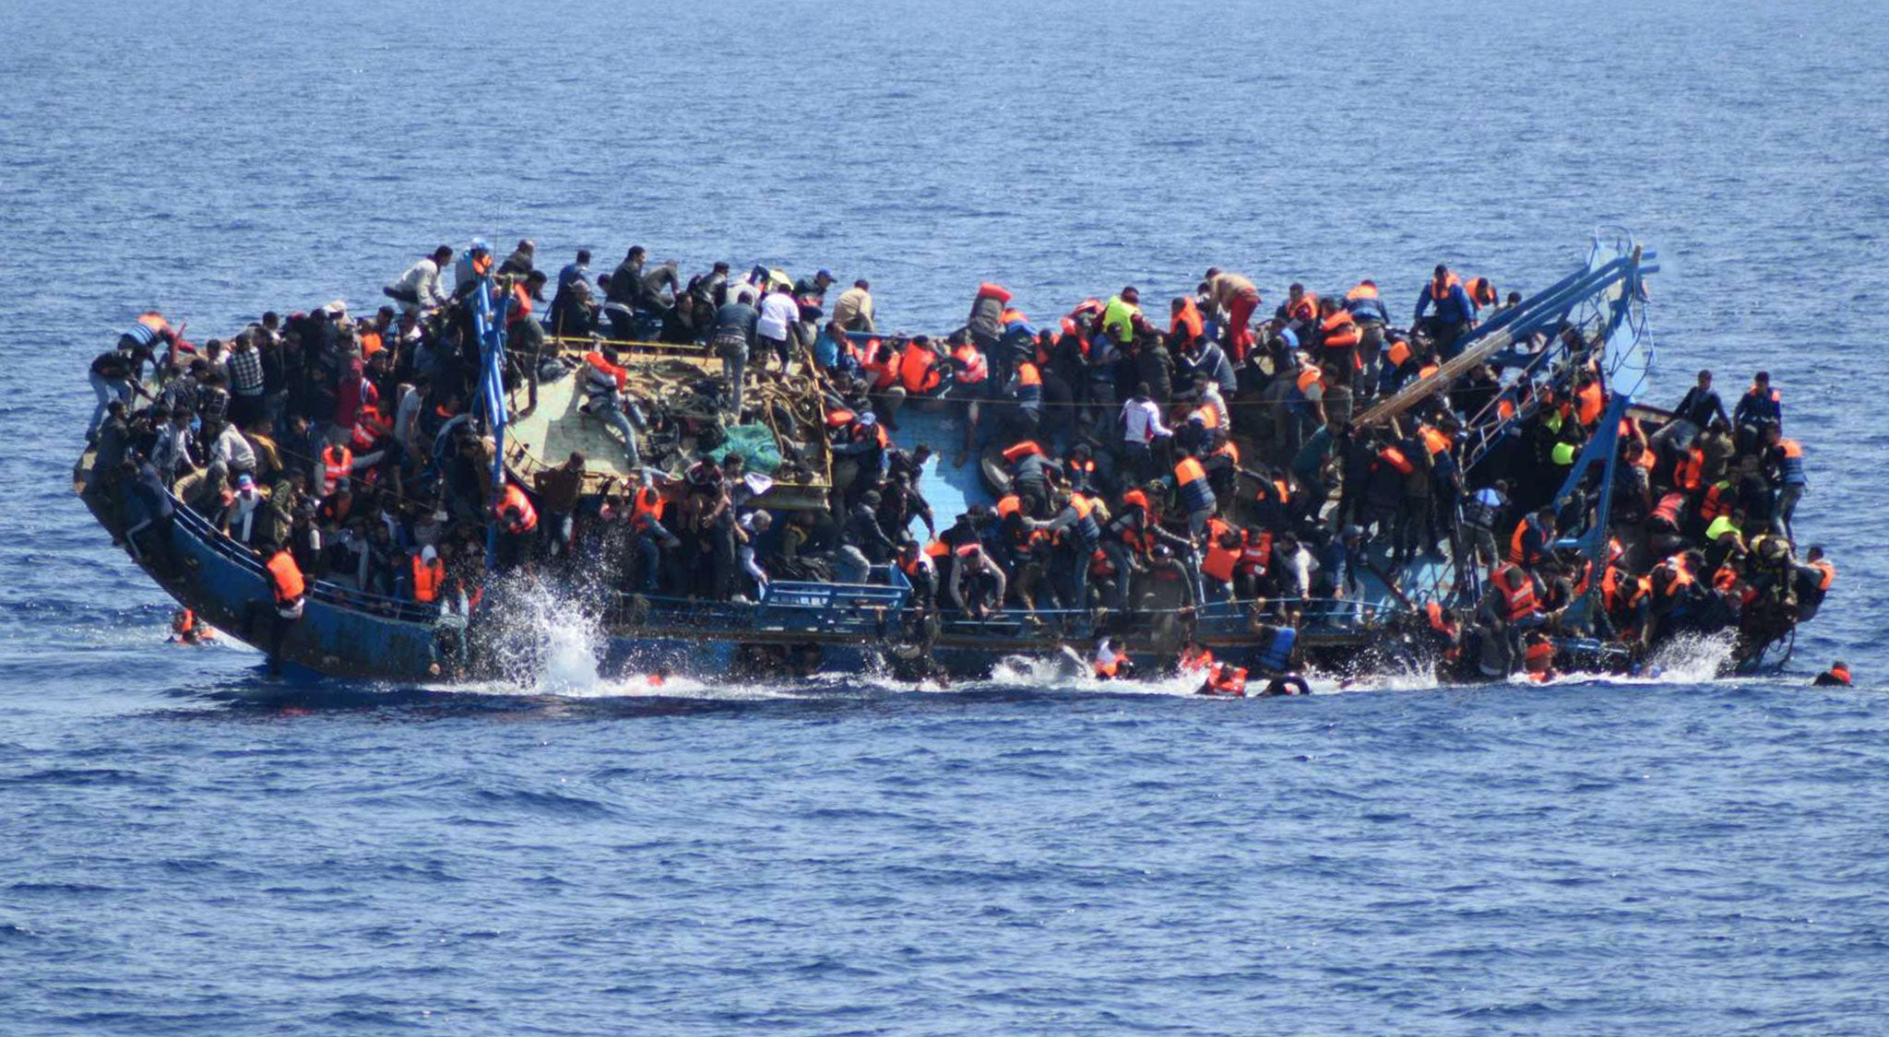
Mediterranean will be 'sea of blood' without rescue boats, UN warns
…more than 1 million refuges flooded Europe following the German Chancellor’s controversial decision of open border migration…

Slide 23
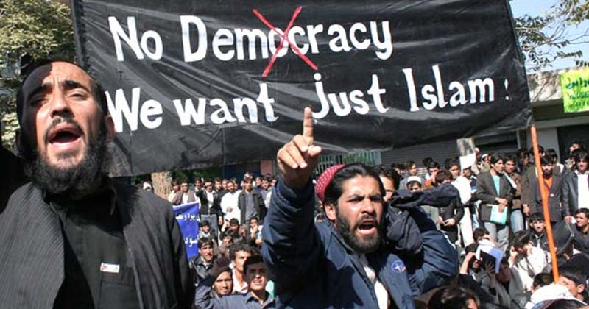

Slide 24
“…My prayer, O Allah, open their [European countries that welcomed Syrian refugees] breasts to [accept] Islam and provide them with the testimony [pledge of allegiance to Allah and Mohammad]. I swear by Allah that they deserve the prayer. What is the achievement of Syrians coming [to Europe]? Islam will be spread even more among them [Europeans], their [Muslims] ratio [in society] will increase and the Syrians will be victorious [conquering Europe], Allah Willing…”
Fatima Benhatta, a Canadian representative of the U.K based international organization Islamic Relief,

Slide 25
Ancient Prophecy…
Habakkuk 1:5-11
"Look at the nations and watch and be utterly amazed. For I am going to do something in your days that you would not believe, even if you were told.
6 I am raising up the Babylonians, that ruthless and impetuous people, who sweep across the whole earth to seize dwellings not their own.

Slide 26
7 They are a feared and dreaded people;
they are a law to themselves and promote their own honor…
9 they all come bent on violence.
Their hordes advance like a desert wind and gather prisoners like sand.
10 They mock kings and scoff at rulers. They laugh at all fortified cities;…11 Then they sweep past like the wind and go on guilty people, whose own strength is their god." TNIV

Slide 28
1 Thessalonians 5:1-6
Now, brothers and sisters, about times and dates we do not need to write to you, 2 for you know very well that the day of the Lord will come like a thief in the night. 3 While people are saying, "Peace and safety," destruction will come on them suddenly, as labor pains on a pregnant woman, and they will not escape. 4 But you, brothers and sisters, are not in darkness so that this day should surprise you like a thief. 5 You are all children of the light and children of the day. We do not belong to the night or to the darkness. TNIV

Slide 29
How to respond in the time
of crisis?

Slide 30
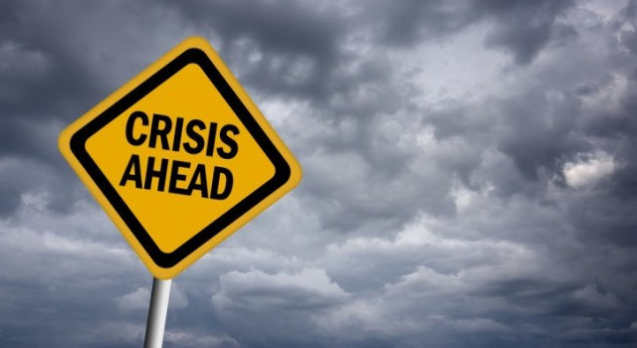
Luke 12:32
32 "Do not be afraid, little flock, for your Father has been pleased to give you the kingdom. TNIV

Slide 31
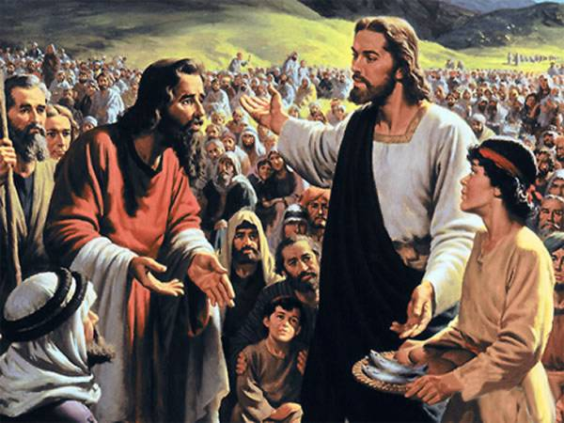
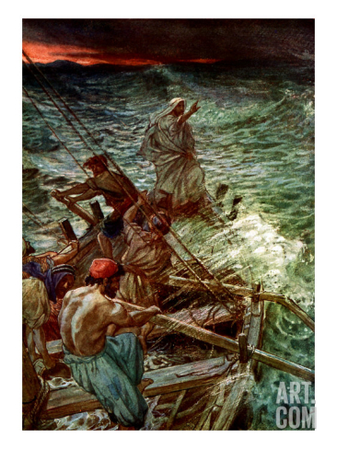
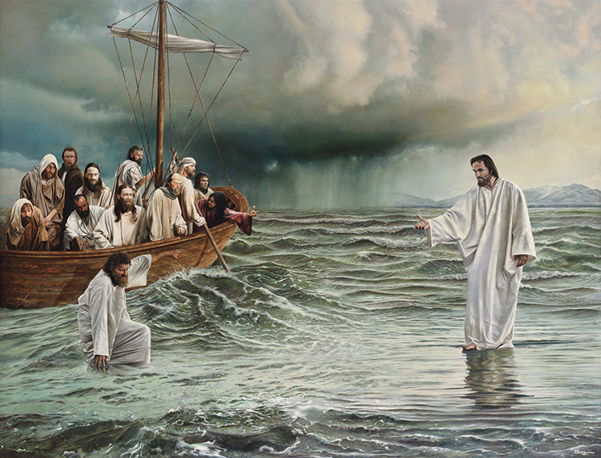
Story…
Feeding the 5000
Crossing the lake
Jesus comes by

Slide 32
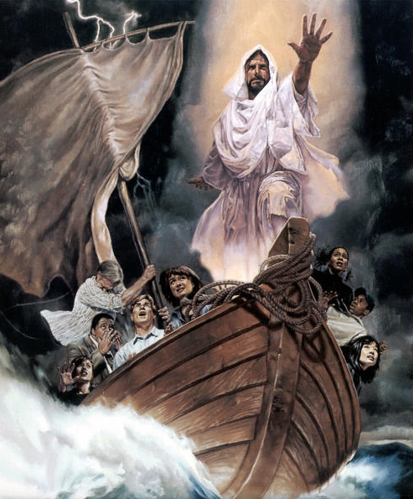
Story…
Mark 6:45-46
Immediately Jesus made his disciples get into the boat and go on ahead of him to Bethsaida, while he dismissed the crowd. After leaving them, he went up on a
mountainside to pray.
NIV
Principles to learn:
1.
“Remember to row by divine instructions!”

Slide 33
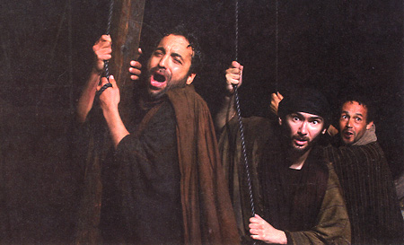
Disciples did not choose to be there
They were coming from a place of miracle (5000 people fed with fish & bread)
Jesus made his disciples (ordered them) to get into the boat and go to the other side
They were in the midst of the storm by divine appointment
Experiencing the rain
Experiencing the storm
“We can lose our lives following Jesus!”

Slide 34
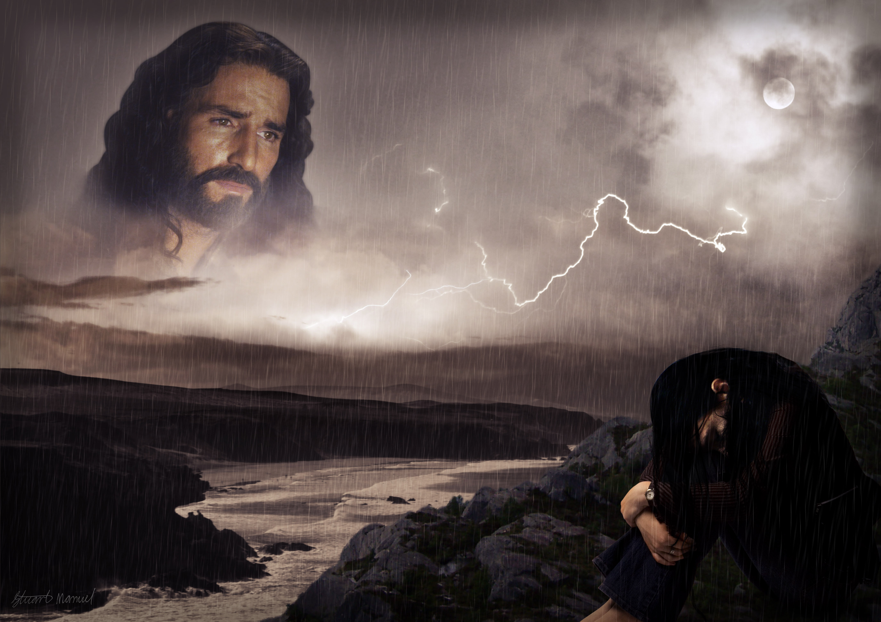
Does God know what He is doing?
Did He make a mistake?
Will the circumstances determine our future?
God has power and authority to calm the storms of our lives down regardless of who caused them!

Slide 35
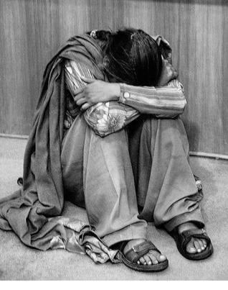
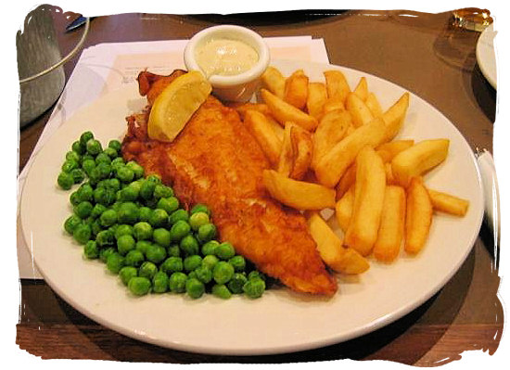
Circumstances in life are created and caused by:
Myself
Devil
God
When God takes you to places, you will experience what no ‘fish and bread’ people would ever experience!
The devil does not play fair; neither does God!

Slide 36
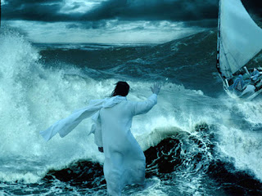
Jesus will come walking on the top of those circumstances which will try to sink you…
Who will find out who Jesus really is?
Those who left their own safety
Those who are going through the storm of their lives
Those who follow God’s instructions
Matthew 14:33
33 Then those who were in the boat worshiped him, saying, "Truly you are the Son of God."
NIV

Slide 37
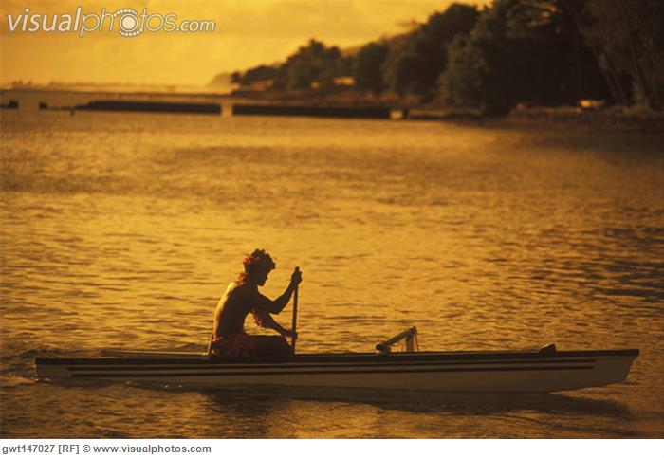
Why did this happen to the disciples?
Fish and bread did not convince the disciples about who Jesus was
Healing the lepers left questions in their head
Watching blind eyes open was not enough evidence
Rowing through the storm an making it safely to the other side did turn them into believers
Regardless to the circumstances
Don’t stop rowing
Don’t let the wind determine your direction

Slide 38
God is looking for people who are not giving up!
Mark 6:46-48
46 After leaving them, he went up on a mountainside to pray. When evening came, the boat was in the middle of the lake, and he was alone on land. He saw
the disciples straining at the oars, because the wind was against them. About the fourth watch of the night he went out to them, walking on the lake.
NIV
Principles to learn:
2.
“Even though I can’t see God in the storm, He sees me all the time!”

Slide 39
Don’t quit!
God sees the good in your life. Keep rowing!
Hold on to Him with your
Faith
Prayers
Hope
Hebrews 11:1
Now faith is the substance of things hoped for, the evidence of things not seen. NKJV

Slide 40
God on the shore is God in the storm!
Mark 6:52
… for they had not understood about the loaves; their hearts were hardened. NIV
We are people with needs
You did not do good - God blessed you
Just remember things God have already done (feeing the 5000)
Principles to learn:
3.
“In the storm you need to pick up some breadcrumbs!”

Slide 41
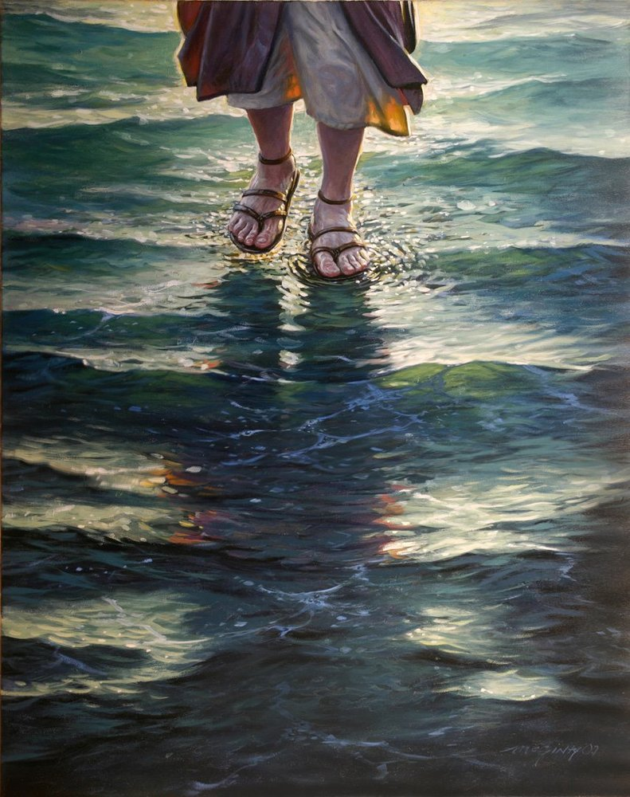
There comes somebody walking on the water
"The Lord is near to those who have a broken heart and saves such as have a broken spirit. Many are the afflictions of the righteous, But the Lord delivers him from them all."
- Psalm 34:18-19

Slide 42
Miracle is at your grasp. Invite Him to your life!
Mark 6:48-49
48 He saw the disciples straining at the oars, because the wind was against them. About the fourth watch of the night he went out to
them, walking on the lake. He was about to pass by them, NIV
Principles to learn:
4.
Always remember to welcome Jesus on board!
Just by going through the motions might make us not notice the presence of Jesus.

Slide 43
1. Remember to row by divine instructions
2. Even though You can’t see God in the storm, He sees me all the time
3. Pick up some breadcrumbs in the storm
4. Always remember to welcome Jesus on board!

