Slide 1
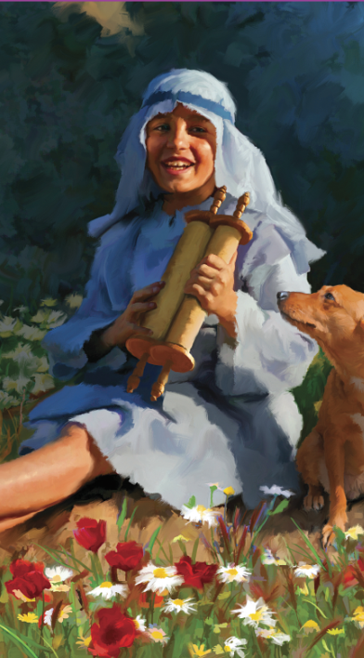
“And Jesus grew in wisdom and stature, and in favor with God and man:”
( Luke 2:52 )

Slide 2
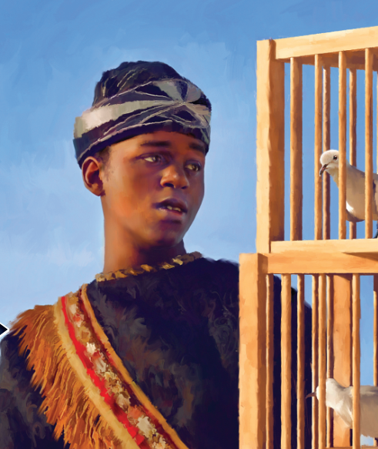
“‘It is written,’ he said to them, ‘ “My house will be called a house of prayer,” but you are making it “a den of robbers” ’ ”
( Matthew 21:13 )

Slide 3
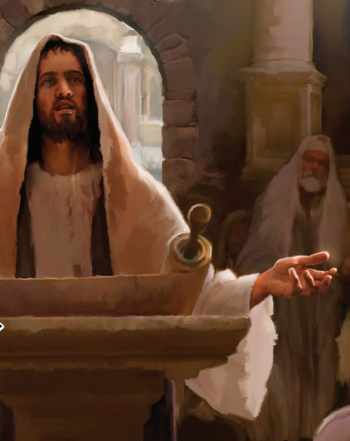
“I will praise the LORD, who counsels me; even at night my heart instructs me. I keep my eyes always on the LORD. With him at my right hand, I will not be shaken.”
( Psalm 16:7-8 )

Slide 4
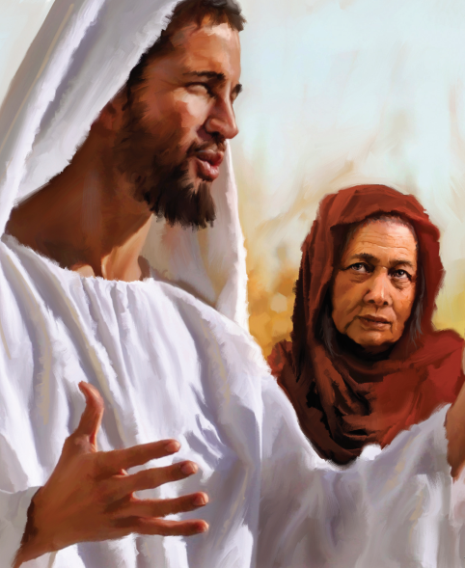
“Enter his gates with thanksgiving and his courts with praise; give thanks to him and praise
his name.”
( Psalm 100:4)

Slide 5
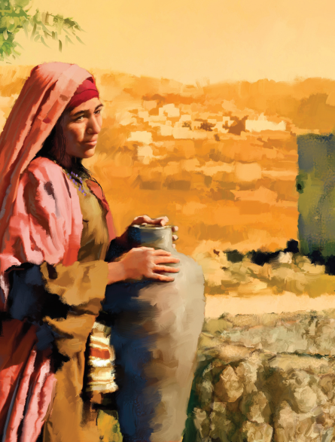
“God is spirit, and his worshipers must worship in the Spirit and in truth.”
( John 4:24 )

Slide 6
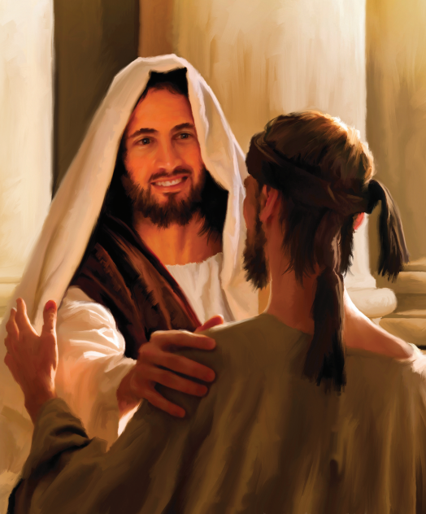
“Jesus heard that they had thrown him out, and when he found him, he said, ‘Do you believe in the Son of Man?’ ‘Who is he, sir?’ the man asked. ‘Tell me so that I may believe in him.’ Jesus said, ‘You have now seen him; in fact, he is the one speaking with you.’ Then
the man said, ‘Lord, I believe,’ and he worshiped him.”
( John 9:35-38 )

Slide 7
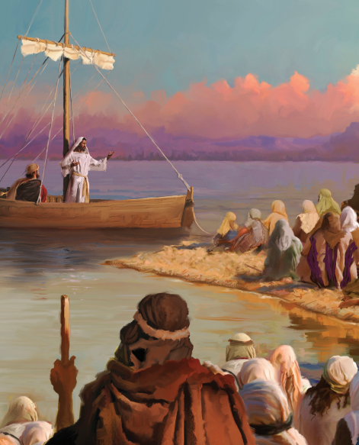
“The Spirit gives life; the flesh counts for nothing. The words I have spoken to you—they are full of the Spirit and life.”
( John 62:63 )

Slide 8
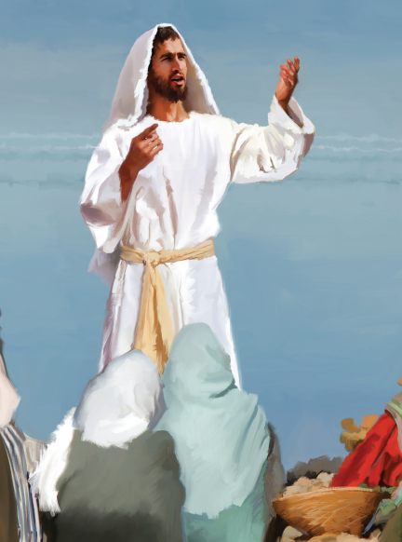
“In all my prayers for all of you, I always pray with joy because of your partnership in the
gospel from the first day until now, being confident of this, that he who began a good
work in you will carry it on to completion until the day of Christ Jesus.”
( Philippians 1:4-6 )

Slide 9
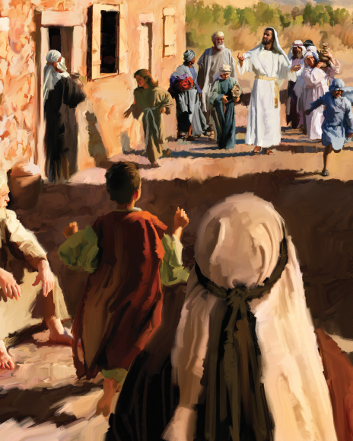
“For you know that it was not with perishable things such as silver or gold that you were redeemed from the empty way of life handed down to you from your ancestors, but with the precious blood of Christ, a lamb without blemish or defect.”
( 1 Peter 1:18-19 )

Slide 10
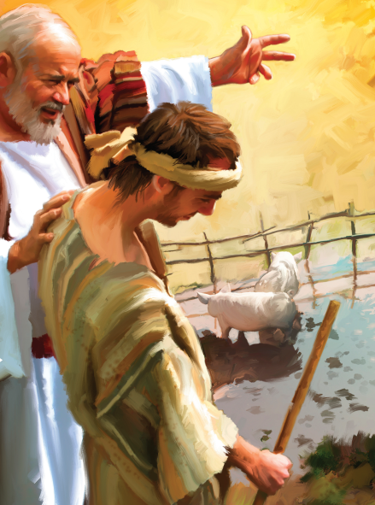
“I will set out and go back to my father and say to him: Father, I have sinned against heaven and against you. I am no longer worthy to be called your son; make me like one of your hired servants”
( Luke 15:18-19 )

Slide 11
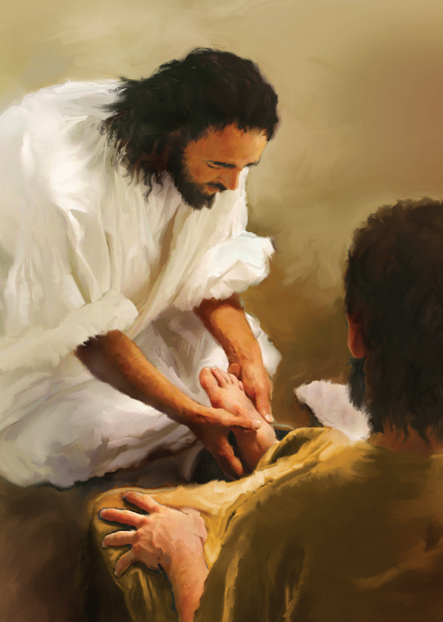
“Now that I, your Lord and Teacher, have washed your feet, you also should wash one
another’s feet. I have set you an example that you should do as I have done for you.”
( John 13:14-15 )

Slide 12
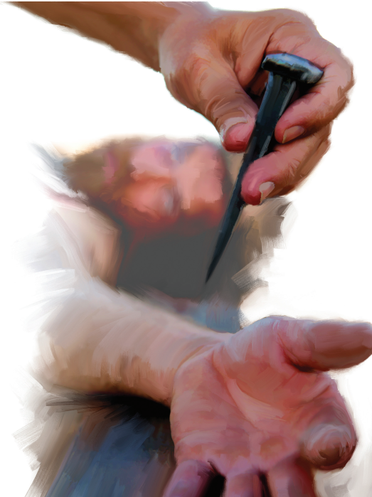
“When the centurion and those with him who were guarding Jesus saw the earthquake and all that had happened, they were terrified, and exclaimed, ‘Surely he was the Son of God!’ ”
( Matthew 27:54)

Slide 13
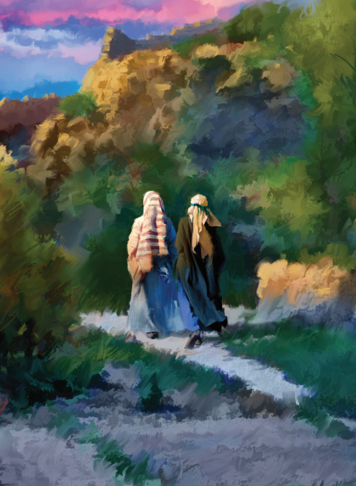
“Praise be to the God and Father of our Lord Jesus Christ! In his great mercy he has given us new birth into a living hope through the resurrection of Jesus Christ from the dead?”
( 1 Peter 1:3 )

