Slide 1
“In the beginning God created the heavens and the earth”
( Genesis 1:1, NIV )

Slide 2
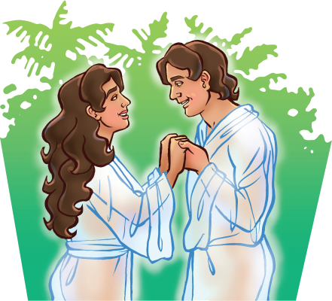
“God created mankind in his own image, in the image of God he created
them; male and female he created them”
( Genesis 1:27, NIV )

Slide 3
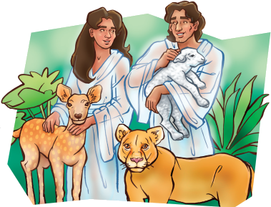
“God blessed the seventh day and made it holy”
( Genesis 2:3, NIV )

Slide 4
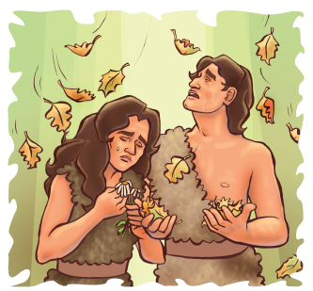
If we confess our sins, he is faithful and just to forgive us our sins and to cleanse us from all unrighteousness.
( 1 John 1:9, NIV )

Slide 5
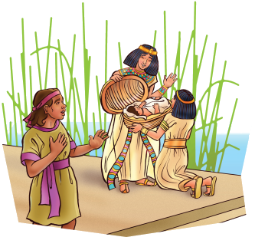
“Let everything that has breath praise the Lord”
( Psalm 105:6, NIV )

Slide 6
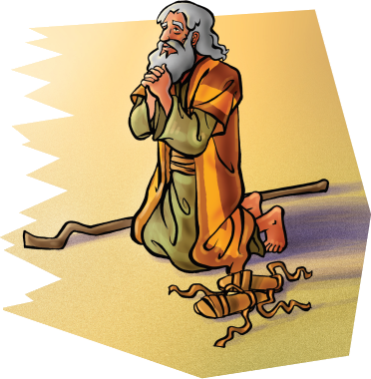
“Take off your sandals, for the place where you are standing is holy ground”
( Exodus 3:5, NIV )

Slide 7
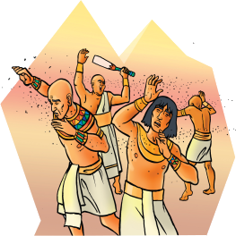
“Praise the Lord, my soul, and forget not all his benefits.”
( Psalm 103:2, NIV )

Slide 8
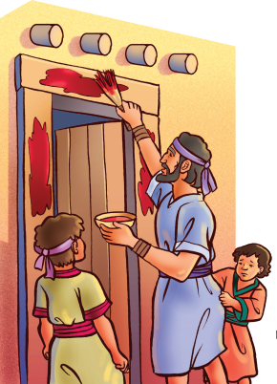
“The angel of the Lord encamps around those who fear him, and he delivers them”
( Psalm 34:7, NIV )

Slide 9
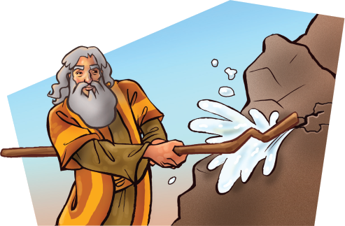
“Let anyone who is thirsty come to me and drink.”
( John 7:37, NIV )

Slide 10
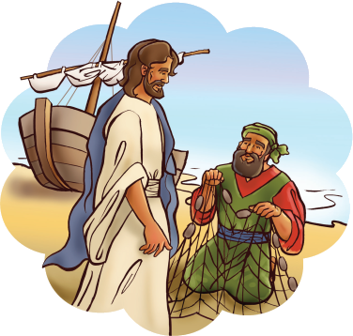
“Come, follow me, . . . and I will send you out to fish for people.”
( Matthew 4:19, NIV )

Slide 11
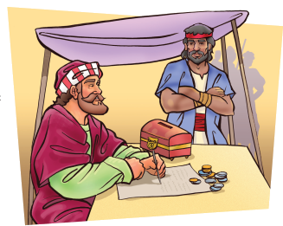
“I have not come to call the righteous, but sinners to repentance”
( Matthew 9:13, NIV )

Slide 12
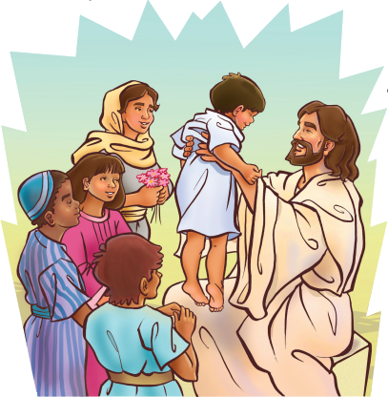
“Let the little children come to me, and do not hinder them, for the kingdom
of God belongs to such as these.”
( Luke 18:16, NIV )

Slide 13
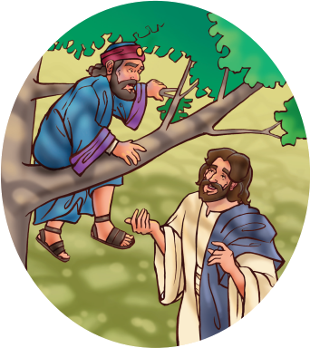
“Here and now I give half of my possessions to the poor.”
( Luke 19:8, NIV )

