Slide 1
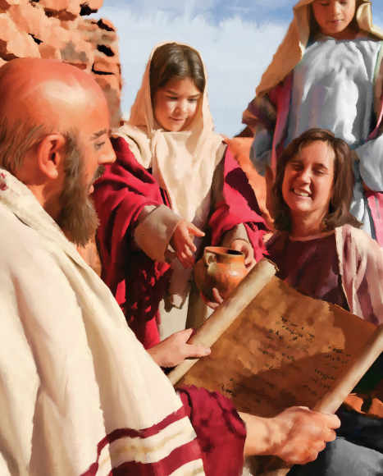
“As we have therefore opportunity, let us do good unto all men, especially unto them who are of the household of faith.”
Galatians 6:10

Slide 2
“And we know that all things work together for good to them that love God, to them who are the called according to his purpose.”
Romans 8:28

Slide 3
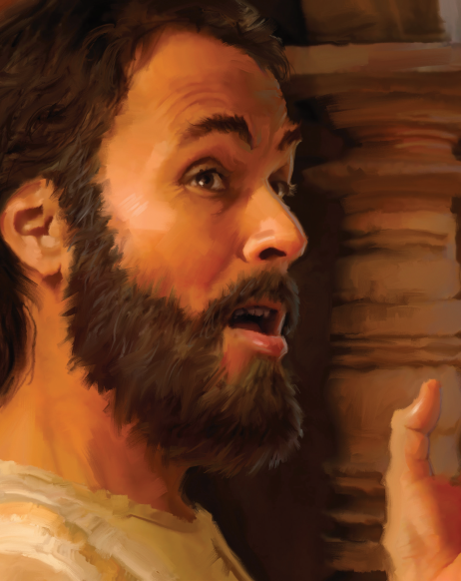
“For so hath the Lord commanded us, saying, I have set thee to be a light of the Gentiles, that thou should be for salvation unto the ends of the earth.”
Acts 13:47

Slide 4
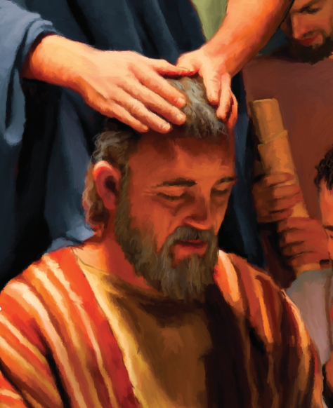
“Now therefore ye are no more strangers and foreigners, but fellow citizens with the saints, and of the household of God; And are built upon the foundation of the apostles and prophets, Jesus Christ himself being the chief corner stone;.”
Ephesians 2:19-20

Slide 5
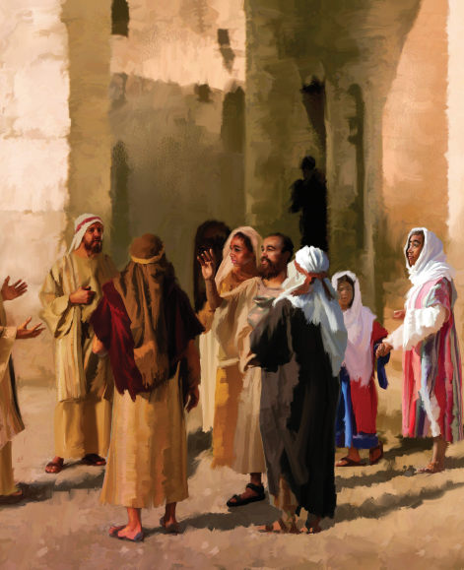
“But we believe that through the grace of the Lord Jesus Christ we shall be saved, even as they.”
Acts 15:11

Slide 6
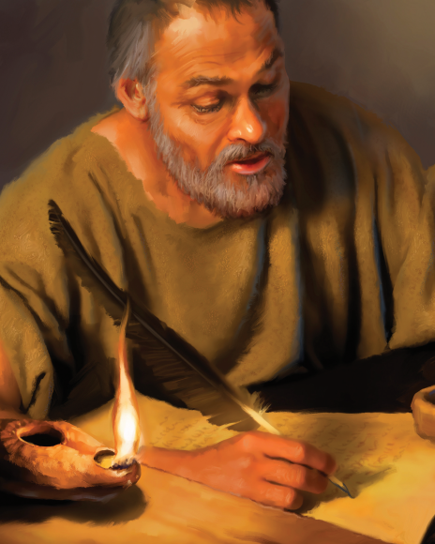
“I am crucified with Christ: nevertheless I live; yet not I, but Christ lives in me: and the life which I now live in the flesh I live by the faith of the Son of God, who loved me, and gave himself for me.”
Galatians 2:20

Slide 7
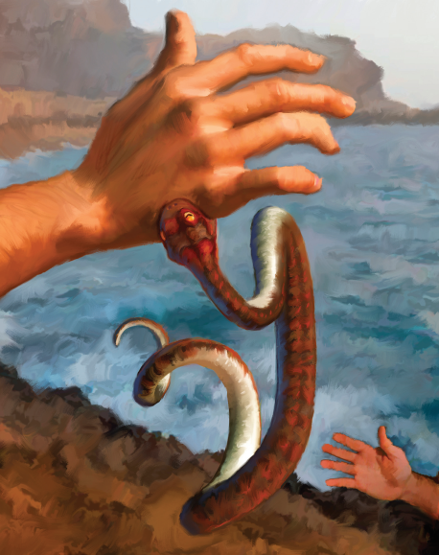
“And he sat down, and called the twelve, and saith unto them, If any man desire to be first, the same shall be last of all, and servant of all.”
Mark 9:35

Slide 8
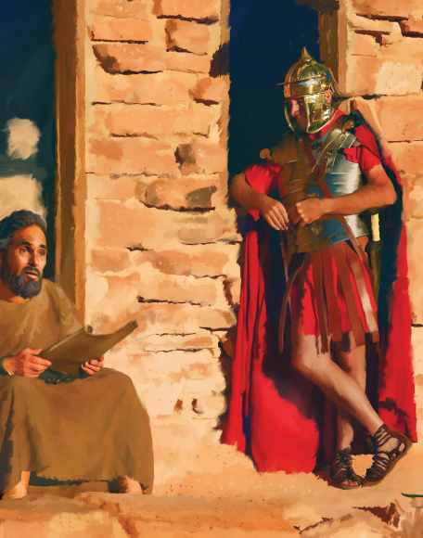
“Not that I speak in respect of want: for I have learned, in whatsoever state I am, therewith to be content. I know both how to be abased, and I know how to abound: every where and in all things I am instructed both to be full and to be hungry, both to abound and to suffer need. I can do all things through Christ which strengthens me.”
Philippians 4:11-13

Slide 9
“Go ye therefore, and teach all nations, baptizing them in the name of the Father, and of the Son, and of the Holy Ghost: Teaching them to observe all things whatsoever I have commanded you: and, lo, I am with you always, even unto the end of the world. Amen.”
Matthew 28:19-20

Slide 10
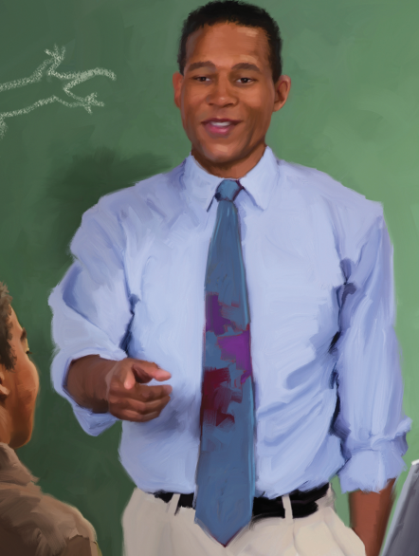
“Wherefore take unto you the whole armour of God, that ye may be able to withstand in the evil day, and having done all, to stand.”
Ephesians 6:13

Slide 11
“I will praise thee; for I am fearfully and wonderfully made: marvelous are thy works; and that my soul knows right well.”
Psalm 139:14

Slide 12
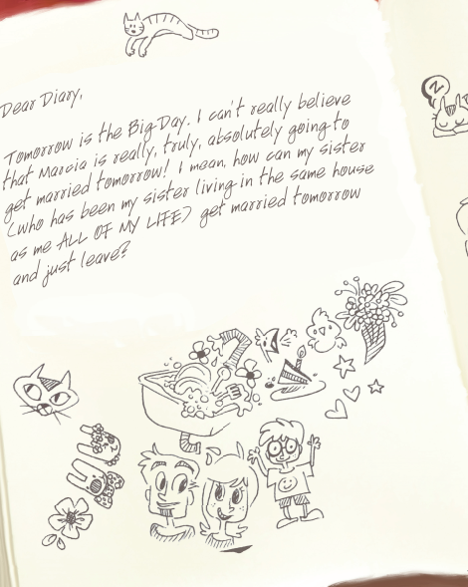
“Therefore if any man be in Christ, he is a new creature: old things are passed away; behold, all things are become new.”
2 Corinthians 5:17

Slide 13
“Which also said, ye men of galilee, why stand ye gazing up into heaven? This same Jesus, which is taken up from you into heaven, shall so come in like manner as ye have seen him go into heaven.”
Acts 1:11

