Slide 1
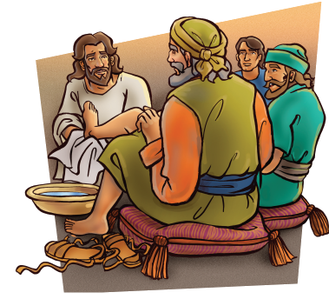
“If I then, your Lord and Master, have washed your feet; ye also ought to wash one another's feet.”
John 13:14

Slide 2
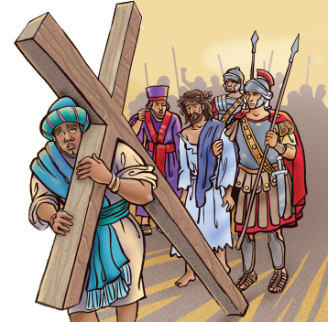
“Bear ye one another's burdens, and so fulfil the law of Christ.”
Galatians 6:2

Slide 3
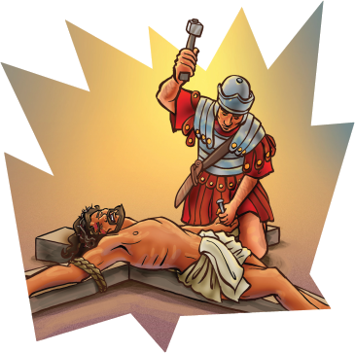
“For God so loved the world, that he gave his only begotten Son, that whosoever believeth in him should not perish, but have everlasting life.
John 3:16

Slide 4
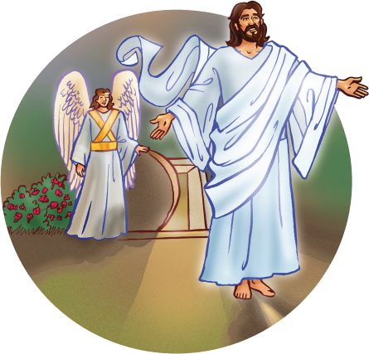
“And he said unto them, Go ye into all the world, and preach the gospel to every creature.”
Mark 16:15

Slide 5
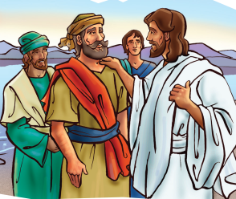
“He saith to him again the second time, Simon, son of Jonas, lovest thou me? He saith unto him, Yea, Lord; thou knowest that I love thee. He saith unto him, Feed my sheep.”
John 21:16

Slide 6
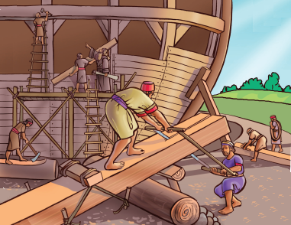
“Teach me to do thy will; for thou art my God: thy spirit is good; lead me into the land of uprightness.”
Psalm 143:10

Slide 7
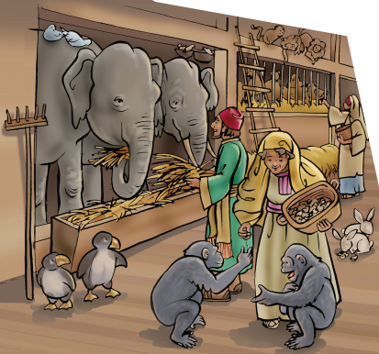
“Only let your conversation be as it becomes the gospel of Christ: that whether I come and see you, or else be absent, I may hear of your affairs, that ye stand fast in one spirit, with one mind striving together for the faith of the gospel;”
Philippians 1:27

Slide 8
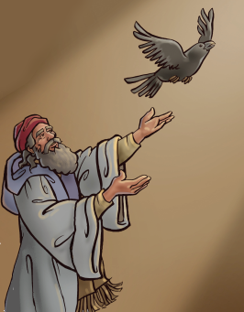
“And let us not be weary in well doing: for in due season we shall reap, if we faint not..”
Galatians 6:9

Slide 9
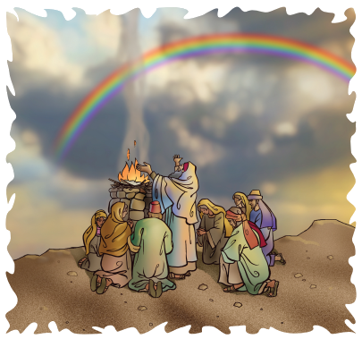
Genesis 9:15
“And I will remember my covenant, which is between me and you and every living creature of all flesh; and the waters shall no more become a flood to destroy all flesh.”

Slide 10
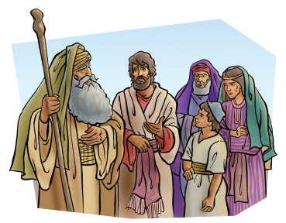
“If thou turn away thy foot from the sabbath, from doing thy pleasure on my holy day; and call the sabbath a delight, . . . Then shalt thou delight thyself in the LORD;....”
Isaiah 58:13-14

Slide 11
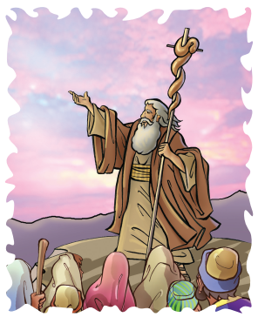
“And Jesus answering saith unto them, Have faith in God.”
Mark 11:22

Slide 12
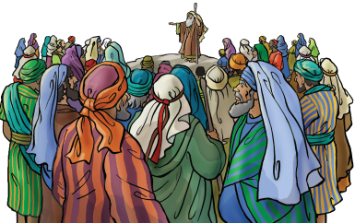
“. . . love the LORD your God, and to serve him with all your heart and with all your soul.”
Deuteronomy 11:13

Slide 13
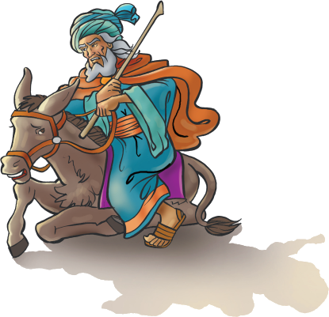
“Jesus answered and said unto him, If a man love me, he will keep my words: and my Father will love him, and we will come unto him, and make our abode with him..”
John 14:23

