Slide 1
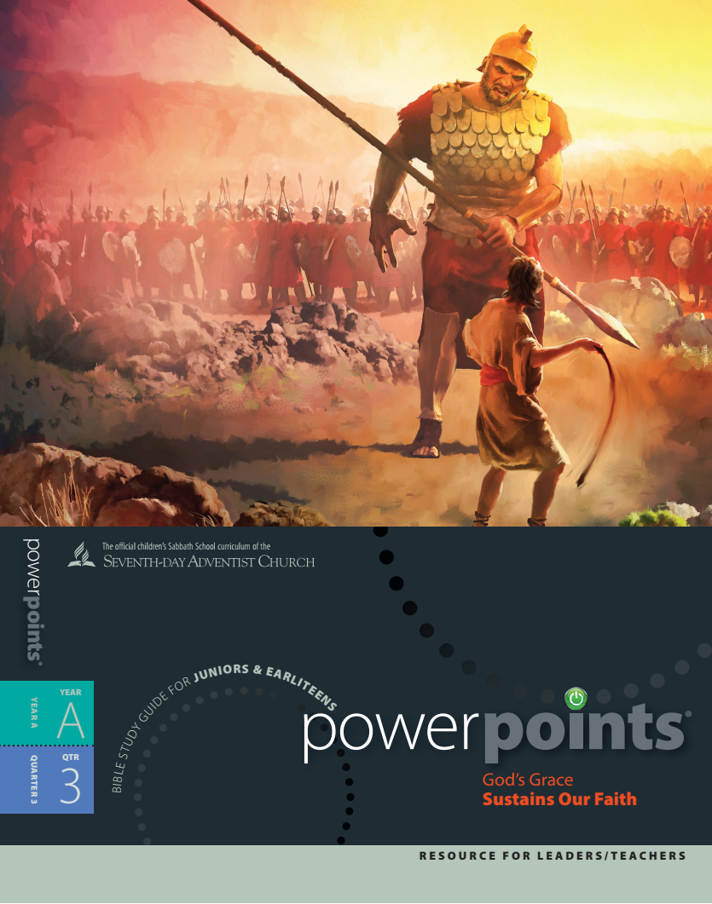

Slide 2
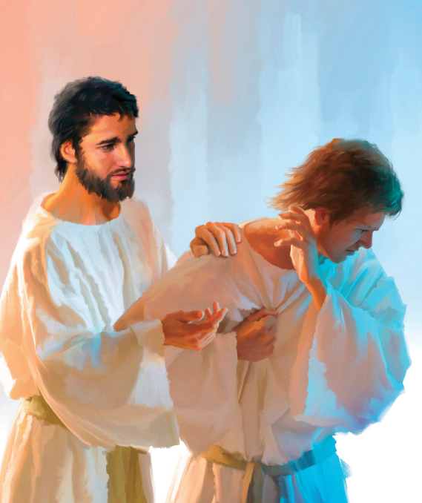
“And The LORD passed by before him and proclaimed, The LORD, The LORD God, merciful and gracious, longsuffering and abundant in goodness and truth, keeping mercy for thousands, forgiving iniquity, transgression and sin, and that by no means clear the guilty; visiting the iniquity of the fathers upon the children and upon the children’s children unto the third and the fourth generation.”
Exodus 34:6-7

Slide 3
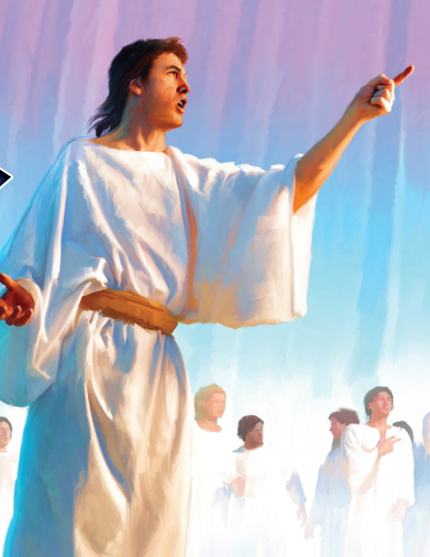
“But the God of all grace, who has called us to His eternal glory by Christ Jesus, after that you have suffered a while, make you perfect, establish, strengthen, and settle you..”
1 Peter 5:10

Slide 4
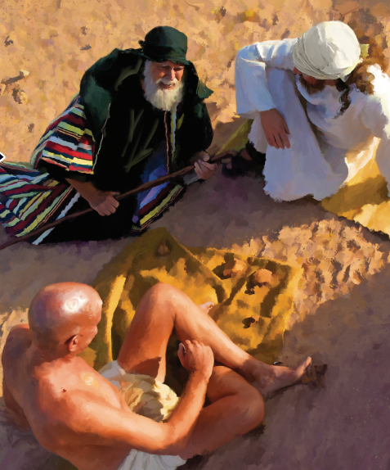
“For now we see through a glass, darkly; but then face to face; now I know in part; but then shall I know even as also I am known.”
1 Corinthians 13:12

Slide 5
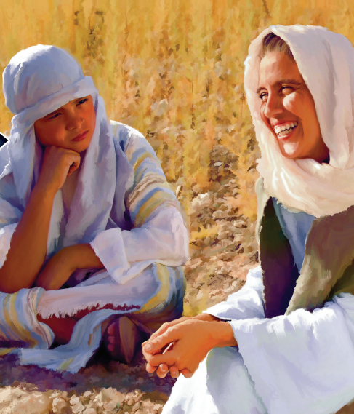
“And even to your old age I am he; and even to hoar hairs will I carry you; I have made, and I will bear; even I will carry, and will deliver you.”
Isaiah 46:4

Slide 6
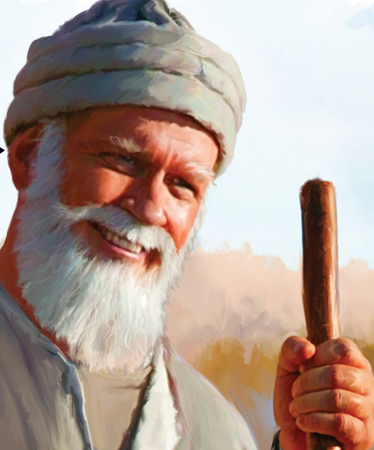
“I have heard of you by the hearing of the ear: but now mine eye sees you.”
Job 42:5

Slide 7
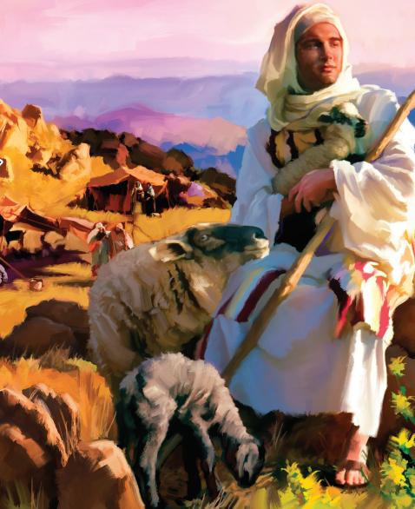
“If any man serve me, let him follow me; and where I am, there shall also my servant be: if any man serve me, him will my Father honour..”
John 12:26

Slide 8
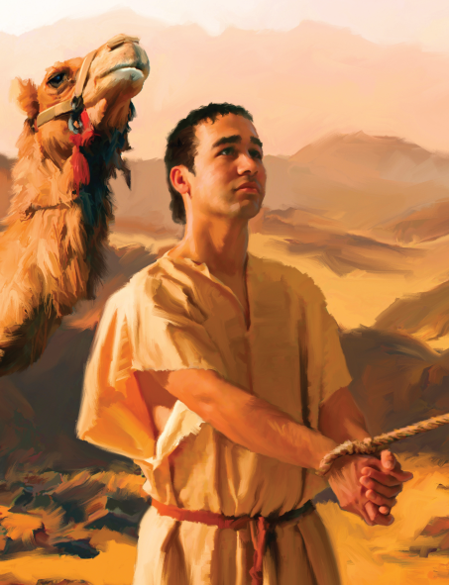
“Who shall separate us from the love of Christ? shall tribulation, or distress, or persecution, or famine, or nakedness, or peril, or sword? As it is written, For thy sake we are killed all the day long; we are accounted as sheep for the slaughter. Nay, in all these things we are more than conquerors through him that loved us.”
Romans 8:35-37

Slide 9
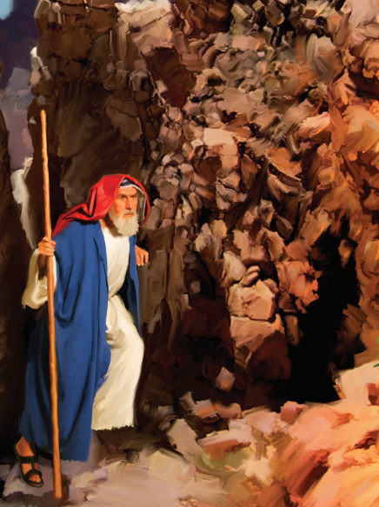
“Having then gifts differing according to the grace that is given to us, whether prophecy, let us prophesy according to the proportion of faith; Or ministry, let us wait on our ministering: or he that teaches, on teaching; Or he that exhorts, on exhortation: he that giveth, let him do it with simplicity; he that rules, with diligence; he that shows mercy, with cheerfulness..”
Romans 12:6-8

Slide 10
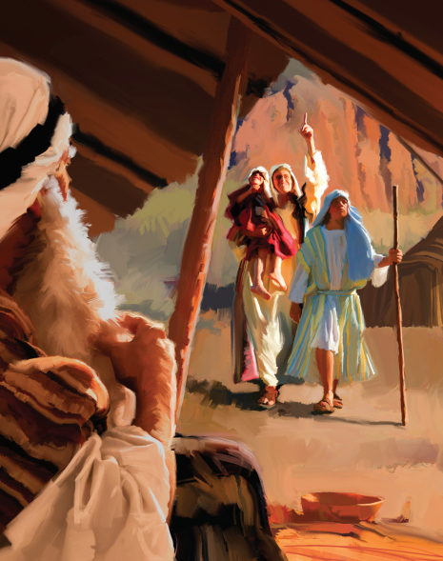
“Let all things be done decently and in order.”
1 Corinthians 14:40

Slide 11
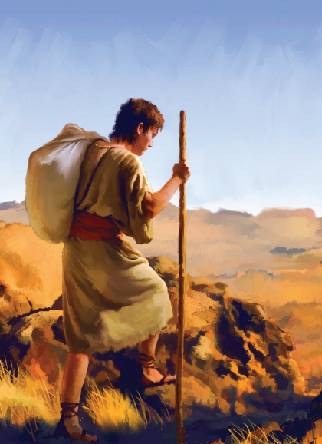
“For the LORD takes pleasure in His people: He will beautify the meek with salvation.”
Psalm 149:4

Slide 12
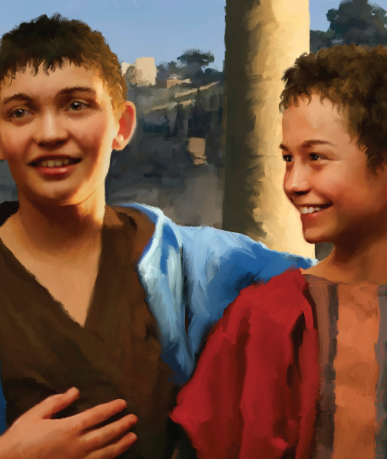
“And Jonathan said to David, Go in peace, forasmuch as we have sworn both of us in the name of the LORD, saying, The LORD be between me and thee, and between my seed and thy seed for ever. And he arose and departed: and Jonathan went into the city.”
1 Samuel 20:42

Slide 13
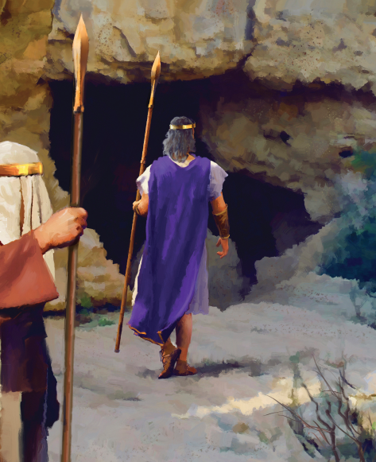
“Honour all men. Love the brotherhood. Fear God. Honour the king.”
1 Peter 2:17

Slide 14
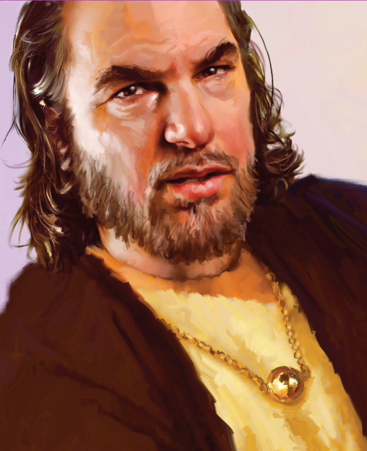
“He hath shewed thee, O man, what is good; and what doth the LORD require of thee, but to do justly, and to love mercy, and to walk humbly with thy god?”
Micah 6:8

