Slide 2
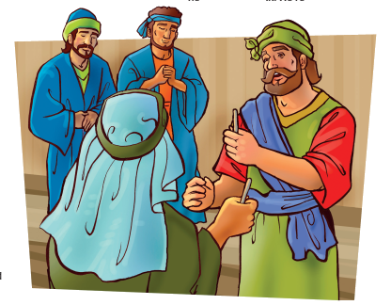
But ye shall receive power, after that the Holy Ghost is come upon you: and ye shall be witnesses unto me both in Jerusalem, and in all Judaea, and in Samaria, and unto the uttermost part of the earth.
Acts 1:8

Slide 3
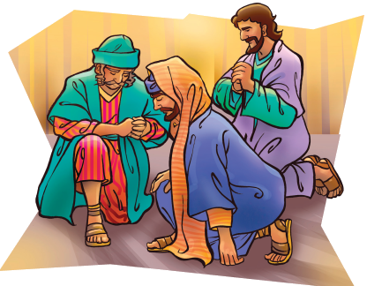
“These all continued with one accord in prayer and supplication, with the women, and Mary the mother of Jesus, and with his brethren.”
Acts 1:14

Slide 4
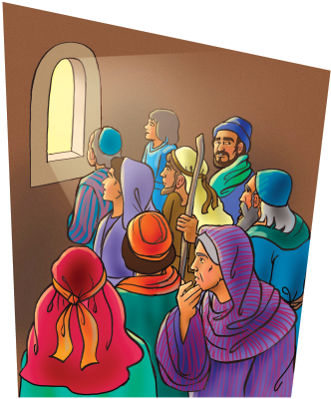
“And it shall come to pass in the last days, saith God, I will pour out of my Spirit upon all flesh: and your sons and your daughters shall prophesy, and your young men shall see visions, and your old men shall dream dreams:”
Acts 2:17

Slide 5
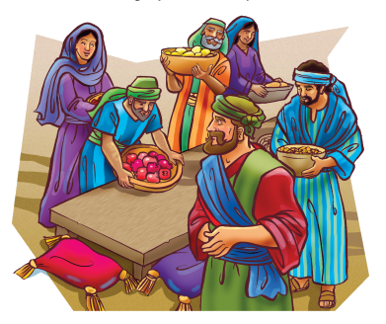
“With good will doing service, as to the Lord, and not to men:.”
Ephesians 6:7

Slide 6
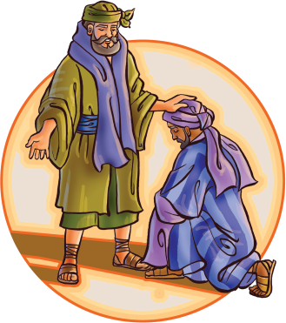
Now there are diversities of gifts, but the same Spirit. And there are differences of administrations, but the same Lord.
1 Corinthians 12:4-5

Slide 7
“The LORD hath appeared of old unto me, saying, Yea, I have loved thee with an everlasting love: therefore with lovingkindness have I drawn thee.”
Jeremiah 31:3

Slide 8
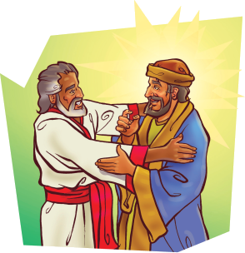
“But the Lord said unto him, Go thy way: for he is a chosen vessel unto me, to bear my name before the Gentiles, and kings, and the children of Israel:”
Acts 9:15

Slide 9
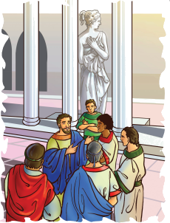
“Then Peter opened his mouth, and said, Of a truth I perceive that God is no respecter of persons: But in every nation he that fears him, and works righteousness, is accepted with him.”
Acts 10:34-35

Slide 10
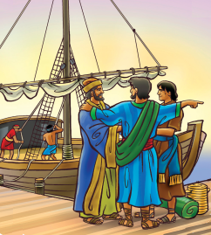
“As they ministered to the Lord, and fasted, The Holy Ghost said, Separate me Barnabas and Saul for the work whereunto I have called them.”
Acts 13:2

Slide 11
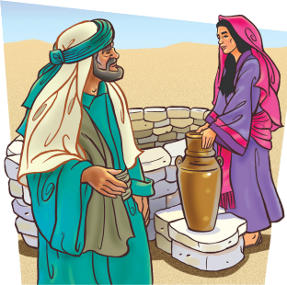
“And he said unto me, The LORD, before whom I walk, will send His angel with you, and prosper your way; and you shall take a wife for my son of my kindred, and of my father’s house:”
Genesis 24:40

Slide 12
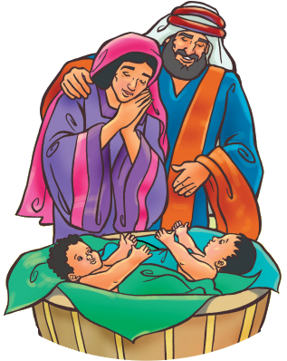
“Be kindly affectioned one to another with brotherly love; in honour preferring one another;”
Romans 12:10

Slide 13
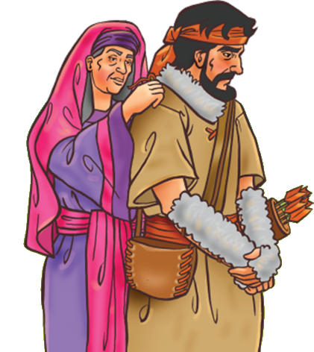
“Ye shall not steal, neither deal falsely, neither lie one to another.”
Leviticus 19:11

Slide 14
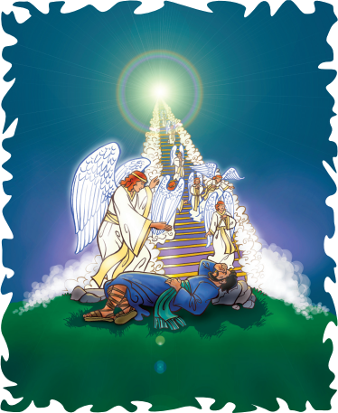
And, behold, I am with you, and will keep you in all places whither you go, and will bring you again into this land; for I will not leave you, until I have done that which I have spoken to you of.
Genesis 28:15

