Slide 2
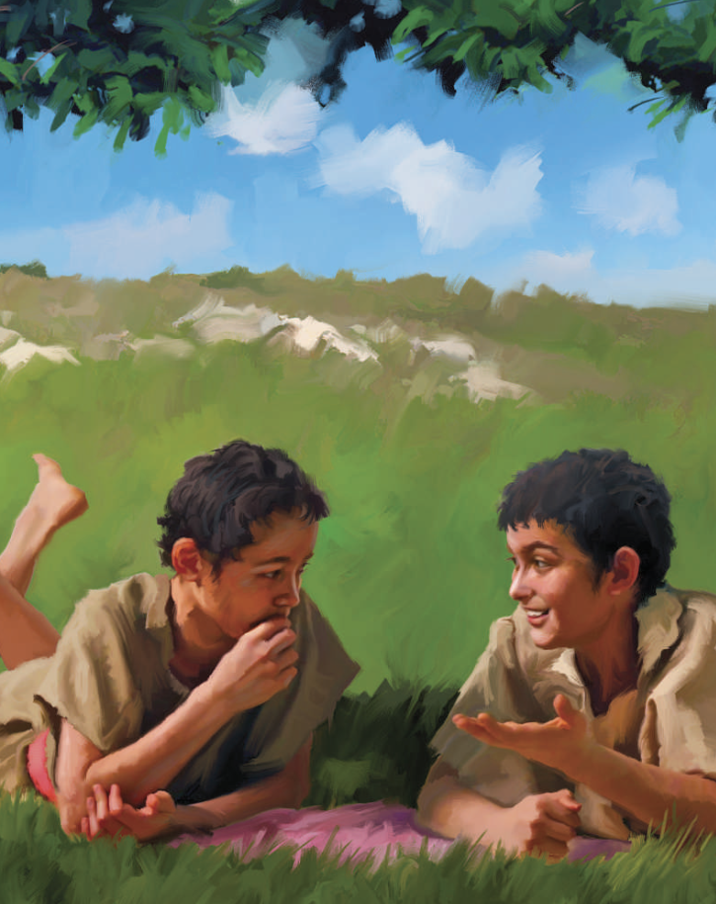
“Every good gift and every perfect gift is from above, and cometh down from the Father of lights, with whom is no variableness, neither shadow of turning.”
James 1:17

Slide 3
“Lying lips are abomination to the LORD: but they that deal truly are his delight.”
Proverbs 12:22

Slide 4
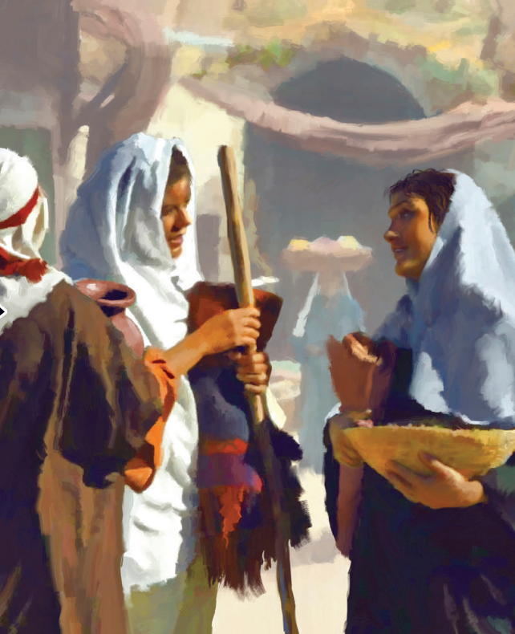
“For if ye forgive men their trespasses, your heavenly Father will also forgive you:.”
Matthew 6:14

Slide 5
Ecclesiastes 4:9-10
“Two are better than one; because they have a good reward for their labour. For if they fall, the one will lift up his fellow: but woe to him that is alone when he falls; for he has not another to help him up.”

Slide 6
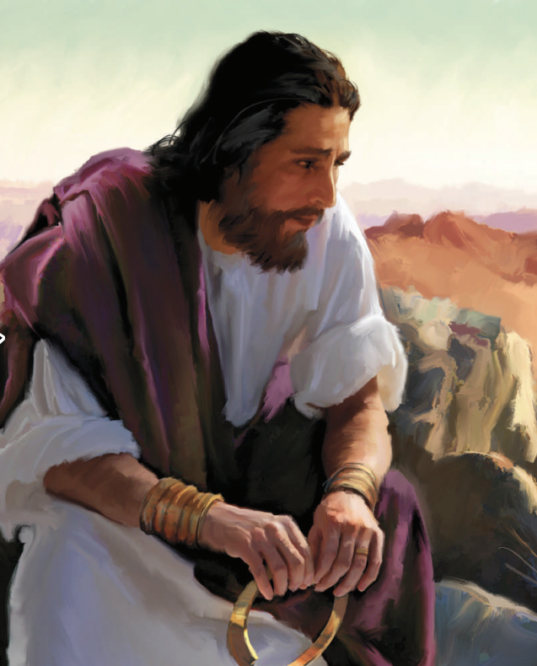
“But I say to you, Love your enemies, bless them that curse you, do good to them that hate you, and pray for them which despitefully use you, and persecute you; That you may be the children of your Father which is in heaven: for he makes his sun to rise on the evil and on the good, and sends rain on the just and on the unjust.”
Matthew 5:44-45

Slide 7
“And the fruit of righteousness is sown in peace of them that make peace.”
James 3:18

Slide 8
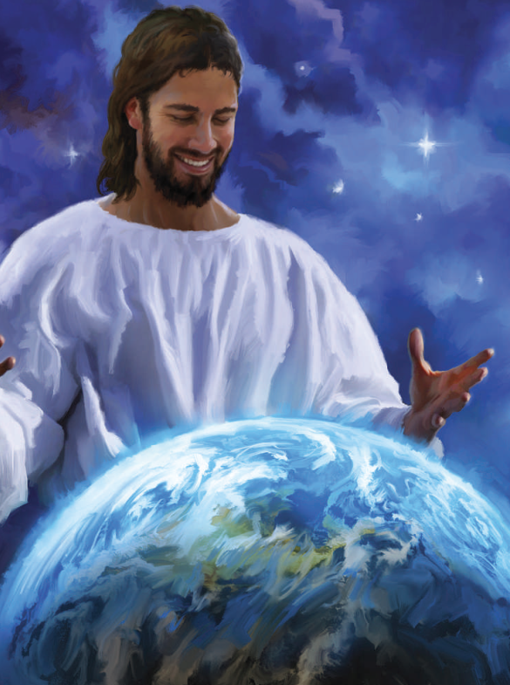
“Bless the LORD, O my soul, and forget not all his benefits: Who forgives all your iniquities; who heals all your diseases; Who redeems your life from destruction; who crowns you with lovingkindness and tender mercies; Who satisfies your mouth with good things; so that your youth is renewed like the eagle's.”
Psalm 103:2-5

Slide 9
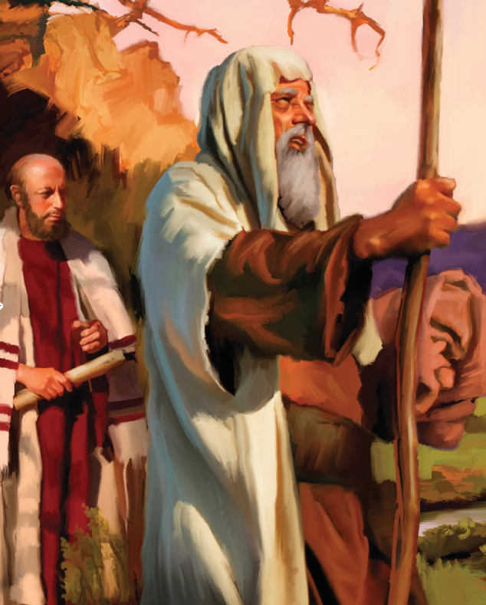
Acts 1:8
“But you shall receive power, after that The Holy Ghost is come upon you: and you shall be witnesses to me both in Jerusalem, and in all Judaea, and in Samaria, and unto the uttermost part of the earth.”

Slide 10
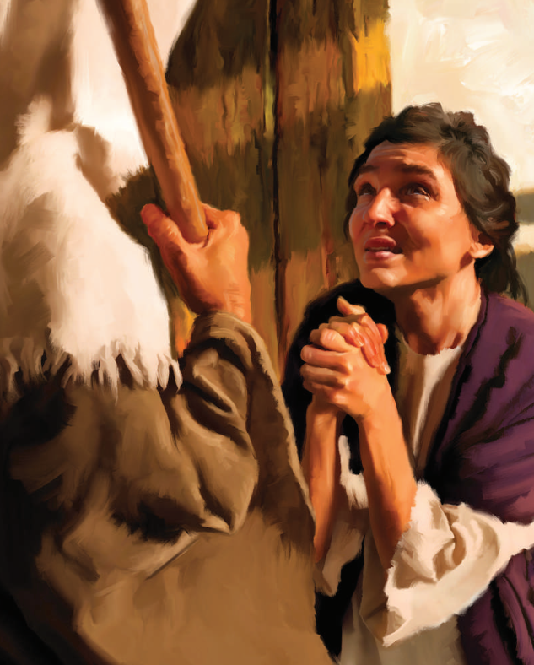
“But my God shall supply all your needs according to his riches in glory by Christ Jesus.”
Philippians 4:19

Slide 11
“But when the fullness of the time was come, God sent forth his Son, made of a woman, made under the law, To redeem them that were under the law, that we might receive the adoption of sons.”
Galatians 4:4-5

Slide 12
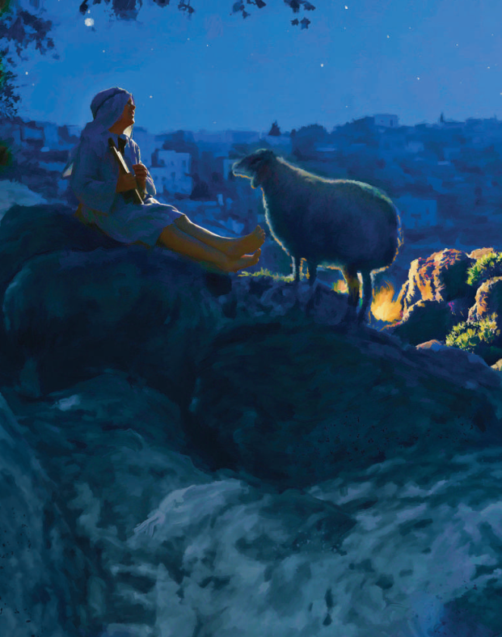
“And suddenly there was with the angel a multitude of the heavenly host praising God, and saying, Glory to God in the highest, and on earth peace, good will toward men.”
Luke 2:13-14

Slide 13
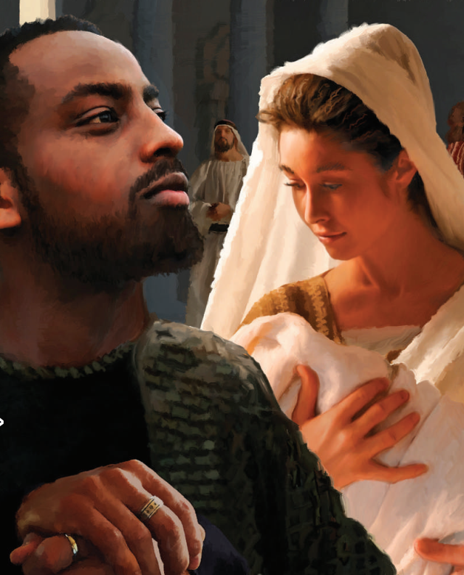
“For mine eyes have seen Your salvation, Which You have prepared before the face of all people;
A light to lighten the Gentiles, and the glory of Your people Israel.”
Luke 2:30-32

Slide 14
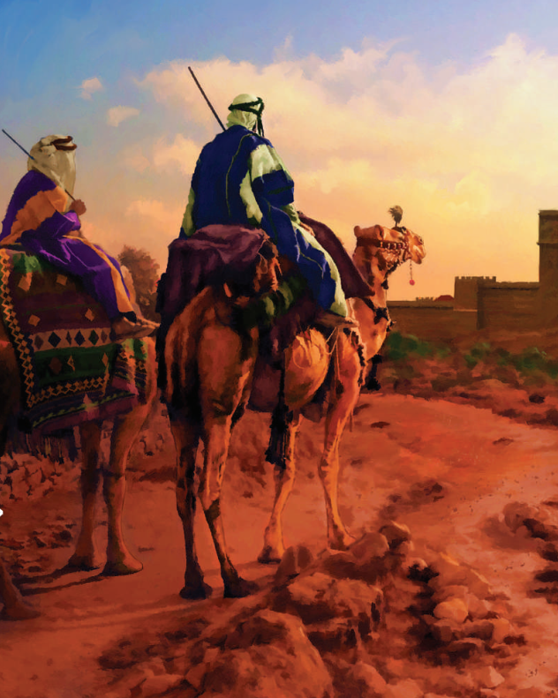
“Give thanks unto the LORD, call upon his name, make known his deeds among the people. Sing unto him, sing psalms unto him, talk ye of all his wondrous works.”
1 Chronicles 16:8-9

