Slide 2
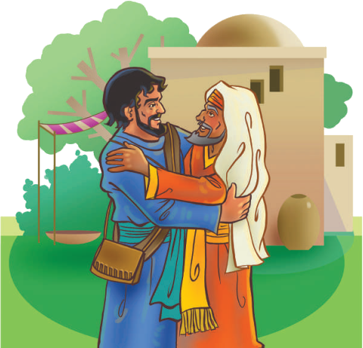
2 Corinthians 6:6
By pureness, by knowledge, by longsuffering, by kindness, by the Holy Ghost, by love unfeigned.

Slide 3
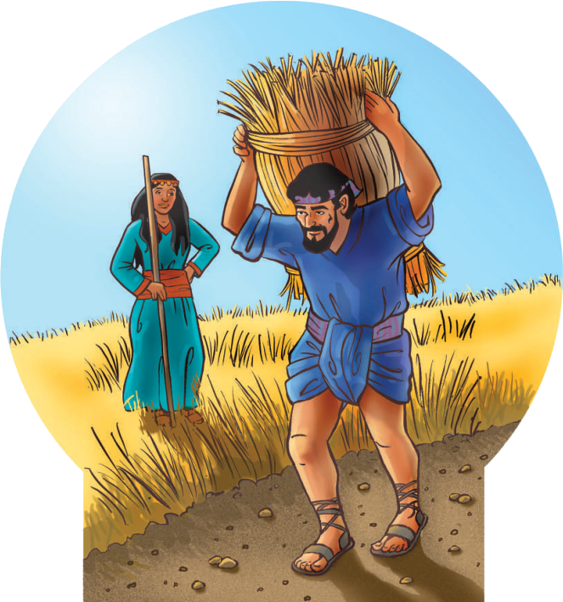
“Love suffers long, and is kind; love envies not; love vaunts not itself, and is not puffed up.”
1 Corinthians 13:4

Slide 4
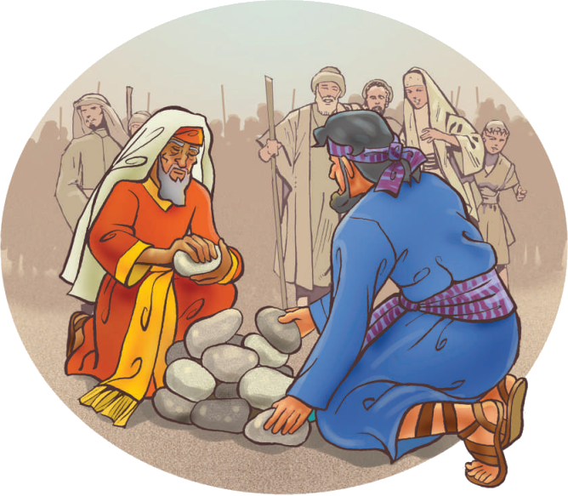
“And whatsoever you do, do it heartily, as to the Lord, and not unto men.”
Colossians 3:23

Slide 5
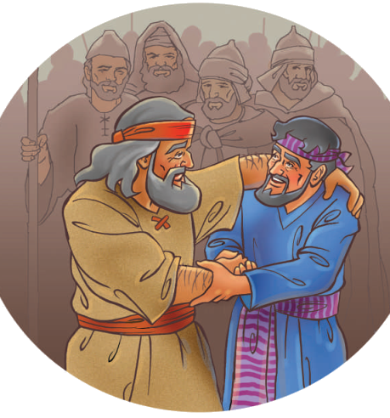
“Take, I pray you, my blessing that is brought to you; because God has dealt graciously with me, and because I have enough. And he urged him, and he took it.”
Genesis 33:11

Slide 6
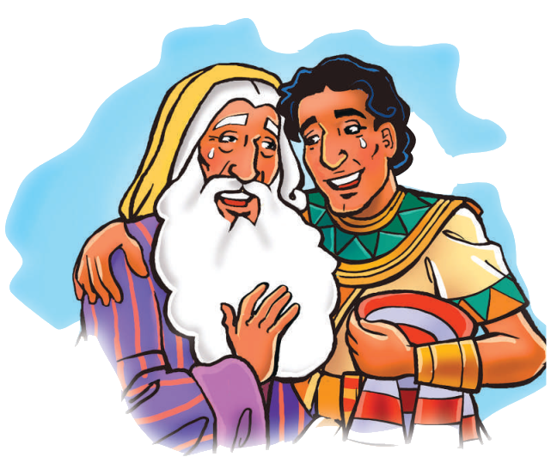
“As we have therefore opportunity, let us do good to all men, especially to them who are of the household of faith.”
Galatians 6:10

Slide 7
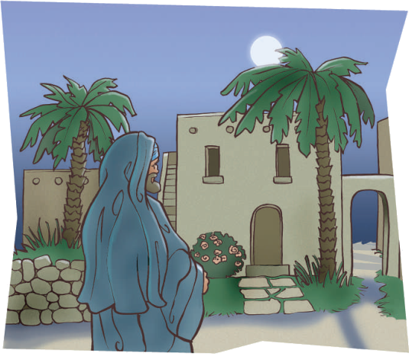
“Behold, what manner of love the Father has bestowed upon us, that we should be called the sons of God: therefore the world knows us not, because it knew him not.”
1 John 3:1

Slide 8
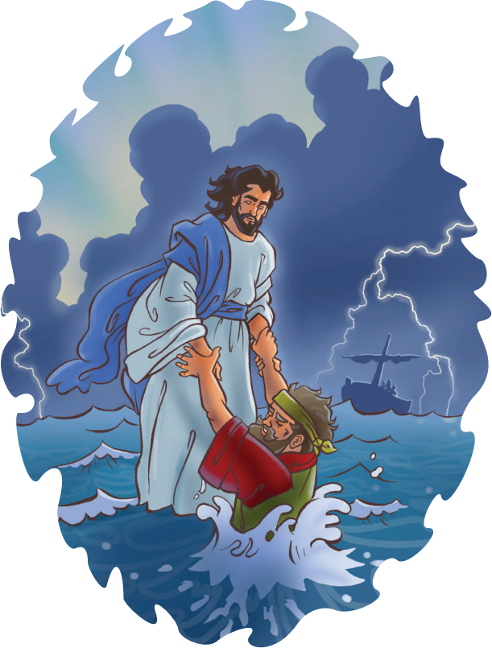
“And He said, The things which are impossible with men are possible with God.”
Luke 18:27

Slide 9
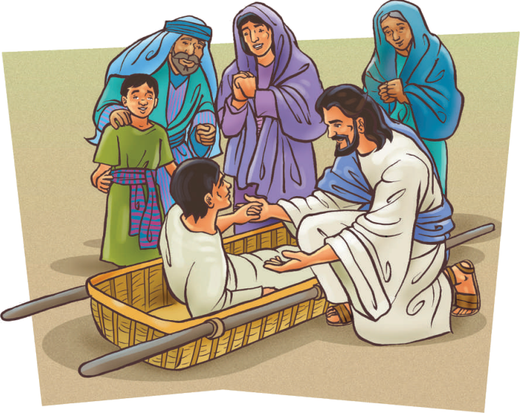
“Then shall the virgin rejoice in the dance, both young men and old together: for I will turn their mourning into joy, and will comfort them, and make them rejoice from their sorrow.”
Jeremiah 31:13

Slide 10
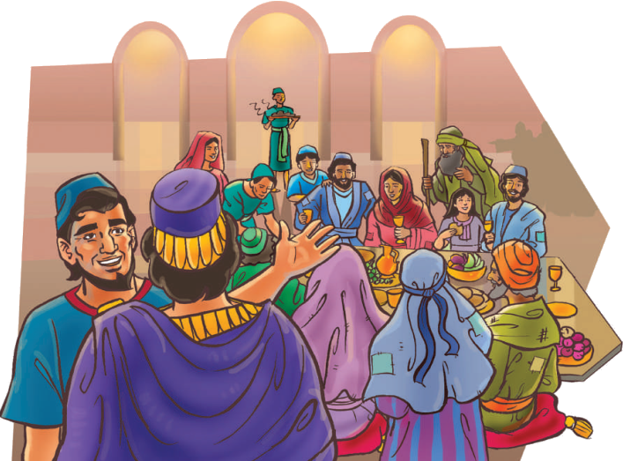
“And when one of them that sat at meat with him heard these things, he said to him, Blessed is he that shall eat bread in the kingdom of God.”
Luke 14:15

Slide 11
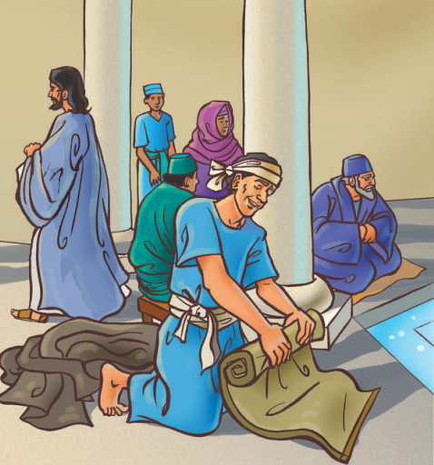
“For by grace are you saved through faith; and that not of yourselves: it is the gift of God.”
Ephesians 2:8

Slide 12
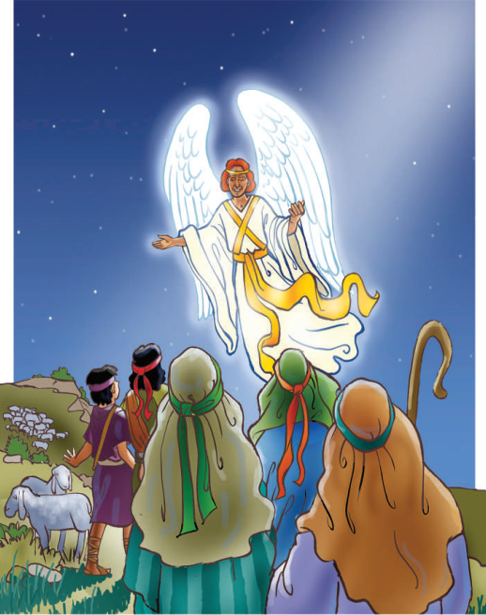
“And the angel said to them, Fear not: for, behold, I bring you good tidings of great joy, which shall be to all people.”
Luke 2:10

Slide 13
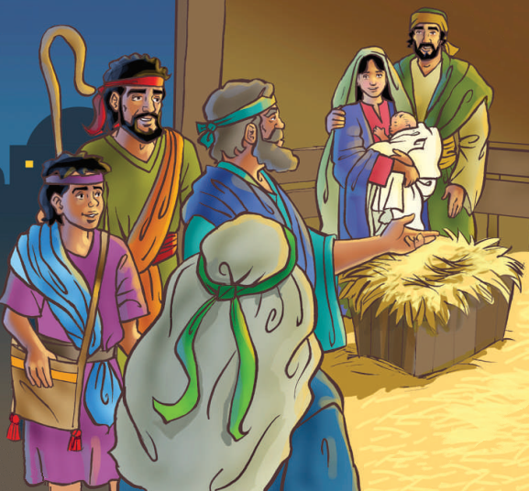
“Glory to God in the highest, and on earth peace, good will toward men.”
Luke 2:14

Slide 14
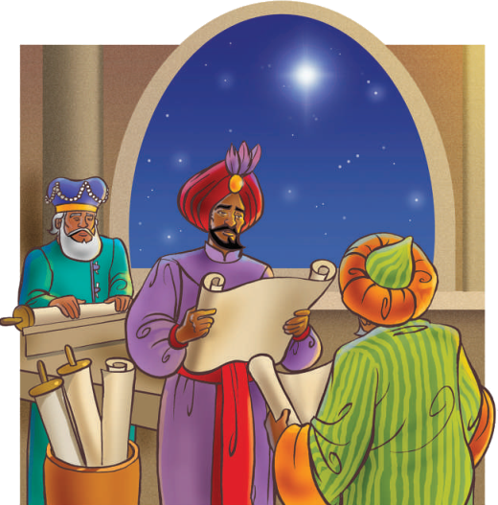
“And when they were come into the house, they saw the young child with Mary his mother, and fell down, and worshipped him: and when they had opened their treasures, they presented to him gifts; gold, and frankincense, and myrrh.”
Matthew 2:11

