Slide 1
GOD LOVES FREELY
Lesson 1 for January 4, 2025

Slide 2
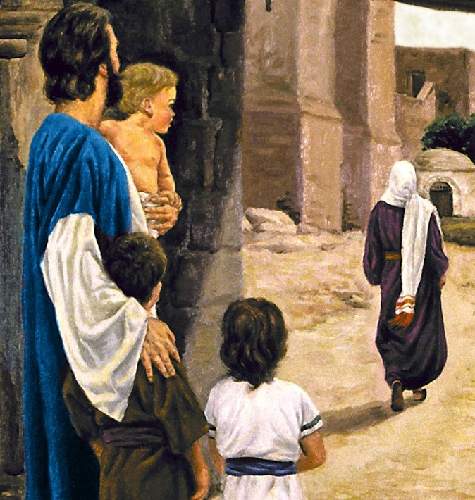
“ ‘I will heal their backsliding, I will love them freely, for My anger has turned away from him’ ”
Hosea 14:4, NKJV

Slide 3
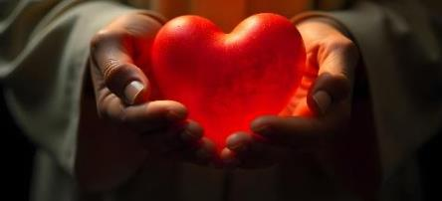
There are many questions that may arise when we talk about God's love and justice. During this quarter, we will seek answers to these and other questions:
Is God's love one-way (that is, he loves, but never receives love)?
Is God's love emotional?
Do you really care about human beings?
Can one reject or renounce God's love?
Does God enter into a relationship of reciprocal love with his human creatures?
Is anger incompatible with love?
What is the relationship between love and justice?
If God is love, why is there so much evil in this world?
Can humans love like God? If so, how?
In this lesson, we will explore these three questions:
Can God's love be measured?
Beyond what is expected
A complete surrender
Does God need to show and receive love?
God loves freely
To love without expecting a response
Can we reject God's love?
Our choice

Slide 4
CAN GOD'S LOVE BE MEASURED?

Slide 5
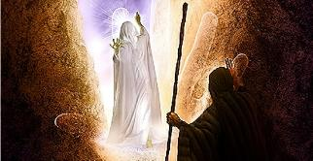
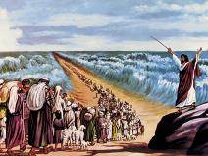
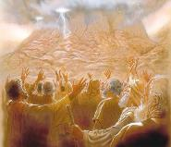
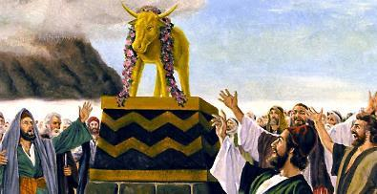
BEYOND WHAT WAS EXPECTED
“And the LORD said, ‘I will cause all my goodness to pass in front of you, and I will proclaim my name, the Lord, in your presence. I will have mercy on whom I will have mercy, and I will have compassion on whom I will have compassion’ ’’ (Exodus 33:19 NIV )
Read out of context, some Bible verses can give us the impression that God's love is capricious, that He loves only when He feels like doing so (Ex. 33:19.)
But let’s look at the whole story. God has brought Israel out of Egypt with great miracles. He has spoken to them personally from Sinai and asked them to make Him their only God. A few days later they build themselves a golden calf and say, “These are your gods, Israel, who brought you up out of Egypt!” (Ex. 32:8 NIV.) God tells Moses what the people deserve: death (Ex. 32:9-10.)
Moses pleads for mercy that the people do not deserve (Ex. 32:11–13, 30–33.) In this context, God assures Moses that he “desires” to have mercy on Israel (Ex. 33:19.) God’s love does not follow the logic of cause and effect. His love is immeasurable; it is constant and inexhaustible. He freely bestows grace, mercy, and compassion even on those who are unworthy of it.

Slide 6
A COMPLETE DELIVERY
“…the Son of God, who loved me and gave himself for me”
(Galatians 2:20b)
On the Cross – the ultimate demonstration of God’s love – we see that Christ gave himself for us of his own free will and initiative. No one took his life, but he offered it voluntarily, following the Plan of Redemption agreed upon in Heaven before the foundation of the world (Jn. 10:17-18; 1P. 1:18-20.)
How far can our love go? To the point of giving our life for someone we love and ardently desire to keep alive? Would we do it for a complete stranger, or for someone who hates us? (Rom. 5:7)
“Christ died for the ungodly” (Rom. 5:6 NIV.) “God demonstrates his own love for us in this: While we were still sinners, Christ died for us” (Rom. 5:8 NIV.)

Slide 7
DOES GOD NEED TO SHOW AND RECEIVE LOVE?

Slide 8
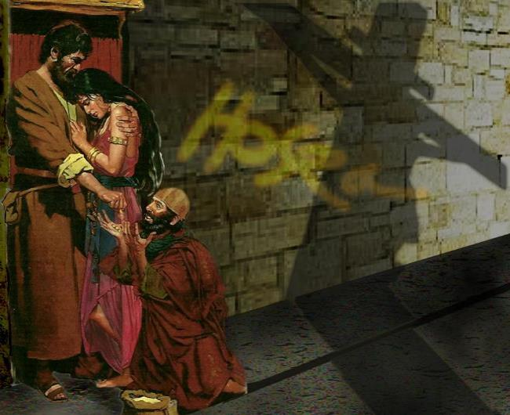
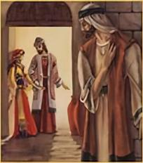
GOD LOVES FREELY
“I will heal their backsliding, I will love them freely, for My anger has turned away from him” (Hosea 14:4)
The story of Hosea shows us what God's love is like. Despite his wife's infidelity, Hosea forgave her time and time again, and continued to love her.
Hosea represents God, and his unfaithful wife represents God’s people. Despite our continued sin and estrangement from God, He continues to love us “freely” (Hos. 14:4.) What does that expression mean?
The Hebrew word, nedabah, describes that which is offered voluntarily (such as voluntary offerings.)
God bestows his love, even though he receives nothing in return. What a contrast to our selfish nature!
What will be your response to this voluntary and selfless love?

Slide 9
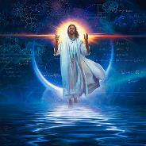
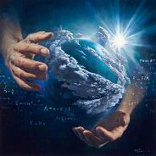
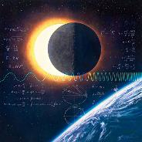
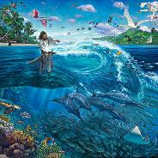
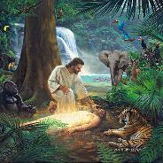
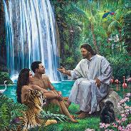
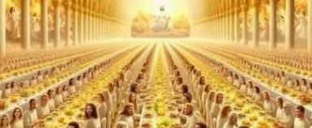
LOVE WITHOUT EXPECTING A RESPONSE
“I know every bird in the mountains, and the insects in the fields are mine. If I were hungry I would not tell you, for the world is mine, and all that is in it” (Psalm 50:11-12)
Did God need to create this world to be loved, honored and worshiped?
God needs nothing from us (Acts 17:25.) In fact, how many even recognize that everything they have, and their very life, is a gift from God? How many today praise and thank Him for it?
Divine love eternally existed before the creation of the universe, as Jesus underscored when He stated that the Father loved Him “before the foundation of the world” (John 17:24.) Thus, the creation of the world was not a necessity for the existence of God’s love. Instead, creation was a divine voluntary activity that resulted from the freedom of His eternal overflowing love.
God is love, and He loves without expecting a response. He loves those who respond to His love, and those who reject it. He loves so much that He has done everything possible so that His Creation, His children, can share with Him a life of eternal happiness.

Slide 10
CAN GOD'S LOVE BE REJECTED?

Slide 11
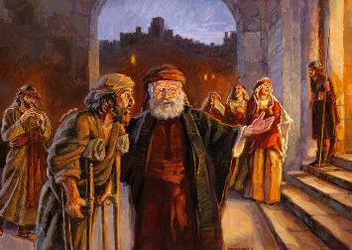
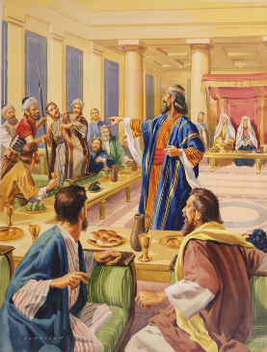
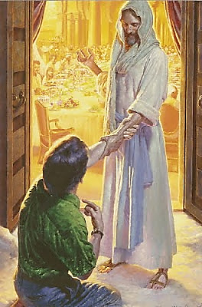
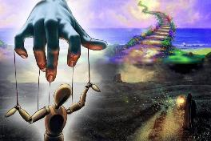
OUR CHOICE
“For many are invited, but few are chosen” (Matthew 22:14)
A king prepares his son's wedding, but the guests reject the invitation. Others are invited and accept, but even among these there are those who do not follow protocol and are expelled (Mt. 22:1-13.)
Jesus' application of this parable has led some to believe that God chooses in advance who will be saved and who will not (Mt. 22:14.) This would imply that God bestows his love on some, but withholds it from others.
The original text emphasizes the invitation and not the election: “Many are INVITED, and few ACCEPT THE INVITATION.”
God has chosen all of us because He loves us all (Jn. 3:16.) It is not God's choice, but our response to His invitation, that determines our destiny.

Slide 12
“The world had lost the original pattern of goodness, and had sunk into universal apostasy and moral corruption; and the life of Jesus was one of laborious, self-denying effort to bring man back to his first estate by imbuing him with the spirit of divine benevolence and unselfish love. While in the world, he was not of the world. It was a continual pain to him to be brought in contact with the enmity, depravity, and impurity which Satan had brought in; but he had a work to do to bring man into harmony with the divine plan, and earth in connection with Heaven, and he counted no sacrifice too great for the accomplishment of the object.”
EGW (Testimonies for the Church, volume 5, page 177)

