Slide 1
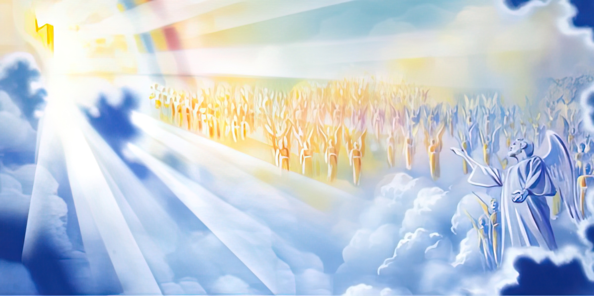
THE RULES OF ENGAGEMENT
Lesson 10 for March 8, 2025

Slide 2
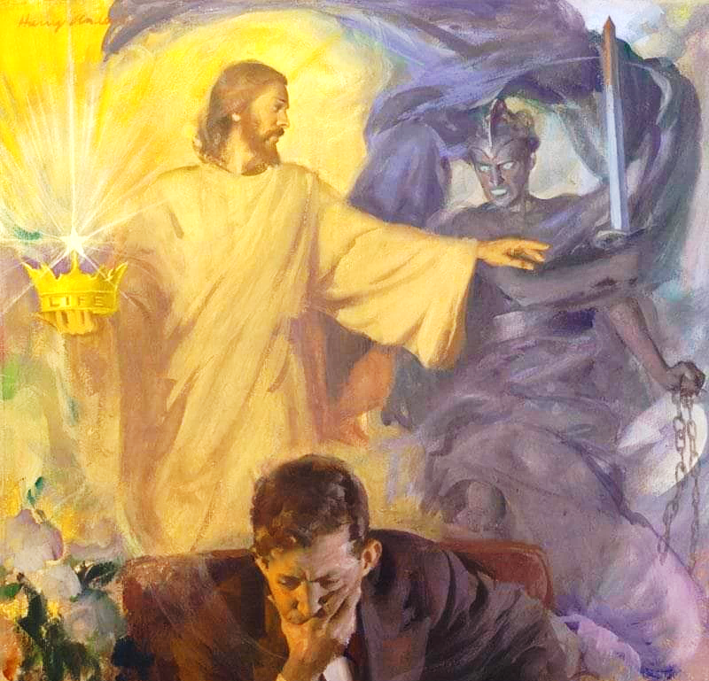
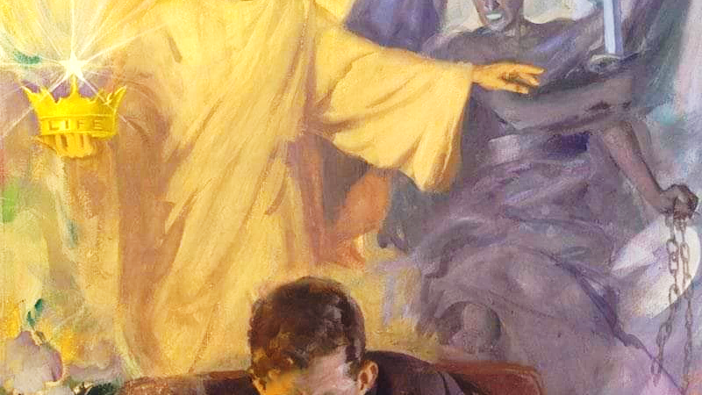
“He who sins is of the devil, for the devil has sinned from the beginning. For this purpose the Son of God was manifested, that He might destroy the works of the devil”
1 Juan 3:8

Slide 3

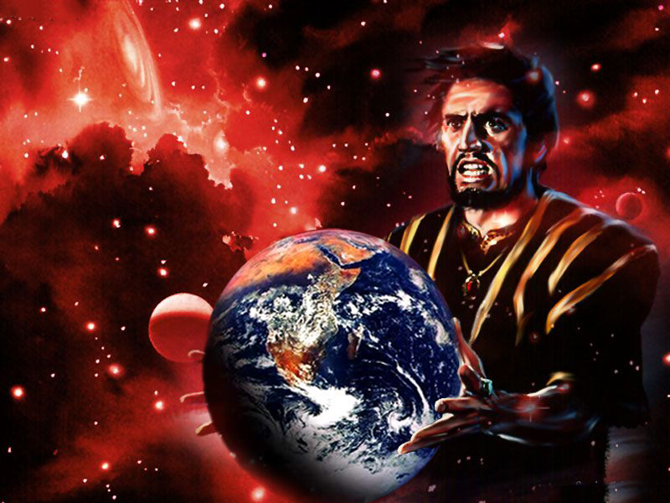
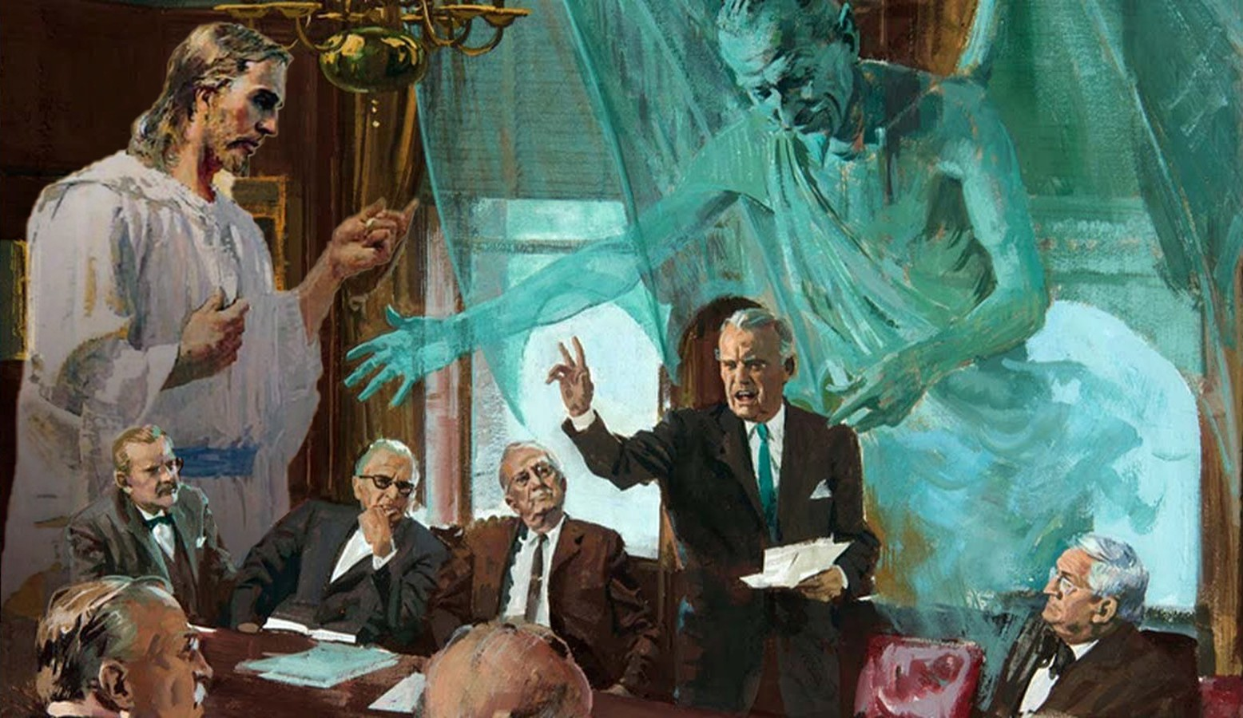








After the fall of Adam and Eve, God allowed Satan to rule this world, but He imposed certain rules and limitations on him.
Although we do not know many of the rules of the Cosmic Conflict, God has given us some knowledge of the limits imposed on evil. He has also revealed to us some of the limits He has imposed on Himself in this Conflict.
What are the rules that govern the Cosmic Conflict between God and Satan?
The rules of Conflict:
  The god of this world.
The Limits of Conflict:
  Time limits.
  Physical limits.
The Weapons of Conflict:
  Restrictions for both parties.
  A weapon at our disposal.

Slide 4

THE RULES OF CONFLICT

Slide 5

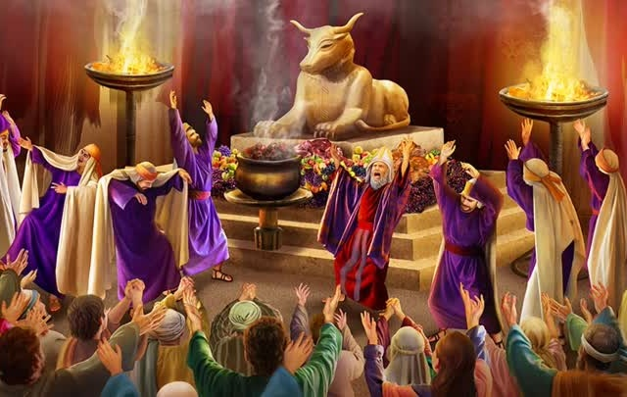
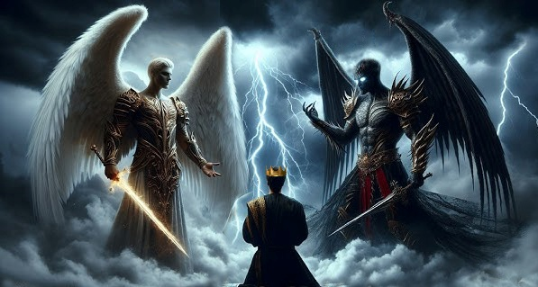

THE GOD OF THIS WORLD
“The god of this age has blinded the minds of unbelievers, so that they cannot see the light of the gospel that displays the glory of Christ, who is the image of God” (2 Corinthians 4:4 NIV )
Until the arrival of Christianity, almost the entire world worshipped idols. But what was behind these idols (Deut . 32:17; 1Co. 10:20)?
Behind the pantheons of Egyptian, Canaanite, Roman and Greek gods were demons, fallen angels. But they are not content to be worshipped through idols or false gods. They make efforts to actively dominate this world and its inhabitants.
When God's people wanted to rebuild the Temple, there was a battle to influence the thoughts of King Cyrus (Dan. 10:1-13.) Satan ("the prince of the kingdom of Persia") fought against Gabriel for three weeks, until he received help from Jesus himself ("Michael.")
God does not use all of His power against Satan. He allows the enemy to have a certain degree of power on this planet. Why? Because God is love, and He does not use coercion or force anyone to obey Him.

Slide 6

THE LIMITS OF CONFLICT

Slide 7

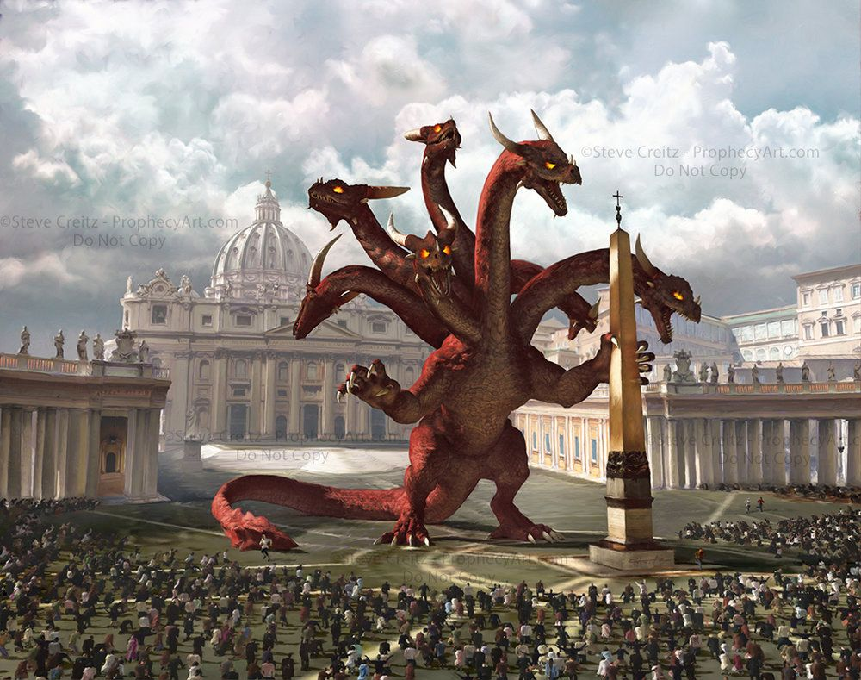

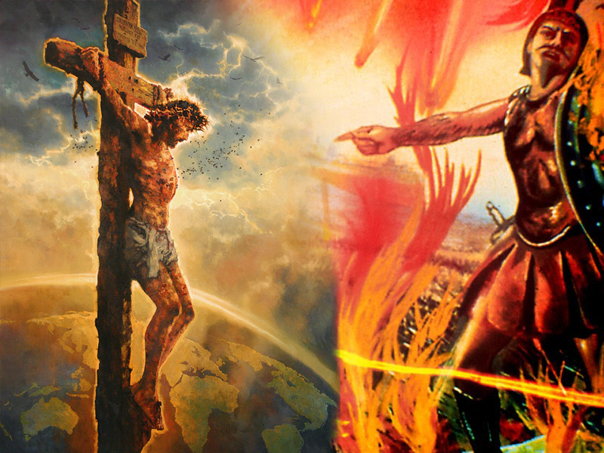
TIME LIMITS
“…The dragon gave the beast his power and his throne and great authority” (Revelation 13:2b)
The Bible makes it clear that Satan has been given authority over this world (Luke 4:6.) At one point in history, he transferred that authority to a religious political power (Rev. 13:1-2.)
This power was also granted other powers (Rev. 13:5, 7,) but temporal limits were imposed on it: 42 months, which are “a time, and times, and half a time,” that is, 1,260 years (Rev. 13:5; 11:2; 12:6, 14.)
Satan himself has also been given time limits (although they are not measured in exact years.) Since Jesus won on the cross, the devil has “a short time” (Rev. 12:10-12.)
Best of all, we know that God has set a time when Satan and his angels will lose all dominion and power (Rom. 16:20;
Rev. 20:7-10; Mt. 25:41.)
1,260 years = 538 – 1798

Slide 8

PHYSICAL LIMITS
“‘The Lord said to Satan, “Very well, then, everything he has is in your power, but on the man himself do not lay a finger.” Then Satan went out from the presence of the Lord. (Job 1:12)
The book of Job helps us understand the limits that God imposes on Satan.
During a council of heavenly beings, Satan appears among them (Job 1:6-7)
In the face of the public accusations that Satan had made against God, He points out the case of Job (Job 1:8)
Satan maintains his accusations, claiming unfair protection towards Job (Job 1:9-11)
God allows him to attack Job's possessions, but not his person (Job 1:12)
In the face of Job's faithfulness, Satan insists on maintaining his accusations against God (Job 2:4-5)
God allows him to physically harm Job, but not to kill him (Job 2:6-7)
We learn many things here, such as that there are rules of engagement in the cosmic conflict. There are parameters in the heavenly court within which the allegations raised against God can be settled,
but without God violating the sacred principles inherent in love.

Slide 9

THE
WEAPONS
OF CONFLICT

Slide 10

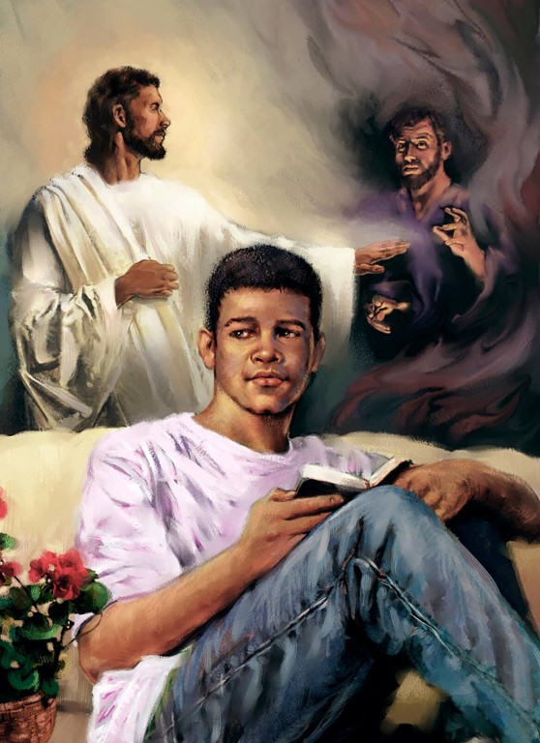
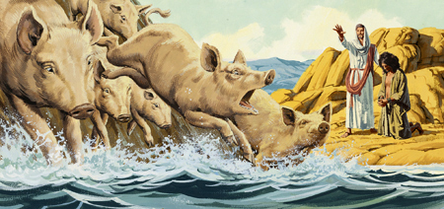

RESTRICTIONS FOR BOTH PARTIES
“I will not say much more to you, for the prince of this world is coming. He has no hold over me” (John 14:30)
God is almighty, Satan is not. God can impose restrictions on the enemy, the enemy cannot impose restrictions on God. However, because of God's very disposition, He has limited His own course of action, without any decrease in His power.
One of Jesus’ functions when He became incarnate was to “destroy the works of the devil” (1 John 3:8.) So what is stopping God from crushing the rebellion right now?
God has limits, such as the granting of free will and other rules, that prevent Him from eradicating evil from this world, which can cause people to question God's existence or goodness.
But it is prophesied that there will be a time in history, and it will happen soon, when all will have taken their part in the Conflict (Rev. 22:11.) Then God will be free to act to completely destroy evil. Evil will not continue forever.

Slide 11


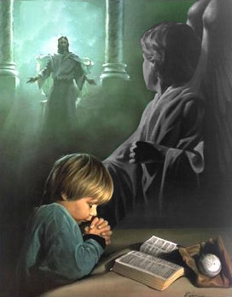

A WEAPON AT OUR DISPOSAL
“He replied, “This kind [of demons] can come out only by prayer. ’” (Mark 9:29)
Why are there rules in Cosmic Conflict?
The issue in conflict is not who is stronger. The issue is who is right. And the question is: Is God fair or unfair in his dealings with his creatures?
In order to resolve the issue, a fair trial is necessary. For this trial to be fair, certain rules (largely unknown to us) must be respected.
One of the rules we know is that there is a power that breaks boundaries: prayer (Mk. 9:29.)
In a way, when we pray we “authorize” God to act in a way that He would not do if we did not ask Him to.
It doesn’t matter whether or not we understand how this weapon works. The important thing is that it works. Through prayer we can make James’s advice a reality: “Submit yourselves, then, to God. Resist the devil, and he will flee from you” (James 4:7.)

Slide 12

“The enemy cannot overcome the humble learner of Christ, the one who walks prayerfully before the Lord. Christ interposes Himself as a shelter, a retreat, from the assaults of the wicked one. […]
Satan was permitted to tempt the too-confident Peter, as he had been permitted to tempt Job; but when that work was done he had to retire. Had Satan been suffered to have his way, there would have been no hope for Peter. He would have made complete shipwreck of faith. But the enemy dare not go one hairbreadth beyond his appointed sphere. There is no power in the whole satanic force that can disable the soul that trusts, in simple confidence, in the wisdom that comes from God.”
EGW (Our Father Cares, February 25)

