Slide 1
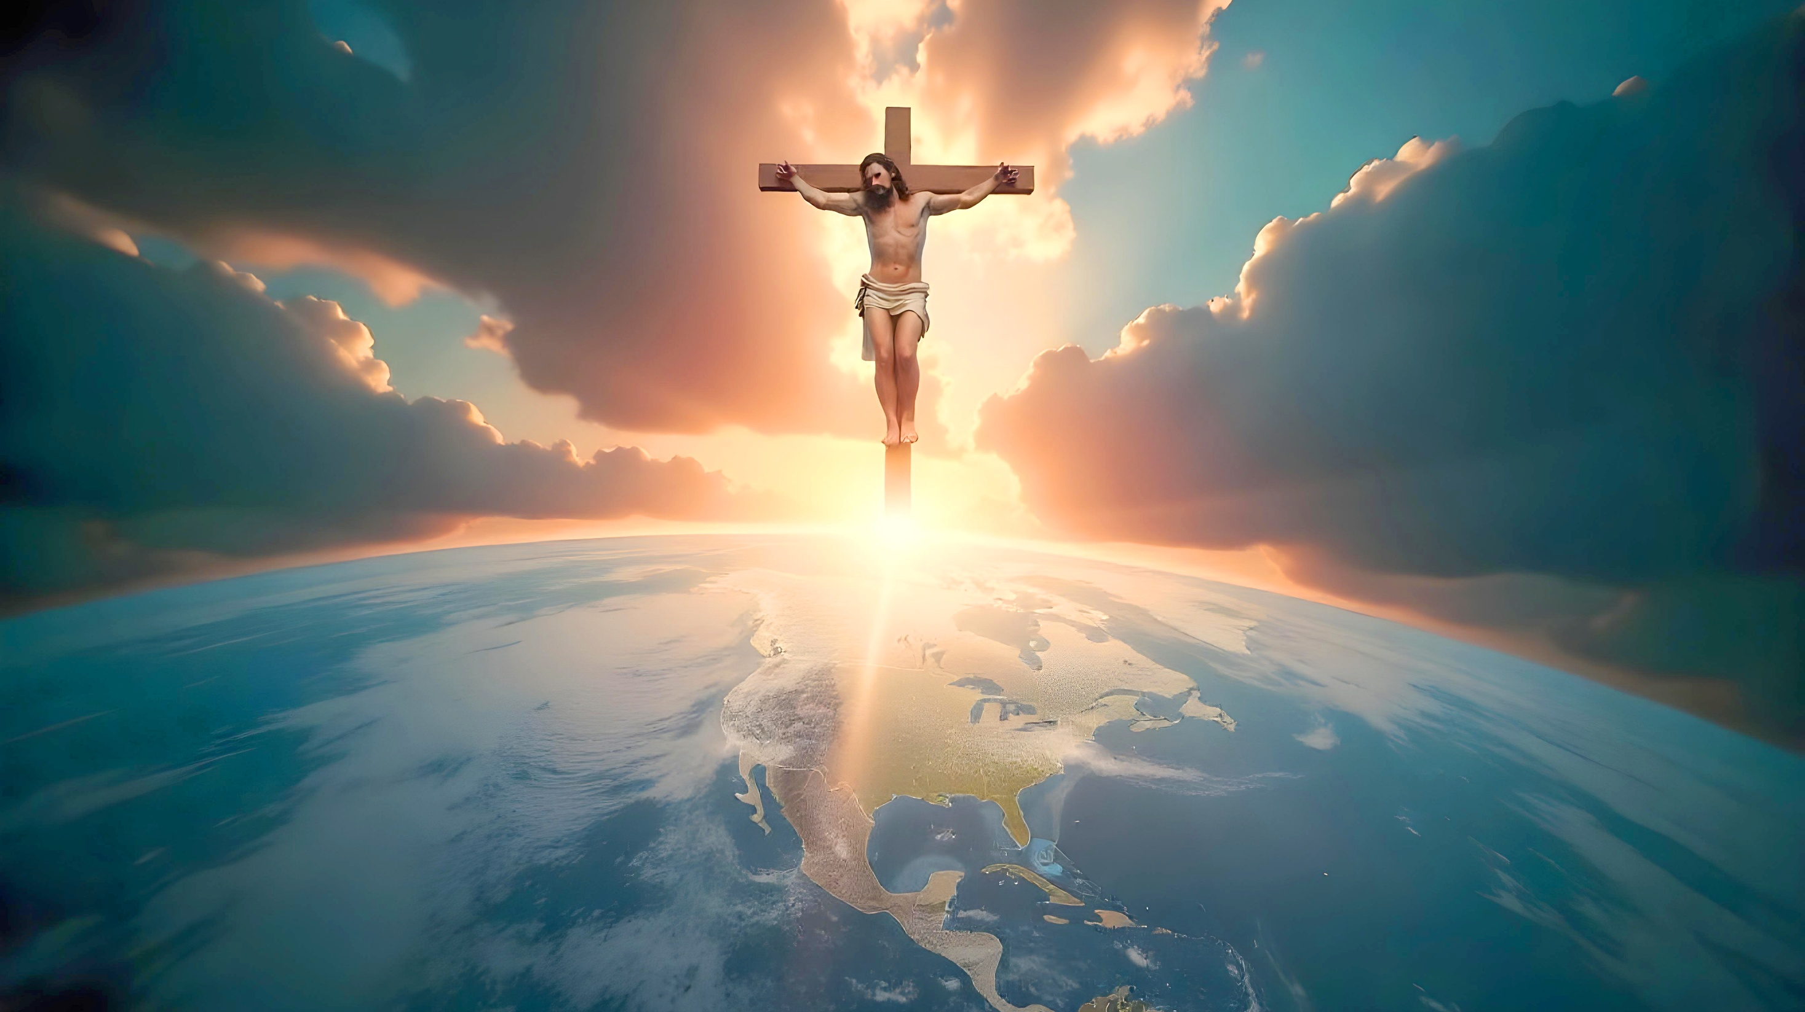
Lesson 11 for March 15, 2025
WHAT MORE COULD I HAVE DONE?

Slide 2
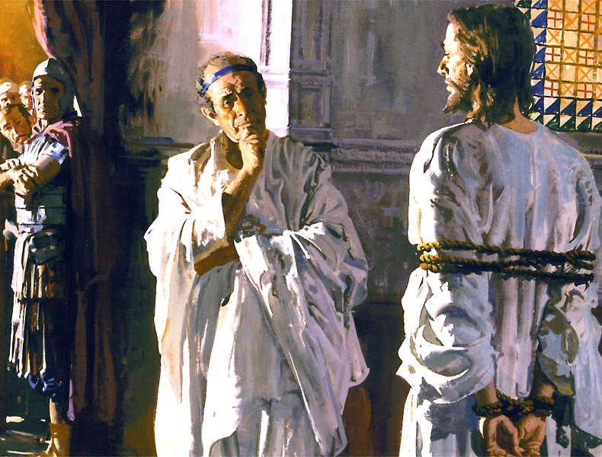
“Pilate therefore said to Him, ‘Are You a king then?’ Jesus answered, ‘You say rightly that I am a king. For this cause I was born, and for this cause I have come into the world, that I should bear witness to the truth. Everyone who is of the truth hears My voice’ ”
John 18:37, NKJV

Slide 3

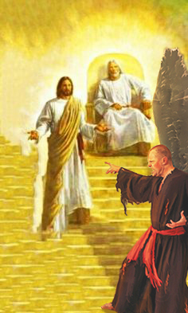
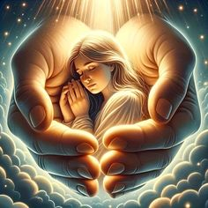

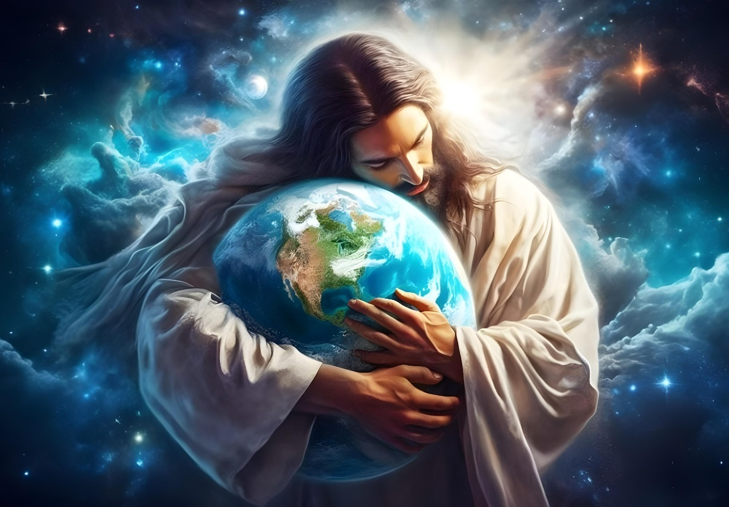








Satan and his minions have called into question the character of God before the angels and before the entire Universe.
Here on Earth, few of us think that God is love, and that He cares for us.
What can God do to vindicate His character? How can He convince the angels, and all the other beings He has created, of the sincerity of His love for them?
The winner of the conflict:
  The victory of Jesus.
  The meaning of the cross.
What else could I do?
  I expected sweetness and received bitterness.
  I gave love and received hate.
The vindication of God's character:
  Judging God.

Slide 4

THE WINNER OF THE CONFLICT

Slide 5

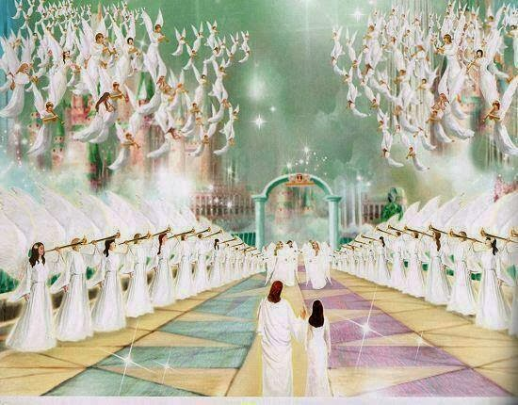
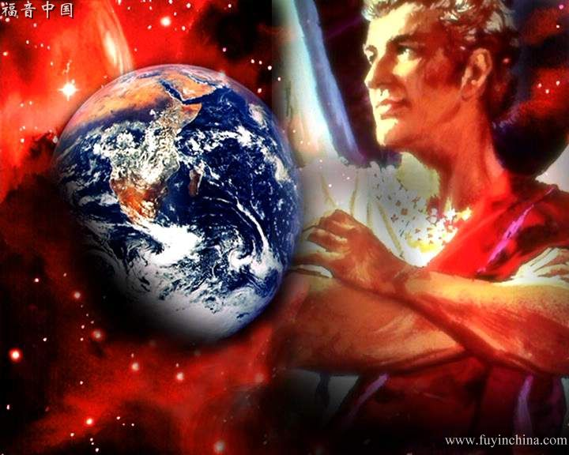
THE VICTORY OF JESUS
“To the one who is victorious, I will give the right to sit with me on my throne, just as I was victorious and sat down with my Father on his throne.” (Revelation 3:21)
Satan maintains that God's character is that of a tyrant. But what is the character of Sanatas?
He is a deceiver (Rev. 12:9)
He is a murderer (Jn. 8:44)
He is an accuser (Rev. 12:10; Zech. 3:1-2)
He is a usurper (1Jn. 5:19)
Because of his lies, he took away Adam’s dominion over the Earth, making him the “prince of this world” (Jn. 14:30.) But Jesus came to take away his dominion (1Jn. 3:8.)
With his life, Jesus bore witness to the truth
(Jn. 18:37)
With his death he obtained victory over the devil, and demonstrated the love and justice of God
(Rom. 3:25-26; 5:8)
Finally, he will destroy Satan, death, and evil (Rev. 20:10, 14)
Thanks to Jesus' victory, our victory is also assured (Rev. 12:11.)

Slide 6

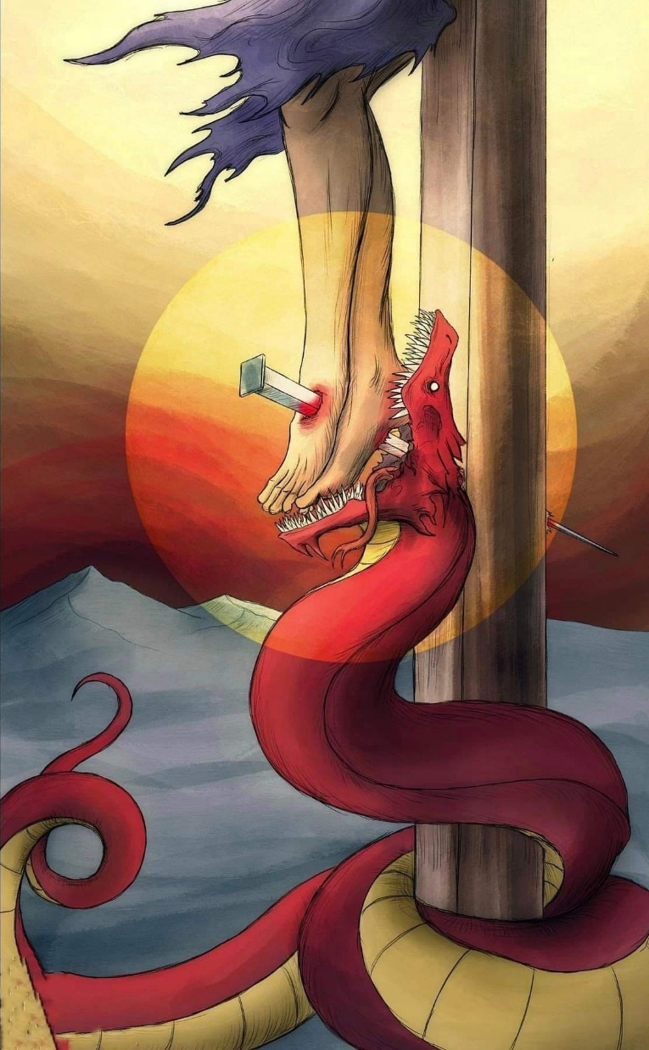
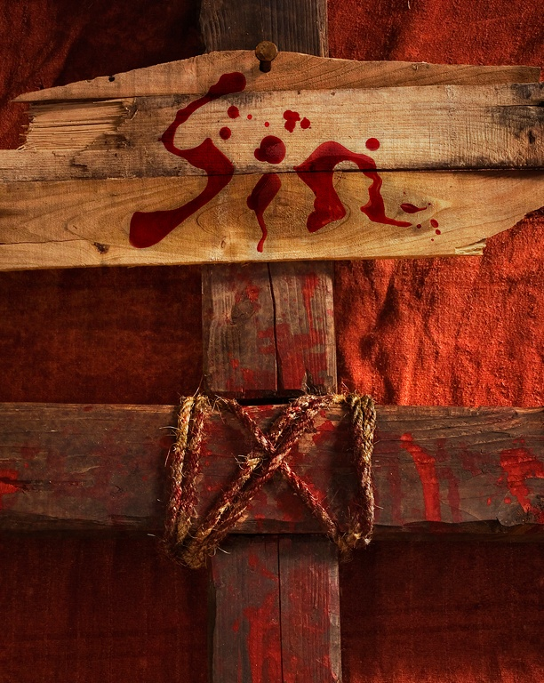
THE MEANING OF THE CROSS
“And having disarmed the powers and authorities, he made a public spectacle of them, triumphing over them by the cross” (Colossians 2:15)
Colossians 2:13-15 clearly shows us Jesus’ work on the cross: “He made you alive […] by forgiving us all our sins.” On what basis did He forgive us? By paying the price for our sin, “blotting out the handwriting of decrees that was against us […] and nailing it to the cross.” At the same time, He “made a public display” of Satan and his angels, “triumphing over them by the cross.”
Sin
At the very moment Satan thought he had inflicted a mortal wound on Jesus [in the heel (Gen. 3:15)], he exposed his true character to the universe. The angels were horrified to realize the true meaning and cost of sin. Satan was discredited before the universe, and the character of God was vindicated.
God did not need to resort to deceitful stratagems; He has always acted with love and justice to obtain victory (Ps. 145:17.)

Slide 7

WHAT ELSE COULD I DO?

Slide 8

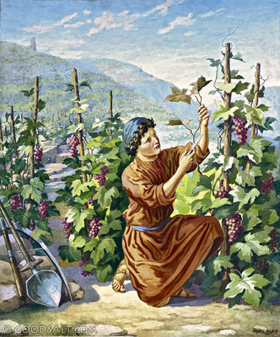
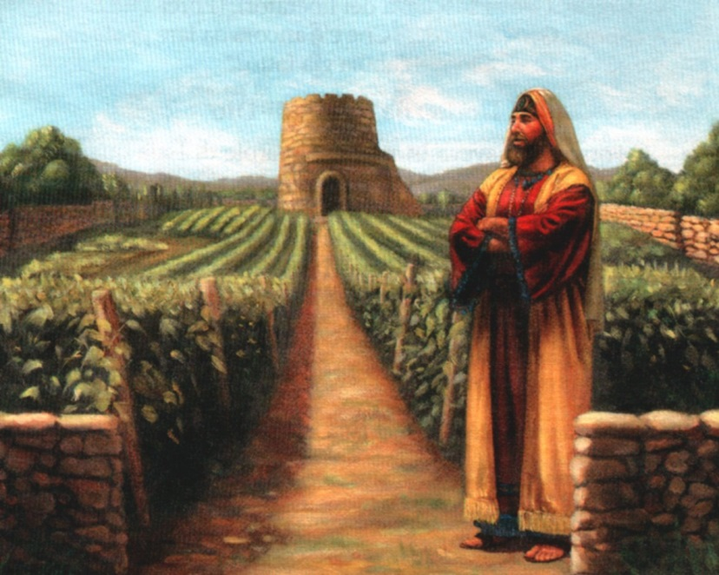
I EXPECTED SWEETNESS AND RECEIVED BITTERNESS
“What more could have been done for my vineyard than I have done for it?
When I looked for good grapes, why did it yield only bad [stinking, rotten]?” (Isaiah 5:4 NIV )
God gave us free will so that we could love Him and enjoy His love. But what have we done with our freedom?
Isaiah 5:1-7 shows us God's expectations, His efforts to attract us, and the bitter response He has received.
One question stands out in this parable: “What more could have been done for my vineyard that I have not done in it?” (Isaiah 5:4.) God has done everything possible except one thing: to force us to accept Him.
Therefore, there is an invitation: “judge now between me and my vineyard” (Is. 5:3.) We truly deserve to be “uprooted.” But, thanks to Jesus, we still have the opportunity to stop being “stinking” grapes and bear “fruit for eternal life” (Jn. 4:36.)
How are you going to use your free will? What will your decision be?

Slide 9

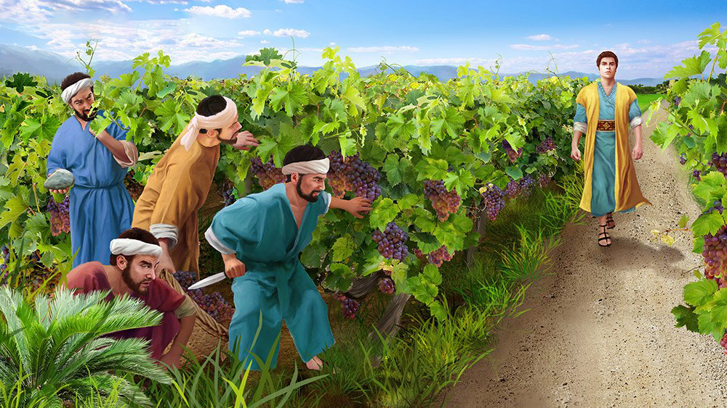
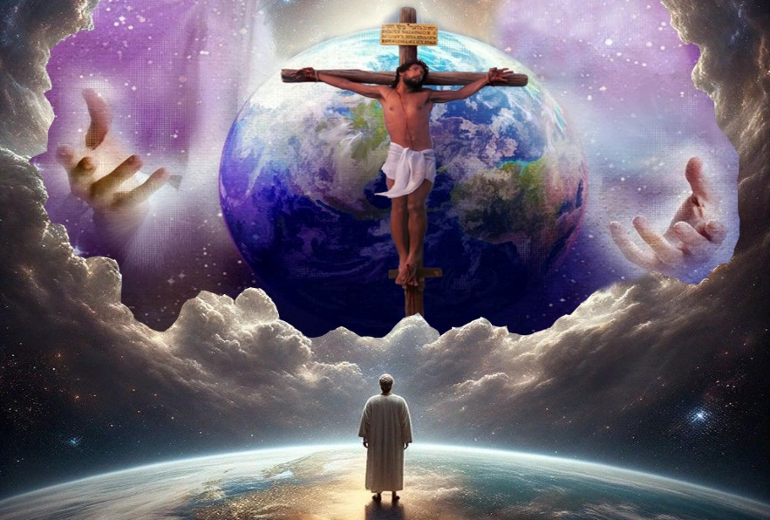
I GAVE LOVE AND RECEIVED HATE
“But when the tenants saw the son, they said to each other, ‘This is the heir. Come, let’s kill him and take his inheritance.’ ” (Matthew 21:38)
Jesus expanded on Isaiah's parable, showing the behavior of those who were to care for his vineyard (Mt. 21:33-41.)
Not only did they refuse to give the Lord what was rightfully His, but they mistreated—and even killed—His messengers, the prophets (Mt. 21:34-35.) After a second unsuccessful attempt, the Lord sends His own Son, Jesus Christ (Mt. 21:36-37.)
We often complain about our sufferings, or about the evil that afflicts the world. But have we thought about the suffering of God?
God has repeatedly cried out for us to return to Him (Ezek. 33:11.) He has given us His most precious gift, His own Son (Jn. 3:16.) What more could He have done?
The cross event demonstrates that God has done everything that could be done to mitigate and eliminate evil, but without destroying the context for the flourishing of genuine love.

Slide 10

THE VINDICATION OF GOD'S CHARACTER

Slide 11

JUDGING GOD
“For true and just are his judgments” (Revelation 19:2a)
God has chosen to make His judgment a transparent process. Therefore, in a sense, He submits Himself to the judgment of His creatures. He wants everyone to trust in His judgment. In order for evil to be eradicated and not rise again, everyone must trust in the perfect character of the Judge (Nahum 1:9 NIV.)
First phase: The Investigative Judgment
(Dan. 7:9-10)
Before the angels and the unfallen worlds, God shows all the necessary evidence to save or condemn sinners
Second phase: The millennial judgment
(Rev. 20:4)
The redeemed review the evidence used in the Investigative Judgment
Third phase: The Final Judgment
(Rev. 20:11-12)
The wicked know the evidence that condemns them
Final phase: All recognize divine justice (Is. 45:23)
“that at the name of Jesus every knee should bow, of things in heaven, and things in earth, and things under the earth” (Phil. 2:10)

Slide 12

“The government of God is not, as Satan would make it appear. […] He cannot accept an homage that is not willingly and intelligently given. A mere forced submission would prevent all real development of mind or character; it would make man a mere automaton. Such is not the purpose of the Creator. […] He invites us to give ourselves to Him, that He may work His will in us. It remains for us to choose whether we will be set free from the bondage of sin, to share the glorious liberty of the sons of God.”
EGW (Steps to Christ, pg. 43)

