Slide 1
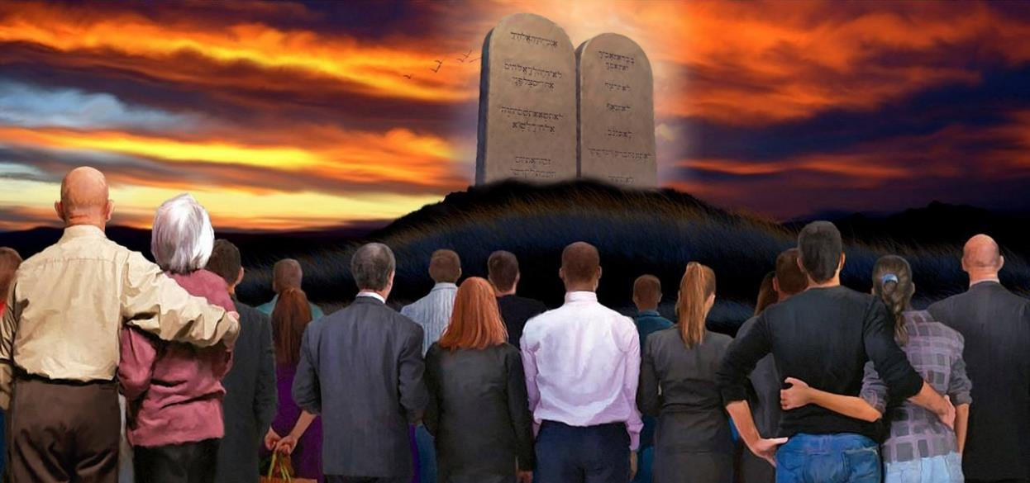
Lesson 12 for March 22, 2025
LOVE AND JUSTICE: THE TWO GREATES COMMANDMENTS

Slide 2
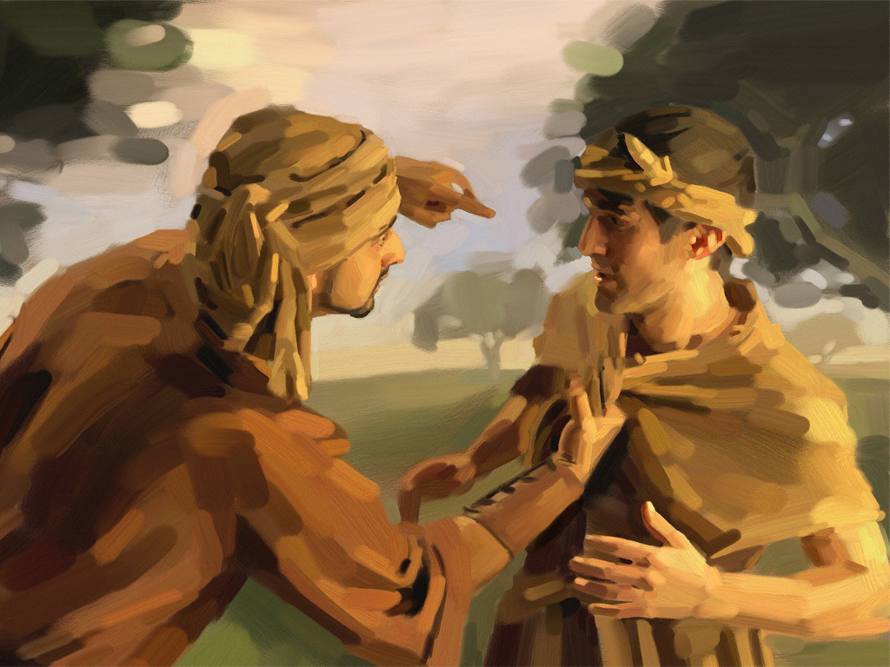
“If someone says, ‘I love God,’ and hates his brother, he is a liar; for he who does not love his brother whom he has seen, how can he love God whom he has not seen?”
1 John 4:20, NKJV

Slide 3
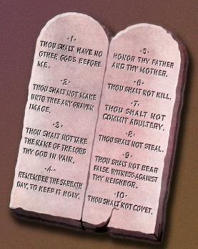
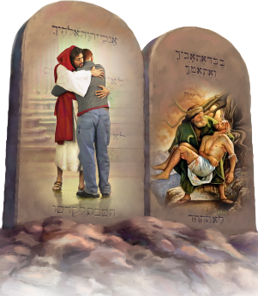
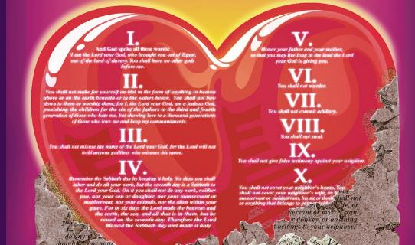
The Ten Commandments are a series of rules that almost always begin with the word “not,” followed by a prohibited action.
What does love have to do with so much prohibition?
It must have a lot to do with it, since the summary of these commandments is: love and love.
It is clear that the Law is not something exclusively personal. It is the code that defines how I should behave towards God and towards my fellow men. Therefore, the Law teaches us to love.
The main point of the Law:
The two main commandments.
The two main sins.
Love and Justice:
God's love for justice.
The most important thing about the Law.
Who is my neighbor?

Slide 4
THE MAIN THING OF THE LAW

Slide 5
THE TWO MAIN COMMANDMENTS
“Jesus replied: “‘Love the Lord your God with all your heart and with all your soul and with all your mind.’ This is the first and greatest commandment. And the second is like it: ‘Love your neighbor as yourself.’ All the Law and the Prophets hang on these two commandments.” (Matthew 22:37-40)
How does love relate to the Law (Mt. 22:37-40; Dt. 6:5; Lv. 19:18)?
Love God
I May God be your only Love
II God does not need intermediaries to receive your love
III Show your love for God by respecting his name
IV Dedicate Saturday to relating to the Creator and Redeemer whom you love
Love your neighbor
V Love your parents at all times
VI Show your love by respecting the lives and feelings of others
VII Love your spouse and always be faithful
VIII Love respects what belongs to the other
IX Love without hurting with his words
X Love without coveting what belongs to the one you love
It seems easy to be righteous by keeping the letter of the Law. But true justice is demonstrated by loving. That is what Jesus asked of the rich young man, who believed he was righteous: show through actions your love for others [“give to the poor”], and your love for God [“come, follow me”] (Mt. 19:16-22.)

Slide 6
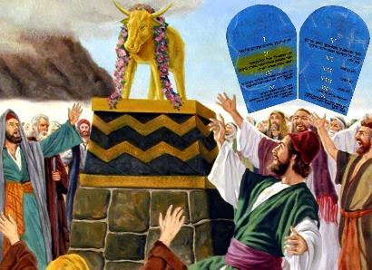
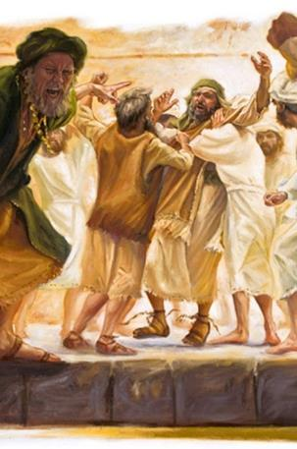
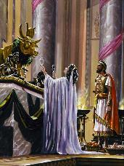
THE TWO MAIN SINS
“He [Ahab] behaved in the vilest manner by going after idols […] Take up the cause of the fatherless; plead the case of the widow ” (1 Kings 21:26a; Isaiah 1:17b)
There are two sins that are mentioned insistently throughout the Bible: idolatry and social injustice. These two sins are the antithesis of the two great commandments:
Love God
Worship idols
Loving others
Harming others
Do you show your love for someone by doing the opposite of what he has asked of you? That is exactly what someone who bows down to an idol does. Even if he says he loves God, he denies Him with his actions; because not only does he not respect His Law, but he shows his love to an inanimate object, instead of to the Creator.
Regarding love for others, Paul makes it very clear: “Love does no harm to a neighbor” (Rom. 13:10.)

Slide 7
LOVE AND JUSTICE

Slide 8
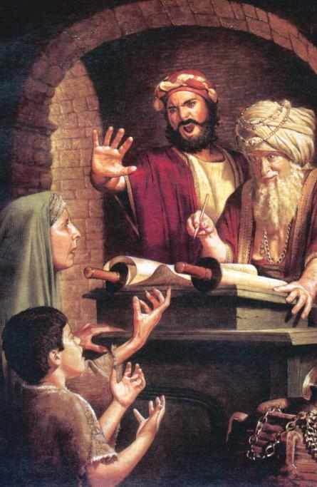
GOD'S LOVE FOR JUSTICE
“The LORD loves justice and righteousness; the earth is full of his love” (Psalm 33:5 NIV)
Since God loves justice (Ps. 33:5,) it is logical that He would be angry with those who act unjustly.
One of the clearest examples is found in Psalm 82, where Asaph shows us God's reaction to the attitude of the judges who had the responsibility of applying justice, but used their authority to act unjustly.
These judges, called gods because of their position of responsibility – exercising justice by divine delegation (Ps. 82:1, 6; Jn. 10:34-36) – defend injustice and favor the wicked.
God especially calls them to defend the helpless and the needy (Ps. 82:2-4 NIV.) If they do not do so, they will die for their unrighteousness (Ps. 82:7.)
And this cry for justice does not concern only those who have judicial responsibilities. God demands that each of us do justice (Mic. 6:8; Dt. 16:20; Pr. 21:3; 1 Jn. 2:29.)

Slide 9
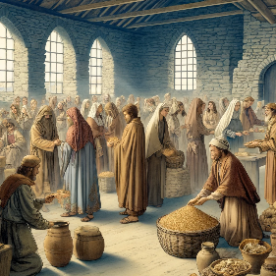
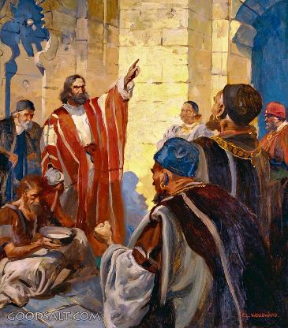
THE MOST IMPORTANT THING ABOUT THE LAW
“Woe to you, teachers of the law and Pharisees, you hypocrites! You give a tenth of your spices—mint, dill and cumin. But you have neglected the more important matters of the law—justice, mercy and faithfulness. You should have practiced the latter, without neglecting the former.” (Matthew 23:23)
Tithing even the smallest thing is obeying the law and therefore doing what is right (Mt 23:23a.) So why does Jesus say that the actions of the scribes and Pharisees set aside justice (Mt. 23:23b)?
To do justice is not to be fair, but to apply the Law correctly to others. Hence, in the Law itself [the Pentateuch] there are exceptions to protect the helpless (Dt. 24:17-21.)
Nearly all the prophets have words of rebuke for those who act unjustly toward others or fail to apply justice in love (Is. 1:23; Jer. 22:3; Ez. 22:7; Zech. 7:10.) For Isaiah, for example, seeking justice involves helping the helpless (Is. 1:17.)
Nehemiah was outraged when, protected by the law, the rich demanded the repayment of loans without taking into account the poverty of their brothers (Neh. 5:6-11.)

Slide 10
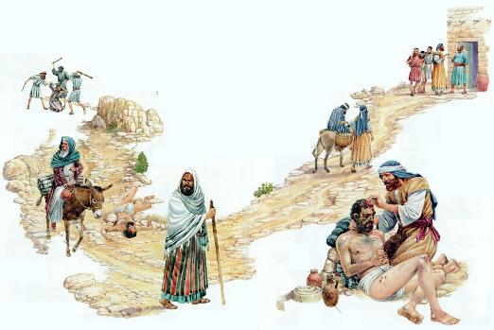
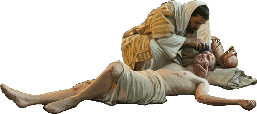
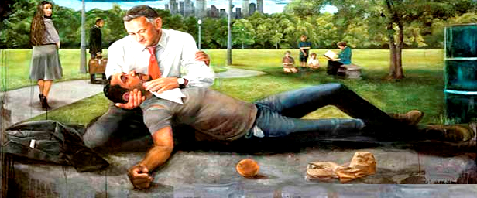
WHO IS MY NEIGHBOR?
“Which of these three do you think was a neighbor to the man who fell into the hands of robbers? The expert in the law replied, The one who had mercy on him. Jesus told him, Go and do likewise.” (Luke 10:36-37)
Many understood the command recorded in Leviticus 19:18 to love one’s neighbor to apply only to those who were Israelites. If you are not an Israelite, you are not my neighbor. However, not everyone held that view. Thus, one scribe who asked a question that he himself was capable of answering wanted to justify himself by asking, “Who is my neighbor?” (Luke 10:25-29.)
Jesus did not reveal the nationality of the wounded man on the road to Jericho. Neither the priest nor the Levite, examples of fulfilling the Law, were interested in the helpless man. However, a “non-neighbor,” a Samaritan, was “moved with compassion” and fulfilled the Law of loving one’s neighbor as oneself (Luke 10:30-37.)
The enemy seeks power and cares about his own well-being. Jesus left his throne, humbled himself, and came down to serve others and give his life for us. Who will we imitate? Let us be followers and imitators of Jesus.

Slide 11
“Those who love God cannot harbor hatred or envy. When the heavenly principle of eternal love fills the heart, it will flow out to others, not merely because favors are received of them, but because love is the principle of action, and modifies the character, governs the impulses, controls the passions, subdues enmity, and elevates and ennobles the affections. This love is not contracted so as merely to include “me and mine,” but is as broad as the world, and as high as heaven, and is in harmony with that of the angel workers. This love cherished in the soul sweetens the entire life and sheds a refining influence on all around. […] If we love God with all the heart we must also love his children. This love is the Spirit of God. It is the heavenly adorning that gives true nobility and dignity to the soul, and assimilates our lives to that of the Master.”
EGW (Testimonies for the Church, volume 4, page 223)

