Slide 1
LOVE IS
THE FULFILLMENT
OF THE LAW
Lesson 13 for March 29, 2025

Slide 2
“Owe no one anything except to love one another, for he who loves another has fulfilled the law” Romans 13:8, NKJV

Slide 3
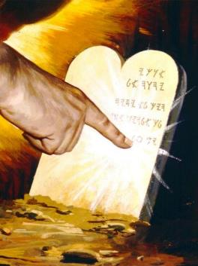
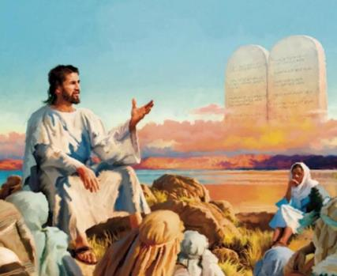
“In setting aside the law of God, men know not what they are doing. God's law is the transcript of His character. It embodies the principles of His kingdom. He who refuses to accept these principles is placing himself outside the channel where God's blessings flow” (Ellen G. White, Christ’s Object Lessons, p. 305) .
If the Law is the transcript of God’s character, we must ask ourselves, what is God’s character? What traits identify God? The best definition we can give is that given by the apostle John: “God is love” (1 John 4:8.) Therefore, the Law is love. To observe its requirements is to love. To love is the fulfillment of the Law.
The nature of the Law:
Love and love.
Holy, righteous and good.
The function of the Law:
Law and Grace.
Law and freedom.
Law and Love.

Slide 4
THE NATURE OF
THE LAW

Slide 5
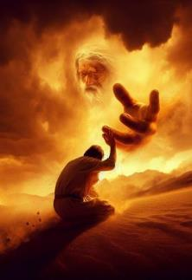
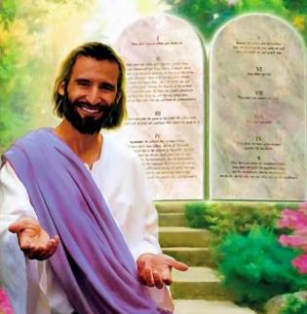
LOVE AND LOVE
“You shall love the Lord your God […] and […] you shall love your neighbor” (Matthew 22:37, 39)
God’s Law, recorded twice—once in Exodus 20 and once in Deuteronomy 5—is all about relationships. Relationships with God, and relationships with our neighbors:
THE LORD YOUR GOD
Do not associate with other gentlemen
Do not use intermediaries in our relationship
YOUR NEIGHBOR
Respect your parents
Respect the life of your neighbor
Be respectful in your relationship with me
Reserve one day a week to connect with me
Respect your spouse
Respect what belongs to your neighbor
Respect the dignity of your neighbor
Admire your neighbor, but do not covet his.
As Jesus said, these relationships marked by the Law must be an expression of love (Mt. 22:37-39.)

Slide 6
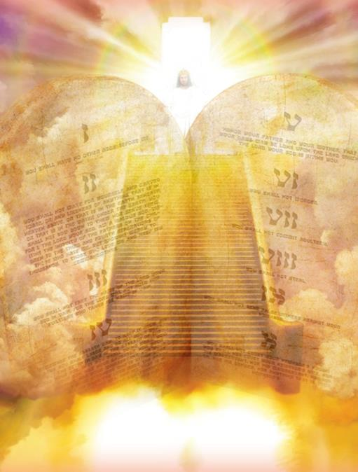
HOLY, RIGHTEOUS AND GOOD
“So then, the law is holy, and the commandment is holy, righteous and good” (Romans 7:12)
The Law, as a reflection of God's character, not only reflects His love, but also other divine characteristics (Rom. 7:12): His holiness, His justice, and His goodness.
The commandment is
HOLY
“Holy, holy, holy is the Lord God Almighty” (Rev. 4:8)
RIGHTEOUS
“Righteous Father” (Jn. 17:25)
GOOD
“There is none good except God alone” (Luke 18:19)

Slide 7
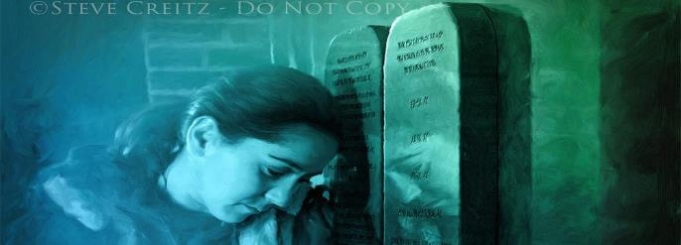
HOLY, RIGHTEOUS AND GOOD
“So then, the law is holy, and the commandment is holy, righteous and good” (Romans 7:12)
Written in stone, the Law is a testimony to God's unchanging character. It represents God's holiness, His perfect character of love, justice, goodness, and truth (Ps. 19:7-8.)
But did not Jesus make void the Law by nailing it to the cross, as many teach? As Paul said, “God forbid!” (Rom. 3:31.)
The apostle clearly says that, once saved by Jesus, we should not continue sinning (Rom. 6:1-2.) This implies that the Law is still in force, since it is what tells us that we are sinners (Rom. 7:7; 1Jn. 3:4.)
Christ came not to do away with the law but to fulfill all that was promised in the Law and in the Prophets. Thus, He emphasizes that “ ‘until heaven and earth pass away,’ ” not even “ ‘the smallest letter or stroke shall pass from the Law’ ” (Matt. 5:18, NASB 1995.)

Slide 8
THE FUNCTION OF THE LAW

Slide 9
LAW AND GRACE
“You who are trying to be justified by the law have been alienated from Christ; you have fallen away from grace” (Galatians 5:4)
Just as many think that love and justice are mutually exclusive, they also think that Grace and Law are antagonistic. But the truth is that each has its own function:
The Law teaches us to differentiate between good and evil
Grace forgives us when we break the Law, and enables us to continue choosing the good.
Furthermore, they work together in purpose. God's Grace works within us, engraving the Law on our hearts (Jer. 31:33; Heb. 8:10.)
The Law, on the other hand, shows us our sin and leads us to Christ, through whom we obtain forgiveness (Gal. 3:24.)
Salvation is a free gift from God (Eph. 2:8.) We do not keep the law to save ourselves, but because we have been saved and, as a consequence, we want to put our lives in harmony with God's will.

Slide 10
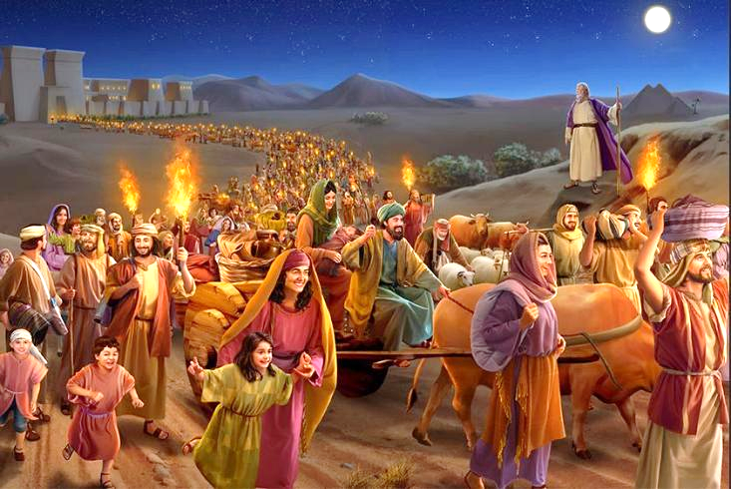
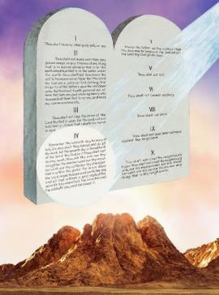
LAW AND FREEDOM
“Speak and act as those who are going to be judged by the law that gives freedom” (James 2:12)
The law that gives freedom (James 2:12)? Shouldn't James have said the law of restrictions?
In reviewing the Law, Moses gave us a reason to keep it: we have been freed from sin (Deut. 5:15.) The Sabbath (the fourth commandment of the Law) constantly reminds us of that freedom.
The freedom that God gives us should lead us to a special fulfillment of the Law: to love. The Sabbath also gives us an example of love interwoven with the commandment.
Isaiah links the Sabbath with love for God (Is. 56:6,) and with love for one's neighbor (Is. 58:10-14.)
Love is the fulfillment of the Law (Rom. 13:10.) But it goes beyond formal fulfillment. Keeping the Law is actively doing good; performing works of love; doing justice; caring for others.

Slide 11
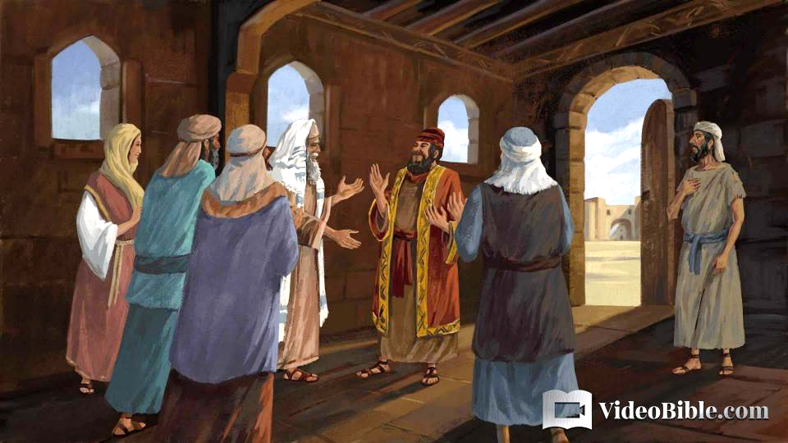
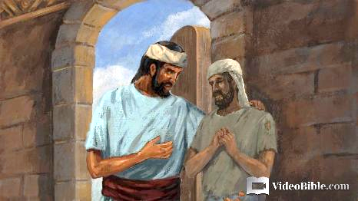
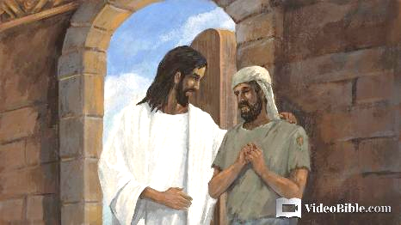
LAW AND LOVE
“If you really keep the royal law found in Scripture, “Love your neighbor as yourself,” you are doing right” (James 2:8)
“But if you show favoritism, you sin and are convicted by the law as lawbreakers” (James 2:9.)
James gives us an interesting example: a rich man is treated with deference, while a poor man is treated with contempt. And that is within the church! (James 2 :1-13.)
To entertain someone from whom we can benefit is not to love. To despise someone who has problems is not to love. And he who does not love does not fulfill the Law (James 2:8.)
What defines us as followers of Jesus is love (Jn. 13:35.) A love that “covers a multitude of sins” (1P. 4:8.)
When we love the world, as Christ has loved the world—then we are fitted for heaven.

Slide 12
EGW (This Day with God, May 17)
“When the law of God is written in the heart it will be exhibited in a pure and holy life. The commandments of God are no dead letter. They are spirit and life, bringing the imaginations and even the thoughts into subjection to the will of Christ. The heart in which they are written will be kept with all diligence; for out of it are the issues of life. All who love Jesus and keep the commandments will seek to avoid the very appearance of evil; not because they are constrained thus to do, but because they are copying a pure model, and feel averse to everything contrary to the law written in their hearts.”

