Slide 1
Lesson 3 for January 18, 2025
TO BE PLEASING TO GOD

Slide 2
“The Lord your God in your midst, the Mighty One, will save; He will rejoice over you with gladness, He will quiet you with His love, He will rejoice over you with singing” Zephaniah 3:17, NKJV

Slide 3
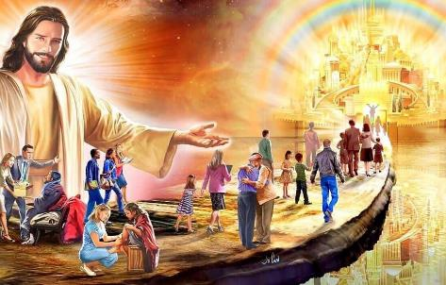
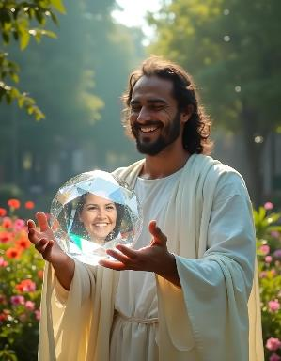
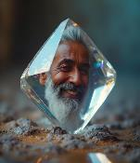
How easy or difficult is it to please God?
Paul invites us to “to be well-pleasing to Him” (2 Cor. 5:9.) “God is pleased with everyone who worships him and does right” (Acts 10:35 CEV,) and “he is pleased with those who try to do right” (Prov. 11:20 ERV.)
To know how to please God we need to know our value to Him, and what makes Him feel joy, pleasure and rejoicing.
Our value in the eyes of God:
How valuable are we to God?
God's Pleasure:
Can God rejoice?
How to please God?
Please God:
How can we please God?
How much faith does it take to please God?

Slide 4
OUR VALUE IN THE EYES OF GOD

Slide 5
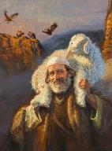
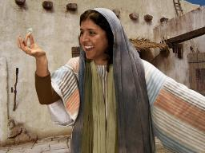
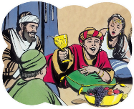
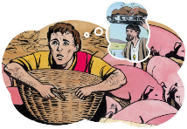
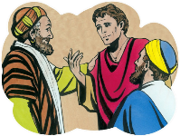
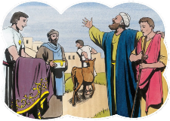
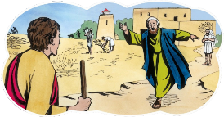
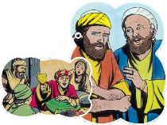
HOW VALUABLE ARE WE TO GOD?
“But we had to celebrate and be glad, because this brother of yours was dead and is alive again; he was lost and is found” (Luke 15:32)
In Luke 15 we find God seeking out His wayward children (that is, us.)
In the parable of the lost sheep, the shepherd, full of joy, invites his friends: “Rejoice with me” (Luke 15:4-6.) In the parable of the lost coin, the woman invites her friends: “Rejoice with me” (Luke 15:8-9.)
In the parable of the prodigal son, the father explains: “It was right that we should make merry and be glad” (Luke 15:32.)
From our point of view, the son was totally unworthy of being celebrated (Luke 15:30.) But I am the son, an unworthy sinner. What value has God seen in me?
We are precious enough to Him to celebrate. His joy is to see us return to Him. Our past doesn't matter. He doesn't even wait for us to come to Him. He runs to welcome us home.

Slide 6
GOD'S PLEASURE

Slide 7
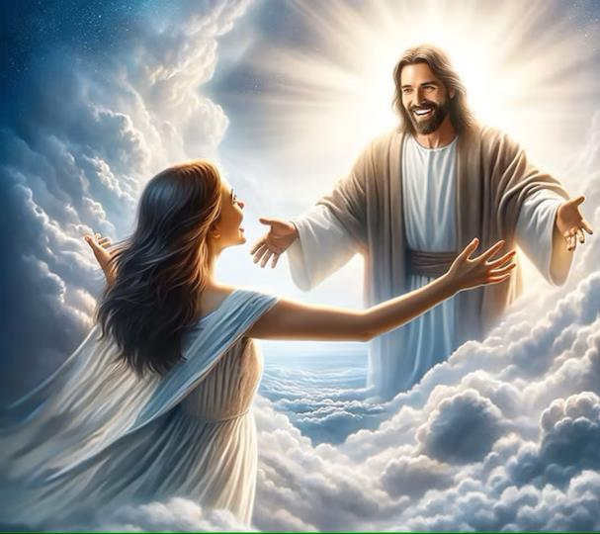
CAN GOD REJOICE?
“The Lord your God in your midst, The Mighty One, will save; He will rejoice over you with gladness, He will quiet you with His love, He will rejoice over you with singing” (Zephaniah 3:17)
If you have ever thought of God as a stern father, always angry at your bad behavior, Zephaniah 3:17 will change your perspective of God.
In this text we find almost all the ways in which one can say, in Hebrew, “I am glad.” God feels immense joy when we allow Him to save us, when we let Him dwell with us (“in your midst”.)
He calls us Hephzibah [my delight] (Is. 62:4.) He rejoices with us, as a husband does with his wife, because he loves us (Eph. 5:25-27, 31-32.)
When we are reconciled with God, we enter into a love relationship with Him, and we are assured of His presence with us.

Slide 8
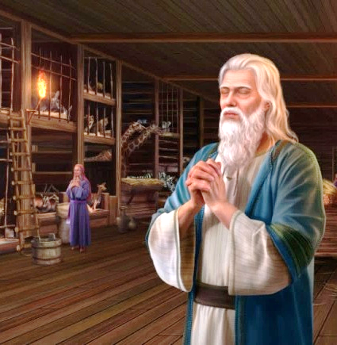
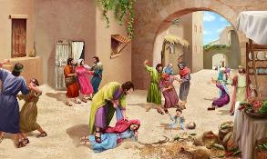
HOW TO PLEASE GOD?
“For the LORD takes pleasure in His people; He will beautify the humble with salvation” (Psalm 149:4)
Is it possible that God takes pleasure in insignificant human beings, when He has a whole retinue of immaculate beings who adore him? What is there in us that can give him joy?
Proverbs 15:8-9; 2 Corinthians 9:7
He dislikes it
The sacrifice of the wicked
It pleases him
The prayer of the upright
The way of the wicked
He who follows justice
The cheerful giver
God's love for us makes us of great esteem before Him (Is. 43:4.) But there are things in us that please Him, and others that displease Him.
The fact that God “loves the righteous” (Ps. 146:8) does not imply that He hates the wicked, but He cannot be pleased with them as He is pleased with the righteous.
God delights in those who respond to his love.

Slide 9
PLEASE GOD

Slide 10
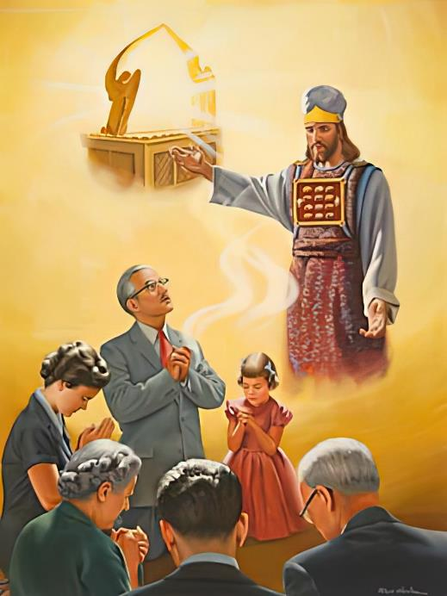
HOW CAN WE PLEASE GOD?
“You also, as living stones, are being built up a spiritual house, a holy priesthood, to offer up spiritual sacrifices acceptable to God through Jesus Christ” (1 Peter 2:5)
God always makes the first move, offering us His love and salvation (Rom. 5:8.) From there, He leaves us free to choose whether we will respond to His love.
If so, we can respond with a simple “thank you, see you in Heaven,” or we can look for a way to better please the one who has loved us so much.
Our response can only be pleasing to God when it is motivated “through Jesus Christ” (1P. 2:5.) It is the work of Jesus and his intercession that makes our actions pleasing to God.
Only through His mediation can we be considered worthy to be transformed into His likeness (2 Cor. 3:18; 1 John 3:2.)

Slide 11
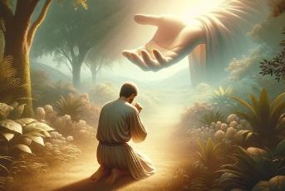
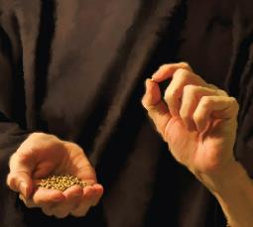
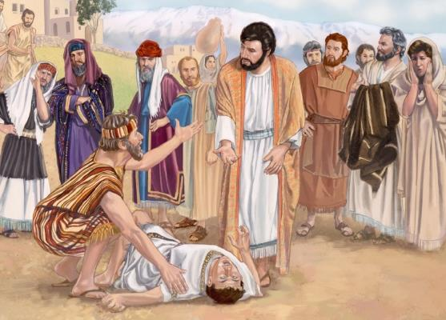
HOW MUCH FAITH DOES IT TAKE TO PLEASE GOD?
“But without faith it is impossible to please Him” (Hebrews 11:6a)
A basic ingredient to pleasing God is faith (Heb. 11:6.) But we can ask ourselves: Do I have enough faith to please God?
Jesus spoke of faith the size of a mustard seed (Luke 17:6.) How much faith is that?
On one occasion, a father brought his son to Jesus' disciples to be healed. They were unable to do so. So when Jesus arrived, the father asked Jesus to perform the miracle (Mark 9:14-18.)
Discouraged, the father's request included the phrase “if You can do anything” (Mark 9:22,) to which Jesus replied, “If you can believe, all things are possible to him who believes” (Mark 9:23.)
The father offered the little faith he had: “If you can do something with this, please do it” (Mark 9:24.) A little faith was enough. Jesus accepts even the smallest faith.

Slide 12
“Be ambitious, for the Master's glory, to cultivate every grace of character. In every phase of your character building you are to please God. This you may do; for Enoch pleased Him though living in a degenerate age. And there are Enochs in this our day.”
“Christ teaches us to address Him by a new name, a name entwined with the dearest associations of the human heart. He gives us the privilege of calling the infinite God our Father. This name, spoken to Him and of Him, is a sign of our love and trust toward Him, and a pledge of His regard and relationship to us. Spoken when asking His favor or blessing, it is as music in His ears.”
EGW (Christ's Object Lessons, pg. 332)
EGW (Christ’s Object Lessons, pg. 141)

