Slide 1
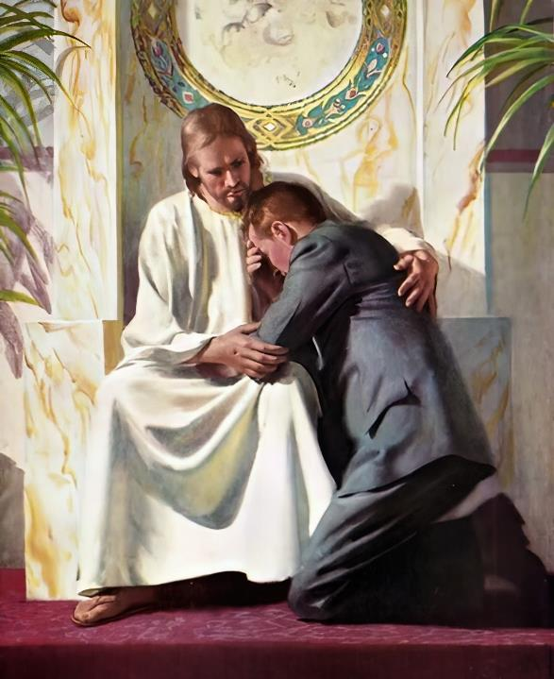
GOD IS PASSIONATE AND COMPASSIONATE
Lesson 4 for January 25, 2025

Slide 2
“Can a woman forget her nursing child, and not have compassion on the son of her womb? Surely they may forget, yet I will not forget you”
Isa. 49:15, NKJV

Slide 3
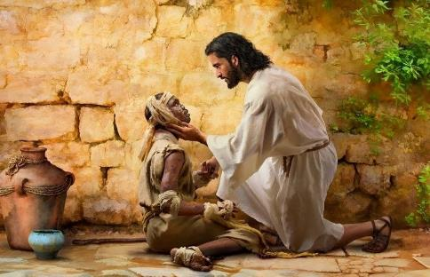
God's love is beyond human understanding. It is a pure, holy love, untainted by any sin. It is the kind of love that Paul expresses in 1 Corinthians 13.
However, so that we can somehow understand it, God has given us examples of the way He loves us, comparing it to human feelings.
As we study this topic, we must be careful not to “humanize” God too much. He is jealous, but is it the same jealousy I feel? His heart is moved (Jeremiah 31:20), but is He moved like I am?
What can the love of God be compared to?
A mother's love.
Deep inside.
How compassionate and merciful is God?
The compassion of Jesus.
This is what God's love is like.
What is God jealous of?

Slide 4
WHAT CAN THE LOVE OF GOD BE COMPARED TO?

Slide 5
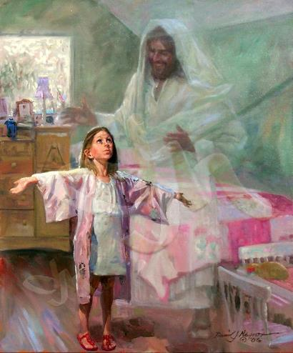
A MOTHER'S LOVE
“Can a mother forget the baby at her breast and have no compassion on the child she has borne? Though she may forget, I will not forget you!!” (Isaiah 49:15 NIV)
A mother's love for her child, even in the animal world, leads her to lay down her life, if necessary, to protect it.
This love is a reflection of God's love, which He placed in every mother. Because of sin, there are mothers who abandon their children. But God's love remains pure, He never stops loving us. We are His children (Is. 49:15.)
In Jeremiah 31:20, God speaks of his people as “a precious child,” “a child in whom I delight.” He says of them that He will have “mercy.” The word used is raḥam . This word comes from “womb.” That is, divine mercy is “love like that of the mother’s womb.”
Even when we disobey Him (and we often do), we are precious to Him; He delights in us; He constantly remembers us; and His heart is moved with pity for us.

Slide 6
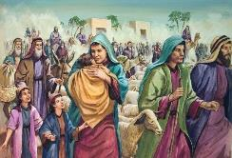
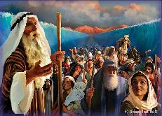
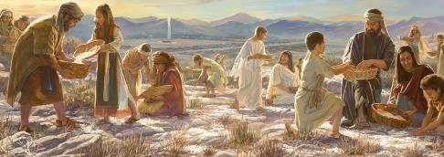
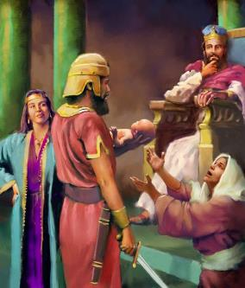
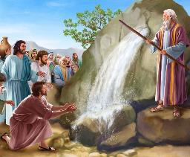
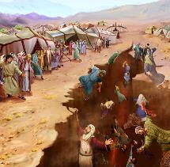
SHOCKED BOWELS
“…My heart is changed within me; all my compassion is aroused” (Hosea 11:8b)
When God speaks to the prophet Hosea, he uses eminently human language: “My heart is turning over, my soul is stirred” (Hosea 11:8 NIV.)
His son, Ephraim (who represents the people of God, and each one of us in particular), whom He has taken by the hand in his first steps and carried in His arms (Hos. 11:3), whom He has attracted with “cords of love” and fed (Hos. 11:4), has continually rebelled against Him, and does not want to worship Him (Hos. 11:2, 7.)
What causes God this intense abdominal pain?
His feeling is the same as the mother whose son was going to be cut in two by Solomon (1Ki 3:26): “Do not harm my son!”
This is how God loves us!

Slide 7
HOW COMPASSIONATE AND MERCIFUL IS GOD?

Slide 8
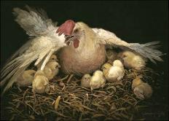
THE COMPASSION OF JESUS
“When Jesus landed and saw a large crowd, he had compassion on them and healed their sick.” (Matthew 14:14)
So far, we have seen the love of God as it is displayed in the Old Testament. As we move into the New Testament, we see God's compassion and mercy fully manifested in Jesus.
He touched the leper because he had mercy (Mark 1:41)
He stopped the funeral procession from Nain because he felt sorry for the widowed mother (Luke 7:13)
He had compassion on the crowds that followed him (Matthew 14:14)
He had compassion on the 5,000 who had not yet eaten (Matthew 15:32)
He had compassion on the blind (Matthew 20:34)
As he looked upon Jerusalem, saddened by its rejection, he cried out: “how often I have longed to gather your children together, as a hen gathers her chicks under her wings, and you were not willing” (Mt. 23:37.)
But, without a doubt, the greatest proof of his compassion was giving his life for us (Eph. 5:2.)

Slide 9
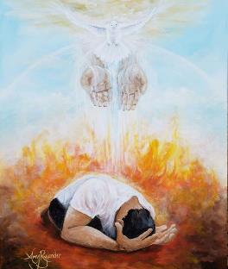
THIS IS THE LOVE OF GOD
“Love is patient, love is kind. It does not envy, it does not boast, it is not proud. It does not dishonor others, it is not self-seeking, it is not easily angered, it keeps no record of wrongs. Love does not delight in evil but rejoices with the truth. It always protects, always trusts, always hopes, always perseveres. Love never fails.” (1 Corinthians 13:4-8a NIV )
Does 1 Corinthians 13:4-8 describe human love or divine love?
We can say both. This is the love of God, and this is the love we reflect in our lives as a fruit of the Holy Spirit (Gal. 5:22.) How can I reflect this love in my life?
Worshipping God, who is love, and thus being transformed by imitation (2Co. 3:18)
Responding to His love, being compassionate and merciful to others (Jn. 13:35)
Asking God to transform us, because he is the only one who can do it
Let us ask God to give us a new heart for Him and for others—a pure and purifying love that elevates what is good and removes the chaff from within.

Slide 10
WHAT IS GOD JEALOUS OF?

Slide 11
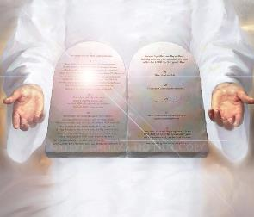
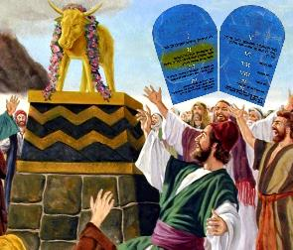
“Do not worship any other god, for the Lord, whose name is Jealous, is a jealous God.” (Exodus 34:14)
“The Lord is a jealous and avenging God; the Lord takes vengeance and is filled with wrath. The Lord takes vengeance on his foes and vents his wrath against his enemies ” (Nahum 1:2)
Jealousy, applied to people, has two aspects: one positive and one negative.
Positive: be jealous
Care or diligence put into doing things
Passion for a person
Negative: being jealous
To be envious and, generally, to wish evil upon another
Suspecting infidelity in the couple and, generally, acting violently
Divine jealousy is free of negative aspects in itself, although its consequences can be negative for those who are unfaithful to the love received (Nahum 1:2.)
God's jealousy comes from a passionate love for us, like the love between spouses. It leads them to desire our good intensely. God's jealousy never comes from envy, nor is it capricious or without reason, but from the desire that He be our only God.
This same zeal is what led Paul to love the churches: “I am jealous over you with godly jealousy: for I have espoused you to one husband, that I may present you as a chaste virgin to Christ” (2Cor. 11:2.)

Slide 12
“Christ's love is deep and earnest, flowing like an irrepressible stream to all who will accept it. There is no selfishness in His love. If this heaven-born love is an abiding principle in the heart, it will make itself known, not only to those we hold most dear in sacred relationship but to all with whom we come in contact. It will lead us to bestow little acts of attention, to make concessions, to perform deeds of kindness, to speak tender, true, encouraging words. It will lead us to sympathize with those whose hearts hunger for sympathy.”
EGW (Mind, Character, and Personality, vol. 1, pg. 208)

