Slide 1
THE WRATH OF DIVINE LOVE
Lesson 5 for February 1, 2025

Slide 2
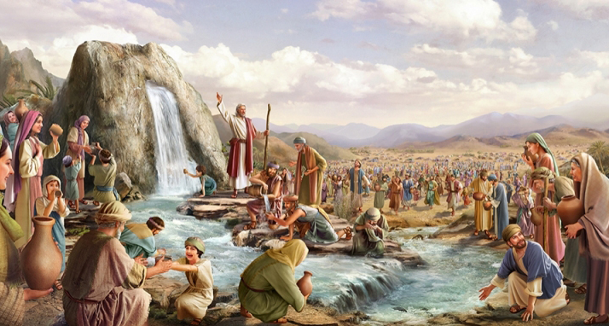
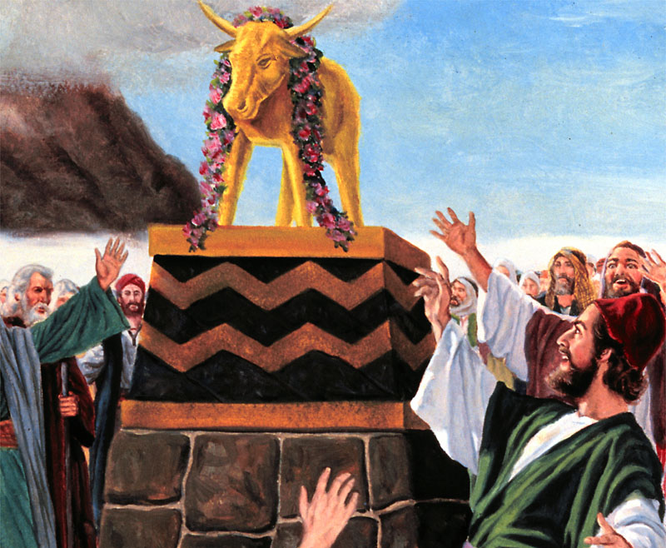
“But He, being full of compassion, forgave their iniquity, and did not destroy them. Yes, many a time He turned His anger away, and did not stir up all His wrath” Psalm 78:38, NKJV

Slide 3
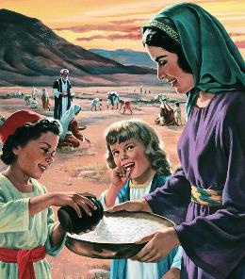
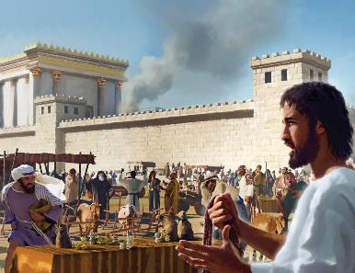
1 THE CYCLICAL ANGER
2 THE SLOW ANGER
3 THE RIGHTEOUS ANGER
4 THE IRREMEDIABLE ANGER
5 THE COMPASSIONATE ANGER
Many think that God is an angry God in the Old Testament, and a loving God in the New.
But with God “there is no variableness, neither shadow of turning” (James 1:17.) Therefore, we can find God’s love in the Old Testament, just as we can find divine wrath in the New Testament.
Both love and wrath are inherent in God's character. What we need to know is the true nature of God's wrath. So what is God's wrath?

Slide 4
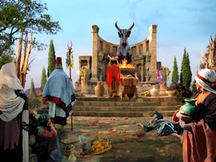
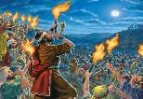
THE CYCLICAL ANGER
“But He, being full of compassion, forgave their iniquity, and did not destroy them. Yes, many a time He turned His anger away, and did not stir up all His wrath.” (Psalm 78:38)
The manifestation of divine wrath responds to a cycle of interaction with His people:
In Psalm 78, Asaph includes several examples of this cycle:
The people rebel against God and do horrible things
God gets angry and withdraws his protection
The people are oppressed by their enemies
The people cry out to God for deliverance
God frees his people
The people follow God… for a time
God divides the sea and brings forth water from the rock → the people ask for meat → God is angry (v. 13, 16-18, 21-22)
If he killed them, they sought God → but they rebelled again (v. 34, 38, 41)
God gave them Canaan → the people made idols → God is angry (v. 54-55, 58-59)
Shiloh was destroyed → the people cried out → God freed and sent David (v. 60-61, 65-66, 70-72)
The wrath of God is manifested in situations of serious sin, in order to stop sin.
God’s wrath is simply the appropriate response of love to evil and injustice. Accordingly, evil provokes God to passion in favor of the victims of evil and against its perpetrators.

Slide 5
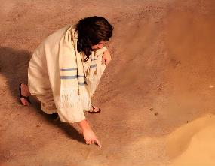
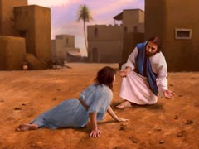
THE SLOW ANGER
“He prayed to the Lord, “Isn’t this what I said, Lord, when I was still at home? That is what I tried to forestall by fleeing to Tarshish. I knew that you are a gracious and compassionate God, slow to anger and abounding in love, a God who relents from sending calamity’” (Jonah 4:2)
The story of Jonah clearly shows how we understand divine wrath: we want God to immediately burn those who harm us (without realizing that we also harm others.)
But God's wrath is not like that. First, it does not come without warning. Because God seeks repentance, not destruction.
On the other hand, God’s anger—as Jonah himself acknowledges—is slow (Jonah 4:2.) Literally, God is “long-nosed.” This Hebrew expression implies that God takes many deep breaths before becoming angry.
He is angry with sin
God loves us and gives us grace. But He cannot tolerate or justify sin. God is angry with sin, but He loves the sinner. He will only show anger toward the sinner when this is the only way to bring him to repentance, or when the sinner has completely rejected the call of the Holy Spirit.
Love the sinner

Slide 6
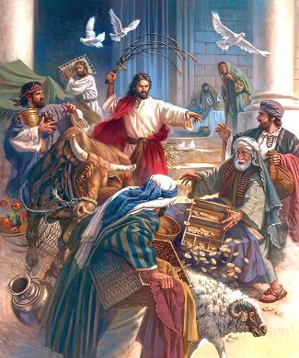
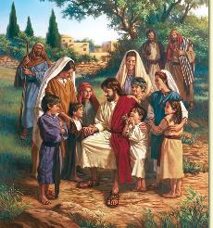
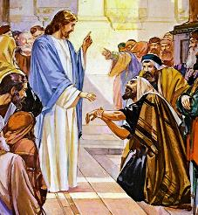
THE RIGHTEOUS ANGER
“So he made a whip out of cords, and drove all from the temple courts, both sheep and cattle; he scattered the coins of the money changers and overturned their tables” (John 2:15)
When is anger justifiable? Is it right to act against another person out of anger or indignation?
On a human level, we get angry when we see injustice, and that anger leads us to act to prevent it.
Think, for example, of a person who is suffering a physical attack. We get angry at the aggressor, and we act to stop the attack.
Outraged at the desecration of the Temple, Jesus became enraged and took a whip, drove out the sellers and animals, and overturned the money-changers' tables (Jn. 2:15.) Angry Jesus? Where is His love?
His love for God led Him to be angry with those who dishonored Him. His love for children made Him angry with His disciples (Mark 10:13-14.) His love for a sick person and His sadness at the hard-heartedness of those present filled Jesus with anger (Mark 3:1-5.)
Christ’s anger is associated here with grief at their hardness; it is the righteous anger of love, just as the anger attributed to God in the OT is the righteous anger of love.
Notes:
Aggression stopped - Temple money changers - child disciples - withered hand

Slide 7
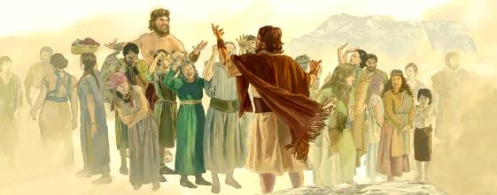
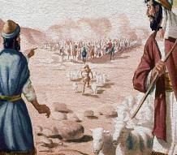
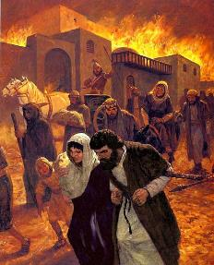
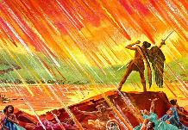
THE IRREMEDIABLE ANGER
“But they mocked God’s messengers, despised his words and scoffed at his prophets until the wrath of the Lord was aroused against his people and there was no remedy” (2 Chronicles 36:16)
God's righteous anger is always directed against those who harm the beings He loves. If there were no evil, God would not be angry.
In the history of Israel, God's wrath was manifested cyclically, always waiting for the people to repent and return to Him.
On all these occasions, God “gave up” His people, that is, He withdrew His protection, and the inevitable happened (Judg. 2:13-14; Ps. 106:41-42.)
But the stakes grew higher and higher, until “there was no remedy,” and Jerusalem was destroyed (2Chr. 36:16.)
Ultimately, God's wrath will destroy unrepentant sinners (Ps. 21:9.) Let us not play with God's wrath, for the time will come when it will manifest itself irremediably.

Slide 8
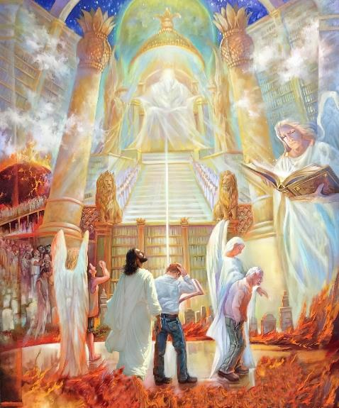
THE COMPASSIONATE ANGER
“It is mine to avenge; I will repay. In due time their foot will slip; their day of disaster is near and their doom rushes upon them.” (Deuteronomy 32:35 NIV )
God's wrath is terrible, and His vengeance is terrible (Heb. 10:30-31.) But it is not immoral or contrary to love. In fact, God expresses His wrath against evil because of love.
For this reason, God's most loving expression will be manifested in his wrath. It is out of compassion—toward sinners and righteous alike—that he will eradicate every trace of evil from the universe (Rev. 20:7-9.) At that time, anger and wrath will also disappear, because injustice and wickedness will no longer exist.
Until that moment arrives, and although it is correct that, at times, we express our anger to avoid a violent or sinful act "in situ," the Bible prevents us from taking revenge for the damage received.
We must leave vengeance to God. God's vengeance is always just, but our vengeance is never proportional to the harm received. Instead of taking revenge, we are encouraged to do good to those who harm us (Rom. 12:17-21.)

Slide 9
“God allows men a period of probation; but there is a point beyond which divine patience is exhausted, and the judgments of God are sure to follow. The Lord bears long with men, and with cities, mercifully giving warnings to save them from divine wrath; but a time will come when pleadings for mercy will no longer be heard, and the rebellious element that continues to reject the light of truth will be blotted out, in mercy to themselves and to those who would otherwise be influenced by their example.”
EGW (Prophets and Kings, pg. 276)

