Slide 1
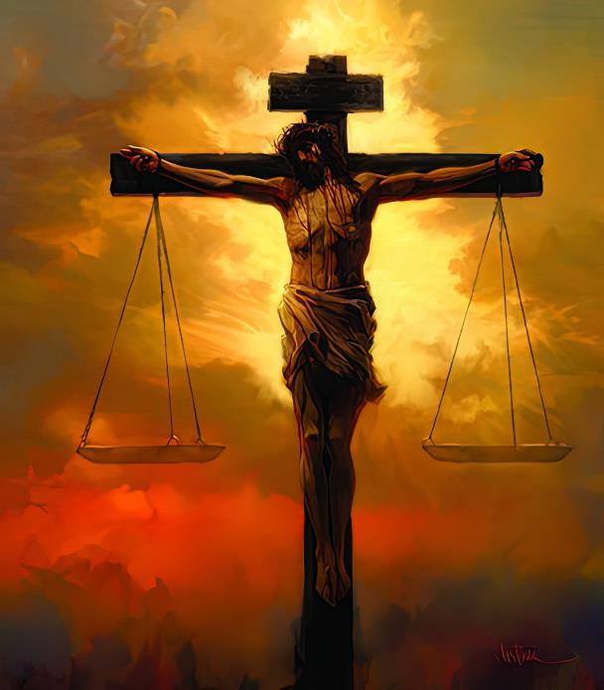
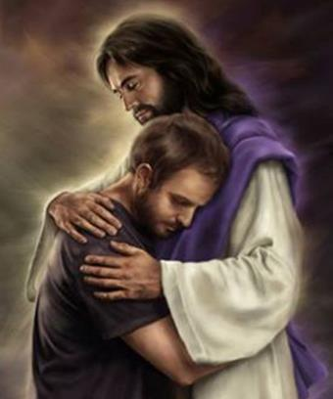
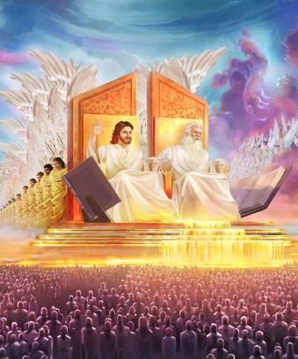
GOD’S LOVE
OF JUSTICE
Lesson 6 for February 8, 2025

Slide 2
“ ‘But let him who glories glory in this, that he understands and knows Me, that I am the Lord, exercising lovingkindness, judgment, and righteousness in the earth. For in these I delight’ says the Lord”
Jer. 9:24, NKJV

Slide 3
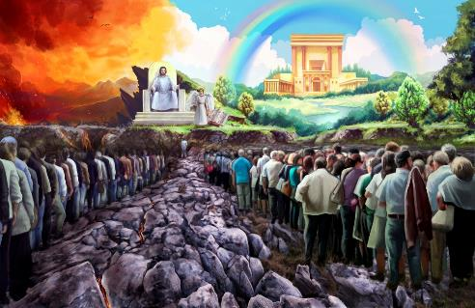
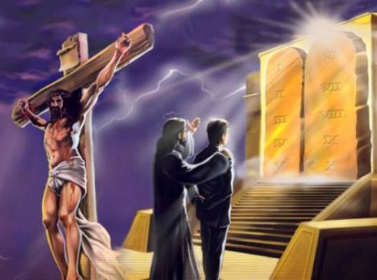
Are love and justice compatible?
What defects does justice have without love?
What defects does love have without justice?
How does God combine these two elements?
Is it fair for God to punish the sinner?
Is it unfair for Him to do this?
Does God regret his acts of justice or love?
Love and justice belong together:
An inseparable tandem.
All love, all justice.
Loving justice demands constancy:
The immutable character of God.
The perfection of divine love and justice.
Loving justice and repentance:
God's repentance.

Slide 4
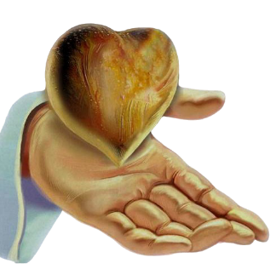
LOVE AND JUSTICE BELONG TOGETHER

Slide 5
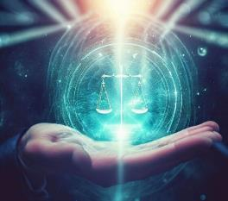
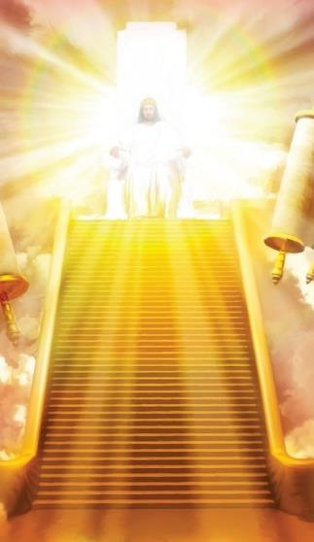
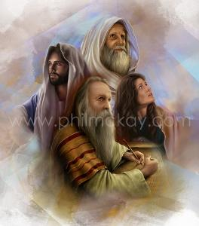
AN INSEPARABLE TANDEM
“Love and faithfulness meet together; righteousness and peace kiss each other”
(Psalm 85:10 NIV)
Love is part of God's character (1 John 4:8.) Is justice also part of His character?
“Righteousness and justice are the foundation of your throne; love and faithfulness go before you” (Ps. 89:14 NIV.) Both justice and love are the very foundation of the government of the Universe, since they are part of God’s character and emanate from Him.
This is the reason why a large part of the messages given by God to the prophets include the denunciation of unjust situations that the people had to rectify in order to be in communion with Him (Is. 1:17; Jer. 2:34-35; Ez. 18:7-9.)
“He has shown you, O mortal, what is good. And what does the Lord require of you? To act justly and to love mercy and to walk humbly with your God” (Micah 6:8 NIV.)

Slide 6
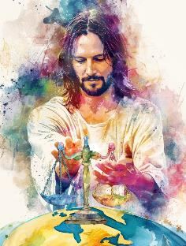
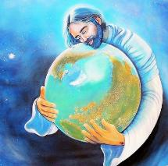
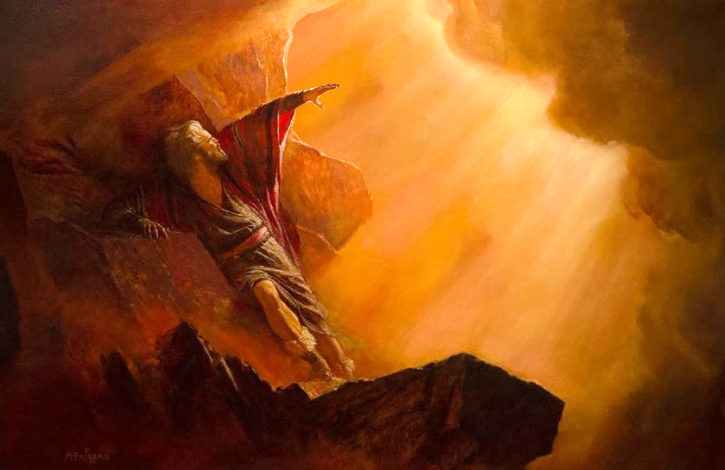
ALL LOVE, ALL JUSTICE
“The Lord is righteous in all his ways and faithful in all he does” (Psalm 145:17)
God doesn't just ask us to do what is right and show love. He always and at all times exemplifies these traits. God only and always does what is loving, right, and just.
The Bible declares that God acts justly every morning (Zeph. 3:5.) God knows what is best for everyone, wants what is best for everyone, and continually works to achieve it.
Despite having all authority and all power; despite having no one above Him who can judge His actions; despite having the right to act as He wishes; God never does anything contrary to justice. He never does anything wrong, nor does He induce anyone to do anything wrong (James 1:13; Ps. 5:4.)
Although He always seeks justice, He never fails to be loving. So when Moses asked to see God’s glory, God replied, “I will cause all my goodness to pass in front of you […] I will have mercy, […] I will have compassion” (Ex. 33:18-19 NIV.)

Slide 7
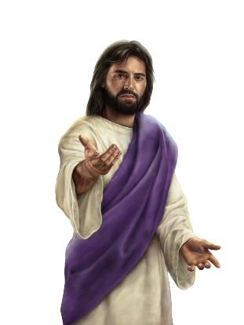
LOVING JUSTICE REQUIRES CONSTANCY

Slide 8
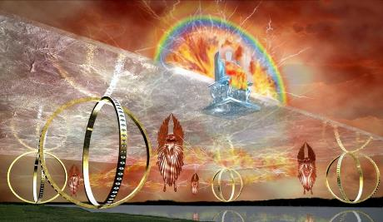
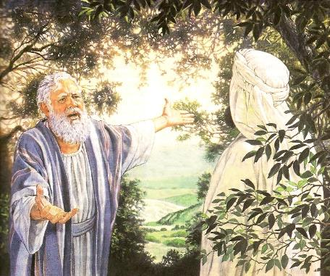
THE IMMUTABLE CHARACTER OF GOD
“Every good and perfect gift is from above, coming down from the Father of the heavenly lights, who does not change like shifting shadows” (James 1:17)
God does not change (Mal. 3:6; James 1:17.) This categorical statement must be understood to mean that God's character is unchangeable. If He is love, He always acts in love. If He is just, He always acts in justice.
As can be seen from his conversation with Abraham about Sodom, God is willing to make changes in his actions, as long as these do not modify his own essence of love and justice (Gen. 18:26-28.)
We find it difficult to understand God's immutability because of our tendency to change our feelings. Today we are faithful, tomorrow we are not. Today we love ardently, tomorrow we are indifferent. Today we promise to always tell the truth, tomorrow we lie shamelessly.
God is not like that. He is always faithful (2 Tim. 2:13); always loving (Jer. 31:3); always true (Titus 1:2); immutable (Heb . 6:17.)

Slide 9
THE PERFECTION OF DIVINE LOVE AND JUSTICE
“He is the Rock, his works are perfect, and all his ways are just. A faithful God who does no wrong, upright and just is he.” (Deuteronomy 32:4 NIV)
The perfection of God's love is clearly vindicated in the act of offering his life to rescue us from sin (Rom. 5:8.) This same act also shows us the perfection of his justice (Rom. 3:25-26.)
Unlike our love, God continues to constantly impart His perfect love even to those who do not love Him, or are not worthy of receiving His benefits (Mt. 5:45.)
God’s love exceeds any reasonable expectation, but it never nullifies or contravenes justice. He invites us to act like Him: “Hold fast to love and justice” (Hos. 12:6, ESV.)
When God finally establishes justice in this world and, out of love, eradicates evil from the universe, every creature will praise God's perfect justice and perfect love (Rev. 15:3-4.)

Slide 10
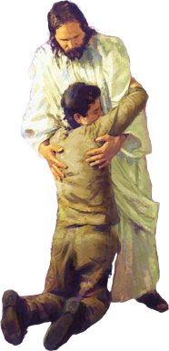
LOVING JUSTICE AND THE
REPENTANCE

Slide 11
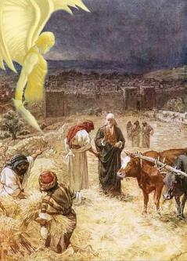
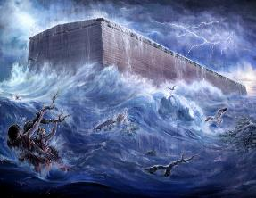
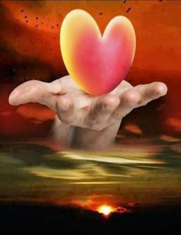
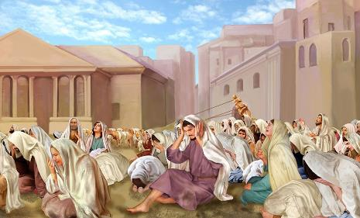
THE REPENTANCE OF GOD
“God is not human, that he should lie, not a human being, that he should change his mind.
Does he speak and then not act? Does he promise and not fulfill?” (Numbers 23:19)
Repentance involves the concept that something has not been done well. Therefore, repentance in God is unthinkable (Num. 23:19; 1S. 15:29.)
However, several biblical texts speak of God's repentance (E.g. Gen. 6:6; 2 Sam. 24:16.)
God does not back down from His plans for our good. That is why His promises are always trustworthy (2 Cor. 1:20.)
Yet He is willing to repent of withdrawing His protection, and decline our punishment, in response to our repentance (Jonah 3:10; Ex. 32:14.)
Therefore, God suspends His judgments in response to repentance precisely because His character is good, just, loving, and merciful.

Slide 12
“God's love has been expressed in His justice no less than in His mercy. Justice is the foundation of His throne, and the fruit of His love. It had been Satan's purpose to divorce mercy from truth and justice. He sought to prove that the righteousness of God's law is an enemy to peace. But Christ shows that in God's plan they are indissolubly joined together; the one cannot exist without the other. “Mercy and truth are met together; righteousness and peace have kissed each other.” Psalm 85:10”
EGW (The Desire of Ages, pg. 762)

