Slide 1
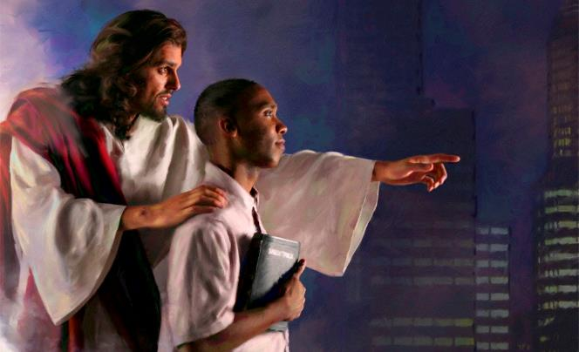
FREE WILL, LOVE AND DIVINE PROVIDENCE
Lesson 8 for February 22, 2025

Slide 2
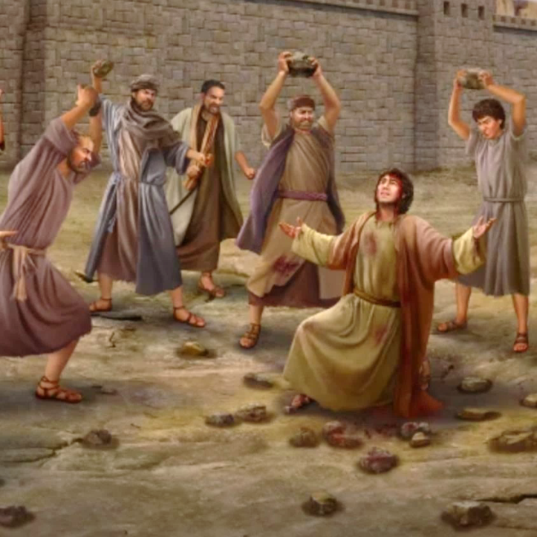
“These things I have spoken to you, that in Me you may have peace.
In the world you will have tribulation;
but be of good cheer, I have overcome the world”
John 16:33, NKJV

Slide 3
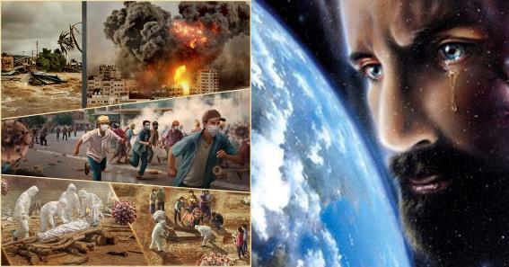
Providence is the term used to describe God's action in the world.
SOVEREIGN GOD
Is everything that happens God's will?
GOD ALMIGHTY
Is anything impossible for God?
GOD OF FREEDOM
Is God responsible for our actions?
GOD OF PREDESTINATION
Does God determine who is saved and who is not?
VICTORIOUS GOD
Does God have control of this world?
Is God responsible for pain, death, wars, hunger…?
Are we predestined by Him to fulfill a specific purpose in this life? If so, where is our free will?
If God gave us freedom of choice, and what happens in this world is not His responsibility, we must ask ourselves: who has control over what happens in this world?

Slide 4
SOVEREIGN GOD

Slide 5
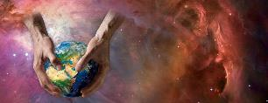
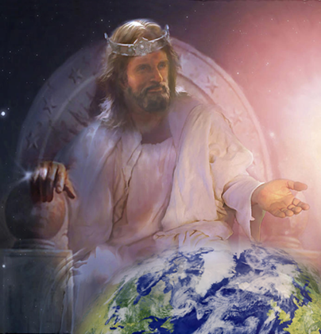
IS EVERYTHING THAT HAPPENS GOD'S WILL?
“…Sovereign Lord,” they said, “you made the heavens and the earth and the sea, and everything in them” (Acts 4:24b)
A sovereign is a monarch who exercises or possesses supreme and independent authority. The sovereigns of this world, such as ancient absolutist kings or great dictators, enforced their will within their territory.
As the Creator, God is the supreme ruler of this world (Acts 4:24.) From this we can deduce that everything that happens in this world is God's will. Is this conclusion true?
Psalm 81 shows us something amazing: God is eager to do his will in this world, but we won't let him (Ps. 81:10-16.)
God wants us to have peace and rest, but we choose other paths (Is. 30:15-16; 66:4.) He loves us so much that He wants to protect us from all evil, but He respects our freedom to reject it (Lk. 13:34.)

Slide 6
GOD ALMIGHTY

Slide 7
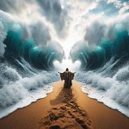
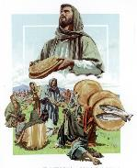
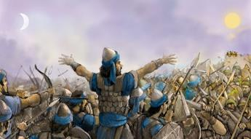
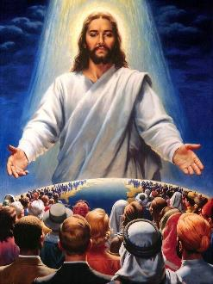
IS THERE ANYTHING IMPOSSIBLE FOR GOD?
“For no word from God will ever fail” (Luke 1:37)
God is all-powerful, meaning He can do anything He wants to do (Rev. 1:8; 11:17; Lk. 1:37.) He can do things that defy natural laws, such as splitting the sea, stopping the sun, feeding thousands of people with a few loaves of bread…
God can do everything (excluding obvious paradoxes such as creating a stone so heavy that He Himself cannot move it.) But that does not imply that He does everything He is capable of doing.
The Bible presents several actions that are impossible for God, because they are contrary to His own character: denying oneself (2 Tim. 2:13); lying (Heb. 6:18; Titus 1:2); or being tempted by evil (James 1:13.)
God could not free Jesus from the Cross and at the same time redeem us from sin. That is why He chose to do what was most beneficial for us (Mt. 26:39.)
God can save us all, but he does not want to force us to be saved.

Slide 8
GOD OF FREEDOM

Slide 9
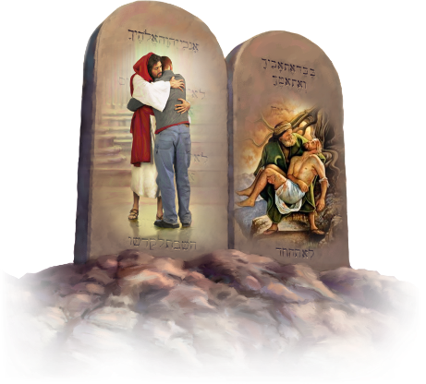
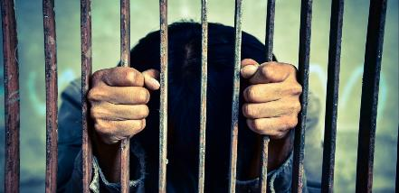
IS GOD RESPONSIBLE FOR OUR ACTIONS?
“Jesus replied: ‘Love the Lord your God with all your heart and with all your soul and with all your mind.’ ” (Matthew 22:37)
God asks us to love Him, and to love others as well, because by doing this we keep the Law and avoid sin (Mt. 22:37-40; Ro. 13:8-10; 1 Jn. 3:4.)
If we all loved as God wants us to love, we would no longer suffer many of the terrible consequences of sin. So why doesn't God force us to love Him and to love each other?
If He forced us to love Him, where would be our freedom? Where would be our responsibility before Him? Besides, could we call love to this kind of forced love?
Many things happen that God would like not to happen, but they do not depend on Him, but on our own choice. We are therefore responsible for our actions.

Slide 10
GOD OF PREDESTINATION

Slide 11
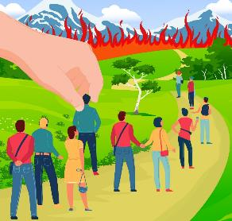
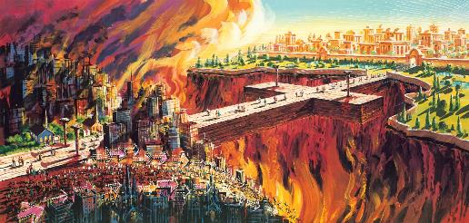
DOES GOD DETERMINE WHO IS SAVED AND WHO IS NOT?
“In him we were also chosen, having been predestined according to the plan of him who works out everything in conformity with the purpose of his will” (Ephesians 1:11)
Paul says that God predestined some to salvation (Rom. 8:29-30; Eph. 1:11,) from which it follows that He predestined others to destruction. Is this conclusion correct?
The Greek term used by Paul and translated as “predestination” is proorizō , which means: to limit in advance; to propose a goal; and, figuratively, to predestine.
God has planned our future and has set a goal for us to reach: eternal life. If we freely decide to accept this plan, He will providentially guide our story so that it can be fulfilled in us (Rom. 8:28.)
Otherwise, He will do everything possible to change our minds. But in the end, He will respect our choice to be saved or lost.

Slide 12
“The only election found in the word of God, where man is elected to be saved. Many have looked at the end, thinking they were surely elected to have heavenly bliss; but this is not the election the Bible reveals. Man is elected to work out his own salvation with fear and trembling. He is elected to put on the armor, to fight the good fight of faith. He is elected to use the means God has placed within his reach to war against every unholy lust, while Satan is playing the game of life for his soul. He is elected to watch unto prayer, to search the Scriptures, and to avoid entering into temptation. He is elected to have faith continually. He is elected to be obedient to every word that proceedeth out of the mouth of God, and that he may be, not a hearer only, but a doer of the word. This is Bible election”
EGW (Testimonies to Ministers and Gospel Workers, pg. 453)

Slide 13
VICTORIOUS GOD

Slide 14
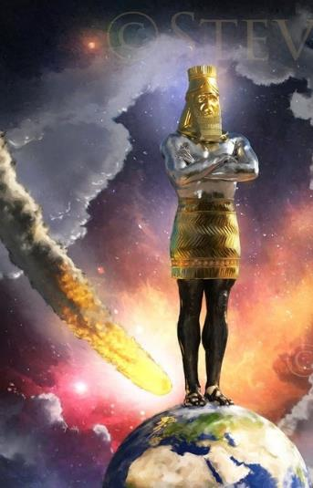
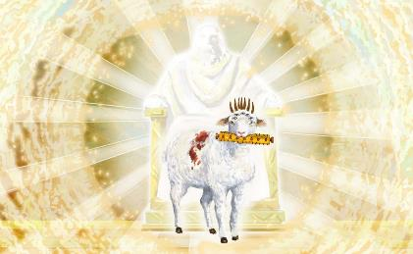
IS GOD IN CONTROL OF THIS WORLD?
“I have told you these things, so that in me you may have peace. In this world you will have trouble. But take heart! I have overcome the world” (John 16:33)
If everything occurred according to God’s ideal will, there would never have been evil but only the perfect bliss of love and harmony.
For this plan to be effective, all created beings must freely accept that God's will is perfect and good.
After the terrible experience of sin, humanity will fulfill the divine purpose because Jesus Christ has triumphed to give us the opportunity to fulfill God's purpose (Rev. 5:5.) But until that moment arrives, we can ask ourselves: Does God control this world?
Although God controls this world, and acts and directs history to reach the end He desires, to a certain extent He allows Satan to take control of certain situations. That is why He warned us: “In the world you will have tribulation; but be of good cheer, I have overcome the world” (Jn. 16:33.)

Slide 15
“The Lord will not compel men to deal justly, to love mercy, and to walk humbly with their God; He sets before the human agent good and evil, and makes plain what will be the sure result of following one course or the other. Christ invites us, saying, “Follow Me.” But we are never forced to walk in His footsteps. If we do walk in His footsteps, it is the result of deliberate choice. As we see the life and character of Christ, strong desire is awakened to be like Him in character; and we follow on to know the Lord, and to know His goings forth are prepared as the morning. We then begin to realize that “the path of the just is as the shining light, that shineth more and more unto the perfect day.” Proverbs 4:18”
EGW (Counsels on Stewardship, pg. 143)

