Slide 1
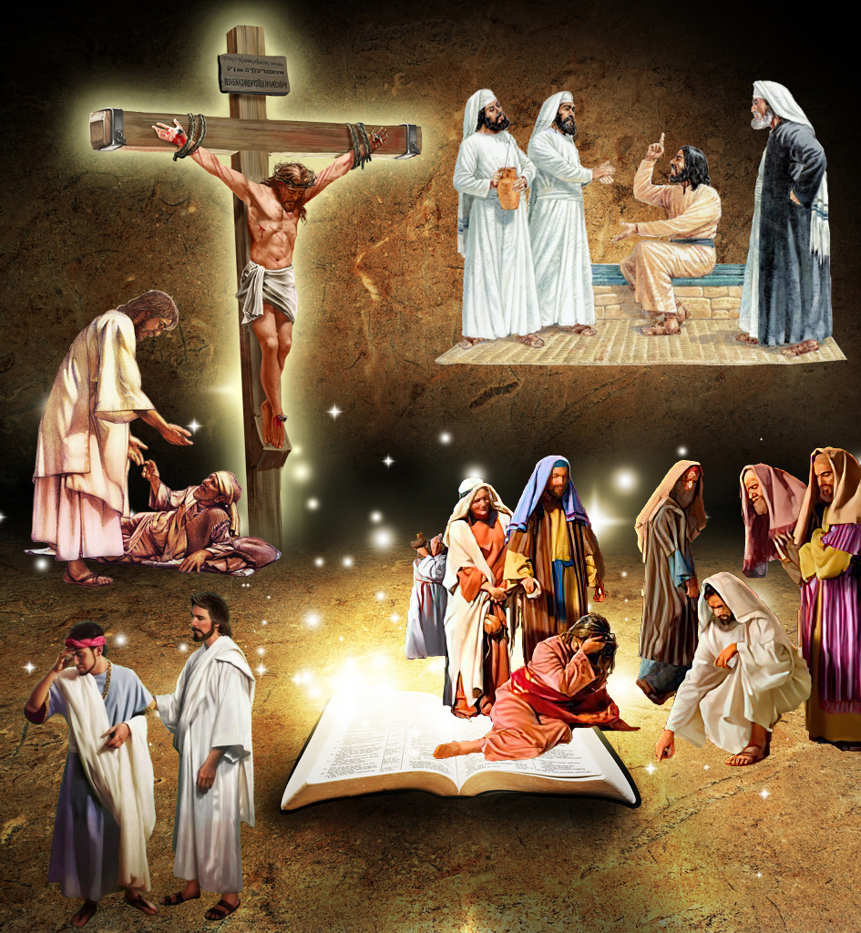
“ ‘But let him who glories glory in this, that he understands and knows Me, that I am the Lord, exercising lovingkindness, judgment, and righteousness in the earth. For in these I delight,’ says the Lord”
Jeremiah 9:24, NKJV

Slide 2
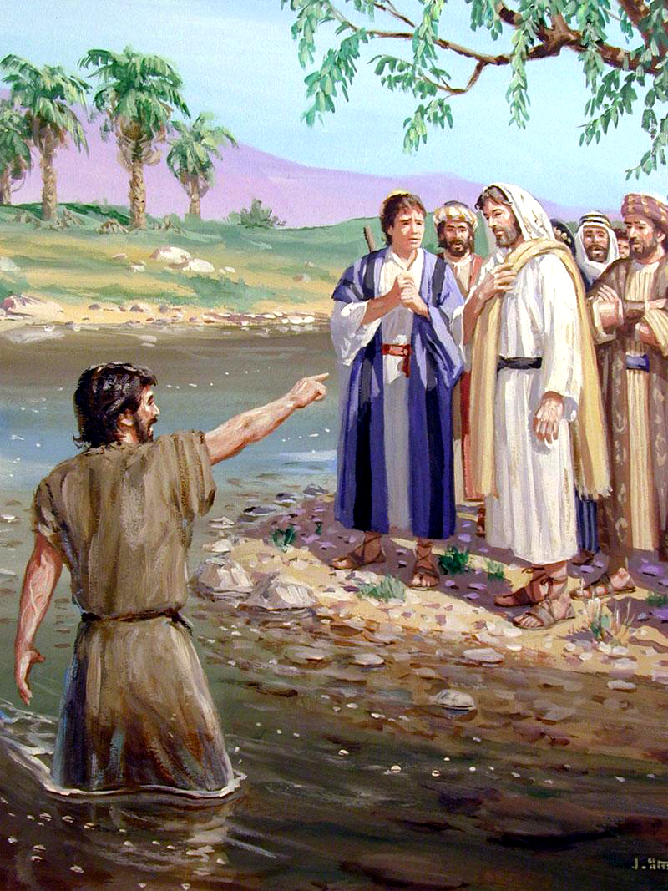
“The next day John saw Jesus coming toward him, and said, ‘Behold! The Lamb of God who takes away the sin of the world!’ ”
John 1:29, NKJV

Slide 3
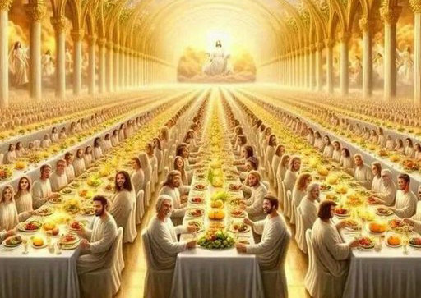
“Then he said to me, ‘Write: “Blessed are those who are called to the marriage supper of the Lamb!” ’ And he said to me, ‘These are the true sayings of God’ ”
Revelation 19:9, NKJV

Slide 4
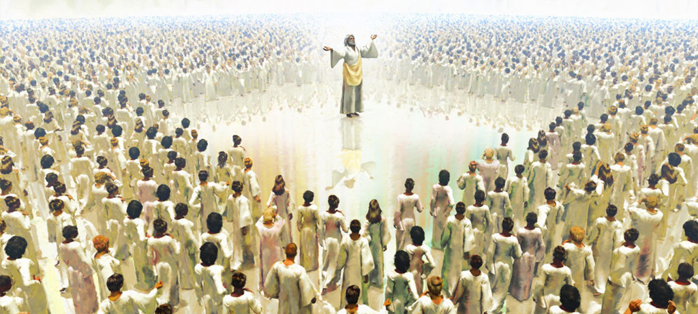
“ ‘Then to Him was given dominion and glory and a kingdom, that all peoples, nations, and languages should serve Him. His dominion is an everlasting dominion, which shall not pass away, and His kingdom the one which shall not be destroyed’ ” Daniel 7:14, NKJV

Slide 5
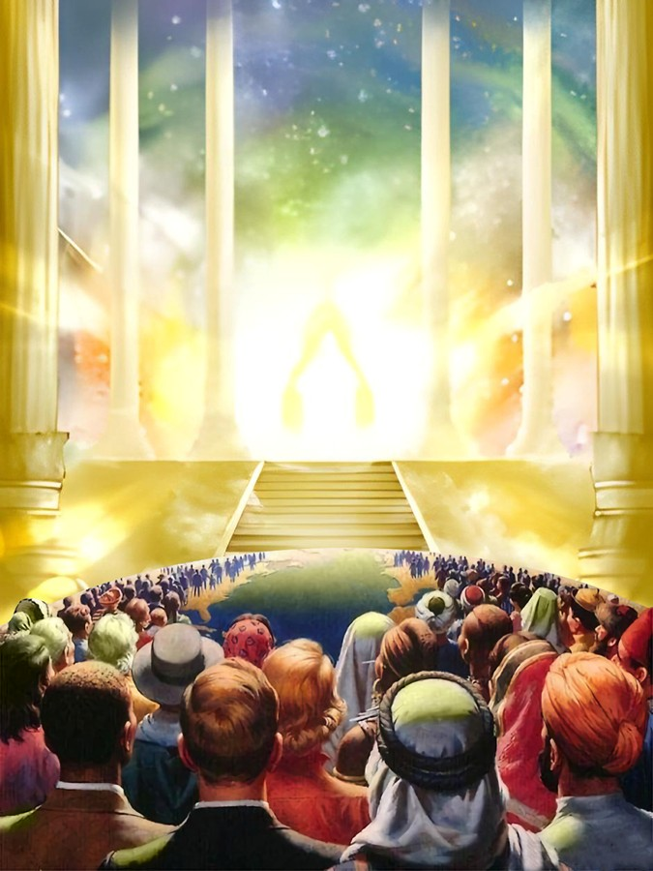
“Be still, and know that I am God; I will be exalted among the nations, I will be exalted in the earth!”
Psalm 46:10, NKJV

Slide 6
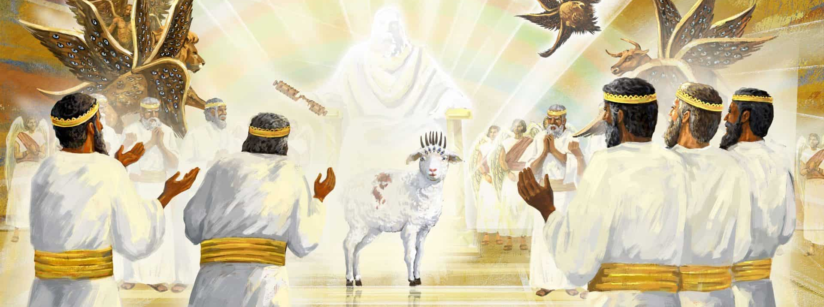
“And they sang a new song, saying: ‘You are worthy to take the scroll, and to open its seals; for You were slain, and have redeemed us to God by Your blood out of every tribe and tongue and people and nation’ ” Revelation 5:9, NKJV

Slide 7
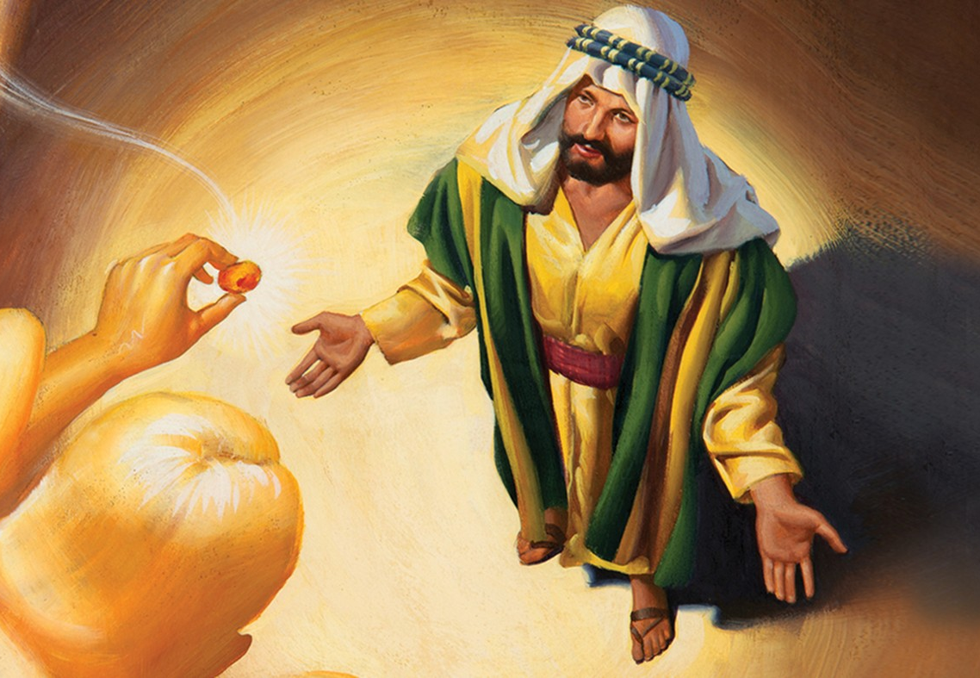
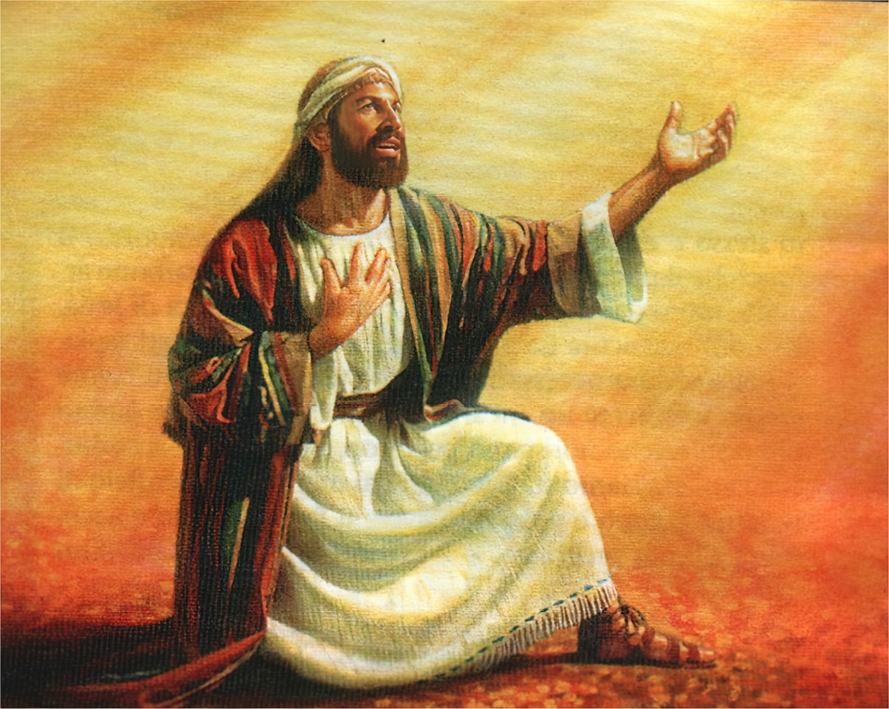
“Also I heard the voice of the Lord, saying: ‘Whom shall I send, and who will go for Us?’ Then I said, ‘Here am I! Send me’ ” Isaiah 6:8, NKJV

Slide 8
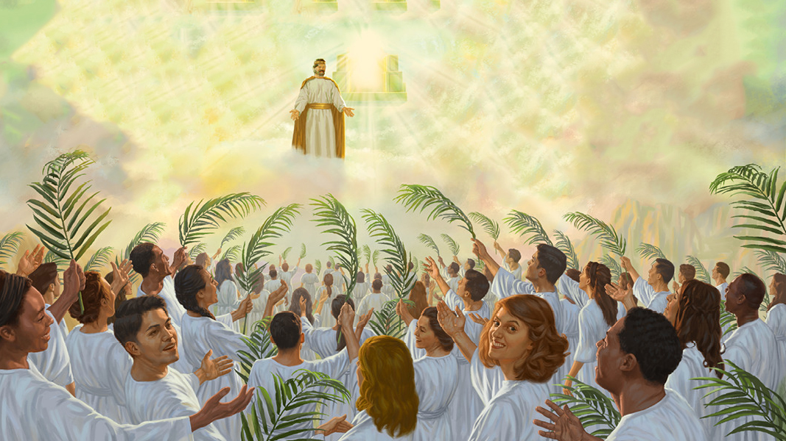
“Then I looked, and behold, a Lamb standing on Mount Zion, and with Him one hundred and forty-four thousand, having His Father’s name written on their foreheads”
Revelation 14:1, NKJV

Slide 9
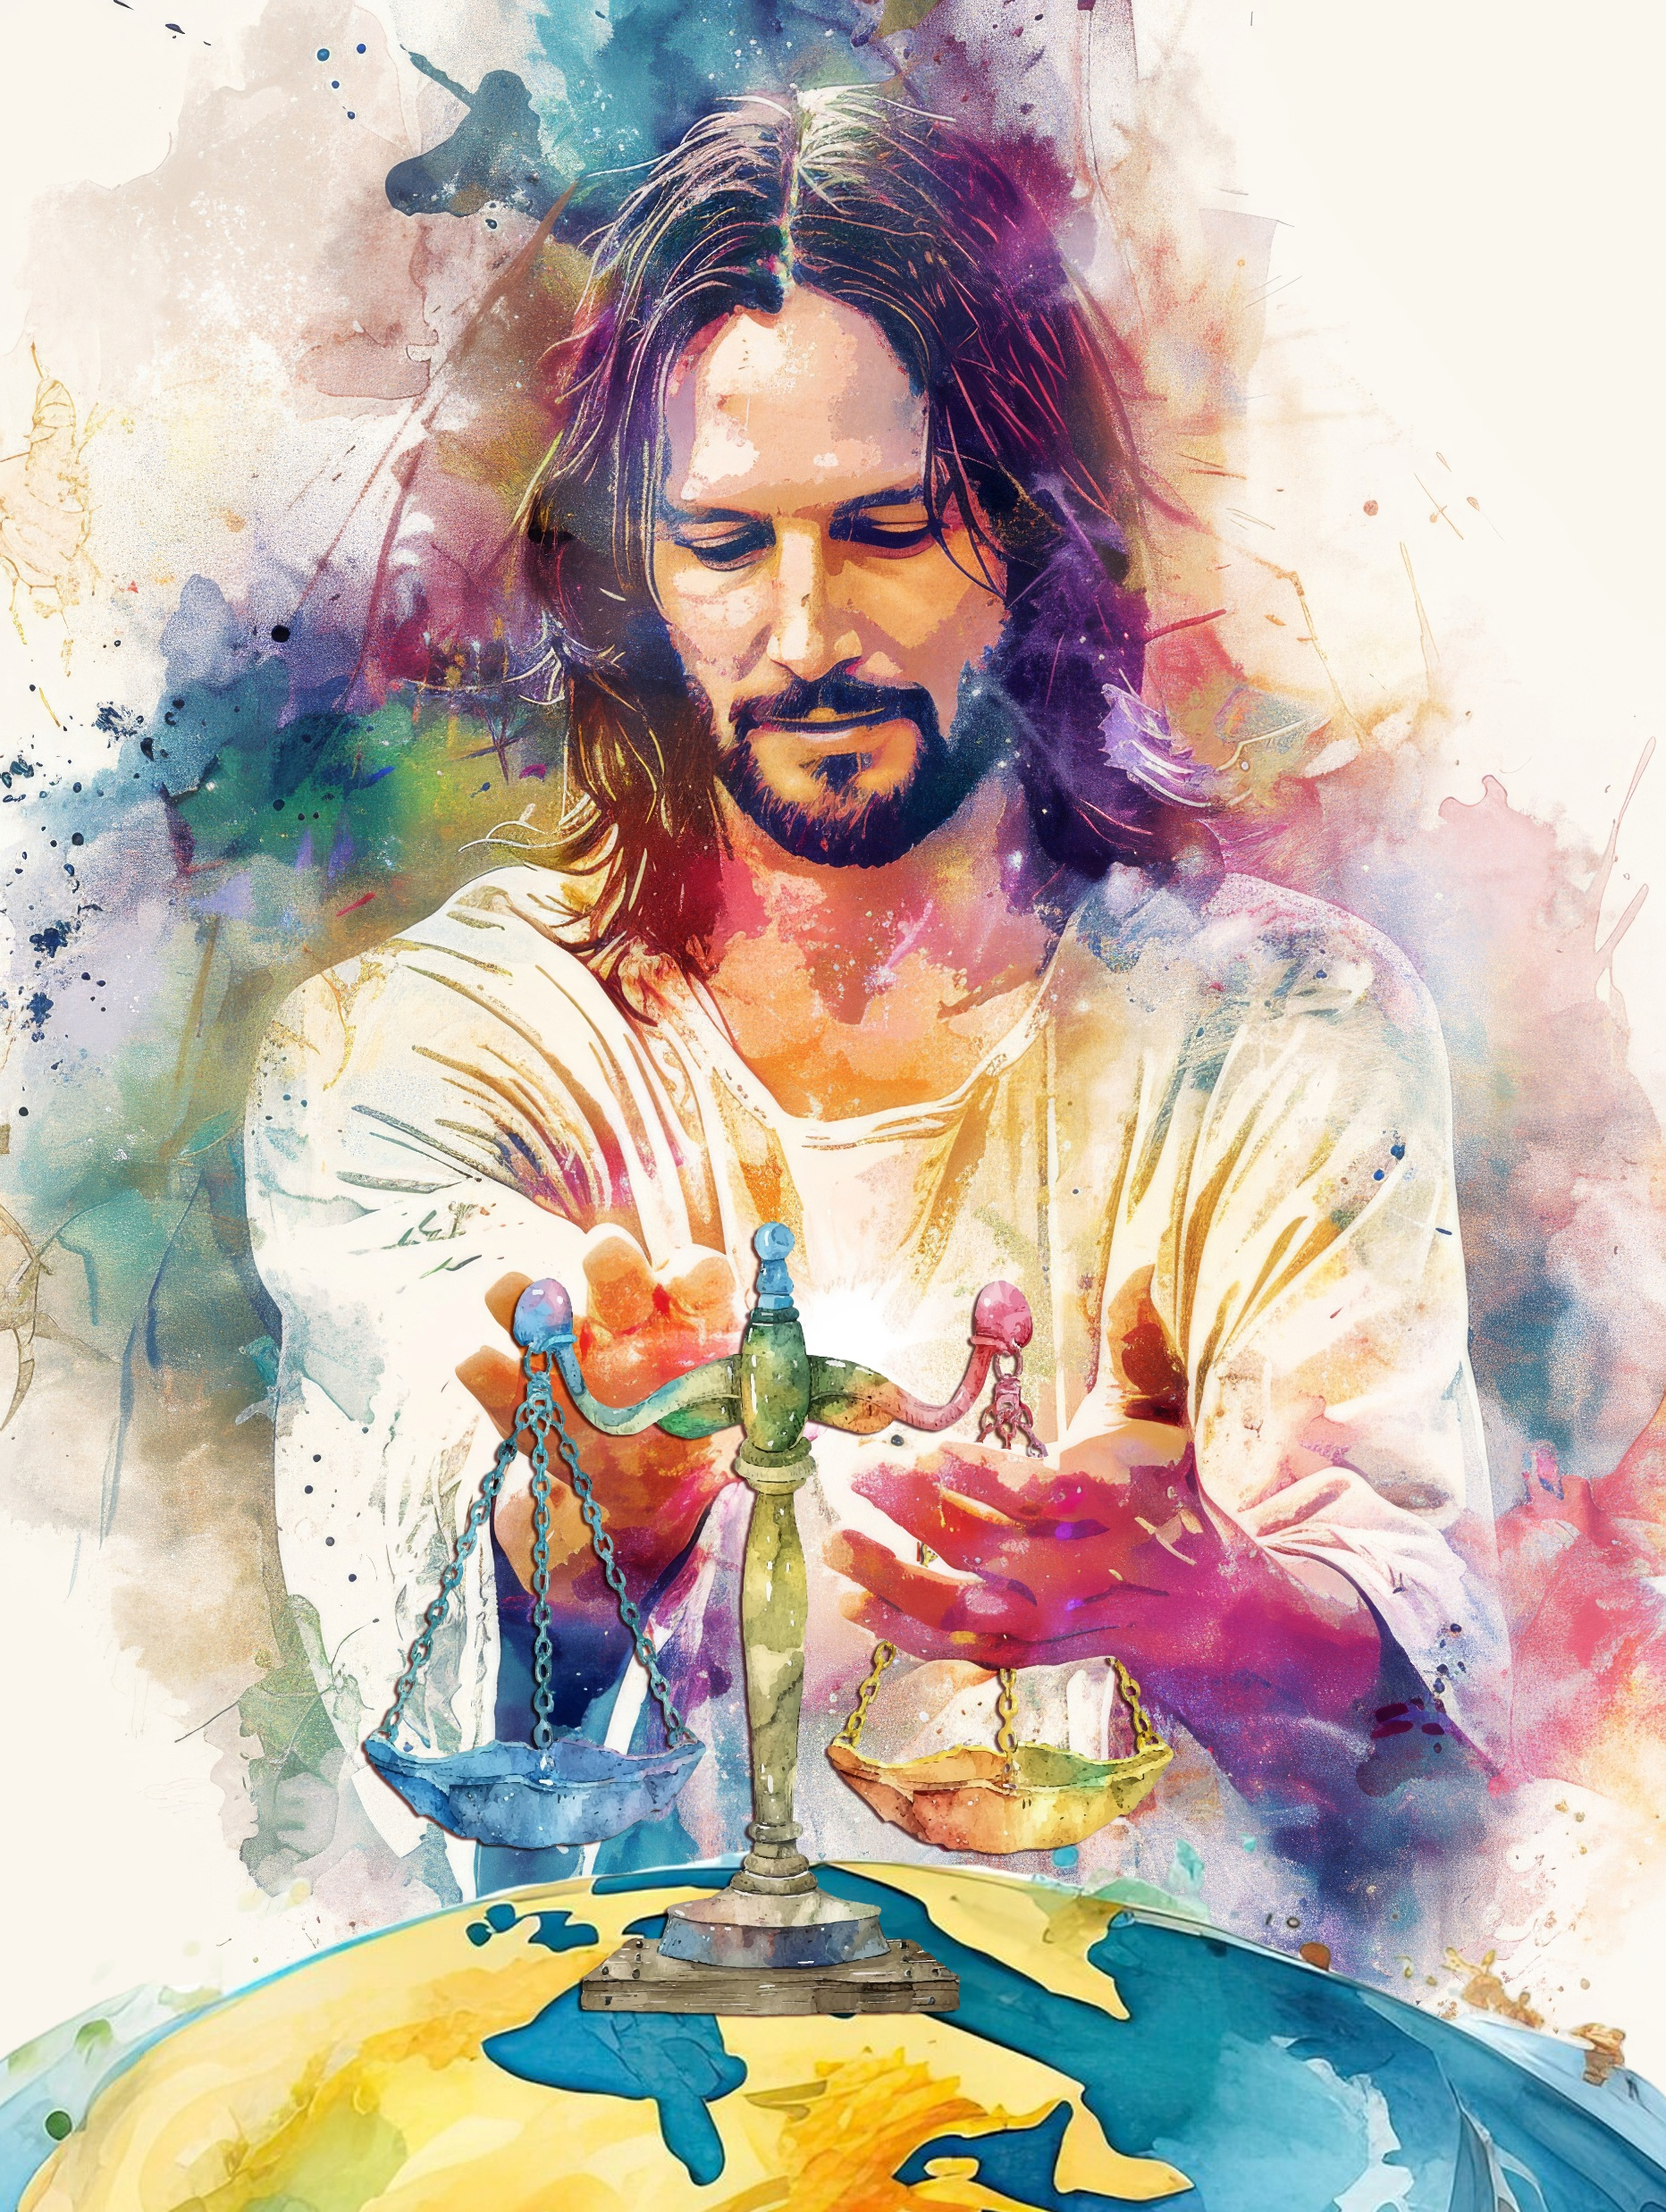
“Let the peoples praise You, O God; let all the peoples praise You. Oh, let the nations be glad and sing for joy! For You shall judge the people righteously, and govern the nations on earth. Selah”
Psalm 67:3, 4, NKJV

Slide 10
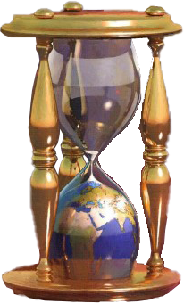
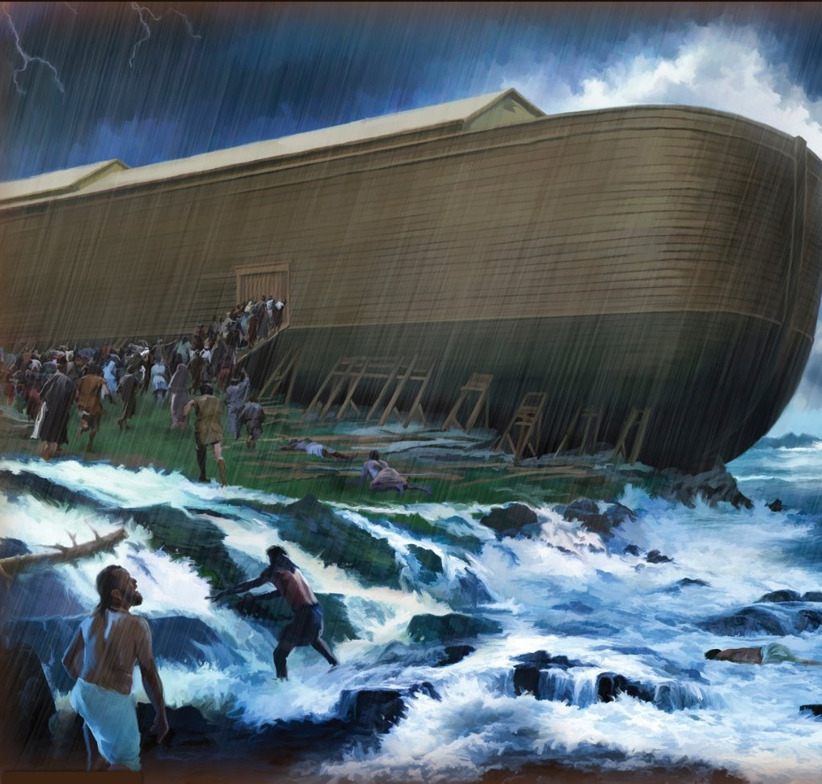
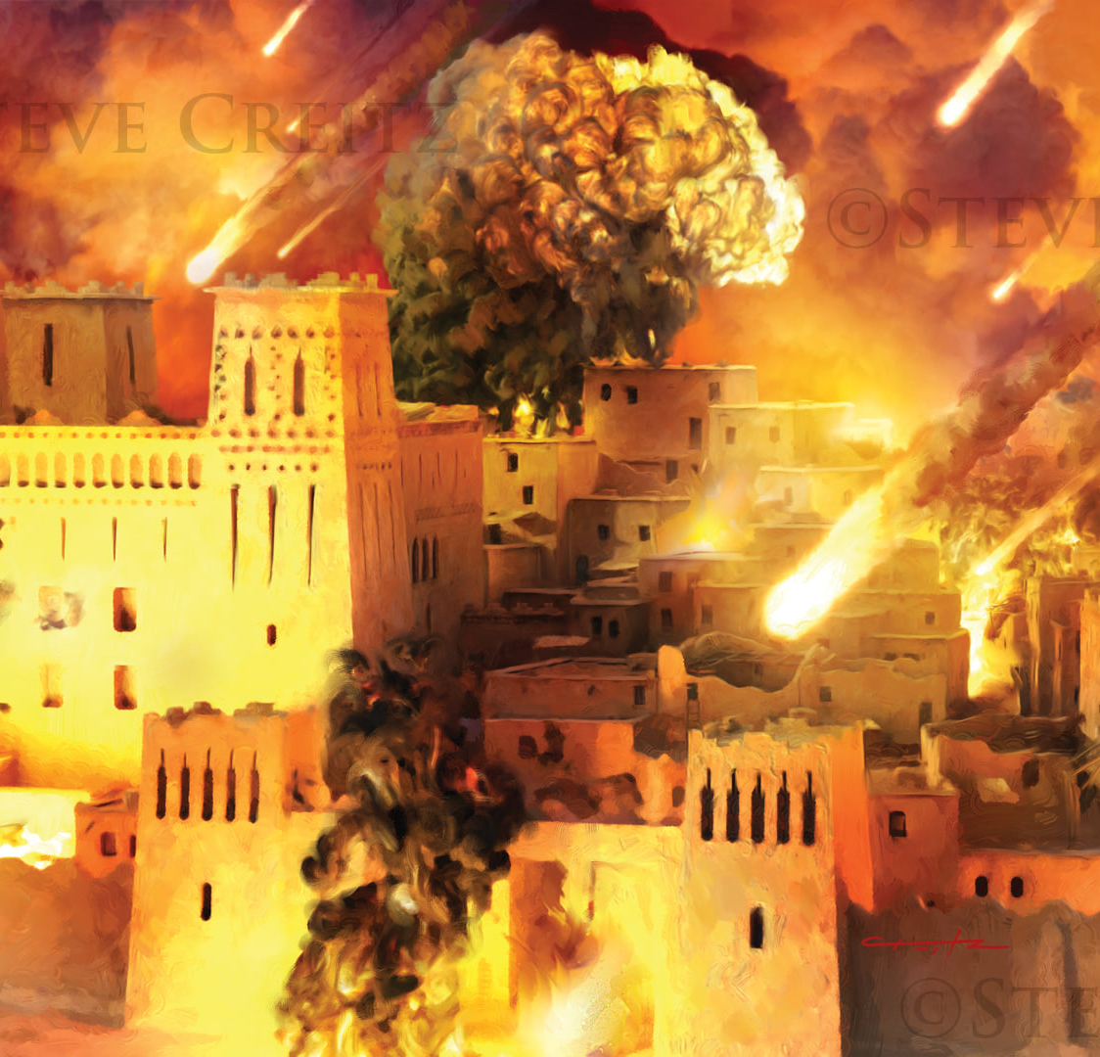
“Now all these things happened to them as examples, and they were written for our admonition, upon whom the ends of the ages have come. Therefore let him who thinks he stands take heed lest he fall”
1 Corinthians 10:11, 12, NKJV

Slide 11
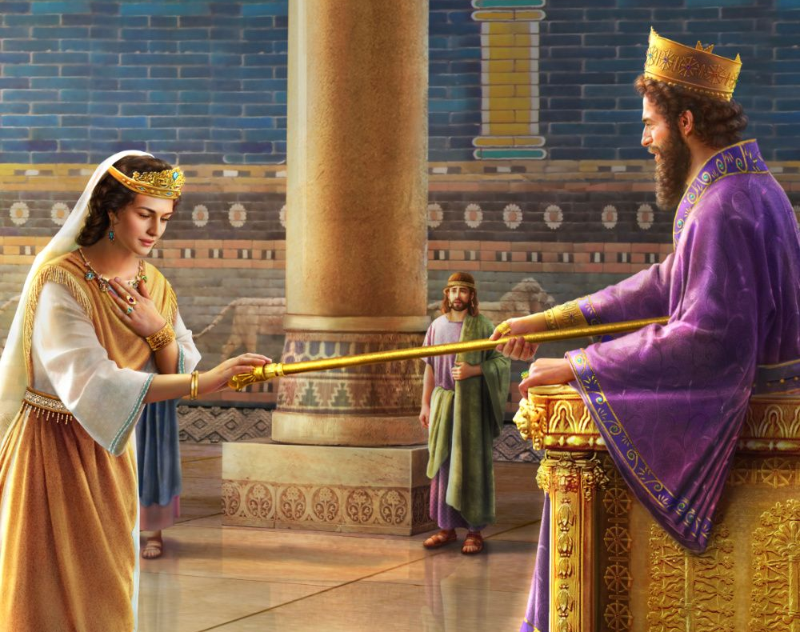
“So it was, when the king saw Queen Esther standing in the court, that she found favor in his sight, and the king held out to Esther the golden scepter that was in his hand. Then Esther went near and touched the top of the scepter”
Esther 5:2, NKJV

Slide 12
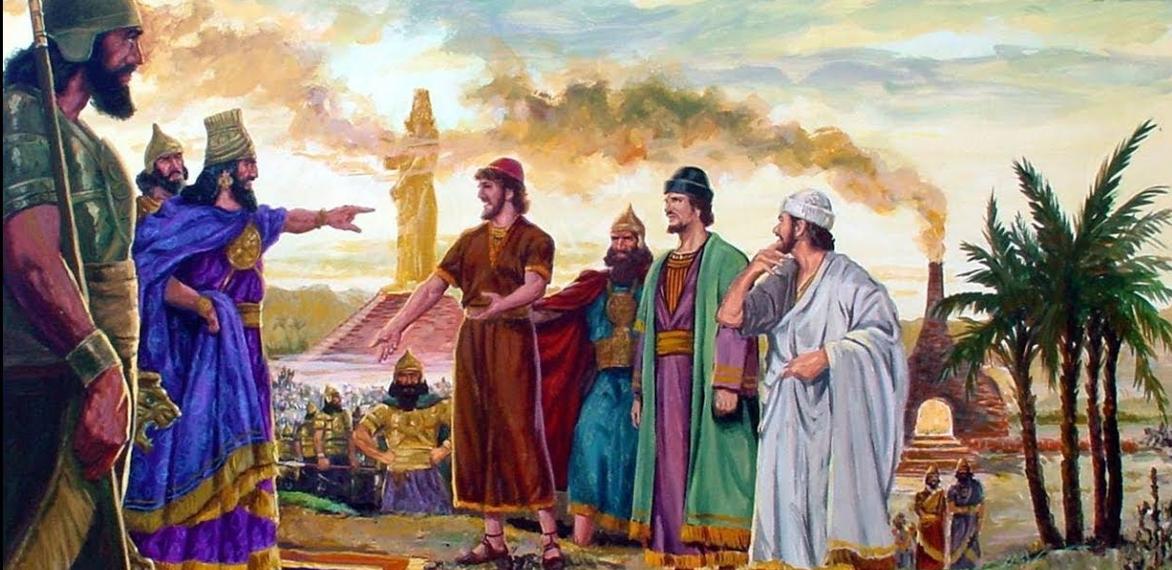
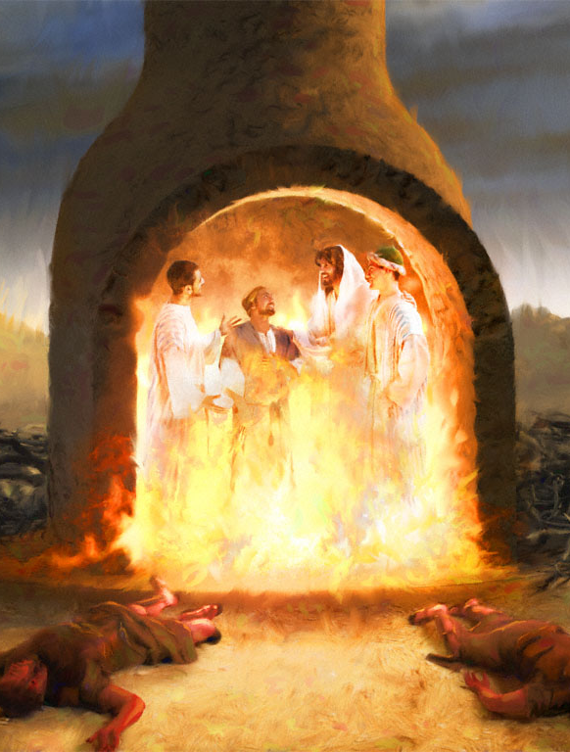
“For God has not given us a spirit of fear, but of power and of love and of a sound mind”
2 Timothy 1:7, NKJV

Slide 13
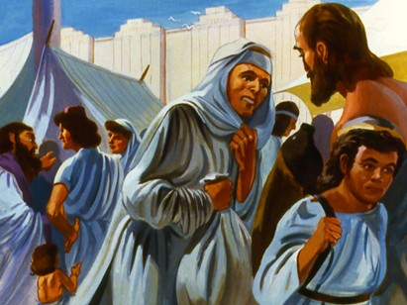
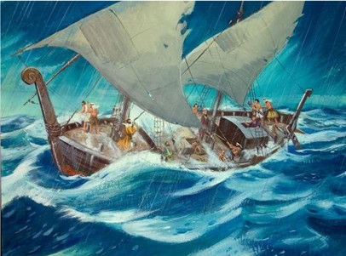
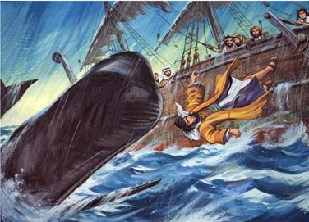
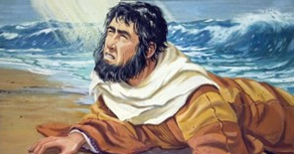
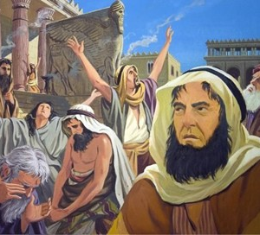
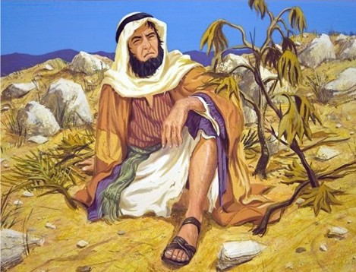
“So he said to them, ‘I am a Hebrew; and I fear the Lord, the God of heaven, who made the sea and the dry land’ ” Jonah 1:9, NKJV

