Slide 1
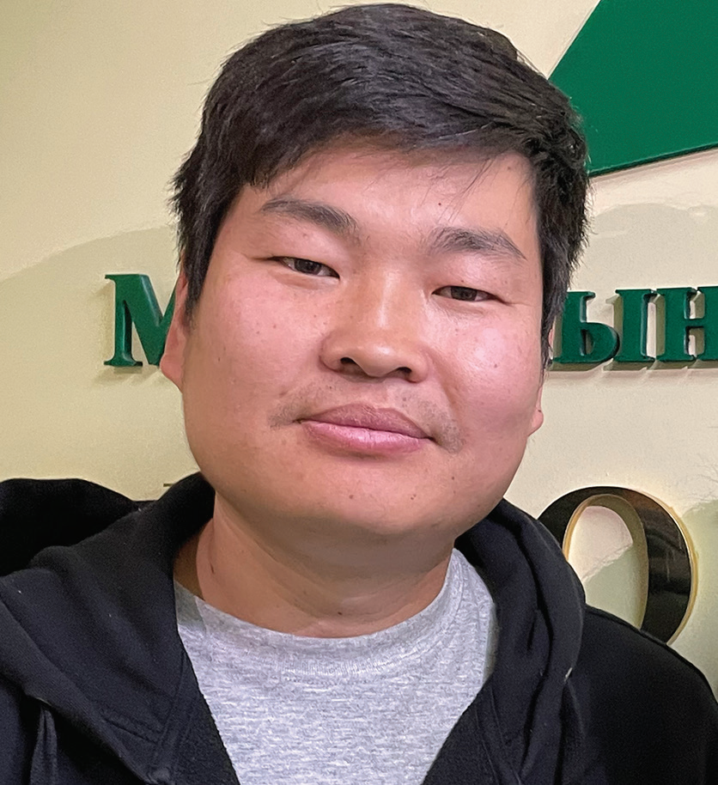
MONGOLIA
JANUARY 4
Something
Different
Tsomo

Slide 2
Tsomo [TSO-mo] never had any interest in Christianity. It was not Mongolia’s traditional religion. Moreover, he didn’t believe in any God. He was an atheist.
Then his aunt visited a Seventh-day Adventist church in Mongolia’s capital, Ulaanbaatar. Wanting to learn English, she had gone to evangelistic meetings led by a guest speaker from Australia. Something about the Adventist church was different, and she invited her 18-year-old nephew to come. “This is a really nice place,” she said. “There are a lot of young people like you.”
“Oh no, Auntie,” Tsomo said. “That’s not our traditional religion. It’s a foreign religion.”
But she still kept inviting him to church. She spoke about the young people and how they played the guitar and sang.
“They’re nice,” she said.
Tsomo went to church with his aunt. He liked the Australian speaker and his companions. He had never met foreigners before, and they were interesting. Moreover, he enjoyed the music. It was so nice. Like his aunt, he sensed something different about the church. He felt something he had never felt before. “These are really nice people,” he thought. “They’re always smiling.”
Tsomo went back to the church many times after the first visit. He became an Adventist. A desire grew in his heart to share his love for Jesus. But how?

Slide 3
A year after becoming an Adventist, Tsomo went to the countryside to visit friends. All of the local teens knew him, and they noticed that something was different.
“You are so different compared to before,” said a girl.
“You’ve changed,” said a boy.
“What happened?”
“I’ve met God,” Tsomo said.
The teens laughed. They weren’t Christians, and they didn’t believe in God.
Now at that time, no rain had fallen in the area for six months. The grass was brown and dry. This was a problem. Grass was needed to feed the horses, cows, sheep, goats, and camels that Mongolians rely on for food, wool, and transportation.
A miracle was needed to end the drought, and the teens decided to test Tsomo’s God.
“If your God really exists, you should pray for rain,” one boy said.
Others agreed.

Slide 4
“Let’s see what your God can do,” said another boy.
Tsomo called together all of the teens.
“OK, let’s do it,” he said. “Let’s pray together.”
He prayed to God for rain.
The next morning, the rain came. The raindrops fell lightly at first, but then the heavens opened up and it poured.
The teens were so surprised! They came running to Tsomo, exclaiming, “It’s raining! It’s raining!”
Some of them began to believe in God.
“Wow, your God is real,” said one.
“I want to know more,” said another.
Tsomo formed a small group of 10 teens. He read the Bible to them, he prayed with them, and he taught them Christian songs. The group met every day for a month. Then Tsomo returned to his home in the city.
Several years have passed since the miraculous rain. Tsomo became an Adventist pastor and today serves in

Slide 5
Mongolia’s capital, Ulaanbaatar. No Adventist church has been established in the region where the miracle took place. But the young people who witnessed the rain remain faithful to God. Several of their parents also have accepted God.
“There is no church there, and there is no pastor there, but they believe in God even today,” Tsomo said.
They believe after seeing something different about the God of heaven.
Part of your Thirteenth Sabbath Offering will go to a new children’s recreation center in Mongolia’s capital, Ulaanbaatar, where children and their parents will be able to learn that something is different about the God of heaven. Thank you for planning a generous offering for this Thirteenth Sabbath project on March 29

Slide 6
