Slide 1

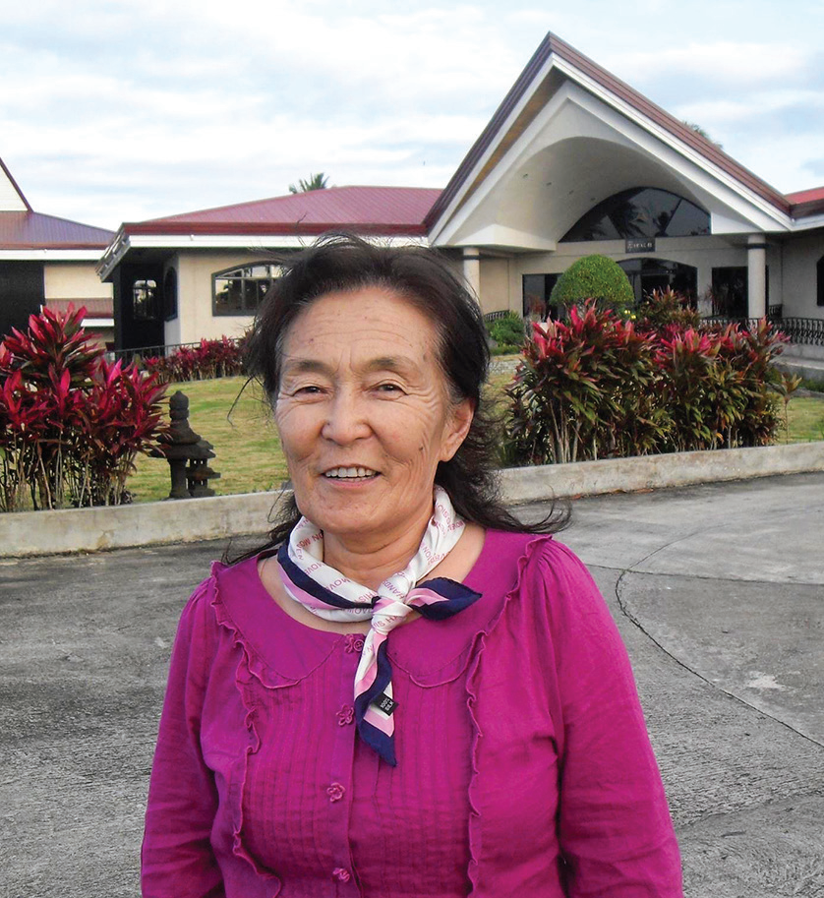

MONGOLIA
JANUARY 18
They’re Spies
Tserenjav Danzan

Slide 2
Mom was upset when her 22-year-old daughter, Debbie, started going to the Seventh-day Adventist church in Mongolia.
“Don’t go to the Americans’ meetings,” she said. “They’re spies.”
It was September 1992, and Mongolia was in a state of post-Communist transition.
Mom’s ire grew when Debbie decided to give her heart to Jesus in baptism in 1993. Debbie was the first Adventist convert in Mongolia after the Communist collapse.
“Americans are bad people,” Mom said.
“They’re spies, and they’re going to ruin our country by winning our hearts and then using us.”
Christianity was not the traditional religion in Mongolia, but Mom thought all religion was bad. She was a staunch atheist who had actively supported communism. Through her influence, many people became Party members. For her work, she had been awarded a special pin of Marx, Engels, and Lenin, and she wore it proudly.
There seemed to be no way that Mom would ever change her mind about God.
Debbie left Mongolia for two years to study at the Adventist International Institute of Advanced Studies (AIIAS) in the Philippines. When she returned home, she invited Mom to a small Bible study group that she had formed. At the time,

Slide 3
Mongolia’s fledging Adventist Church consisted mostly of young people, and the small Bible study group was aimed at
older people. The group’s first five members were Mom, two of her sisters, the mother of the first Mongolian pastor, and the mother of another church member.
Mom was very cautious about the small Bible study group, but she also was curious. She had seen a change in Debbie. Once proud, Debbie had become mild. Once bossy, she had become obedient to her mother and respectful of her sister.
“She has changed,” Mom thought. “What caused her to change?”
Then Debbie’s sister, who once had fiercely opposed Christianity, was herself baptized. Mom saw that she also had changed.
That was enough. In 2000, Mom decided to give her allegiance to the God of heaven. She was baptized and joined the Adventist Church at the age of 53. In fact, all five members of the small Bible study group ended up getting baptized.
Once an active recruiter for Lenin, Mother became an ardent witness for God. Once a seeker of members for the Party, she became a seeker of lost sheep for the Kingdom. Through her influence, many people gave their hearts to Jesus.
Mom was faithful until her death. She not only loved God, but she also loved to give to God. When she grew so weak that she could no longer go to church, a house church was organized in her home. She said that a worship service was not complete without the offering so, at her request, a collection box was brought to her bed so she could personally give an

Slide 4
offering.
Mom died of gallbladder cancer at the age of 74 in 2020. But she remained a witness even after her death.
A traditional Mongolian funeral usually involves many expensive rituals. But, at her request, she was buried at a simple Christian funeral. Her funeral was so different from the usual funerals that her relatives were amazed. They realized that something was different about Christianity.
“Wow, what a peaceful funeral,” said one. “I would like my funeral to be like that,” said another.
But Mom’s witness didn’t end there. She continues to preach from her tombstone in the cemetery. Her tombstone contains the promise of Isaiah 30:18, “Blessed are all those who wait for Him” (NKJV).
Shortly before she died, she told Debbie, “My hope is in Christ. I want to sleep until He comes.”
Now Mom is waiting on the Lord to raise her up on that glorious morning.
Thank you for your Thirteenth Sabbath Offering that will continue the missionary work of Mom — whose name is Tserenjav Danzan [ CZAR-en-jav DAN-za ] — and other faithful Seventh-day Adventists who are now resting in their graves in Mongolia. Part of this quarter’s offering on March 29 will help open a recreation center that will teach children and their parents about Jesus in Mongolia’s capital, Ulaanbaatar

Slide 5

