Slide 1
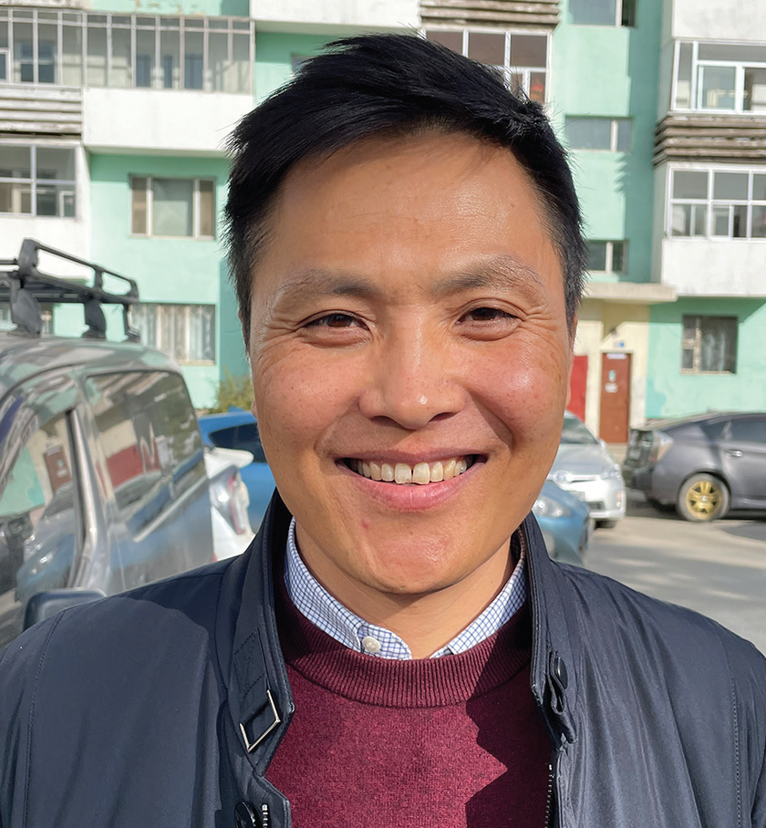
MONGOLIA
FEBRUARY 1
Teacher’s Helper
Part 2
Bold Batsukh

Slide 2
Editor’s note: This is the story of how Bold Batsukh, Mongolia’s first Seventh-day Adventist pastor, gave his heart to God in the early 1990s. The story picks up with 13-year old Bold bitterly seeking answers to why his father died unexpectedly. He noticed that his mother was finding answers to her own questions from a teacher from a traditional Mongolian religion. Mother agreed to take the boy to meet the teacher.
People crowded outside the teacher’s house every day to ask for advice on how to solve their problems in Mongolia. People sat and waited to be called into the house.
When someone entered the house, the teacher asked, “What’s your problem?”
Then he listened for a long time. After that, he opened his sacred writings and chanted something from it in the Tibetan language.
No one understood what he said because no one spoke Tibetan, but people left the house looking happy.
The teacher couldn’t tell Bold why his father had died, but the boy was impressed by him and his sacred writings. Bold thought, “If I could help him, I could spend more time with him, and it would be a good way to get out of going to school!”
Back at home, he told Mom, “Maybe I’ll become a teacher, too. Could you ask your teacher if he would train me?”
Mother was reluctant, but she agreed to ask.

Slide 3
A few days later, she returned home from the teacher’s house with a big smile.
“The teacher was so happy when I told him your request,” she said. “He said that he has wanted to mentor a boy for a long time.”
Bold went to live with the teacher.
At 6 o’clock every morning, the teacher poked Bold with a wooden stick to wake him up. Then Bold sat for hours, learning the Tibetan language and memorizing texts from the sacred writings. He also had many chores, cooking for the teacher and cleaning his house.
Bold lived with the teacher for two years. He memorized all the texts that the teacher told him to memorize. He did everything that the teacher told him to do. When he was 15, the teacher took him to a monastery where he could be trained to become a teacher, too.
The head teacher at the monastery quizzed Bold. “What have you learned?” he asked. “Can you chant this text? Can you chant that text?”
Bold, the boy who once had asked many questions, was now able to give many answers from the sacred writings.
The head teacher was impressed.
“He is well trained,” he told Bold’s teacher.

Slide 4
“But we have just accepted some other boys, and we don’t have any space left. If you come back next year, we will take him first.”
It was a turning point. If Bold couldn’t train to become a teacher, he wanted to go back to regular school. He moved back home to Mom and his sister, who was his twin.
He hadn’t gone to school for two years, and he was far behind his former classmates. But he wanted to study with them again.
Mom spoke with the school principal, and he agreed to allow Bold to study with his old classmates for two months. If he could keep up with them, he could stay in the class.
Bold sat in the front row. Unlike before, when he was 13, he now was eager to learn.
To his surprise, the schoolwork was easy, and he quickly rose to the top of his class. His classmates couldn’t understand why he was doing so well. He had missed two years of school while they had been studying. Bold only realized later that two years of memorizing texts had cleared and disciplined his mind, enabling him to easily complete his school assignments.
After graduating from high school, Bold decided to learn English and become an English teacher. He already spoke Mongolian and Russian, and he thought that a third language wouldn’t be too difficult.

Slide 5
But after a few days of university classes, he was failing. English was much harder than he had expected. He wondered what to do. His twin sister had an idea. She had met some Americans, and they were teaching her English. “Come meet the Americans,” she said.
Bold wasn’t interested. Later, his sister showed him a New Testament in the Mongolian language.
“The Americans are Christians,” she said. “They’re talking about Christ.” Bold was alarmed. “Don’t go to them anymore,” he said. “We have our own traditional religion in Mongolia.”
But his sister wouldn’t listen. “These people are really nice,” she said.
Bold continued to struggle with his English classes. One day, as he labored over his homework, he remembered the Americans. He thought, “Maybe they could help me with my English.” He promised himself that if the Americans spoke about Christianity, he would show them that their religion was utterly unacceptable for Mongolians. He asked his sister if he could meet them.
The sister told the Americans about her brother. One of them replied, “Bring him to our house church this Sabbath.”
Pray for the people of Mongolia who, like Bold, are looking for answers. Part of this quarter’s Thirteenth Sabbath Offering will help open a children’s recreation center to share the gospel in Ulaanbaatar, Mongolia. Thank you for planning a generous offering on March 29.

Slide 6
