Slide 1
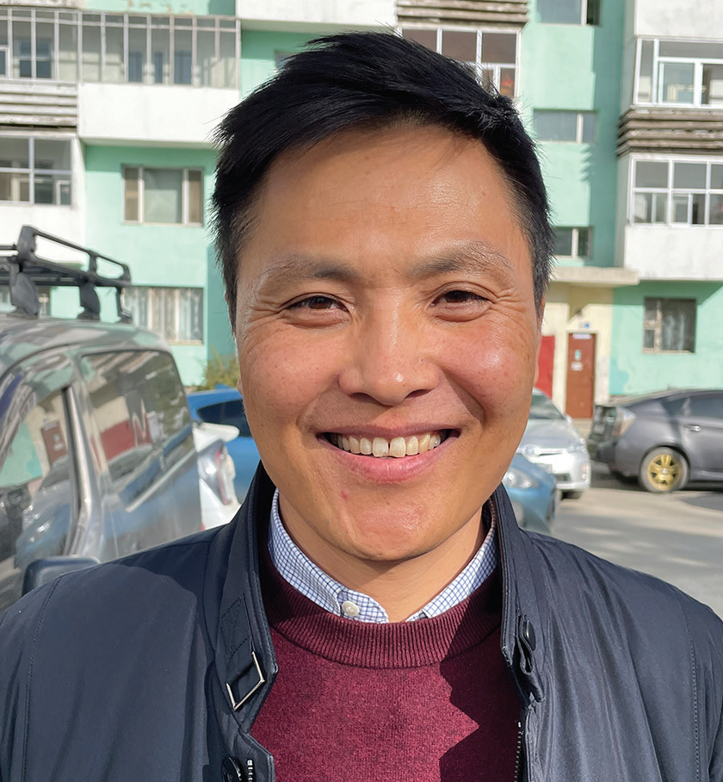
MONGOLIA
February 8
Giving Bible a Chance - Part 3
Bold Batsukh

Slide 2
Editor’s note: This is the story of how Bold Batsukh, Mongolia’s first Seventh-day Adventist pastor, gave his heart to God in the early 1990s. The story picks up with Bold struggling to study English at a university in Mongolia. He asks his twin sister to introduce him to some Americans who are teaching her English and about God. He is determined to learn English from them and, if necessary, show them that Christianity has no place in Mongolia.
The Americans didn’t meet in a church but in the living room of their house.
They greeted Bold kindly when he came with his twin sister to their house church in Mongolia’s capital, Ulaanbaatar.
It was a most unusual experience for Bold. About 20 people were sitting in a circle on the floor, singing from songbooks. The words of the songs seemed so odd to Bold. He was confused and amused. He thought, “What do they mean by ‘hosanna’? Why are they singing about a ‘Lamb’?” He held a songbook over his face to hide his laughter.
After the song service, the Americans led a Sabbath School class. They spoke about King Nebuchadnezzar’s dream in Daniel 2.
Bold was fascinated and had many questions. But he kept silent.
Then one of the Americans preached a short sermon. None of the words made sense to Bold. The preacher talked about an image in the book of Revelation that Bold didn’t understand. The preacher spoke about Jesus coming back, and Bold wondered, “Where did He go, and why does He need to come back?”

Slide 3
After lunch, the house-church group went to an orphanage to do crafts with children.
When Bold returned home that night, he felt good. It had been a good day, and he had enjoyed helping the children. “I’ll have to give the Americans a chance,” he thought. “Maybe I should listen to their ideas.”
He eagerly waited for the next Sabbath.
After the Sabbath sermon, he sat down with the Americans and listened. What he heard was very different from what he had been taught. The Americans opened a Bible to Genesis and shared the Creation story. Bold was very interested. He had studied with a teacher from a traditional Mongolian religion for two years as a boy, but his teacher hadn’t been able to explain the origin of life. The teacher had told a legend about dust coming together and forming the Earth. But the legend didn’t explain the origins of water, air, and living things. To those questions, the teacher had no answers. But the Bible had clear answers about all of those things.
Bold had many questions, and he began to ask them. The American missionaries answered his questions from the Bible. When they learned that he knew Russian, they gave him a Russian Bible. At the time, only the New Testament was available in the Mongolian language so, with the Russian Bible, Bold had access to the whole Word of God.
On his third Sabbath at the church, a missionary said, “Why don’t you teach Old Testament stories with children’s felts?”
Bold was surprised. He didn’t feel qualified to teach the Bible to anyone.

Slide 4
The missionary encouraged him to try. “Just go for it,” he said.
The challenge intrigued Bold, so he agreed.
That week, he carefully read the Russian Old Testament and took notes in Mongolian. On Friday, he went to the missionaries’ house and picked out the felts that he wanted to use the next day. On Sabbath, he told Old Testament stories in Mongolian to a rapt audience at the house church.
At home, Bold kept reading the Bible, and he found answers to all of his questions. He learned that God and the devil are real. He read in Genesis 3 that the devil, disguised as a snake, brought sin and death into the world. He also read in Genesis 3 that God put forth a plan to save humanity. As a result, he learned, death is not the end, and people who believe in Jesus have eternal life. In John 3:16, he read, “For God so loved the world that He gave His only begotten Son, that whoever believes in Him should not perish but have everlasting life” (NKJV).
He gave his heart to Jesus.
Today, Bold is a leader of the Adventist Church in Mongolia. He holds the distinctions of being not only the first Mongolian Adventist pastor but also the first ordained Mongolian pastor. He also speaks fluent English.
“I learned in the Bible about a loving God who created us and, when we sinned, came to rescue us. That was more appealing than anything that I had been taught before. I gave the Bible a chance, and that’s why I’m an Adventist today.”

Slide 5
He said that even though he suffered after his father died, he found God as a result.
“Even though it was a tragedy in my life, it ended up being so good,” he said. “By coming to Christ, I found answers to all my questions. God was with me all that time.”
Pray for the people of Mongolia who, like Bold, are looking for answers. Part of this quarter’s Thirteenth Sabbath Offering will help open a children’s recreation center to share the gospel in Ulaanbaatar, Mongolia. Thank you for planning a generous offering on March 29.

Slide 6
