Slide 1
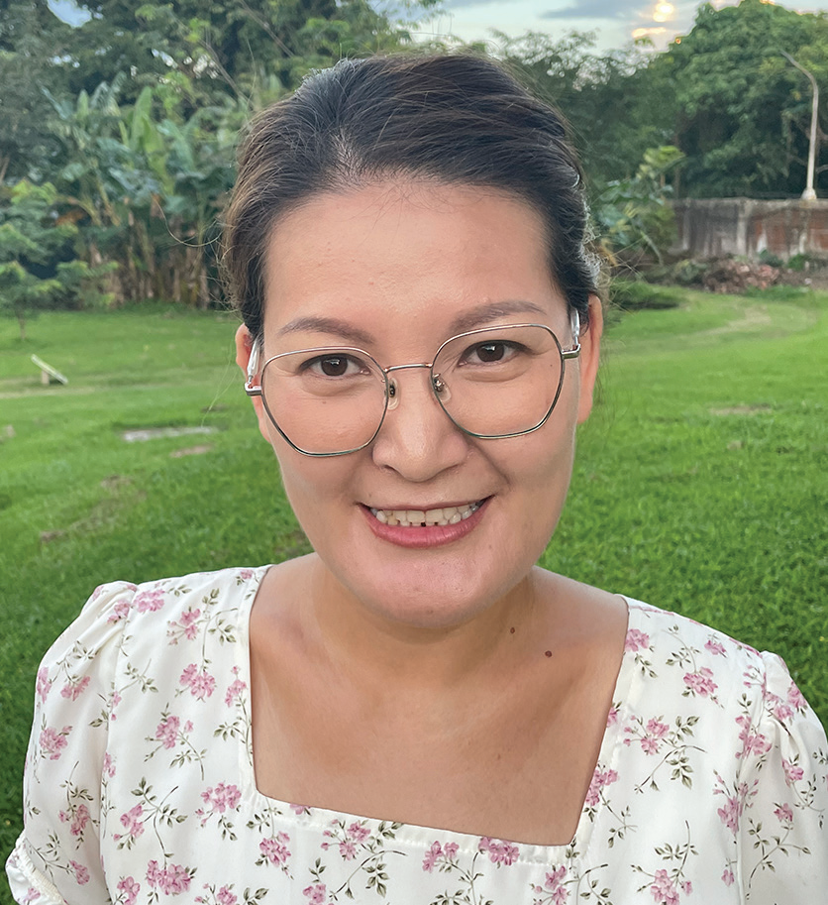
MONGOLIA
February 15
An Impossible Dream
Eegii

Slide 2
Editor’s note: Eegii was among the first teachers who taught at Mongolia’s only Seventh-day Adventist school when it opened in 2009. She had just graduated from a Mongolian university and had no experience teaching at an Adventist school. She and the other teachers led the first year’s group of 13 children with prayer and passion. Today, Tusgal School has 250 students. This is Eegii’s story.
Eegii taught at the Seventh-day Adventist school in Mongolia, but she wished for an Adventist education of her own. She wondered, “How can I show God’s love better?”
Years passed, and Eegii attended seminars about Adventist education in Mongolia. But the seminars were short, and Eegii longed for more. She prayed. She added the Adventist International Institute of Advanced Studies (AIIAS) to her prayers when she learned it offered a master’s degree in education in the Philippines. But her dream seemed impossible. She prayed for 10 years.
Then the Northern Asia-Pacific Division, whose territory includes Mongolia, offered Eegii a scholarship to study at AIIAS. Eegii was overjoyed! God had answered her prayers. But she didn’t know if she could accept the scholarship, which only covered her education. She would still need to pay for housing, utilities, and food. She also had a husband and two school-age sons whom she couldn’t leave behind. They would need tickets to fly to the Philippines, and her boys would need money to study at an Adventist school there.
Eegii prayed and prayed. Her dream seemed impossible. Then she and her husband decided to step out in faith. They sold their car and furniture. When they added the money to their family savings, however, they still didn’t have enough.

Slide 3
That night, Eegii went to bed worried.
As she slept, she had a dream. She was pacing back and forth in a small room without any doors or windows. She was trapped. Then God gave her a piece of paper and said, “I will help you.” A moment later, she was sitting in the back of a pickup, traveling down a road. The pickup stopped at a railroad crossing, a train passed, and the pickup drove on. Eegii woke up with all of her worries gone. God’s words rang in her ears, “I’ll help you.” Eegii was no longer worried, but she still didn’t know what to do. Her dream seemed impossible.
A few days later, as Eegii walked to church on Sabbath, an unusual sight caught her eye. A large tree was growing out of a row of private parking garages. The roots of the tree were sunk deep into the concrete roof of the garages. Eegii thought, “It’s impossible for a tree to grow on a concrete roof.”
Immediately, the angel’s words to Mary sprang into her mind, “For with God nothing will be impossible” (Luke 1:37, NKJV).
She thought, “God is showing me that everything is possible for Him!”
Eegii took a photo of the tree on her cellphone and happily showed it to her friends at church. She had no doubt that she and her family would go to the Philippines.
That’s exactly what happened. Over the next few weeks, Eegii got plane tickets and left Mongolia. God even blessed

Slide 4
her en route to the Philippines. She had a six-hour layover to change planes in Turkey, and she got to spend time with two
relatives living there.
When she arrived at AIIAS, she was alone, just like she had been alone in the back of the pickup in her dream. But she believed that God would help her. She believed a tree could grow out of a concrete roof. She prayed and waited. Two months later, her husband sold the last of their possessions, and he and their two sons had the funds to join her.
Today, the family is living at AIIAS as Eegii studies for her master’s in education. She couldn’t be happier. Her impossible dream is being fulfilled. She is obtaining an Adventist education, and she can’t wait to share God’s love in new ways back home.
“We need to look at God rather than at our problems, and we need to move forward in faith,” she said.
“When the Israelites fled Egypt, they stopped at the Red Sea in fear,” she said. “But then when they stepped forward in faith, they saw God miraculously part the water. So, walk forward with God in faith, prayer, and thanksgiving.”
Pray for Eegii and the other teachers at Tusgal School, the only Seventh-day Adventist school in Mongolia. Part of a previous Thirteenth Sabbath Offering helped the school expand with new classrooms and a library. Thank you for planning a generous offering on March 29 for this quarter’s Thirteenth Sabbath projects in Mongolia and elsewhere in the Northern Asia-Pacific Division.

Slide 5
