Slide 1
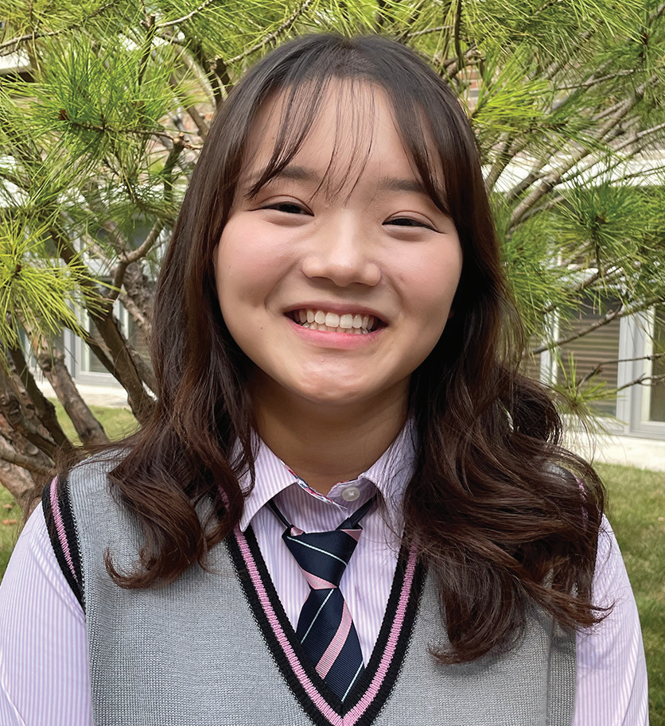
SOUTH KOREA
February 22
Book Worth Reading
Yu Jin

Slide 2
When Yu Jin [YOU-jeen] was 9 years old, her mom gave her a book to read.
“Since you read a lot of books, you should read this book, too,” she said. “It’s in Korean and English. Study it. Read it. This is a good book.”
It was the small book Steps to Christ by Ellen White.
Up to that point, Yu Jin had only read books in Korean. But Mom wanted her to learn English.
An obedient child, Yu Jin immediately began to read the book.
She read it every day on the bus as she traveled to and from school in South Korea. She read during lunch break at school.
The English text was too hard to read, so she skipped it and finished the Korean part of the book in a week.
She didn’t understand everything that she read, but she felt a strong conviction that she needed to be baptized.
She went to Mom.
“I want to be baptized,” she said.

Slide 3
Mom smiled.
“When you grow up, you can be baptized,” she said.
Korean children often start thinking about baptism when they are about 13 years old. But Yu Jin was 9, and 13 was four long years away. She wasn’t happy about having to wait. But she was an obedient child.
“OK, fine,” she said.
She didn’t speak about baptism again.
As time passed, she kept attending church every Sabbath as she had in the past. But she went because she wanted to participate in Pathfinders and other fun activities, not because she desired a close relationship with God.
When she turned 13, she was baptized with the rest of her friends. But she didn’t have the same conviction to be baptized as when she was 9.
As a teen, she spent more and more time with non-Christian friends, and her love for God gradually dimmed. She ate like her friends and sometimes skipped church on Sabbath. She was tired on Sabbath morning and didn’t want to make the effort to go to church.
Doubts even crept into her mind about the existence of God.

Slide 4
Then one summer, when she was 16, she volunteered to help with an evangelism program. Her job was to invite other young people to come to the church meetings by handing out flyers.
No young people came to the first meeting as a result of her invitations, and she felt like a failure.
A missionary from the meetings saw her disappointment and prayed with her.
To Yu Jin’s amazement, several young people whom she had invited showed up at the next meeting.
A flicker of faith flashed in her heart.
Then heavy rain threatened to disrupt a meeting. She prayed, and the rain stopped. The meeting went ahead as planned.
Yu Jin was a new person when she returned to her Adventist high school in the fall. She eagerly attended a student-led prayer group, called “Kneelers,” that met every Friday evening after worship services. She got a new copy of Steps to Christ. But this time, she didn’t finish the book in a week. She read it with a group of other students at the rate of about a chapter a week. For her, it was like reading the book for the first time.
Yu Jin said she is glad that she read Steps to Christ when she was 9.
“When I read it for the first time, my heart was stirred deeply to follow Jesus and to be baptized,” she said.

Slide 5
She is even more glad that she read it again. She said the book cannot be read too many times.
“Surely the Lord is coming again,” she said.
Yu Jin goes to Hankook Sahmyook Academy, which will receive part of this quarter’s Thirteenth Sabbath Offering to open a gym and missionary training center, in Seoul, South Korea. Thank you for planning a generous offering on March 29.

Slide 6
