Slide 1

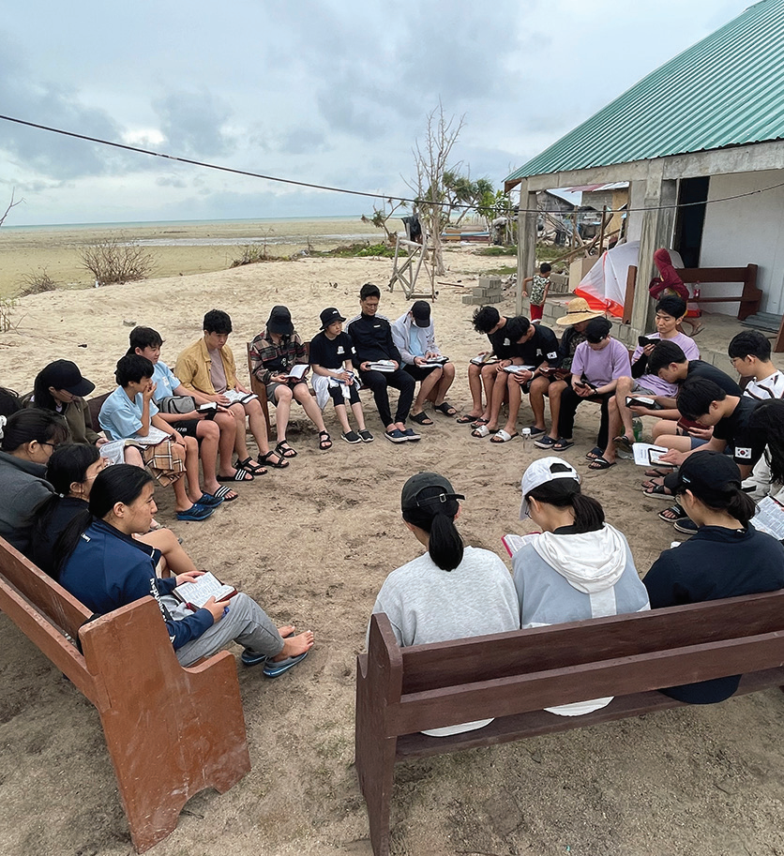

SOUTH KOREA
March 1
Praying in the Storm
Academy Missionary Movement
South Korea

Slide 2
One of this quarter’s Thirteenth Sabbath projects is to train children and teens to be missionaries in South Korea. The project envisages the opening of a missionary training center at Hankook Sahmyook Academy, which includes a middle school and a high school, in South Korea’s capital, Seoul.
Missionary training programs are a staple of Adventist life in South Korea. This week’s story is about a group of 19 Korean teens who joined one such program called Academy Missionary Movement.
A fierce thunderstorm broke out on the first night that 19 South Korean teenage missionaries spent on a Philippine island.
The teens, ages 14 to 17, had not signed up for a thunderstorm when they joined a one-year mission training program called Academy Missionary Movement. Part of the program required them to participate in an international mission trip, and they had come to the remote island to assist with evangelistic meetings under the guidance of a South Korean pastor, who would preach.
But the storm that greeted them on their first night threatened to spoil their plans.
Eleven boys were sleeping in tents set up on the concrete floor of a partially constructed church building located on a sandy beach. Eight girls were sleeping in a thatched house nearby.
The night was pitch-black except for sharp flashes of lightning. Rain poured down, and the wind howled. The church building had no doors or windows, and the tents sheltering the boys trembled violently.

Slide 3
Then the South Korean pastor began to wake up the boys.
“The situation is serious,” he told two boys in one tent. “We need to get up and pray.”
He asked the boys to rouse the boys in the next tent and tell them to pass on the word until everyone had assembled to pray in the thatched house.
Meanwhile, the mission program director woke up the girls in the thatched house with similar instructions.
Before long, the teens had gathered in the thatched house. The building’s walls shook against the blast of the storm.
None of the teens or adults had seen such a bad rainstorm.
It was 4 a.m.
Everyone knelt down and prayed for God to stop the storm. For two hours, the missionaries prayed as the wind howled, the lightning flashed, and the rain fell. The pastor asked God to forgive the sins of everyone in the group. The teens sang worship songs. Each person took time for personal prayer. The pastor also gave a short sermon about God being a refuge in the storm.
By 6 a.m., the storm started to die down.

Slide 4
The pastor told the teens to go to bed. Seeing that it was their first night on the island, he didn’t want them to be too exhausted on their first full day.
The sun was shining brightly in the blue sky when everyone woke up two hours later.
The storm set the scene for the rest of the week. The mission trip became a season of prayer. Whenever it rained, everyone knelt and prayed. Whenever a teen faced a challenge, like inviting people to attend the evening meetings, everyone knelt and prayed. The teens realized that they were fighting for the salvation of souls. Sometimes they knelt in pairs and prayed for someone whom they had just met in a nearby village.
The mission trip offered some surprises for the teens, who were accustomed to conveniences like running water and heated toilet seats back home in South Korea. On the island, they used shovels to dig their own toilets and took outdoor baths with buckets or in the ocean. No one complained.
Every evening, the teens gathered near the unfinished church building to read the Bible, discuss the day, and thank God for life, food, and good weather.
At the end of the trip, seven people were baptized in the ocean. They had taken Bible studies with local church members and made the decision to get baptized during the evangelistic meetings.
The teens rejoiced that seven people had given their hearts to Jesus. They returned to South Korea, expressing an eagerness to be lifelong missionaries for Jesus.

Slide 5
Part of this quarter’s Thirteenth Sabbath Offering will train students to become missionaries at Hankook Sahmyook Academy in Seoul, South Korea. Your offering will help open a missionary training center and gym at the academy. Thank you for planning a generous offering on March 29

Slide 6

