Slide 1
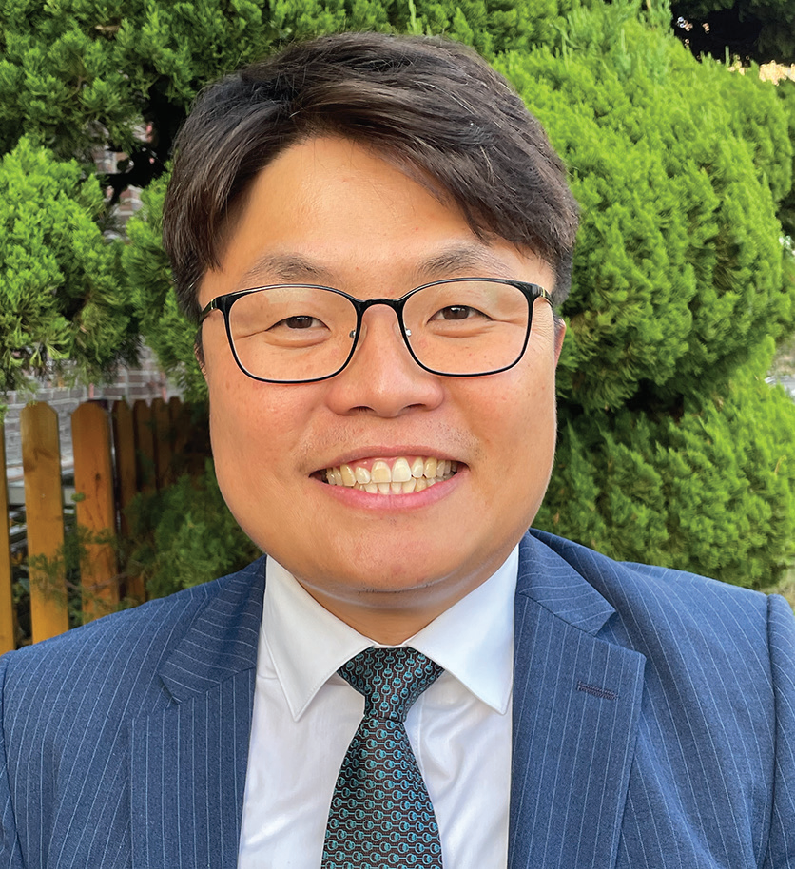
SOUTH KOREA
March 8
“I Can’t Live Like This!”
Jin-seok

Slide 2
Jin-seok [GIN-see-ok] was 2 when his father died. He has no memories of his father.
Dad was a Seventh-day Adventist pastor in South Korea, and Mom singlehandedly raised Jin-seok and his brother. Her faith was Jinseok’s faith — until he grew into a teenager.
Then Jin-seok began to think for himself, and he refused to believe in God.
He thought, “If God exists, why did He allow Dad to die?”
The boy told God, “If You exist, You can kill me, too. I can’t live like this!”
When he was 15, Jin-seok decided that he had had enough.
During family worship, he abruptly stood up and ripped his Bible in two.
“Mom, don’t tell me to believe in God,” he said.
With that, he dropped out of school and moved out of the house.
For the next 10 years, Jin-seok smoked, drank, and mingled with worldly friends. He didn’t have a Bible, and he hated Christians, especially Adventists.

Slide 3
One day, he inadvertently ended up on the campus of an Adventist university in South Korea’s capital, Seoul. He was accompanying a friend who had business at Sahmyook University.
As he waited for his friend, he wanted to smoke, but smoking was prohibited at the university. So, he looked for a place where he could smoke without getting caught.
Finding a remote park-like area with trees and bushes, he sat down on a bench and lit up a cigarette.
As he smoked, he looked around and saw a Bible verse engraved on a stone. He suddenly realized that he was in the university’s prayer garden.
A flood of emotions filled his heart. He had no memories of his father, but he remembered that Dad had studied at that same university to become a pastor. Dad had probably prayed in the same prayer garden.
Then Jin-seok’s thoughts turned to his mother. He remembered hearing that Mom was very ill. Several people had told him that she would die soon.
Grief filled his heart. Dad had died when he was 2, and now Mom was dying when he was 25.
“I can’t live like this!” he exclaimed.
Now Jin-seok began to feel sorry for his mother. He thought, “Mom lost her husband. She has two sons, but she lost

Slide 4
me, too. I’m breaking her heart, and now she’s going to die.”
Tears poured down his cheeks.
In the university prayer garden, with a lit cigarette between his fingers, he spoke to God for the first time in years.
“God, if you exist, please help me,” he said. “Please help Mom. If You do, I’ll surrender my heart to you. I’ll give my life to you.”
Not long after that prayer, Mom recovered, and Jin-seok kept his promise. He became a pastor just like his father. He graduated from Sahmyook University just like his father.
Mom was thrilled!
But the story didn’t end there. Jin-seok got married, had a daughter, and is now helping raise four boys from single-mother homes. Remembering how he grew up without a dad, he began caring for the four boys with the support of the members of the church that he pastors in rural South Korea.
The boys, who are now teens, are living very different lives than Jin-seok did at their age because they see Jin-seok’s love and know that they have a Father in heaven who loves them even more. All four boys have given their hearts to Jesus in baptism.

Slide 5
Jin-seok hopes to send them to an Adventist high school in Seoul one day. He hopes that they will become missionaries.
Gone are the days when Jin-seok exclaimed, “I can’t live like this!” He has found that life with God is worth living, and he looks forward to meeting his father at Jesus’ soon coming.
Part of this quarter’s Thirteenth Sabbath Offering will go to Hankook Sahmyook Academy, where Jin-seok hopes to send his adopted sons to study, in Seoul, South Korea. Your offering will support the opening of a missionary training center and gym at the school. Thank you for planning a generous offering on March 29.

Slide 6
