Slide 1
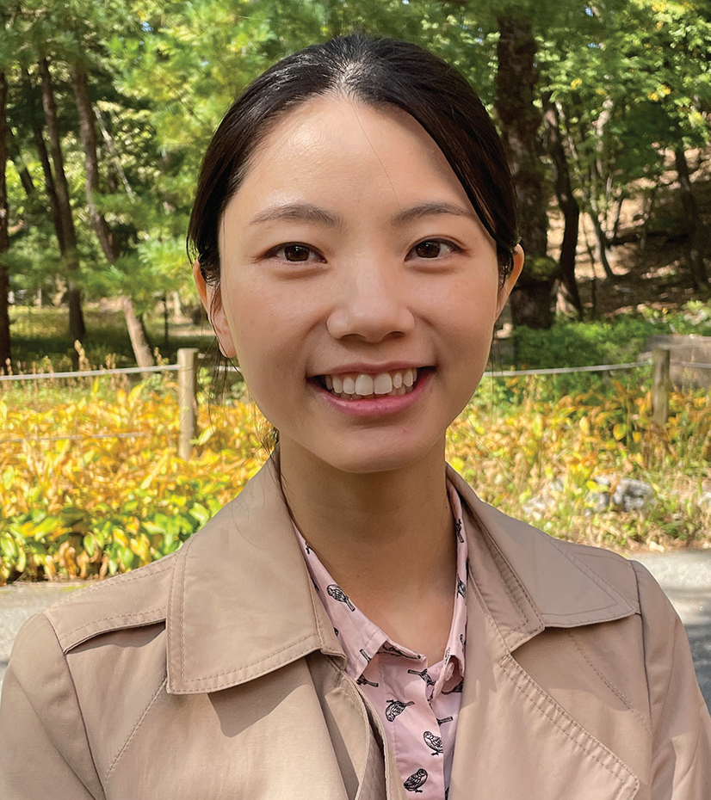
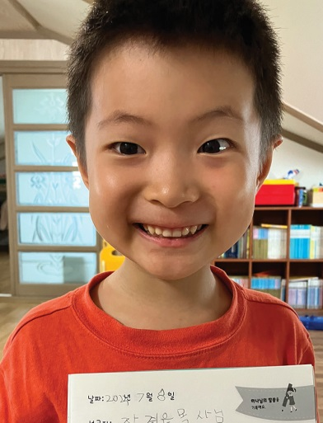
SOUTH KOREA
March 15
Storing God’s Word
Olivia & David

Slide 2
This quarter, the Northern Asia-Pacific Division is placing an emphasis on training children to be missionaries through a Thirteenth Sabbath project that envisages the opening of a missionary training center at Hankook Sahmyook Academy in South Korea. But a South Korean mother says the training of children to be missionaries begins at home. She started with her son when he was just beginning to talk. This is the story of how Olivia plants the Word of God in her children’s hearts.
When David was 18 months old, his mother began to read four small books to him. Each book had a Bible passage with simple pictures. The first book had Psalm 1; the second, Matthew 5:3–12, the third, John 14:1–4, and the fourth, 1 Corinthians 13.
Mom read the books when David got up in the morning, She read when he went to bed at night. She also read during the day.
In only a month, little David, who was just learning to talk, had memorized all four books. Today, David is 7, and he has memorized between 350–400 Bible verses.
How was it possible?
David’s mother, whose name is Olivia Kim, was inspired by her own mother-in-law, who taught four adopted children to read and write by memorizing Bible verses. Olivia was deeply touched when she saw firsthand how the Bible transformed little hearts. When she became a mother, she wanted to do the same for her son. So, she began to read the four small books, which her mother-in-law made.

Slide 3
As she read, David’s eyes followed the pictures and his ears followed her voice. He didn’t say anything. He couldn’t read. But after a month, he had memorized the books. When Mom showed a picture, he recognized it and repeated the words on the page. Mom was amazed because this was about the same time that he was beginning to talk and make meaningful words and sentences.
Then Mom made books with Psalm 121, Leviticus 6:4–9, the three angels’ messages in Revelation 14, the Ten Commandments in Exodus 20, and the blessings and curses of Deuteronomy 28. She read to David for 20–30 minutes in the morning and for 20–30 minutes at night. She also read during the day. He memorized those books as well.
David and Mom rely on Bible verses in every-day life. David goes to a kindergarten where the teacher sometimes shows cartoons during breaktime. Popular Korean cartoons feature ghosts that look cute and harmless, but the storylines can be serious. After watching one of those cartoons, David got scared one night and ran to Mom’s bedroom.
“Mommy, I’m scared,” he said.
“Why are you scared?” Mom asked.
“I remember a cartoon that I watched today,” he said.
“Don’t be scared because God is with you,” Mom said. “This house is under God’s protection. Angels are watching over us. Let’s recite Psalm 121 together.”

Slide 4
Mom and son recited Psalm 121, which begins with the words, “I will lift up my eyes to the hills — from whence comes my help? My help comes from the Lord, who made heaven and earth” (NKJV).
Another time, David was being mischievous. He was 4 and overly excited after evening worship. He didn’t want to wash his face, brush his teeth, or pick up his toys. Mom was busy with housework, washing dishes, doing laundry, and caring for a 6-month-old baby daughter. It was an hour past his usual 7 p.m. bedtime. Mom grew frustrated as David kept playing and running around the house. Finally, she lost her patience and exclaimed, “Why are you acting like this? Do as I say! Do your chores!”
The boy froze. Mom hardly ever talked like that. He looked up at Mom, and Mom looked down at him. Mom felt sorry that she had raised her voice. As the two stood still, 1 Corinthians 13 sprang to Mom’s mind, and she began to recite it, silently, “Though I speak with the tongues of men and of angels, but have not love, I have become sounding brass or a clanging cymbal.” Then she looked at David and saw in his eyes that he also was reciting 1 Corinthians 13 in his mind. She smiled. David smiled. The two hugged each other. “I’m sorry that I raised my voice,” Mom said. David smiled and clung to her more tightly. Then he changed into his pajamas, brushed his teeth, and went to bed.
Today, David loves memorizing the Bible. His sister, Abigail, is 3 and is memorizing the first four books that he memorized. Mother has memorized everything that they memorize. She has found that the memorization process happens automatically for her while she is teaching her children.
“I earnestly hope that the verses we are memorizing today will be boldly proclaimed from my children’s lips one day as they become missionaries for the kingdom of God,” she said.

Slide 5
Pray for Olivia and every parent seeking to plant the Word of God in children’s hearts. Pray that these homes produce a bountiful crop of missionaries. Pray also for the missionary training center that will open with the help of this quarter’s Thirteenth Sabbath Offering at Hankook Sahmyook Academy in South Korea. Thank you for planning a generous offering on June 29.

Slide 6
