Slide 1
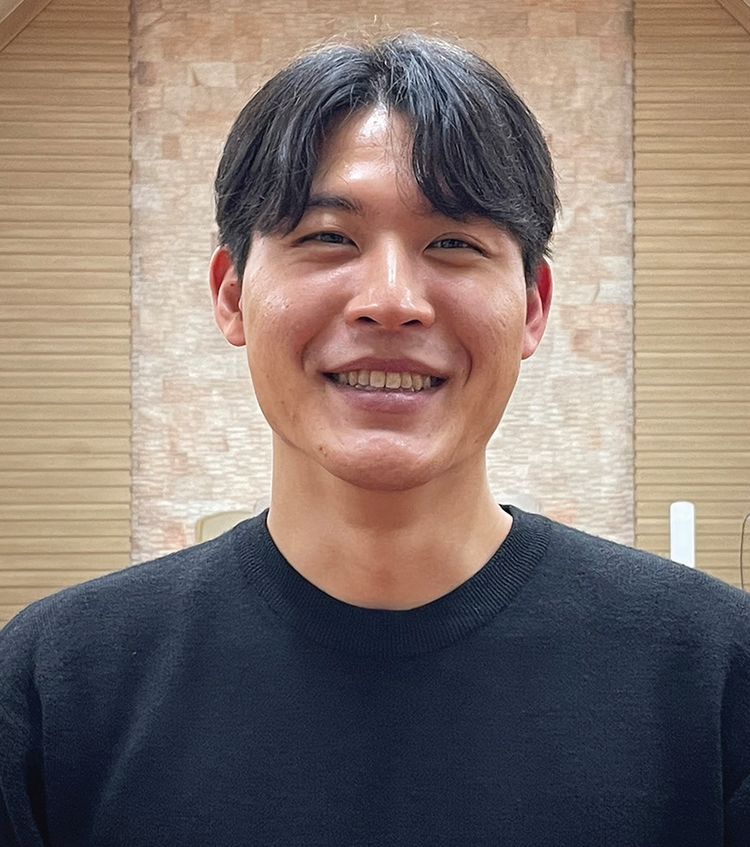
SOUTH KOREA
March 22
The Annoyed Missionary
Philip

Slide 2
One of this quarter’s Thirteenth Sabbath projects aims to train young people to be missionaries in South Korea. The project envisages the opening of a missionary training center at Hankook Sahmyook Academy in Seoul. Missionary training programs are a staple of Adventist life in South Korea. This week’s story is about Philip, who joined one such program called Compass Missionary Training Program, which included three months as a missionary in the U.S. city of Atlanta.
Philip stepped off the airplane in Atlanta, ready to work in urban mission for three months. The 23-year-old South Korean missionary had a busy schedule ahead of him. During the week, he was to work with refugees, including mentoring refugee children with their schoolwork. On Sabbaths, he was to teach children’s Sabbath School and do other activities.
But he quickly ran into a problem: his roommate.
Philip arrived with a group of other South Koreans to serve as short-term missionaries. They were divided into pairs, and Philip was teamed up with Samuel, who was 20. Philip and Samuel moved into a rented house.
It didn’t take long for Philip to grow annoyed with his roommate. Samuel thought for a very long time, every time, before he spoke. Then, when he spoke, he spoke very slowly. Philip thought crossly, “Why can’t you think and talk more quickly?”
His discontent grew. The two young men ate simple meals, usually salad and other food left over from the Sabbath fellowship meal at a local Korean church. One day, Samuel decided to reheat a leftover Korean rice cake in the oven.

Slide 3
But the rice cake burned and stuck to the baking dish. Philip was annoyed because he had cautioned Samuel to be careful about heating up the rice cake. Then Samuel tried to reheat another rice cake, this time in a frying pan on the stovetop. But the rice cake burned and stuck to the pan. Philip’s irritation grew but he didn’t say anything.
Samuel also didn’t say anything until about a month into their stay in the United States. One day, he suggested praying together before going out to work with the refugees. The two had never prayed together.
Samuel’s prayer shocked Philip. Speaking very slowly as he always did, he prayed, “Please, Lord, help me not to hate Philip.”
Philip understood that Samuel was praying for them to get along. But he gained no joy from the prayer. He was annoyed. His irritation grew when Samuel repeated the same prayer the next day and then the next. “Please, Lord,” Samuel prayed, “help me not to hate Philip.”
Philip and Samuel spoke less and less to each other. Finally, they stopped talking all together.
The conflict came to a head a month before their time ended in the United States. Philip was driving a car, and Samuel was seated beside him. Both were exhausted, and both fell asleep. Abruptly, they woke up and saw that they were about to smash into the vehicle in front of them. Philip swerved to the left, and they crossed into the oncoming lane. They collided head-on with a big truck.

Slide 4
The car was wrecked, but Philip and Samuel escaped uninjured. The truck driver also wasn’t hurt, and the truck suffered only a small dent on the front bumper.
At home, Philip and Samuel embraced and fell on their knees to thank God for life.
Philip felt ashamed. He had come to the United States to share God with others but had instead been focusing on himself. This was the root of his conflict with Samuel. But now the conflict seemed so small and unimportant. Philip thought, “We should have been hugging and praying together this whole time so God could have blessed us as missionaries.”
Samuel suggested that they tell the Korean owners of their rented house, a married, non-Christian couple, about the crash.
A short time later, Philip and Samuel were telling the couple about their two-month personal conflict and the crash. They shared everything from the beginning to the end. It wasn’t a biblical discourse on salvation. It was their story of how God had been with them in the United States. For Philip, it was the first time that he had ever shared what God meant to him. He feared that the couple might react negatively. But they only expressed worry for his and Samuel’s health.
The mission trip to the United States marked a turning point for Philip. When he returned to South Korea, he was asked to write a testimony about his experience.
He wrote a list of his accomplishments, including resolving the conflict with Samuel. But when he read over the list,

Slide 5
he felt ashamed to see it filled with “I did this” and “I did that.” Not once was Jesus mentioned.
He wrote a second draft that he didn’t like any better. He realized that he hadn’t accomplished anything. His testimony was that God had used him to accomplish something. He whittled down his testimony in one sentence: “God used me, a weak and proud person, but He used me.”
Pray for the Korean young people who are serving as missionaries around the world. Pray for Hankook Sahmyook Academy, whose students will study at a missionary training center that opens with the help of your Thirteenth Sabbath Offering on June 29. Thank you for planning a generous offering for this project in Seoul, South Korea.

Slide 6
