Slide 1

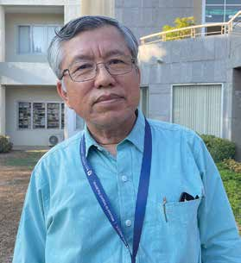
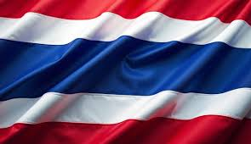
THAILAND
April 12
The Only
Living God
Surachet

Slide 2
Editor’s note: Today’s mission story is about a man in Thailand whose life was touched by two Thirteenth Sabbath Offerings that were collected 27 years apart.
Surachet [SOO-RA-chet] arrived at a Seventh-day Adventist high school in Thailand with a promise. He told himself, “I’ll stay in the dorm, but I’ll never change my religion.”
Surachet had been raised in a non-Christian world religion. The majority of Thailand’s population belonged to the same religion. He chose the school because it had a dormitory for students who were far from home. He lived more than 600 miles (1,000 kilometers) away in northern Thailand.
At the Adventist school, Surachet was fascinated by world civilization class. In Bible class, he was astonished to hear a prophecy about the rise and fall of major world civilizations in the book of Daniel. He wondered, “How do I harmonize the information about world civilizations that I’m hearing in these two classes?”
Around the same time, he noticed headlines in newspapers about the 1967 Six-Day War, which had recently ended with Israel defeating neighboring Arab countries. He wondered how Israel, a small country established in 1948, could defeat larger and much older neighbors. He wondered about the origin of the Jewish people.
“Is this the same Israel as in the Bible that we are studying in Bible class?” he thought.
He searched for more information and found a book about the Jewish people written by a Thai philosopher. The author, who like Surachet wasn’t a Christian, recorded Israel’s history over several thousand years.

Slide 3
Surachet thought about his own family’s religion and wondered, “Is the God of Israel the true God?”
Reading the Bible, he learned that the God of Israel had pleaded with His people thousands of years ago not to bow down to images of stone and wood. Surachet’s religion bowed down to images of stone and wood.
He learned that the Bible taught that the God of Israel was the only living God not formed by human hands. Jeremiah 10:10 says, “But the Lord is the true God; He is the living God and the everlasting King” (NKJV).
Surachet signed up for Bible lessons from the Voice of Prophecy. At the time, the Voice of Prophecy had a flourishing presence in Thailand after receiving a building in Thailand’s capital, Bangkok, with the help of a Thirteenth Sabbath Offering several years earlier in 1961. Surachet finished the Bible studies in just a week and decided to give his heart to the true and living God.
His father was furious when Surachet asked for permission to be baptized. “If you want to be a Christian, go to the Christians,” he said. “You don’t have to come back home.”
Surachet said he would come back if his life didn’t improve under the living God. Surachet has no regrets. He went on to earn bachelor’s and master’s degrees in theology and a doctorate in missiology. He has worked as a pastor, communication director for the Adventist Church in Thailand, and regional director for Adventist World Radio. His desire is to teach others about the living God. Today, he is teaching at Asia-Pacific International University, whose campus in Thailand was built with the help of a Thirteenth Sabbath Offering in 1988.

Slide 4
He tells his students that Christianity entered Thailand more than 200 years ago and the Adventist Church arrived when a literature evangelist began to sell books in 1906. But despite a more than 100-year presence, the church’s membership is no more than 16,000 people, or only 0.02 percent of Thailand’s population of 71 million. “This is one of the most difficult countries in the world,” Surachet said. “In some places, Satan is doing his work through resistance and opposition. But here, Christianity is welcome but cultural belief in satanic agencies is strong. We are not fighting against flesh and blood. We are fighting with evil spirits. We are fighting with Satan himself. We need more workers in Thailand.”
Thank you for your faithful Thirteenth Sabbath Offerings that have had a major impact on the lives of people like Surachet Insom. Asia-Pacific International University, where Surachet teaches, has provided a Christian education to thousands of students since a 1988 Thirteenth Sabbath Offering helped build its campus. Every year, students from non-Christian homes are baptized at the university. The Voice of Prophecy building, which opened in Bangkok with the help of a 1961 Thirteenth Sabbath Offering, has since been demolished. But other church buildings have taken its place, and its influence continues to reverberate through the lives of Surachet and others. Thank you for planning a generous Thirteenth Sabbath Offering on June 28 that, with God’s help, will also have a long-lasting impact.
By Andrew McChesney

Slide 5

