Slide 1
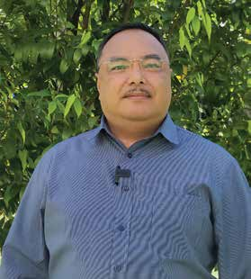
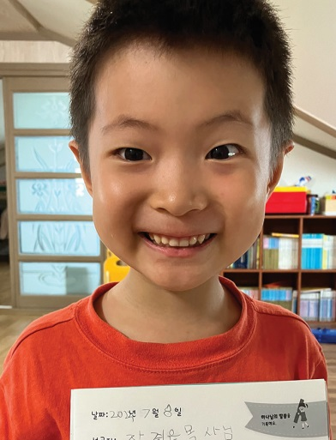
INDONESIA
June 14
Praying for
Churchless Town
Jerry

Slide 2
As a boy, Jerry traveled with his father from town to town to visit church members on the Indonesian island of Papua. His father, a Seventh-day Adventist pastor, would stop from time to time outside a town that didn’t have an Adventist church.
“Dear God,” Father prayed. “Please bless this town by giving it an Adventist church one day.”
Jerry saw God answer those prayers. In one town, a church was established five years after his father prayed. In another town, a church opened 20 years later.
Jerry followed in his father’s footsteps and became a pastor in Papua. As he visited church members around Sentani Lake on one occasion, he was inspired to see a number of churches that had been planted in towns that his father had prayed for years earlier.
But then he saw a town on Sentani Lake without any Adventist church and without any Adventists. His small boat passed the town of Yoboi as he sailed to another town with church members.
Jerry remembered his father’s habit of praying for towns without churches, and he asked the boatman to slow down. He wanted to pray for Yoboi.
Bowing his head, he said, “Dear God, Please bless this town by giving it an Adventist church one day.”
What happened next, he only learned about later.

Slide 3
A prominent resident of the town happened to travel to Israel for a Holy Land tour two months after Jerry’s prayer. The man, whose name was Thonce, looked out the window of his Jerusalem hotel as the sun set and noticed unusual activity on the street. A siren blasted, and buses sped to their stations. Then everything fell quiet.
Thonce looked at his watch and saw that it was Friday evening. He realized that the Jewish people were stopping their work for the Sabbath.
Then he remembered that he worked with several Adventists in Papua who also stopped their work from sunset Friday to sunset Saturday to keep the Sabbath. He wondered, “The Adventist Church worships on the same day as the people of Israel. Why doesn’t my church, too? My church claims to worship the God of Israel.” He resolved to find answers when he returned home.
Back in Papua, he went to an Adventist church in a neighboring town and learned that it was holding evangelistic meetings. The church’s pastor, Jerry, invited Thonce to attend.
At the meetings, Thonce found biblical answers to all question about the Sabbath. He decided to keep the Sabbath, and he and his wife became Seventh-day Adventists.
Not long after their baptisms, Jerry visited their home in Yoboi and helped organize a house church. It was an answer to his prayer and the continuation of his father’s legacy.
“I’m very grateful for the heritage that my dad has left me,” said Jerry Jacobs, who is now pastor of the Adventist

Slide 4
church at Klabat University. “Let’s continue to pray that a church building will open in this town one day.”
Pray for the town of Yoboi in Papua, Indonesia. Pray that the gospel will reach more places on the island and more churches will be built there. Part of this quarter’s Thirteenth Sabbath Offering will help spread the gospel in Papua through the construction of classrooms, an administrative building, a library, and an auditorium at Papua Adventist Theology College. The college moved to its current location in Nabire after its old campus in another part of Papua was destroyed by a flood in 2019. Currently, students meet in classrooms that are on loan from an Adventist academy. Thank you for planning a generous Thirteenth Sabbath Offering to support the training of pastors and Bible workers at the college.
By Andrew McChesney

Slide 5
