Slide 1
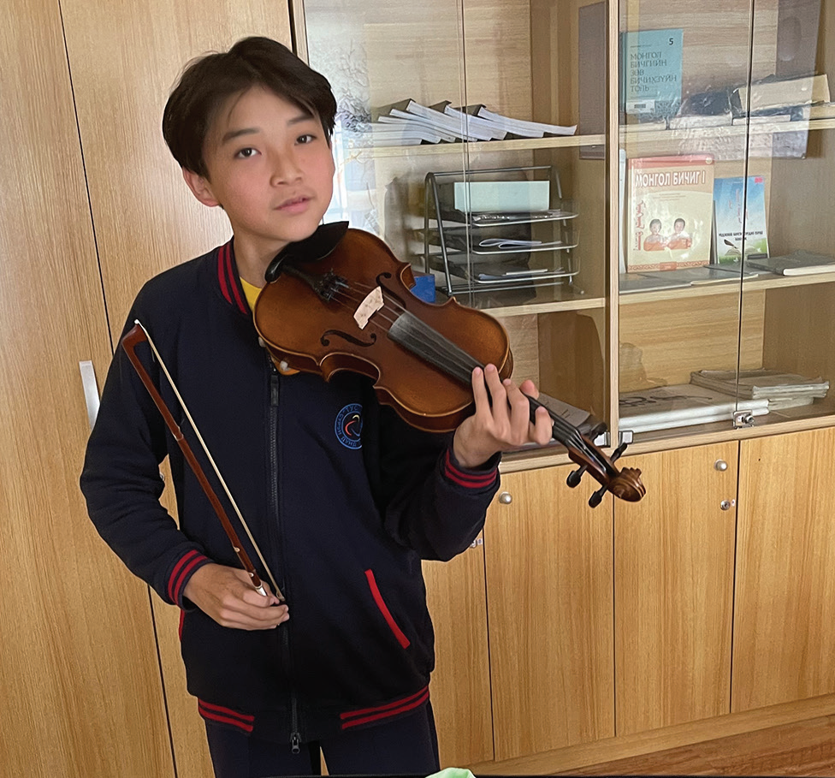
Week 1
MONGOLIA
January 4
Happy
Butterflies
Tamir

Slide 2
Five-year-old Tamir [ta-MIR] was bored. He was waiting for Mom to finish her work at the Seventh-day Adventist school in Mongolia. Mom worked as an accountant, which meant she counted money for the school. Tamir went to the school’s preschool. Now his classes were over, and he was sitting on a chair, waiting to go home.
“Mommy, can I have your phone?” he asked.
Mom handed the phone to the boy. His eyes stopped on an app with a picture of a man with wavy white hair and a red jacket.
“Mommy,” he said, “who is that?”
“That’s Mozart,” Mom said.
“Wow,” Tamir said. “He’s so handsome.”
Mom smiled. She opened the app and pressed “play” on a song written by the famous Austrian composer Wolfgang Amadeus Mozart. Tamir’s eyes opened wide with amazement as violin and piano music filled the room. It was beautiful! Happy butterflies filled his tummy.
Tamir couldn’t stop thinking about the music. Two days later, he told Mom and Dad that he wanted to learn to play the violin and the piano. Dad shook his head. “We don’t have money for music lessons,” he said.

Slide 3
Tears came to Tamir’s eyes. He wanted to play the violin and piano, and he didn’t give up. He asked again the next year when he was 6 years old. He asked when he was 7 and then 8. He asked when he was 9 and then 10. He asked when he was 11 and then 12. Every time, Mom and Dad shook their heads. But Tamir didn’t give up. He asked again when he was 13.
This time, Mom and Dad didn’t shake their heads.
“I’ll take you to violin lessons tomorrow,” Mom said. She had a friend who would teach the violin to Tamir.
Tamir was so happy! His smile stretched from ear to ear. Happy butterflies filled his tummy. He excitedly told his friends.
They were surprised. “Are you really going to play the violin?” one boy asked.
“Yes!” he replied. “I’m going to learn the violin tomorrow!”
“Wow!” said another boy. “You’re going to be famous one day!”
Learning the violin wasn’t easy. It was difficult to learn the notes. Sometimes Tamir wanted to play with friends, but he had to practice. He didn’t mind. He wanted to fill his tummy with happy butterflies.
A year passed, and Tamir kept practicing. Then he was asked to play for special music at church. Mom was so happy!

Slide 4
On Sabbath morning, she excitedly told everyone, “My son is playing the violin up front today.”
But Tamir wasn’t so happy. His hands began sweating. His neck began sweating. His face began sweating. He was scared about playing in front of a crowd. He thought, “No, no, no! I don’t want to play the violin anymore. I want to go home.”
Dad saw that the boy was nervous. “Don’t worry,” he said. “Jesus will help you.”
Tamir knew that Dad was right. He wondered why he hadn’t thought about that first. He silently prayed, “God, please help me not to be scared of the people when I play the violin. Please bless me.”
Then he played in front of all those people. He wasn’t scared. His face wasn’t sweating. His neck wasn’t sweating. His hands weren’t sweating. Happy butterflies filled his tummy. He felt good! When he finished, everyone was so happy.
“Wow, you are a good player,” someone said.
“One day, you’ll be famous,” someone else said.
Tamir knew that God had helped him.
To play well, Tamir needs to practice every day, and he needs to pray every day. Tamir wants to represent Mongolia and God before the world. He wants happy butterflies in fill his tummy all the time.

Slide 5
Pray that Tamir will be a good representative of God as he learns the violin and studies at Tusgal School in Ulaanbaatar, Mongolia. His school received part of a previous Thirteenth Sabbath Offering to grow with new classrooms and a library. This quarter’s Thirteenth Sabbath Offering will help open a children’s recreation center in Ulaanbaatar, where children will be able learn about the God who answers prayers.
By Andrew McChesney

Slide 6
