Slide 1
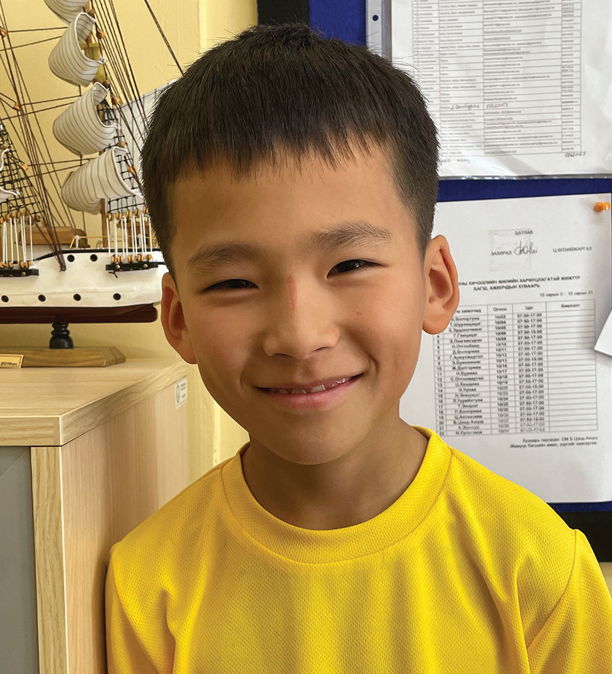
Week 2
MONGOLIA
January 11
Prayer of
Faith
Itgel

Slide 2
Itgel [IT-gil] is a 10-year-old boy in Mongolia. His name, Itgel, means “faith” in the Mongolian language. Itgel has a lot of faith.
When the school year began, Itgel was excited to return to the Seventh-day Adventist school where he studied in Ulaanbaatar, the capital city of Mongolia. He was ready to start fourth grade.
But his joy lasted only for a week.
At the end of the first week of school, all of the boys and girls got together for a special sports day. Itgel enjoyed being outdoors. It was fun to be out in the open air. He ran and ran and ran as fast as he could.
That night, however, Itgel didn’t feel well. His legs hurt terribly. He could barely move. Mom was worried, and she put a hand on his forehead. He was burning up with fever. Mom and Dad took the boy to the hospital.
When the doctor saw Itgel’s high fever and heard about the pain in his legs, he also was worried. He pulled out a syringe and gave Itgel a shot. Itgel had to stay at the hospital.
That night, Itgel tried to fall asleep, but it was hard to sleep when he felt so hot and his legs hurt so much.
He prayed in his heart, “God, please heal me quickly.”
In the morning, the doctor gave Itgel another shot. At noon, he gave him a third shot.

Slide 3
Itgel began to feel a little bit better. But he still couldn’t walk. His legs hurt and felt so weak. The doctor told him not to try to stand up. A nurse helped him sit in a wheelchair so he could go around the hospital.
Itgel was happy for the wheelchair, but he wanted to walk. He wanted to go back to school. He already missed his friends. He prayed in his heart, “God please heal me quickly. I want to start walking on my own. I want to go back to school to see my friends.”
He didn’t know when he would be able to go home, but he believed that God would heal him. He decided to keep praying. When he woke up the next day, he immediately prayed, “God please heal me quickly. I want to start walking on my own. I want to go back to school to see my friends.”
When the doctor came to help him, he prayed, “God please heal me quickly. I want to start walking on my own. I want to go back to school to see my friends.”
When he went to bed at night, he prayed, “God please heal me quickly. I want to start walking on my own. I want to go back to school to see my friends.”
For two weeks, Itgel prayed.
One day, the doctor said, “Let’s see how you’re doing.”
He looked at the boy, gave him a shot, and said, “You’re well! You can go home.”

Slide 4
Itgel was so happy! A big smile filled his face. God had answered his prayers.
When Itgel returned to school, his friends had many questions. They had missed him.
“What happened?” one boy asked.
“I was really sick,” Itgel said.
“How did you get well?” asked another boy.
“God healed me,” Itgel said. “I was really sick, but now I’m well because I prayed.”
Some of Itgel’s friends didn’t come from Christian homes and didn’t believe in God.
“What?” said one boy. “It’s just pure luck that you got well.”
“No way,” said another. “You aren’t telling the truth.”
Itgel wasn’t surprised. He wasn’t upset. He knew that his friends didn’t understand because they didn’t know God. But he knew God, and he knew that God had healed him.
“You can say whatever you like, but it’s true,” he said. “God healed me.”

Slide 5
Itgel wants his friends to know God. Ever since his sickness, he hasn’t stopped telling them about Him.
Itgel’s name means “faith,” and he intends to always have faith in God. “Even though some of my friends don’t believe in God, I still believe in Him,” he said. “I saw that He healed me.”
Pray for Itgel and his friends at Tusgal School in Ulaanbaatar, Mongolia. A previous Thirteenth Sabbath Offering went to help his school grow with new classrooms and a library. This quarter’s Thirteenth Sabbath Offering will help open a children’s recreation center in Ulaanbaatar, where children will be able learn about the God who answers prayers.
By Andrew McChesney

Slide 6
