Slide 1
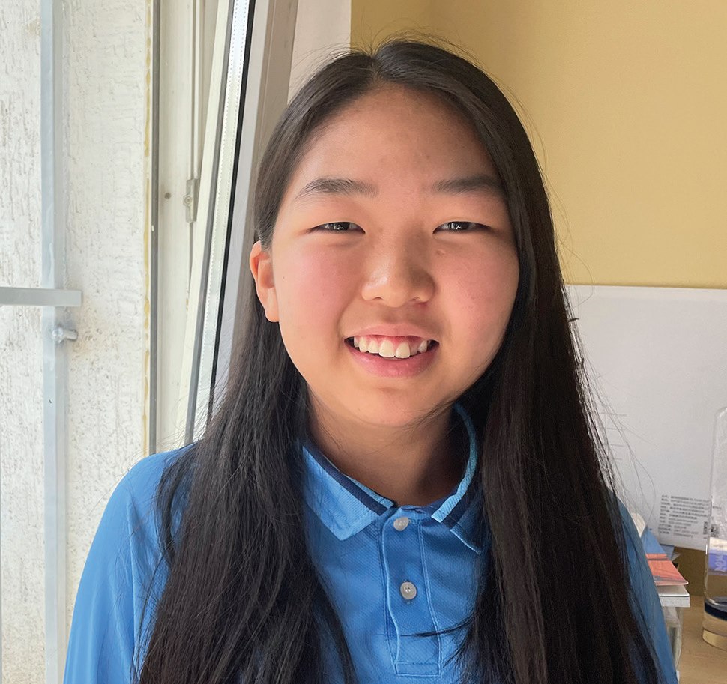
Week 3
MONGOLIA
January 18
The Biggest
Decision
Michelle

Slide 2
Thirteen-year-old Michelle was talking with her best friend, Enkhjin, [INKH-zhin] at a Pathfinder club meeting, and Enkhjin told her that she planned to get baptized on Sabbath.
“Don’t you want to get baptized together?” she asked.
Michelle thought to herself, “Should I get baptized, or should I wait? Maybe I’ll ask Mom when I get home.”
Out loud, she said, “I don’t know.”
Enkhjin looked disappointed. The two girls had learned about Jesus in Pathfinders together. They had studied the Bible together. Now Enkhjin wanted to give her heart to Jesus in baptism, and she wanted Michelle to join her. She looked sad, but out loud she said only, “OK, OK.”
Michelle decided to talk with Mom.
When she returned home, she first went to her bedroom to change out of her Pathfinder uniform. In her bedroom was her older cousin, whose name was also Enkhjin.
“I’m going to get baptized on Sabbath,” Enkhjin said. “Why don’t we get baptized together?”
Michelle was so surprised! In one day, two girls named Enkhjin had told her that they planned to be baptized. In one day, two girls named Enkhjin had asked her to be baptized.

Slide 3
Now she really wanted to talk to Mom.
“I need to talk with Mom,” she said.
Enkhjin looked disappointed. They had studied the Bible together. That summer, they had gone to evangelistic meetings every night at their church together. Now she wanted to give her heart to Jesus in baptism, and she wanted Michelle to join her.
Michelle found Mom. She didn’t tell her about the conversations with Enkhjin or Enkhjin. She just asked, “Should I get baptized next Sabbath?”
Mom looked thoughtful. Dad was away from home for work, and she knew that he wouldn’t want to miss his daughter’s baptism. “Dad is away, so he wouldn’t be able to see it,” she said. “Why don’t you get baptized at the big Pathfinder camporee in South Korea instead?”
In a few weeks, Michelle planned to go to South Korea for a camporee of Pathfinders from all over Mongolia and other countries.
But Mom’s idea didn’t make sense to Michelle. Neither Dad nor Mom planned to go to the camporee. If she waited, neither of them would see her baptism. At that moment, she knew what decision she had to make. If she didn’t give her heart to Jesus next Sabbath, there would always be an excuse for waiting until later. She loved Jesus with all her heart, and she wanted to give it to Him. She told Mom, “I’d better get baptized here and now.”

Slide 4
Mom smiled. “Well, go ahead and get baptized then,” she said.
Michelle’s cousin Enkhjin was so happy when she heard that they would be baptized together. Michelle’s best friend, Enkhjin, was so happy when she heard that they would be baptized together.
On Sabbath, the girls got on a bus and rode to a river with other people who were going to be baptized.
Right before Michelle entered the river, a question popped into her head.
“Am I really ready?” she thought. “Is this really my decision?”
She remembered how her best friend had asked her to get baptized. She wondered, “Am I getting baptized because Enkhjin asked me?” She remembered how her cousin had asked her to get baptized. She wondered, “Am I getting baptized because the other Enkhjin asked me?” She remembered how Mom had suggested that she wait. Then she remembered how much she loved Jesus and how she wanted to live for Him today and forever. She got baptized with a happy smile.
Afterward, many people congratulated Michelle on her decision.
“You have made the most important decision of your life,” someone said.
Today, Michelle is so happy that she got baptized. She could have waited and kept saying, “Tomorrow, tomorrow,

Slide 5
tomorrow.” But instead, she decided to make the biggest decision of her life on that summer day.
“I always knew that I wanted to give my heart to Jesus, but I didn’t know when the right time was,” she said. “Now I know that the right time was not tomorrow but today.”
Michelle is a student at Tusgal School in Ulaanbaatar, Mongolia. A previous Thirteenth Sabbath Offering went to help her school grow with new classrooms and a library. This quarter’s Thirteenth Sabbath Offering will help open a children’s recreation center in Ulaanbaatar, where more children will be able learn about God.
By Andrew McChesney

Slide 6
