Slide 1
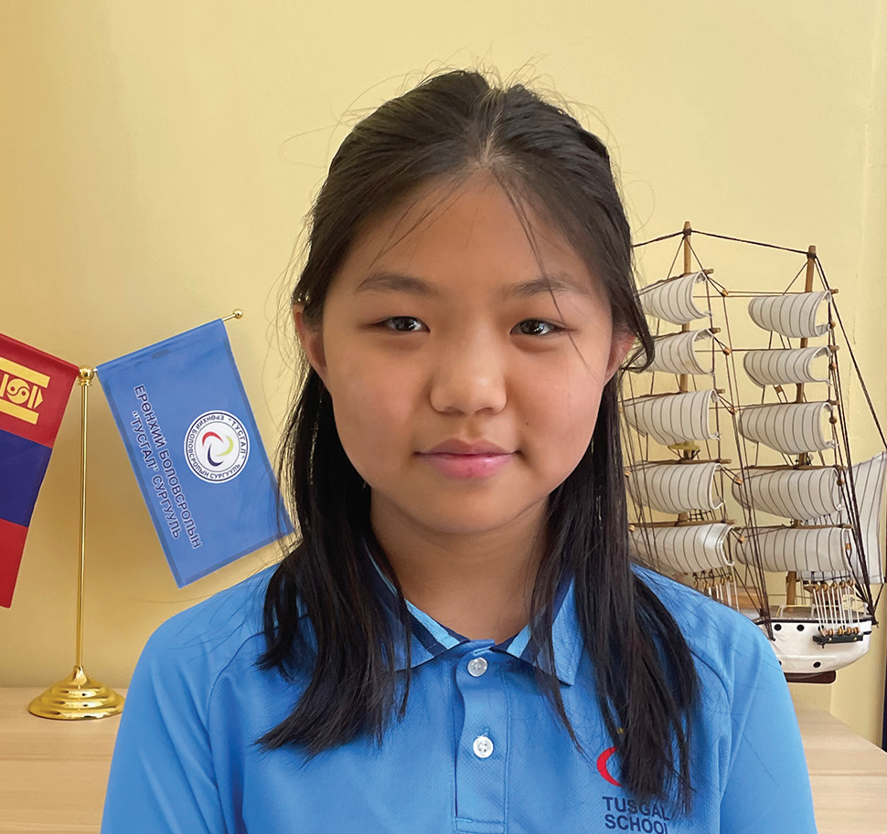
Week 4
ALASKA
January 25
Bullied Missionary Kid
Ninjin

Slide 2
When Ninjin [nin-GIN] was 8, she and her parents moved far away from their home in Mongolia to live as missionaries in a foreign land.
Ninjin was excited to move. She couldn’t wait to make new friends. But the first day at her new school was hard. She didn’t understand a word that anyone said. She just sat at her desk and was quiet. The next day, Ninjin decided to make new friends. She introduced herself to the other children by pointing to herself and saying her name, “Ninjin, Ninjin.” A month passed, and Ninjin was able to talk a little bit with the other children. But it seemed like the other children didn’t really want to talk with her.
One day, the teacher told all the children to take turns reading out loud from a textbook.
When Ninjin began to read, the girl in front of her turned around with an angry face.
“You’re talking too loud,” she said. “Shh!”
The other children tittered.
Ninjin didn’t understand what the girl said. When it was her turn to read again, she read just as loudly as the first time.
The girl again scowled and hissed, “Shh!” The other children giggled. Ninjin didn’t understand and kept on reading.

Slide 3
Then the girl picked up a stick of glue and threw it at Ninjin. The glue hit her on the head, and the children laughed. The angry girl stood up and hit Ninjin.
Ninjin was shocked. She looked over at the teacher, who was sitting at her desk. The teacher was looking at the textbook and didn’t seem to notice anything.
When Ninjin went home, she told Mom what had happened. Mom went to school and spoke with the teacher.
The teacher didn’t believe Ninjin’s story. She said that the girl sitting in front of Ninjin would never act unkindly to anyone.
“She’s a very sweet girl,” she said.
Ninjin realized that the teacher wouldn’t help her, but she was sure God would help her. She decided to pray.
A few days later, Ninjin was changing out of her school clothes after school and found glue all over the back of her skirt. The skirt was ruined. She wondered how the glue had gotten there. When she went to school the next day, she found dried glue smeared on her chair. She realized that someone must have poured glue on her chair and that was how it got onto her skirt.
She told Mom, and Mom spoke with the school principal. A security camera in Ninjin’s classroom had recorded the whole thing. Ninjin watched the video recording. It showed Ninjin leaving the classroom to go to the restroom. It showed several girls rubbing glue all over her chair. Ninjin could see their faces.

Slide 4
At that moment, Ninjin felt very lonely. It was hard being a missionary kid in a country where she didn’t know the language and no one seemed to want to be her friend. She missed Mongolia.
After that, Ninjin didn’t want to go to school anymore. But she had to go. There was no other school. Ninjin prayed.
Two months later, Mom said they were moving back to Mongolia. The family couldn’t get new visas, allowing them to stay. The missionaries had no choice but to leave.
“This must be God’s will,” Dad said.
Today, Ninjin is 12 years old, and she has forgiven the kids who bullied her.
“At first, I couldn’t forgive them,” she said.
But then she remembered what Jesus teaches about forgiveness. He said, “For if you forgive men their trespasses, your heavenly Father will also forgive you. But if you do not forgive men their trespasses, neither will your Father forgive your trespasses” (Matthew 6:14, 15; NKJV). That means Jesus cannot forgive the sins of anyone who refuses to forgive others.
“After talking to God several times, I remembered that He has forgiven me for all my sins,” Ninjin said. “So, I realized that I have to forgive those bullies, too.”

Slide 5
She is glad that she had the bad experience. She is more sensitive to kids who are picked on for being weaker or not knowing the language. She gently confronts unkind children, saying, “That kid you’re picking on has feelings, too. Please be kind.”
“I’m really thankful that God blessed me with this school and this country and the experience that He gave me as a missionary kid,” she said. “I just thank Him that I have Him beside me.”
Ninjin studies at Tusgal School in Ulaanbaatar, Mongolia. A previous Thirteenth Sabbath Offering helped her school grow with new classrooms and a library. Thank you for your Thirteenth Sabbath Offering this quarter that will help open a children’s recreation center in Ulaanbaatar.
By Andrew McChesney

Slide 6
