Slide 1
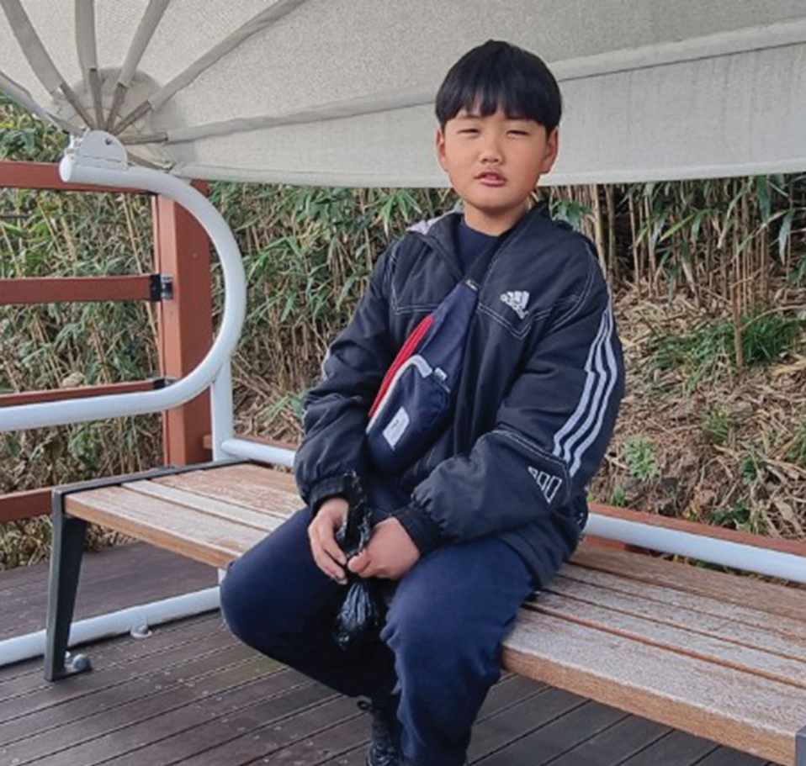
Week 7
SOUTH KOREA
February 15
Who Dressed First?
Tae-Hyung

Slide 2
Eleven-year-old Tae-Hyung likes school, and he likes to get good grades in South Korea. But to get good grades, he has to know the correct answers. To know the correct answers, he carefully does all of his schoolwork.
One day, the teacher asked the children a hard question. “When did human beings start to wear clothes?” she asked.
Tae-Hyung’s hand shot up.
“I know!” he said.
“What is the right answer?” the teacher said. “When did human beings start to wear clothes?”
“When Adam and Eve sinned,” the boy said, confidently. “God gave them clothes made from animal skin.”
The teacher looked surprised. That was not the answer that she was expecting. The school textbook didn’t mention Adam or Eve. It also said didn’t mention sin or God.
The boy saw the startled expression on his teacher’s face. He knew that his answer did not come from the textbook. He had read the textbook. But he also had read the Bible at an afterschool program at the Seventh-day Adventist church. He believed that the Bible was more correct than his textbook. He spoke up again. “The Bible says God gave clothes to Adam and Eve when they sinned,” he said.
The teacher wasn’t sure what to say. For a long moment she looked at the other children. Then she looked at

Slide 3
Tae-Hyung. She refused to accept his answer as correct.
“There are many odd stories in the Bible,” she said. “Could someone else answer the question? When did human beings start to wear clothes?”
Another child raised his hand and provided the answer from the textbook. He said human beings began to wear clothes 170,000 years ago.
After school, Tae-Hyung went as usual to the Adventist church to participate in the afterschool program. He and many of the 45 children in the program did not come from Christian homes, but their parents were happy that they could learn about the Bible.
Tae-Hyung’s favorite part of the program was a Bible club with a teacher named Mr. Cho. In the club, Tae-Hyung had read in the Bible that God created a perfect world and everything in it, including Adam and Eve.
He had read that sin entered the perfect world when Adam and Eve disobeyed God by eating forbidden fruit. He had read that Adam and Eve tried to cover themselves with fig leaves and then God gave them the first clothing. Genesis 3:21 says, “The Lord God made garments of skin for Adam and his wife and clothed them” (NIV).
That day, Tae-Hyung told the Bible club about what had happened at school. All of the other children agreed that he had given the correct answer. They expressed sadness that the schoolteacher had refused to accept his answer, and they said that she should have agreed with him.

Slide 4
The Bible club teacher was very proud of Tae-Hyung. By sharing the Bible in class, the boy had shown his faith that the Bible is the Word of God and that its stories are true. He had given the correct answer in front of his classmates and schoolteacher — and maybe one day they also would believe that the Bible has all the correct answers.
Pray for Tae-Hyung, his classmates, and schoolteacher to know God better. Pray for millions of people in South Korea and the rest of the Northern Asia-Pacific Division to know the correct answer about when human beings started to wear clothes. Part of your Thirteenth Sabbath Offering this quarter will go to 14 after-school programs similar to TaeHyung’s in Japan. Thank you for planning a generous offering on March 29.
By Andrew McChesney

Slide 5
