Slide 1
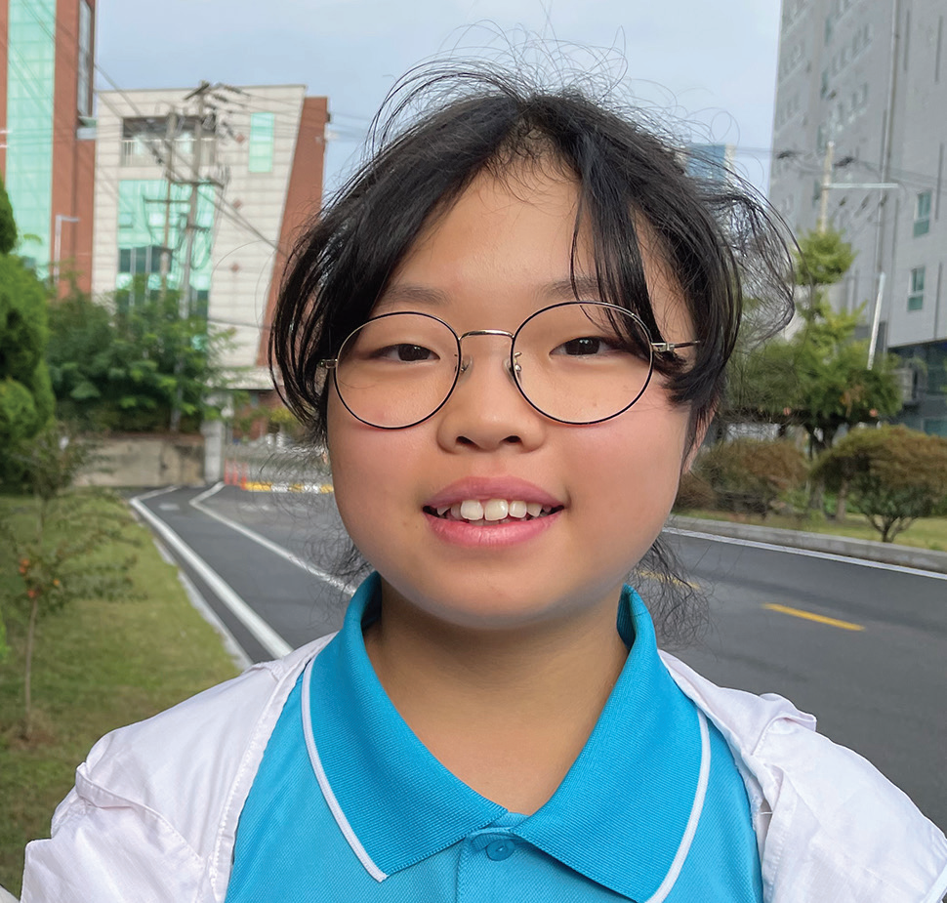
Week 8
SOUTH KOREA
February 22
A Persistent
Girl
Ee-un

Slide 2
Ee-un [EE-oo-yen] was happy when she learned that a fun Bible club would open at her church every day after school in South Korea. She loved Jesus, and she wanted her friends to love Jesus, too. But she felt kind of shy. What if she invited them to the Bible club and they said no? What if they refused to come?
Ee-un prayed for courage and then thought about who she would invite to the Bible club. It was hard to choose one or two children. She wanted everyone in her class to love Jesus. So, she asked all of her classmates.
“Can you join us?” she said. “Can you come at least one time? You can come at least one time, can’t you?”
But Korean schoolchildren are very busy. One girl said she had to help her mother after school. Another said she had too much homework. A third said she had music lessons.
Ee-un prayed, “Please, Lord, bring one of my classmates to the Bible club.” Then she kept inviting her classmates, even those who said they were too busy to come.
“Can you join us?” she said. “Can you come at least one time? You can come at least one time, can’t you?”
Then a girl accepted her invitation! Saleng said she would go with Ee-un to the Bible club.
Ee-un was so happy! God had answered her prayer! When she came home, she excitedly told Mom.
But the next day at school, Saleng had bad news. She couldn’t go after all.

Slide 3
Ee-un felt sad. She had looked forward to going with Saleng. She had thought that God had answered her prayer. But she was not discouraged. She decided to keep on praying and to keep on inviting her classmates.
“Can you join us?” she said. “Can you come at least one time? You can come at least one time, can’t you?”
Then another girl accepted her invitation! Jeong-yeon said she would go with Ee-un to the Bible club. But she said that she could not go every day.
“I can go with you on Fridays and Sundays,” she said.
Ee-un was so happy! But she wondered if Jeong-yeon would change her mind. She prayed for her to come.
On Friday afternoon, Ee-un saw Jeong-yeon walk into the Seventh-day Adventist church to attend the Bible club. She was overjoyed!
Jeong-yeon said her mom had given her a ride to church.
“I really wanted to come,” she said. “I begged my mom, ‘I want to go. Please, let me go.”
That day, Ee-un and Jeong-yeon enjoyed learning about Jesus from the Bible.
On Sunday afternoon, Jeong-yeon came to the Bible club again. Ee-un was so happy to see her. Again, the two girls

Slide 4
enjoyed learning about Jesus from the Bible.
Ee-un saw that it was important to keep inviting her classmates to the Bible club. The Bible says, “Let us not become weary in doing good, for at the proper time we will reap a harvest if we do not give up” (Galatians 6:9, NIV). Ee-un didn’t give up, and finally a girl accepted her invitation and came to the Bible club.
However, Jeong-yeon didn’t come the next Friday. Ee-un wondered what had happened. Jeong-yeon also didn’t come on Sunday afternoon.
At school on Monday, Ee-un found out that Jeong-yeon had moved to another part of South Korea. She lived so far away that she could no longer come to the Bible club.
Ee-un hopes that Jeong-yeon will learn to love Jesus even though she only came to the Bible club two times.
“I hope that she will believe in Jesus,” she said. “I hope to meet her in heaven.” In the meantime, Ee-un will keep inviting her classmates to come to the Bible club.
Pray for Jeong-yeon and all of Ee-un’s classmates to love Jesus. Part of your Thirteenth Sabbath Offering this quarter will go to two projects in South Korea that will help many people to know and love Jesus. Thank you for planning a generous offering on March 29.
By Andrew McChesney

Slide 5
