Slide 1
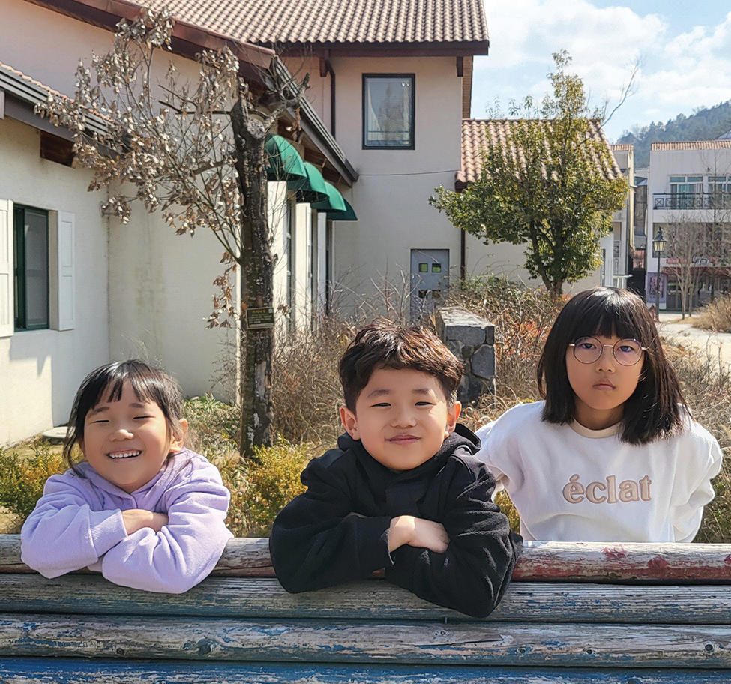
Week 9
SOUTH KOREA
March 1
Getting to
Know God
Sion, Chea-Hwan, & Ye-rim

Slide 2
Two little girls and their brother had never gone to church in South Korea. Their dad didn’t know God. Their mom didn’t know God. So, the children didn’t know God. But their auntie knew God, and she wanted the whole family to go to church.
The children heard Auntie call Dad on the phone. “Come to church with me on Sabbath, and bring Mom and the kids,” Auntie said.
“I don’t believe in God anymore,” Dad replied. “Some Christian kids were mean to me in school.”
The children weren’t sure about what had happened to Dad when he was a boy. But they knew that he had gone to a Seventh-day Adventist school and that something bad had happened to him.
Auntie didn’t give up. She really wanted Dad, Mom, and their three children to go to church.
“I think that the kids who were mean to you didn’t know God,” she said. “That is why they were mean. But if they had known God, they would have been different.
“You also would be different today if you knew God,” Auntie said. “If you had faith and went to church, you could teach your children to be kind to other kids and not be mean like those kids at your school. I want you to come to church with me.”
Dad, however, stood firm. “I don’t want to go to church anymore,” he said. “But if you insist on asking me, you can

Slide 3
take my kids to church.”
The three children looked at each other with excitement. They loved Auntie, and they were eager to go to church with her.
Auntie picked up the children on Sabbath morning. The two girls, 10-year-old Ye-rim [YEH heh-REEM] and 7-year-old Sion, [see-ON] and their 6-year-old brother, Chea-Hwan, [CHEE-ah HWAHN] had never been to church before, and they loved it! They learned happy songs, they listened to interesting stories, and they learned to pray to God.
The three children loved church so much that they told their friends about it. Then their friends also wanted to go to church on Sabbath. Before long, the three children were bringing eight friends to church every Sabbath. Auntie didn’t have enough room in her car for all of them, so she asked Mom if she could help drive children in her car. Mom agreed, and so it was that Mom also started to go to church every Sabbath.
One Sabbath, Auntie learned that the children were praying to God on their own at home. They prayed when they woke up in the morning, saying, “We thank You, God, for giving us this day and for giving us good health.” At night, when they went to bed, they prayed, “Thank You, God, for giving us a great day.” Auntie was so happy! The children who had not known God were now praying to Him every day.
When Mom saw the children praying, she began to think more about God.
Auntie asked her, “Can we study the Bible together?”

Slide 4
“Yes,” Mom said.
So, Mom and Auntie started studying the Bible together. Then Mom began opening the Bible at home and teaching her children about God. She even helped lead out in the children’s activities at church.
Before long, Dad changed his mind about God. While he still didn’t want to go to church on Sabbath, he was happy that Mom and the children were going. Their life had become a lot happier ever since the children and Mom had started to get to know God.
Pray for Dad and the rest of the family as they get to know God better. Part of your Thirteenth Sabbath Offering this quarter will go to two projects in South Korea that will help many people get to know God better. Thank you for planning a generous offering on March 29.
By Andrew McChesney

Slide 5
