Slide 1
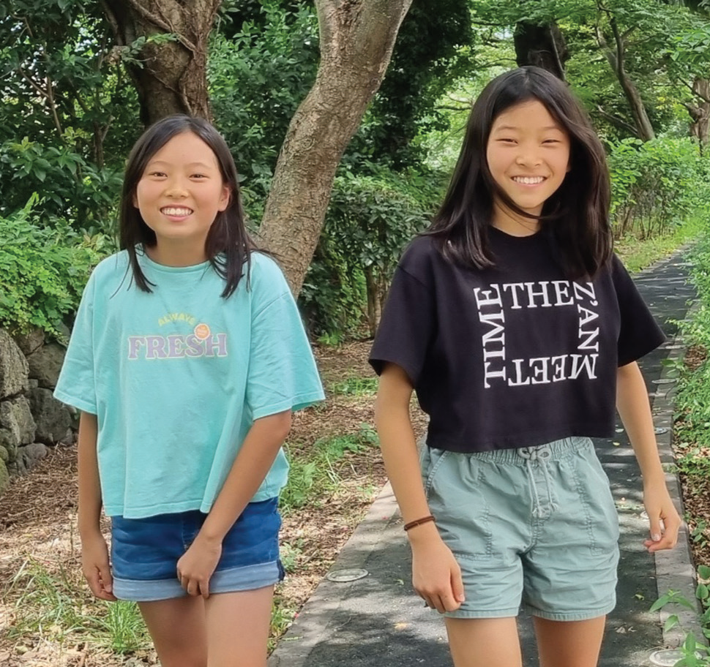
Week 10
SOUTH KOREA
March 8
Bugs, Lizards
And Cats
Haon and Sion

Slide 2
Five-year-old Haon [HA-on] and 4-year-old Sion [see-ON] were two sisters living in South Korea. They loved playing with their 5-year-old neighbor friend, a girl named Jooyoung. [ZOO-young] When the three little girls got together, they had big adventures.
Now some girls might be scared of insects and lizards. But not these girls. They had no fear of any creature, big or small.
One of the girls’ favorite activities was catching flies and bugs and putting them into a jar. All around their apartment building they went, hunting high and low for flies and bugs.
When Haon, Sion, and Jooyoung had caught enough flies and bugs, they looked for a lizard. All around their apartment building they went, hunting high and low for a lizard.
What do you think that the girls did when they captured a lizard? They fed it a delicious meal of flies and bugs, of course! Then they released the lizard to resume its interrupted journey across an apartment building wall.
Haon and Sion would have liked to bring the lizard and the flies and bugs into their apartment. But Mom wouldn’t let them. She said lizards, flies, and bugs belonged outdoors.
Mom also said cats belonged outdoors. Several stray cats with no home lived in the garden outside the apartment building. Haon, Sion, and Jooyoung enjoyed petting them, talking to them, and feeding them.

Slide 3
What do you think that the girls fed the stray cats? No, not lizards or flies or bugs! They fed the cats tuna that Mom gave them from a can, of course.
Mom didn’t allow flies, bugs, lizards, and stray cats in the apartment. But she did make an exception for a baby bird. Once, the girls found a baby sparrow that was shivering with cold after falling out of its mother’s nest. Mom allowed the girls to bring it into the apartment to warm up in a box. Then they returned the baby sparrow to its mother.
Haon, Sion, and Jooyoung were the best of friends. They loved to play, and they loved animals. But they had one big difference. Haon and Sion also loved Jesus, but Jooyoung had never heard of Jesus. Haon and Sion were waiting for Jesus to come and take His children to heaven. Jooyoung had never heard that Jesus would come and take people to heaven. Haon and Sion wanted their friend to know and love Jesus. They began praying every night for her and her family to know Him. The girls couldn’t bear the thought of not playing with their dear friend in heaven.
Then the girls grew older and started to go to school. They didn’t have as much time to play. One Sabbath morning, Jooyoung knocked on her friends’ door.
“Can we play at your place today?” she asked.
“We can’t play here today because we are going to church,” Haon said.
“It would be great if we could go together to church,” Sion said.

Slide 4
Jooyoung couldn’t go that day. But she kept coming over on Sabbath mornings, and her friends kept inviting her to church. One Sabbath morning, she agreed to go to church. Haon and Sion were overjoyed! It was an answer to their prayers. They had prayed every night for two years for Jooyoung to know Jesus.
Today, Haon is 13, and Sion is 12. Jooyoung is 13, and she has been going to church with them every Sabbath for six years. The girls are also Pathfinders, and they look forward to playing with insects, lizards, and cats in heaven one day.
Pray for Jooyoung’s family to also know Jesus. Part of your Thirteenth Sabbath Offering this quarter will go to two projects in South Korea that will help people to know Jesus. Thank you for planning a generous offering on March 29.
By Andrew McChesney

