Slide 1
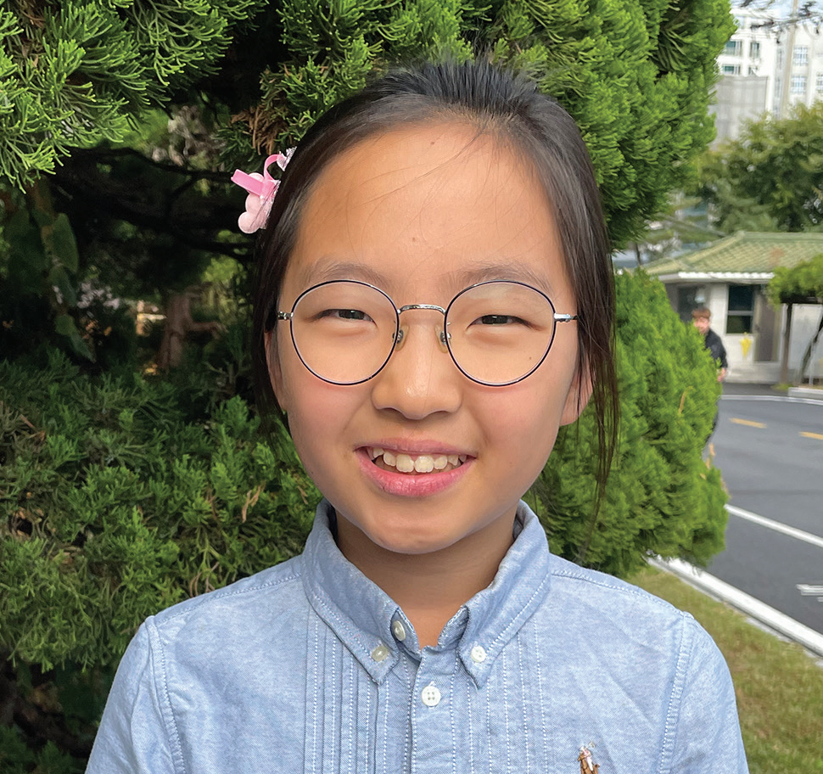
Week 11
SOUTH KOREA
March 15
Not Giving Up
Onyu

Slide 2
Ten-year-old Onyu [o-nyu] is outgoing, and she likes to talk with friends at school. When she learned that her church was planning a Vacation Bible School, she was excited that she would have something new to talk about with her friends. She could invite them to the Vacation Bible School.
Onyu goes to a Seventh-day Adventist school in South Korea. But many of her classmates come from families who do not believe in God.
So, at school lunchtime, Onyu stood up in front of all her classmates. She spoke up loudly so everyone could hear her.
“Is anyone interested in coming to my church?” she said. “We will have a good Vacation Bible School on Friday, Saturday, and Sunday. Do you have time?”
In her hand, she held four colorful fans that she had made. On each fan, she had written a personal invitation to the Vacation Bible School. She wanted to give the fans to anyone who wanted to go.
Many children said that they couldn’t go. They had to do homework, help with chores, or do other things.
But Onyu didn’t give up.
“Please come,” she said. “We are going to the swimming pool on Sunday. I would like you to go with me.”
Then two girls and a boy said that they would like to go. Onyu gave fans to each of them.

Slide 3
The next day, one of the girls said that she couldn’t go. Her parents had told her that she was too busy. But the other girl and the boy said that their parents had given them permission to go.
Onyu was so excited! She smiled as bright at the sun.
But a few days later, the girl said that her mom had changed her mind. She couldn’t go after all.
Onyu was sad, but she was happy that at least one classmate, the boy, would be able to attend. His name was Jisung. [jee sung]
On the first day of the Vacation Bible School, Onyu eagerly looked around for Jisung.
“Where is here?” she thought.
She waited and waited and began to grow worried.
“Why isn’t he coming?” she wondered.
Jisung didn’t come on Friday.
The next day, on Saturday, Onyu couldn’t check to see if he was there because she was sick at home.

Slide 4
But Jisung showed up at the swimming pool on Sunday.
Onyu was overjoyed when she saw him!
Jisung was also thrilled to be there, and he enjoyed every moment of the day. Like Onyu, Jisung was also outgoing, and he liked to talk with friends at school.
At school on Monday, he excitedly told everyone about the Vacation Bible School and about all of the fun that he had had. He was so excited! He wanted to go back again.
“When is the next Vacation Bible School?” he asked Onyu. “I’ll tell everyone about it, and I’ll definitely go again.”
He also said that he wanted to go to church with Onyu on Sabbath.
That night, Onyu offered a prayer of gratitude to God.
“Thank You, God, for using me as Your instrument for mission,” she prayed.
Onyu goes to Hankook Sahmyook Academy in Seoul, South Korea. Part of this quarter’s Thirteenth Sabbath Offering will help the school open a gym and missionary training center. Thank you for planning a generous offering on March 29.
By Andrew McChesney

Slide 5
