Slide 1
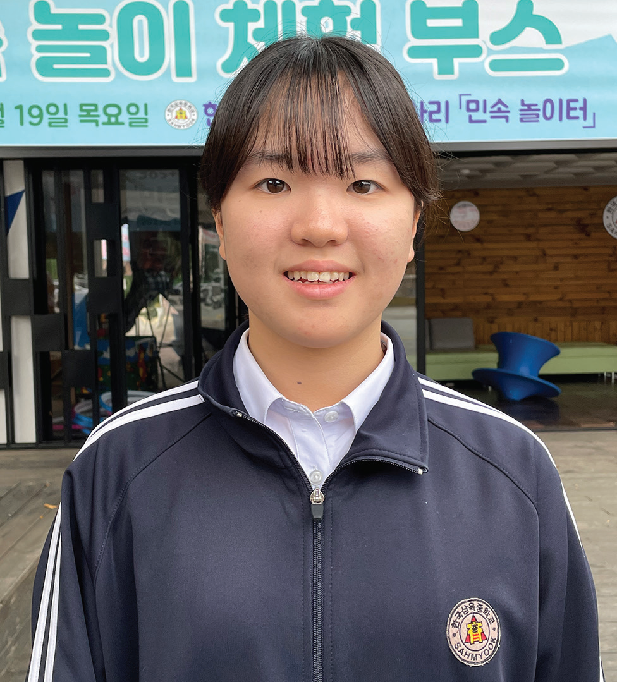
Week 12
SOUTH KOREA
March 22
“I Don’t
Eat Pork”
Yeseo

Slide 2
Schoolchildren teased Yeseo [YE-syo] for as long as she can remember. They didn’t tease her because of the way she looked. They didn’t tease her because of the clothes that she wore. They teased her because of the food that she ate.
Yeseo went to public school in South Korea. She was the only Seventh-day Adventist at the school.
Before leaving school every day, Yeseo looked at the school’s lunch menu to see what food would be served the next day in the school cafeteria. She needed to know if she could eat the school’s lunch or if Mom should pack her a special meal.
One day, she saw that lunch would be black-bean noodles with pork and yellow radish. When she got home, she told Mom, and Mom prepared her a lunch of fried rice with mixed vegetables and kimchi.
The school didn’t allow children to bring food from home for lunch. It was against the school rules. So, when Yeseo took out her fried rice and mixed vegetables at lunch, the other children looked at her strangely.
“Are you sick?” asked one.
“Do you have a problem?” said another. “Why did you bring a lunch?”
“I’m Seventh-day Adventist,” Yeseo said. “I don’t eat pork.”
“What is a Seventh-day Adventist?” a girl asked.

Slide 3
“It is a church that believes in God,” Yeseo said.
That was the easiest way that she could explain it. Many of her classmates did not come from Christian homes and did not believe in God.
The next day, the school cafeteria served vegetables and pork cutlets with sheets of roasted seaweed. The pork wasn’t mixed with the other food, so a teacher gave Yeseo extra vegetables and seaweed but no pork.
The children again looked at Yeseo strangely. “Why are you special?” said one. “What makes you so special?”
“You aren’t special,” said another. “So, why do you get extra food?”
“It’s because I’m a Seventh-day Adventist,” Yeseo said. “God told me not to eat pork. I’m trying to obey Him.”
The children looked at Yeseo with odd expressions on their faces.
“Poor you,” said a boy.
“You have a hard life,” said a girl. “Why do live that way?”
“I’m fine,” Yeseo assured them. “I’m happy with my life. I have a happy life.”

Slide 4
With all the strange looks and curious questions, Yeseo felt like a total stranger at school. No one seemed to want to be her friend. She felt all alone.
One day, Yeseo brought her own lunch again because the cafeteria was serving pork. The children looked at her strangely as usual, and several teased her. She explained again that she was a Seventh-day Adventist.
Then one girl stopped teasing her and asked if she felt healthy even though she didn’t eat pork.
Yeseo replied that she felt good because she ate only good food. She invited the girl to do the same.
The girl was curious to know more. “Can I come to church with you?” she asked.
After that, the two girls went to church together every Sabbath. Yeseo was so happy! She had a new friend, and she had made the friend simply by obeying God.
Today, Yeseo is happy to no longer have problems with food at school. When she started high school, she moved to an Adventist school, Hankook Sahmyook Academy, in Seoul, South Korea. Part of next Sabbath’s Thirteenth Sabbath Offering will help his school open a gym and missionary training center. Thank you for planning a generous offering next Sabbath.
By Andrew McChesney

Slide 5
