Slide 1
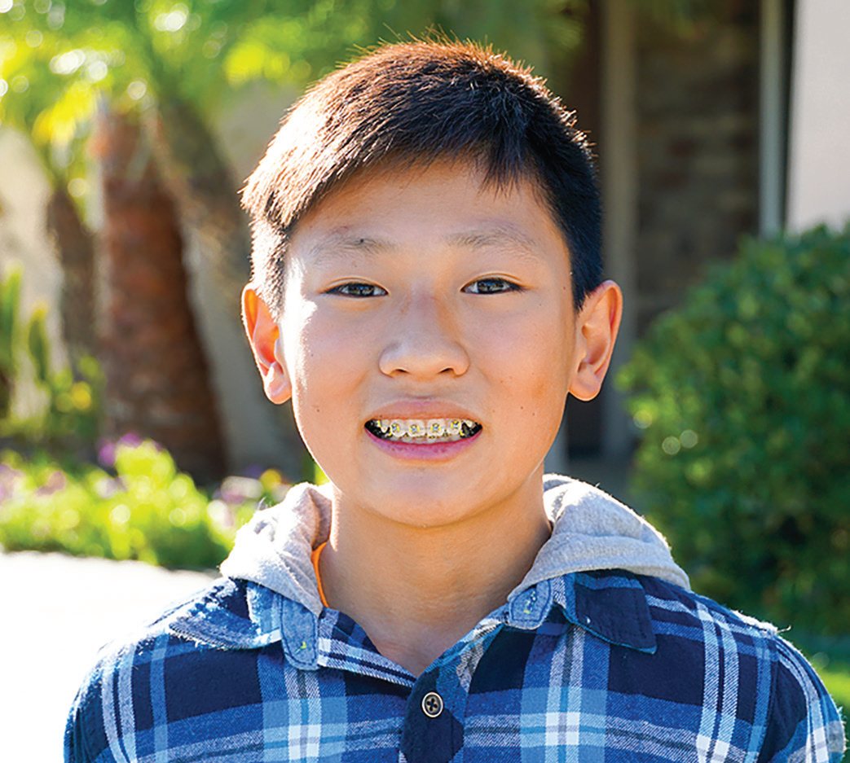
Week 13
13th Sabbath
SOUTH KOREA
March 29
Hard Bible
Test
Joon-woo

Slide 2
Twelve-year-old Joon-woo [JOON-woo] didn’t belong to a Christian family. He had never read the Bible. But he knew more than anything that he wanted to go to a Seventh-day Adventist school in Seoul, South Korea.
Many children wanted to go to the Adventist school because it had a good reputation. Joon-woo and every other child who wanted to study at the school had to pass a special entrance exam. For the exam, Joonwoo would have to sit down with a teacher and answer questions about math, science, and English. He also would have to answer questions about the Bible.
Joon-woo wasn’t worried about being tested on math, science, and English. He was a bright boy, and he knew that he could ace those questions. But the Bible? He wasn’t so sure about that. How could he answer Bible questions without knowing the Bible?
Joon-woo’s mom also wanted him to go to the Adventist school. She had heard about it from an Adventist mom whose son went there. Mom asked the Adventist mom for help. “How can my son pass the Bible part of the entrance exam?” she asked.
The Adventist mom had an idea.
“The best way to pass the exam is to go to an Adventist church every Saturday and learn the Bible,” she said.
So, Joon-woo and Mom showed up at an Adventist church on Sabbath. Joon-woo wasn’t the only child from a non-

Slide 3
Christian family who came to church that Sabbath. Five other boys and girls came with their moms because they also
wanted to learn the Bible so they could go to the Adventist school.
Everything about the church was unusual and strange to Joon-woo. He didn’t understand many of the words that he heard from the Bible. He didn’t get along well with the other children. But because he wanted to study at the Adventist school, he came back to church the next Sabbath and then the next. During Sabbath School, he studied the Bible with other children who also wanted to go to the Adventist school.
Joon-woo was silent during Sabbath School. His face didn’t show any expression. It was impossible to know whether he liked Sabbath School or didn’t like Sabbath School. But he came every Sabbath for four months. The other five children from non-Christian families also came for four months.
Then the day of the big entrance exam arrived. Joon-woo easily answered the questions about math, science, and English. He wondered if he could answer the Bible questions.
Then the teacher asked, “Which of God’s commandment is about keeping the Sabbath?”
Joon-woo remembered learning the Ten Commandments in Sabbath School, and he answered, “The fourth commandment.”
“Correct!” the teacher said.

Slide 4
The next question was more difficult. “Who did Philip baptize?” the teacher asked.
Joon-woo remembered reading in the Bible about Philip being sent by an angel to meet with a man on the road between Jerusalem to Gaza.
“An Ethiopian eunuch who was treasurer of the queen of the Ethiopians,” Joon-woo said.
“Correct!” the teacher said.
The next question was, “What happens to people when they die?”
That was a tough one. But Joon-woo remembered reading in the Bible that the dead will sleep in the ground until Jesus wakes them with a loud shout at the Second Coming.
“They wait in their graves until Jesus comes to resurrect them,” he said.
Joon-woo passed the entrance exam. The other five children also passed it, and all of them entered the Adventist school.
Joon-woo and the other five children stopped going to church on Sabbath. They no longer needed to study the Bible for the entrance exam, and they found other things that they wanted to do. But one of their moms kept going to church.

Slide 5
She gave her heart to Jesus and was baptized.
After a while, however, Joon-woo started to miss Sabbath School. He went back to church from time to time. Then he
began to go every Sabbath again.
Today, Joon-woo is 15 and he loves to go to church every Sabbath. He loves studying at the Adventist school. More than anything, he wants to become a pastor when he grows up.
Pray for Joon-woo to become a missionary for God. Joon-woo goes to Hankook Sahmyook Academy in Seoul, South Korea. Part of today’s Thirteenth Sabbath Offering will help his school open a gym and missionary training center. Today’s offering Future Thirteenth Sabbath Projects will also support four other important projects in the Northern Asia-Pacific Division, including a shelter for single mothers in Ansan, South Korea; after-school centers at 14 schools in Japan; a children’s recreation center in Ulaanbaatar, Mongolia; and the establishment of an Adventist elementary school system in Taiwan.
By Andrew McChesney

Slide 6
