Slide 1
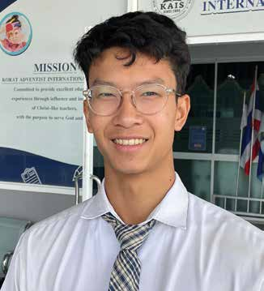
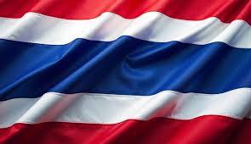
Week 2
THAILAND
April 12
To Help,
Or Not
Kaopan

Slide 2
Have you heard the story about the Good Samaritan from the Bible?
Kaopan [COW-paan] heard about the Good Samaritan for the first time when he was 4. He didn’t own a Bible. He had never heard Bible stories at home because his family wasn’t Christian. He heard about the Good Samaritan at his Seventh-day Adventist kindergarten in Thailand.
Little Kaopan listened with rapt attention as the teacher told the story about a certain man who was traveling from Jerusalem to Jericho when he was attacked by robbers and left half-dead. Then a priest happened to come down the road. When the priest saw the hurt man, he didn’t stop to help but passed by on the other side. After that, a Levite came down the road. He looked at the hurt man and also passed by without helping. But then a Samaritan came down the road. He felt sorry for the hurt man. He wrapped bandages around the man’s wounds, put him on his donkey, and took him to an inn. There, he cared for hurt man all night and paid the innkeeper to take care of him the next day.
Kaopan wasn’t surprised that the priest and Levite hadn’t stopped to help the hurt man. Why should they? They didn’t know him, and they were busy. But the Samaritan surprised him. He wondered, “Why would this man help even though he didn’t get anything back for himself?”
Kaopan finished kindergarten and began studying at the Adventist school that was located in the same building as the kindergarten. He heard the story about the Good Samaritan several more times. Every time, he was amazed that the Samaritan had helped even though he didn’t get anything back for himself.
Then one day, when he was 8, he saw a man asking for money at a gas station. Kaopan and his dad stopped at the gas

Slide 3
station to fill up the car, and then they went inside the gas station’s store to buy something. As they were coming out, Kaopan saw the man sitting outside the door. The man’s clothes were torn and dirty. He didn’t say anything to Kaopan. He was looking at a cardboard box on the ground in front of him. Inside the box were a few coins.
Kaopan remembered the story of the Good Samaritan. He thought, “The Good Samaritan helped the man even though
he didn’t get anything back for himself. I’ll give it a try. It might be a good decision, or it might be bad decision. Let’s find out.”
Turning to his dad, Kaopan asked, “Can I have some money? I want to give it to the poor man.”
“Sure,” Dad said and gave the boy a green paper bill. It was a 20-Thai baht banknote worth about 50 U.S. cents.
Kaopan put the money in the box.
The man in the torn, dirty clothes smiled. He had yellow, crooked teeth. Then he put his hands together to say, “Thank you.” In Thailand, people put their hands together to say thank you.
Kaopan replied by putting his own hands together. The man was older than him, and children show respect to older people in Thailand by putting their hands together.
Kaopan felt good. He had made the man happy, and now he also felt happy.
At that moment, he realized that he had made a good decision. In giving money to the man, he hadn’t expected

Slide 4
anything in return. But he had gotten something back. He had seen the man’s happiness, and that happiness had made him happy. By blessing the man, he had received a blessing back.
Today, Kaopan is getting to graduate from Korat Adventist International School, where he learned about the Good Samaritan. He will always remember the Good Samaritan.
“There are people who need our help,” he said. “You can help them or not, but it’s good to help.”
Part of a Thirteenth Sabbath Offering helped build Korat Adventist International School in Thailand several years ago. Thank you for your Thirteenth Sabbath Offering this quarter that will help other children in Asia also learn about God and the happiness that comes from helping others.
By Andrew McChesney

Slide 5
