Slide 1
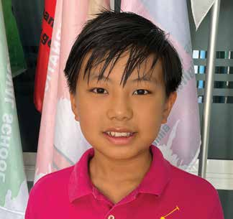
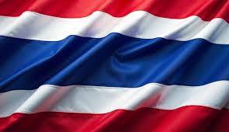
Week 4
THAILAND
April 26
Kid Without
A Home
PeiPei

Slide 2
Where are you from? Peipei [PAY-pay] wasn’t sure where he was from.
You see, Peipei’s dad was from India, and his mom was from the Philippines. But he didn’t feel like he was from India. He didn’t feel like he was from the Philippines. Instead, he could imagine himself coming from a country that was half India and half the Philippines. The imaginary country could be called Indippines or Philippia. But no such country existed in the world.
Peipei also wasn’t sure where he was from because he had never lived in India and he had never lived in the Philippines. Peipei lives in Thailand. He is a missionary kid, and he has lived his whole life in Thailand. His dad works as a missionary teacher at a Seventh-day Adventist school in the big city of Korat. His mom also works as a missionary teacher at the school.
One Sabbath afternoon, Peipei grew quite confused when he had to decide where he was from. He and the other kids in their Pathfinder club were supposed to form groups and sing a song in their own language. The Pathfinder club had kids from many countries: India, the Philippines, Thailand, and other places. Peipei didn’t know which group to join. Children from India were singing in the Hindi language. But Peipei didn’t speak Hindi even though his dad was from India. Children from the Philippines were singing in the Tagalog language. But Peipei didn’t speak Tagalog even though his mom was from the Philippines.
Peipei knew how to speak English, which he spoke at home and at the mission school. He also knew how to speak a little Thai, which he had learned at the mission school.

Slide 3
“What should I do?” he asked his mom.
“Go and join the kids singing in the Thai language,” his mom said.
Peipei joined the Thai children in singing a song about Jesus in Thai. But he didn’t feel very comfortable. Thai didn’t feel like his language. His eyes became sad, and his shoulders sagged.
A teacher saw his sad face and went over to him.
“What’s wrong?” she asked.
“Teacher Ann, I don’t know where I’m from,” Peipei said.
“What do you mean?” she said.
“I’m half Indian, but I don’t know how to speak Hindi,” Peipei explained. “I’m half Filipino, but I don’t know how to speak Tagalog. I live in Thailand, but I only know a little Thai. Of these three languages, I know Thai the most, but I’m not comfortable being in any of these groups. I don’t know where I’m from.”
Teacher Ann wrapped a comforting arm around Peipei’s shoulders. She had been born in Thailand, and her first language was Thai. But she spoke to him in English.

Slide 4
“I’m from Thailand,” she said. “Today, I’m adopting you and officially making you a citizen of Thailand. Today, you are from Thailand.”
Peipei straightened his shoulders. His eyes brightened, and a smile spread across his face. Today, he officially had a homeland. Today, he was from Thailand.
Peipei returned to the group of singing Thai children. He was at home. He opened his mouth and joined the Thai children in singing joyfully about the Jesus who would one day soon take them to their new home, heaven.
Peipei is a missionary kid studying at Korat Adventist International School in Thailand. While his parents are Seventh-day Adventist, many children at the school come from families who have never heard about God.
Part of a Thirteenth Sabbath Offering several years ago helped build the school. Thank you for your Thirteenth Sabbath Offering this quarter that will help other children in Asia also learn about God.
By Andrew McChesney

Slide 5
