Slide 1
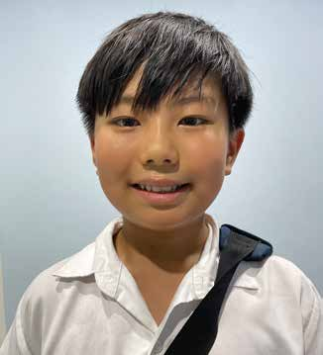
Week 5
THAILAND
May 3
A Cupcake
To Share
PeiPei

Slide 2
Peipei [PAY-pay] loves his little sister, Shim-Shim, very much. He loves her so much that he wants to include her in all the good things that happen in his life. When he is smiling, he wants her to smile. When he is laughing, he wants her to laugh. And when he gets a special treat, he wants her to get a special treat. So, when a friend had a birthday and celebrated by giving Peipei a cupcake at school, Peipei also wanted for her to have a cupcake.
On the big day of the birthday, the birthday boy brought a bunch of yummy looking cupcakes to Peipei’s school in Korat, Thailand, and put them on a classroom table. They looked so delicious with frosting on top. Each boy and girl took a cupcake from the table. They eagerly peeled off the wrappers and began eating. Peipei also took a cupcake off the table. He also wanted to eat. But then he remembered his little sister. He wanted her to enjoy a cupcake, too. He looked back at the table and saw that a few extra cupcakes remained. He wondered if he could take one of those cupcakes to give to Shim-Shim at home.
He went to the teacher. “Could I please have one of those cupcakes?” he asked.
The teacher looked at Peipei. She didn’t understand that he wanted a second cupcake to give to his little sister. She thought that he wanted a second cupcake for himself. But if he took a second cupcake, maybe the other boys and girls in the class also would want a second cupcake. There weren’t enough cupcakes for all the boys and girls to have a second cupcake.
The teacher shook her head. “No, there is only enough cupcakes for every boy and girl in our class to have one,” she said.

Slide 3
Peipei looked down sadly. Then he looked at the other boys and girls in the classroom. They were still enjoying their cupcakes. He looked at his cupcake. He wanted to enjoy it, too. But he loved his little sister so much. He decided to save his cupcake for her. He took the cupcake to his desk and carefully set it in a corner where it would be safe and sound until he could take it home.
The teacher saw the sad expression on Peipei’s face. She saw him go his desk. She watched as he carefully set aside the cupcake without eating it. She went to Peipei.
“Why aren’t you eating your cupcake?” she asked.
Peipei explained that he was saving it for his little sister. He wanted her to enjoy the birthday celebration, too.
Now the teacher understood why Peipei had asked for a second cupcake. It wasn’t because he wanted to eat two cupcakes. It was because he loved his little sister and wanted to share the treat with her. When he couldn’t take a second cupcake, he had decided to give his cupcake to her.
The teacher’s heart was touched by Peipei’s sacrificial spirit. She went to the table with the cupcakes.
“Peipei, you can take a second cupcake to give to your little sister,” she said.
Peipei’s face lit up like the sun. He smiled radiantly as he took a second cupcake from the table. Now he could enjoy a cupcake — and his little sister could enjoy one, too!

Slide 4
Now, whenever one of Peipei’s friends has a birthday party at school, the teacher always gives Peipei an extra treat so he can take it home to his little sister.
Peipei is a missionary kid studying at Korat Adventist International School in Thailand. Part of a Thirteenth Sabbath Offering several years ago helped build the school. Just like Peipei showed a sacrificial spirit in being willing to give his cupcake to his sister, we can show a sacrificial spirit by giving up something for the Thirteenth Sabbath Offering. Ask a grown-up for ideas on what you can do (see Story Tips sidebar).
By Andrew McChesney

Slide 5
