Slide 1
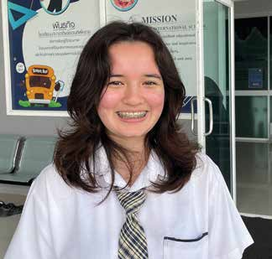
Week 8
THAILAND
May 24
Distance, Acceleration and Velocity
Naomi

Slide 2
Thirteen-year-old Naomi thought that she was going to fail her science test at her school in Thailand. She looked at her notes on her tablet at home. Nothing made sense. She saw words like “distance,” “acceleration,” and “velocity.” She felt worries growing inside of her. She just had to get a good grade on the test. Her future depended on it. She wanted to grow up to become a scientist. But how could she become a scientist if she failed the science test?
Naomi looked at the clock. It was late. She needed to go to bed. But the test was the next day. She looked back at her tablet. Again, she only saw confusing words like “distance,” “acceleration,” and “velocity.”
“Aghhhh!” she exclaimed in despair.
She felt desperate. What could she do? Her parents were asleep, so she couldn’t ask them for help. She couldn’t ask her friends for help because they also didn’t understand distance, acceleration, and velocity.
Then an idea popped into her mind. “Why not pray?” she thought.
Naomi had learned at school to pray in the morning and at night. Now it was night, so why not pray about her science test? Naomi closed her eyes and folded her hands. “Dear God,” she said, “please help me pass this test.”
Then she explained to God that she wanted to pass the test so she could become a scientist. When she finished talking to God, she felt better. She still was a little worried, but she was glad that she had been able to tell God about her worries. She studied a few more minutes and went to bed. She felt peaceful after praying and fell asleep quickly.

Slide 3
In the morning, Naomi still felt peaceful, but she also felt also a little worried. Dad reassured her that everything would be fine.
“It’s OK,” he said. “It’s just a grade, and grades don’t matter in the real world.”
But Naomi still wanted a good grade on the test.
After breakfast, she quickly reviewed her notes one last time on her tablet, and she went to school.
When it came time for the test, something seemed different. Naomi understood the meaning of words like distance, acceleration, and velocity. The test wasn’t easy, but she felt comfortable as she took it.
When she received her grade, she saw that she had passed with flying colors. She was shocked and very happy.
That night, before going to sleep, she prayed gratefully in her bed.
“Thank You for helping me get a good grade,” she said.
These days, Naomi loves to pray to God about everything. She has found that praying is much more fun than worrying.
“Don’t worry about anything but pray for everything,” she said.

Slide 4
Naomi is right. After all, the Bible says, “Be anxious for nothing, but in everything by prayer and supplication, with thanksgiving, let your requests be made known to God; and the peace of God, which surpasses all understanding, will guard your hearts and minds through Christ Jesus” (Philippians 4:6, 7; NKJV).
Naomi studies at Korat Adventist International School in Thailand, where many children come from families who have never heard about God.
Part of a Thirteenth Sabbath Offering several years ago helped build the school. Thank you for your Thirteenth Sabbath Offering this quarter that will help other children in Asia also learn about God.
By Andrew McChesney

Slide 5
