Slide 1
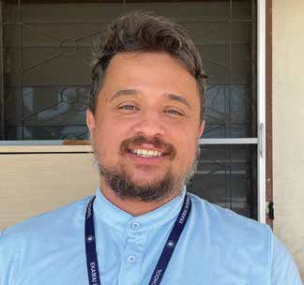
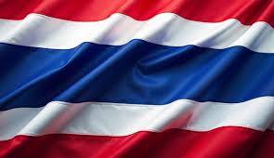
Week 10
THAILAND
June 7
Rich Kids
Renato

Slide 2
Renato moved far, far away from his home in Brazil to become a missionary in Thailand. He teaches 100 children in the fourth grade at a Seventh-day Adventist school in Bangkok.
While Renato was still at home in Brazil, he prayed and prayed about becoming a missionary. When he received an invitation to become a missionary teacher in Thailand, he thought that God had answered his prayers. But when he arrived in Thailand, he wasn’t sure. He had always thought that missionaries were supposed to teach poor people about Jesus. But the children at his new school weren’t poor. They were rich kids. All of them came from wealthy families. Their daddies and mommies were ambassadors, models, and soccer players.
Renato was confused. Why had God allowed him to come to Thailand? He prayed, “God, did You want me to travel 10,000 miles to serve rich people? There are many poor people in Brazil who need my help. Why did You bring me here?”
Then came Renato’s first day as teacher at the school. He felt a little scared. He felt a little nervous all over. But somehow, he managed to get through the day.
The next day, he decided to eat with the children in the school cafeteria. He wanted to hear what the children were talking about. He wanted to make new friends.
Renato went through line and received a bowl of noodles. Then he sat down at a table with a group of fourth graders from his class. But before eating, he closed his eyes to pray.
Usually, Renato also folded his hands to pray. But on this day, he stretched out his hands with the palms facing up. He

Slide 3
wasn’t sure why he prayed that way. He just did.
“Dear God,” he prayed silently. “Thank You for this food. Please bless it.”
When he opened his eyes, he saw that one of his new students, a 9-year-old girl, was staring at him intently.
When she saw that he was looking at him, she spoke up.
“What were you doing?” she asked.
“I was praying,” he said.
The girl looked puzzled.
“But you can’t pray like that,” she said. “You need to fold your hands.”
The girl, like many of the 1,500 children at the school, came from a non-Christian home. No one prayed to the God of heaven at her home. Everything that she knew about praying to God had been taught at the school. Her previous teacher had taught her to close her eyes and fold her hands when she prayed, and now she couldn’t understand why Renato had closed his eyes but hadn’t folded his hands.
“Does God listen to this kind of prayer?” she said.

Slide 4
“For sure!” Renato said with a big smile. “He listens to everyone. I have prayed driving a car with open eyes.”
Shock and amazement flashed across the girl’s face.
“Can you pray with open eyes?” she said.
Renato’s smile grew bigger.
“I’ve prayed while cooking,” he said. “I’ve prayed while working out.”
The girl’s shock and amazement grew even bigger. Renato decided to have some fun. He said that he had even prayed to God in the bathroom.
“What?” the girl exclaimed. “Can God hear you there?”
“God can hear you everywhere,” Renato said. “He is just waiting for you to talk to Him. Sometimes, He talks to you even if you don’t talk to Him. But You can pray to Him everywhere, even with open eyes and open hands.”
The girl didn’t say anything. She was so shocked and amazed that she didn’t even blink. After a long moment of silence, she got up and left the table. She had a lot to think about.
At that moment, Renato realized why God had sent him to Thailand. Rich kids also needed to know God. Being a

Slide 5
missionary wasn’t only about sharing the God’s love with poor people. Being a missionary was about sharing God’s love with everyone, everywhere.
Pray for Adventist missionaries like Renato at Ekamai International School in Bangkok, Thailand, as they share God’s love with everyone around the world. Thank you for your Thirteenth Sabbath Offering this quarter that will help more kids know about the God who hears prayers everywhere.
By Andrew McChesney

Slide 6
