Slide 1
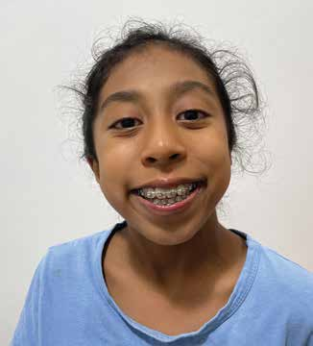
Week 11
PHILIPPINES
June 14
A New
Heart
Hannah

Slide 2
Hannah loved her twin brothers, Zechy [ZAK-i] and Jerry, but they could be so annoying. As their older sister, she felt like she needed to make sure that they controlled themselves and were well-behaved.
So, she spoke up at lunch when the boys loaded their plates with food.
“Save some for Mommy and Daddy,” she said.
“It’s fine,” Zechy said, without putting back any food.
“Mommy and Daddy already ate,” Jerry chimed in.
But it seemed to Hannah that the boy had taken too much food, and she wanted them to put some back.
“No, they haven’t eaten yet,” Hannah insisted, her voice rising. “Save some for them.”
“Really, it’s fine,” Zechy declared, his voice also rising.
Overhearing the growing disagreement, Daddy and Mommy sought to restore calm.
“It’s fine,” Daddy said.
“Let the boys eat,” Mommy said.

Slide 3
But that wasn’t all that Hannah found annoying. The twins also liked to go into her bedroom and play with her toys. She was alarmed one day when they took her teddy bear and began to play-fight with it. She worried that they might accidentally tear it apart. She grabbed the teddy bear. “Play with your own things,” she whispered, fiercely.
She whispered because she didn’t want to disturb Daddy and Mommy. The family was living in an apartment on the campus of the Adventist International Institute of Advanced Studies in the Philippines. Daddy was in another room, studying to become a missionary, and Mommy was working.
The twins weren’t bothered that Hannah had taken the teddy bear. They found another teddy bear in her room and started to play-fight. “Stop!” Hannah whispered. “Take your own things to play-fight with.”
And so, it went on and on and on. It was so annoying. Hannah didn’t know what to do.
Then Hannah and her family went to the week of spiritual emphasis at the Adventist International Institute of Advanced Studies. Hannah listened carefully to the speaker. Her heart was touched as she heard about Jesus’ great love. When the speaker asked who would like to give their hearts to Jesus and be baptized, she looked up at her parents.
“Daddy and Mommy, should I go?” she whispered.
Daddy and Mommy saw that Hannah loved Jesus very much. They saw that the Holy Spirit was speaking to her heart. They nodded their heads that she could go. Hannah made her way to the front. Zechy and Jerry joined her, as did other children.

Slide 4
The church pastor prayed a special prayer for the children and invited them to study the Bible with him. Then, on a bright, happy Sabbath, Hannah and her brothers gave their hearts to Jesus in baptism.
Something happened after her baptism. Hannah began to wake up 30 minutes earlier to have her own morning worship. As she read, she felt that God was really with her. She liked being with God, and she prayed. “Dear Heavenly Father,” she whispered. “Thank You for this day. Please help me to understand this devotional. Help me to understand what I hear today. Please bless my parents and brothers.”
As Hannah prayed, things began to change at home. She found that the things that once annoyed her were no longer annoying. She was no longer annoyed by anything, and she only had kind things to say to her brothers.
Today, Hannah is happy all the time, and she is sure that God is making her heart to be like His.
“God is changing my heart,” she said.
Your Thirteenth Sabbath Offering this quarter will help children in the Southern Asia-Pacific Division, which includes the Philippines, learn about the God who changes hearts to be like His. Thank you for planning a generous offering on June 28.
By Andrew McChesney

Slide 5
